Slide 1
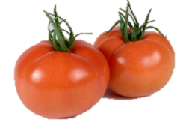
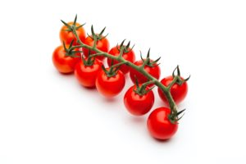
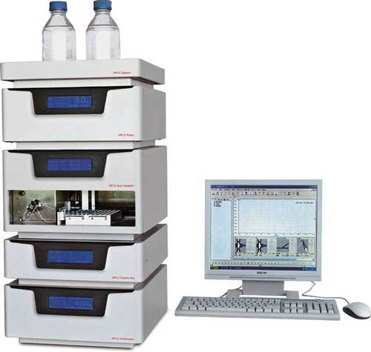
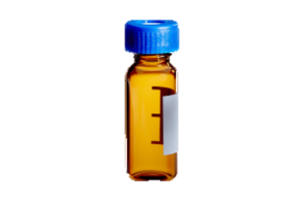
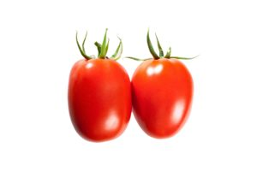
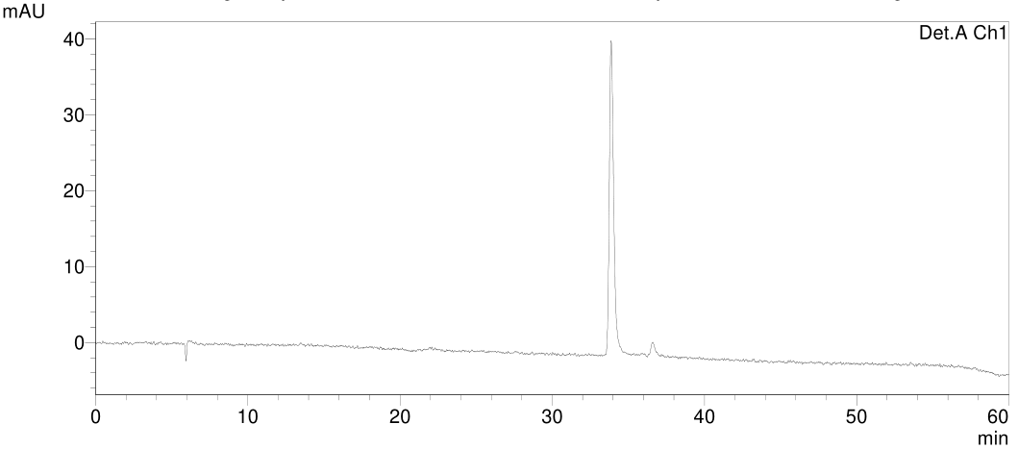
Samples with unknown concentration
1
2
HPLC
Lycopene extraction
3
Tomato varieties (V)
Data
mAU signal (S)
V | S
… | …
… | …
… | …
… | …
… | …
Concentration prediction

