Slide 1

Computer Vision using Convolutional NN
Oct 2017
Juan Pablo Campos G

Slide 2
Computer vision:
Computers gaining high level understanding from images and videos. Some Areas:
Image classification
Object Recognition
Object Detection
Semantic Segmentation
Instance Segmentation – automatic delineation of
3D reconstruction
Before ANN:
SURF, SIFT features + SVMs for object detection
EigenFaces for Face Recognition
Kernels for edge detection… Convolutions were used before CNNs!
Notes:
There are micro-climates in Mexico city caused by the topography. The southern part of the city receives most of the rain, while the north east receives the smallest yearly amounts.

Slide 3
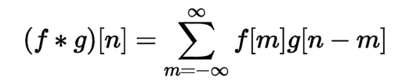
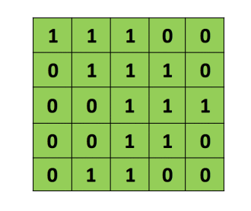
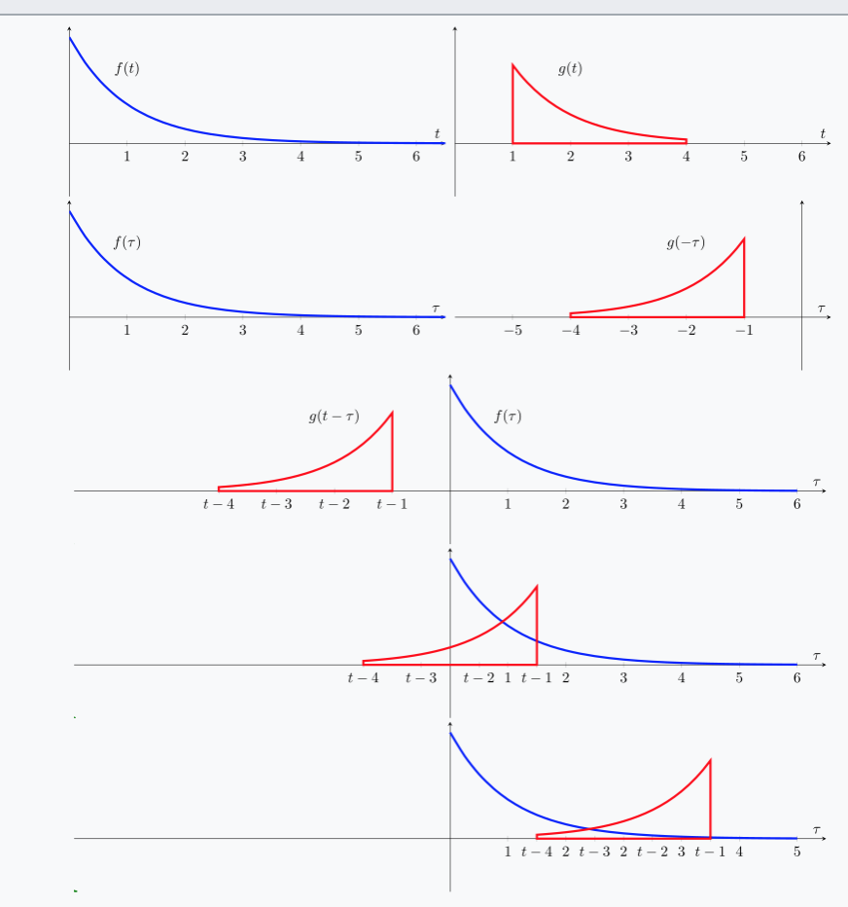
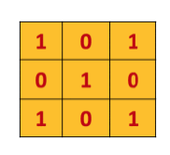
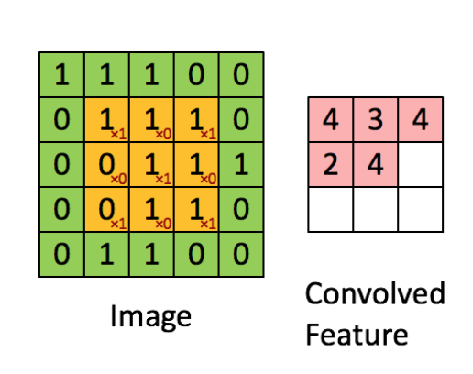
Image Convolutions:
Convolution Mathematics
Convolution images
*
Notes:
There are micro-climates in Mexico city caused by the topography. The southern part of the city receives most of the rain, while the north east receives the smallest yearly amounts.

Slide 4
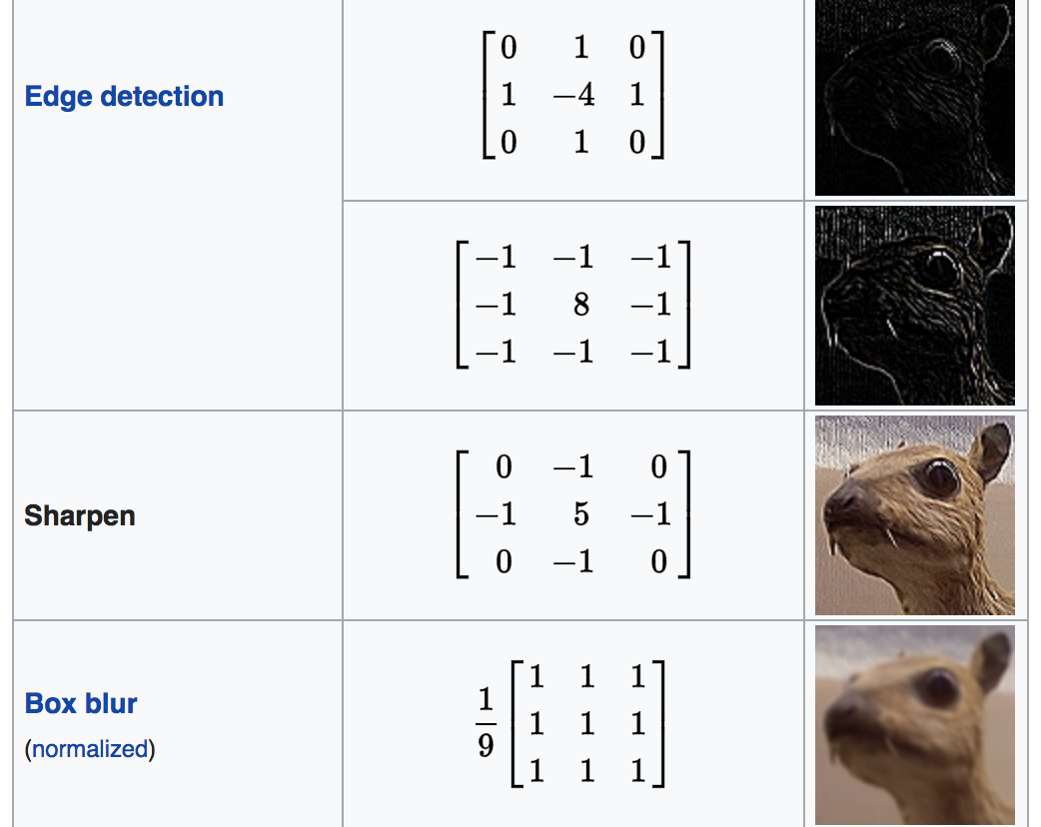
Kernels
Notes:
There are micro-climates in Mexico city caused by the topography. The southern part of the city receives most of the rain, while the north east receives the smallest yearly amounts.

Slide 5
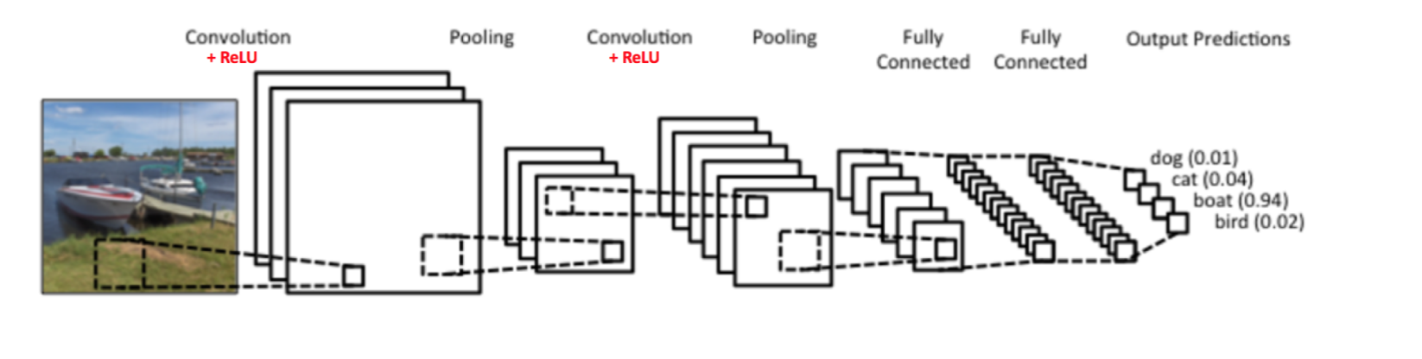
CNN for Image classification
http://scs.ryerson.ca/~aharley/vis/conv/flat.html
Hyperparameters:
Architecture of the Network:
- Number and type of layers
- Depth: number of kernels for a particular layer
Type of Activation Functions
Optimization:
Learning Rate
Parameters depending on the function used.
Batches
Notes:
There are micro-climates in Mexico city caused by the topography. The southern part of the city receives most of the rain, while the north east receives the smallest yearly amounts.

Slide 6
History of CNNs
LeNet 1990s
1990s to 2012: convolutional neural network were in incubation.
AlexNet (2012) – In 2012, Alex Krizhevsky (and others) released AlexNet which was a deeper and much wider version of the LeNet and won by a large margin the difficult ImageNet LSVR Challenge in 2012.
ZF Net (2013) – The ILSVRC 2013 winner was a Convolutional Network from Matthew Zeiler and Rob Fergus. It was an improvement on AlexNet by tweaking the architecture hyperparameters.
GoogLeNet (2014) – The ILSVRC 2014 winner was a Convolutional Network from Szegedy et al.from Google. Its main contribution was the development of an Inception Module that dramatically reduced the number of parameters in the network (4M, compared to AlexNet with 60M).
VGGNet (2014) – The runner-up in ILSVRC 2014 was the network that became known as the VGGNet. Its main contribution was in showing that the depth of the network (number of layers) is a critical component for good performance.
ResNets (2015) – Residual Network developed by Kaiming He (and others) was the winner of ILSVRC 2015.
DenseNet (August 2016) – Recently published by Gao Huang (and others), the Densely Connected Convolutional Network has each layer directly connected to every other layer in a feed-forward fashion. The DenseNet has been shown to obtain significant improvements over previous state-of-the-art architectures on five highly competitive object recognition benchmark tasks. Check out the Torch implementation here.
Notes:
There are micro-climates in Mexico city caused by the topography. The southern part of the city receives most of the rain, while the north east receives the smallest yearly amounts.

Slide 7
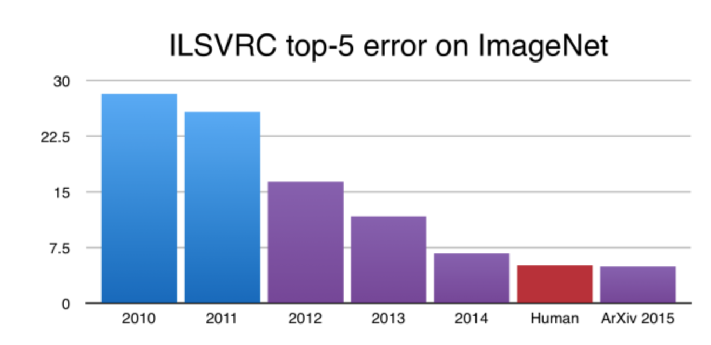
ImageNet model errors
Notes:
There are micro-climates in Mexico city caused by the topography. The southern part of the city receives most of the rain, while the north east receives the smallest yearly amounts.

Slide 8
CNNs for Object Detection and Object Segmentation
Extending the achievements of Alexnet to Instance Segmentation.
R-CNN (Regional CNN) – Extend AlexNet for Image classification. Propose a bunch of boxes and then do Image classification. Boxes are selected using a process called Selective Search which you can read about here. SVM model and optimal box model added.
Fast R-CNN. Efficiency while proposing regions, because they overlap and combine all models into one single network.
Faster R-CNN. Use same image features for both selecting regions and classification.
Mask R-CNN. Add a branch of faster R-CNN to create a Mask (Pixel level segmentation.
Notes:
There are micro-climates in Mexico city caused by the topography. The southern part of the city receives most of the rain, while the north east receives the smallest yearly amounts.

Slide 9
Ideas for next session
Implementation and challenges:
Optimizers: which optimizers to use?
Hyper parameters, how to choose them?
Model overfitting:
Regularization
Visualize plots: learning curve, etc.
Which functions to use for the middle layers?
Which functions to use in the last layers?
Notes:
There are micro-climates in Mexico city caused by the topography. The southern part of the city receives most of the rain, while the north east receives the smallest yearly amounts.

