Slide 1

AEQUUM - Reducing inequality in WASH through education
Group 2 : Carlo, Saskia, Chao, Manoj
Introduction to Data Science
AEQUUM

Slide 2
AEQUUM
To Identify vulnerable region for UNICEF to invest
To identify stakeholders such as schools, government organization etc.
To find Interaction between Water, sanitation and hygiene.

Slide 3
AEQUUM Approach
Understanding the WASH data
Search for external data
Chose Literacy data for year 2016
Cleaning of WASH data (removing blanks)
Merging of WASH and literacy data
Cleaning of merged data
EDA of merged data

Slide 4
Challenges during AEQUUM development
Finding the quality data
EDA
AEQUUM
Pre-processing of data

Slide 5
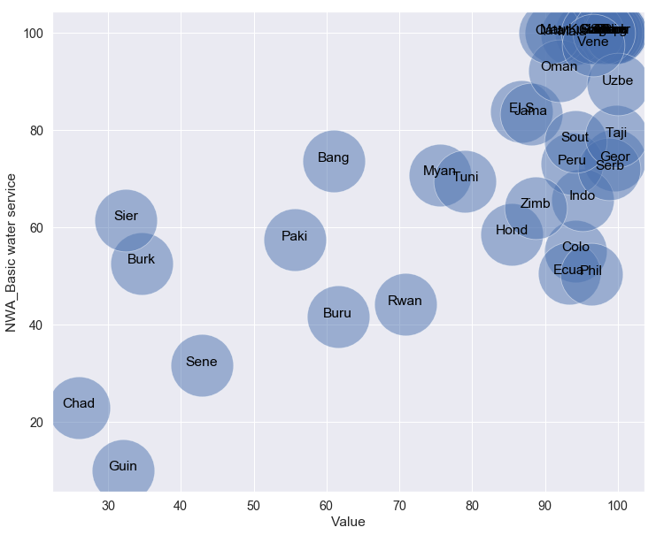
Identifying the region of interest
Literacy vs basic water service

Slide 6
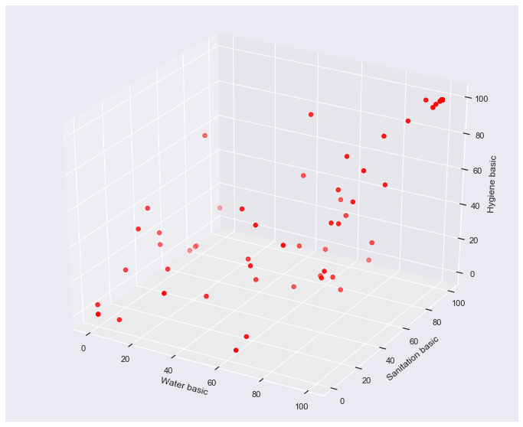

Slide 7
How the clustering is done
Clustering is done with k-means clustering algorithm
Optimal amount of clusters is determined with the elbow method

Slide 8
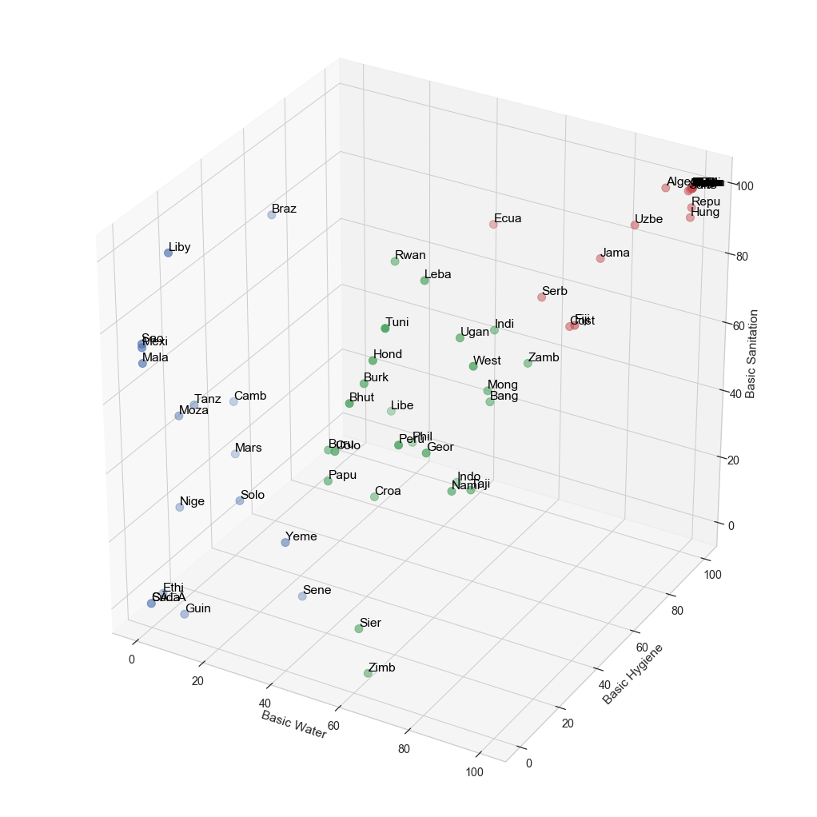

Slide 9
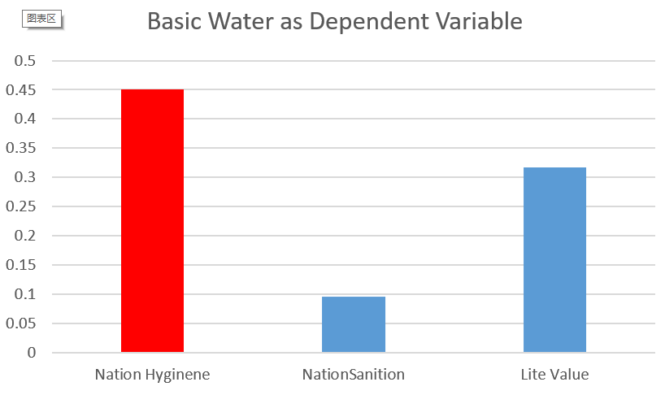
Linear Regression

Slide 10
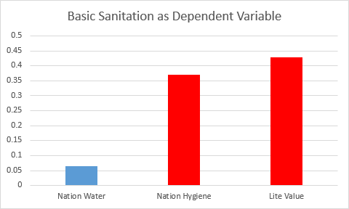
Linear Regression

Slide 11
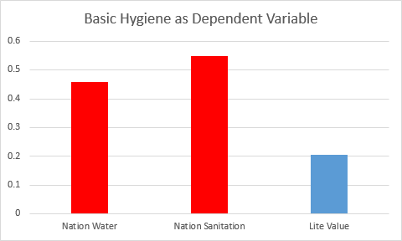
Linear Regression

Slide 12
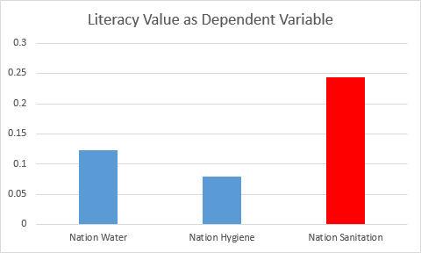
Linear Regression

