Slide 1
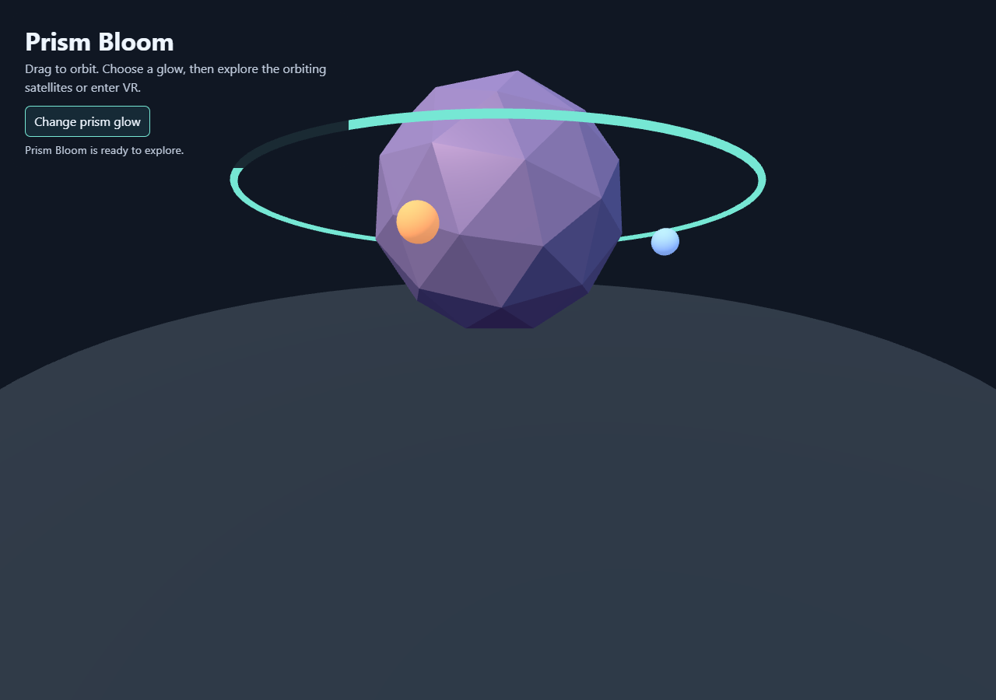
RUN GUIDE / 10 FOCUSED EXAMPLES
Run the XR
examples
A practical guide to launching each project and understanding the capability it demonstrates.
4 browser demos
4 Unity integrations
Android + visionOS
Separate samples. Real SDKs. Hardware where required.
ALL-VR-MR-AR-SDKs | RUN GUIDE
01

Slide 2
01 / CHOOSE A ROUTE
Start with the platform you can run today
These folders are independent examples, not one cross-platform app. Read the matching folder README before setup.
BROWSER
UNITY
ANDROID
VISIONOS
Fastest start
Headset examples
ARCore placement
Spatial Atlas
Python static server
Current browser + WebGL
Network access for CDN libraries
Unity Editor + package versions
Copy scripts into a Unity project
Compatible runtime / device
Android Studio + SDK 35 + JDK 17
ARCore-supported Android device
Camera permission
macOS + Xcode 16+
visionOS 2 SDK
Simulator or Apple Vision Pro
Tip: the Unity folders contain scripts and setup notes, not full Unity projects.
ALL-VR-MR-AR-SDKs | RUN GUIDE
02

Slide 3
02 / BROWSER QUICK START
One local server runs all four web examples
Run the command from the repository root so each example folder has its own URL path.
1 START THE SERVER
DEMO URLS
http://localhost:8000/a-frame/
python -m http.server 8000
http://localhost:8000/threejs/
2 OPEN A DEMO URL
http://localhost:8000/babylonjs/
localhost is a secure context for WebXR development.
Use Ctrl+C in the terminal to stop the server.
http://localhost:8000/webxr/
WebGL and internet access are needed for the CDN-hosted libraries. A desktop fallback is not the same as a headset session.
ALL-VR-MR-AR-SDKs | RUN GUIDE
03

Slide 4
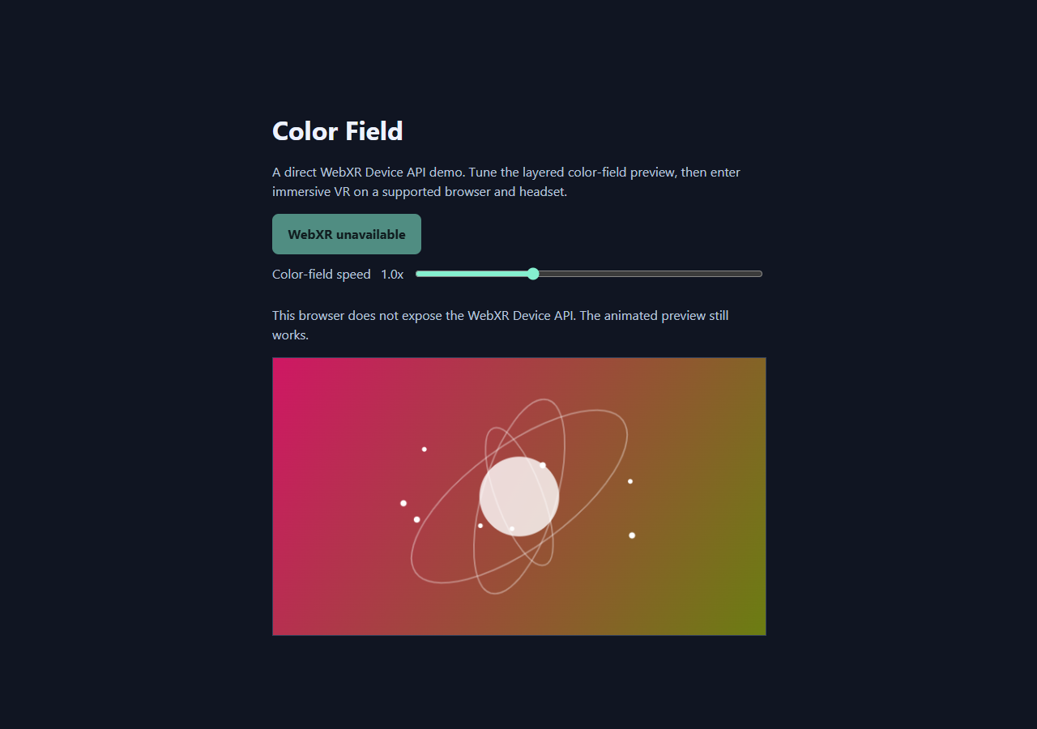
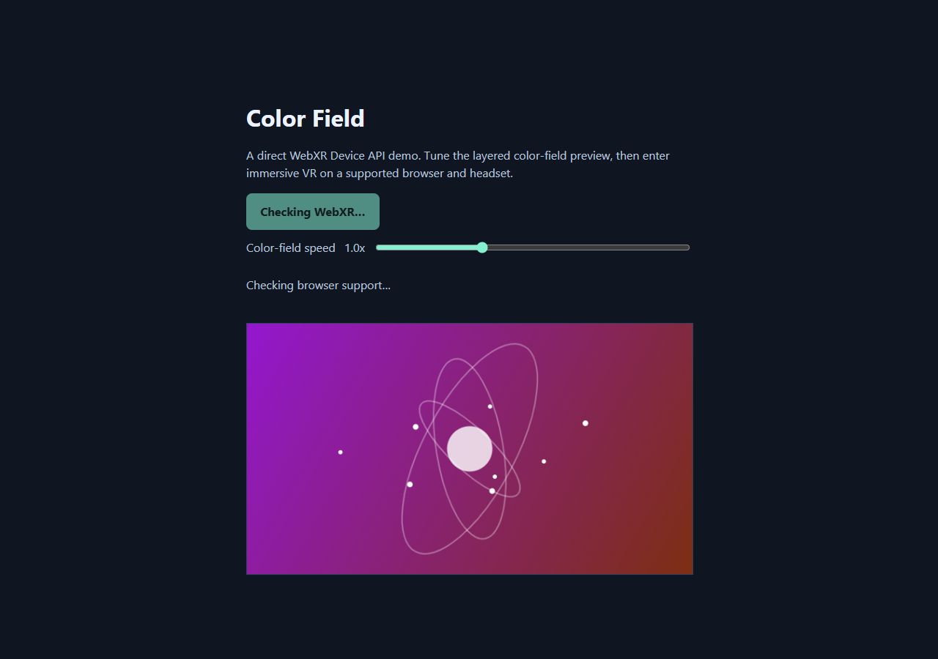
BROWSER EXAMPLE
WebXR | Color Field
Browser API first: request an immersive session directly.
WHAT IT ILLUSTRATES
Session support checks, the user-gesture session request, and a fallback when immersive VR is unavailable.
RUN FROM THE REPOSITORY ROOT
python -m http.server 8000
Open: http://localhost:8000/webxr/
TRY THIS
Change the animation speed. On a compatible headset, click Enter VR to begin the session.
No 3D geometry in XR: this sample focuses on session setup and lifecycle.
DESKTOP SCENE | immersive XR requires a supported device
ALL-VR-MR-AR-SDKs | RUN GUIDE
04

Slide 5
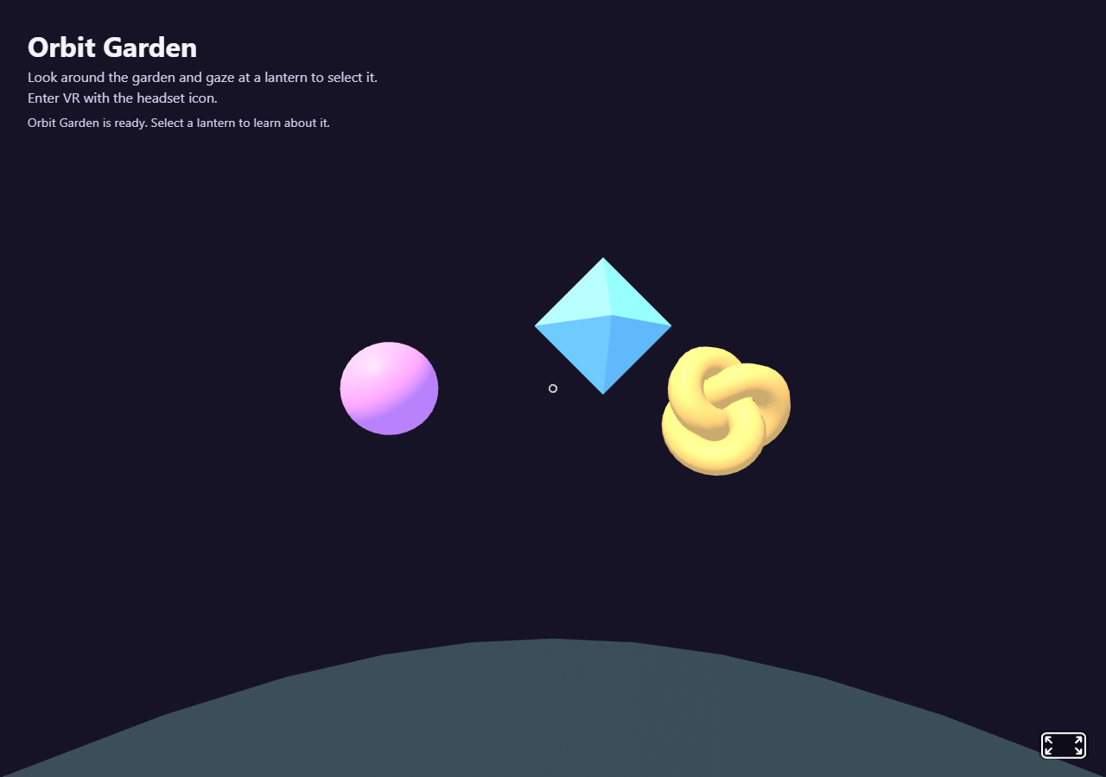
BROWSER EXAMPLE
A-Frame | Orbit Garden
Declarative scene composition with gaze interaction.
WHAT IT ILLUSTRATES
HTML-like scene entities, built-in animation, camera controls, and cursor-driven selection.
RUN FROM THE REPOSITORY ROOT
python -m http.server 8000
Open: http://localhost:8000/a-frame/
TRY THIS
Look at a lantern to select it; the selected lantern grows and the status label names it.
VR entry is available when the browser and device support WebXR.
DESKTOP SCENE | immersive XR requires a supported device
ALL-VR-MR-AR-SDKs | RUN GUIDE
05

Slide 6
BROWSER EXAMPLE
Three.js | Prism Bloom
Custom scene construction and WebXR renderer entry.
WHAT IT ILLUSTRATES
Three.js geometry, materials, lighting, orbit controls, animation, and its VR entry button.
RUN FROM THE REPOSITORY ROOT
python -m http.server 8000
Open: http://localhost:8000/threejs/
TRY THIS
Drag to orbit, cycle the prism glow, and inspect the three moving satellites.
A desktop browser can show the scene even if immersive VR is unavailable.
DESKTOP SCENE | immersive XR requires a supported device
ALL-VR-MR-AR-SDKs | RUN GUIDE
06

Slide 7
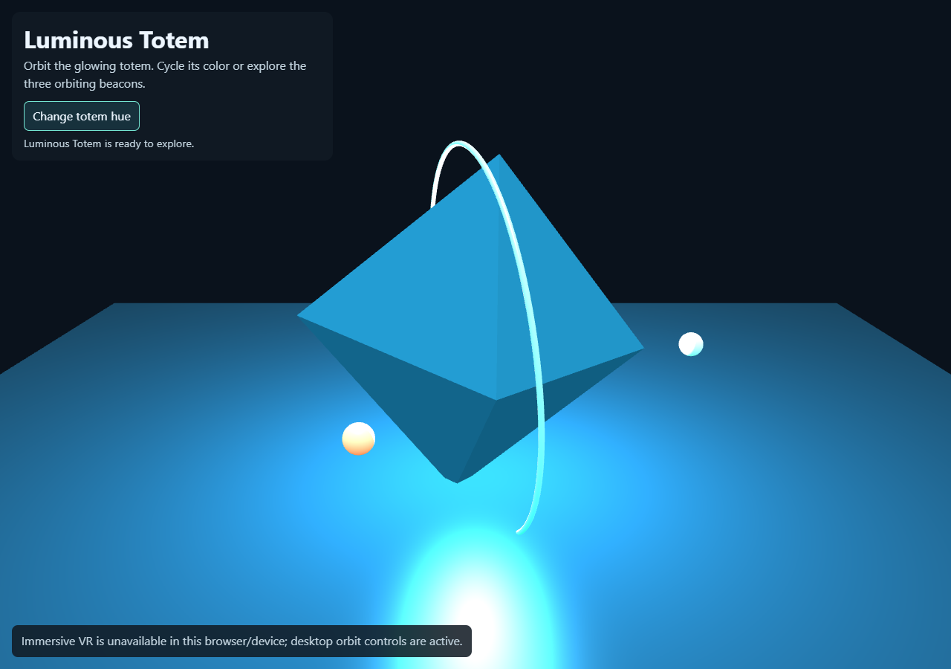
BROWSER EXAMPLE
Babylon.js | Luminous Totem
A full 3D engine with a default XR experience flow.
WHAT IT ILLUSTRATES
Babylon.js scene setup, orbit camera, lights, emissive materials, animated beacons, and XR UI.
RUN FROM THE REPOSITORY ROOT
python -m http.server 8000
Open: http://localhost:8000/babylonjs/
TRY THIS
Orbit the totem and use Change totem hue to cycle its emissive palette.
XR initialization fails gracefully on unsupported desktop contexts.
DESKTOP SCENE | immersive XR requires a supported device
ALL-VR-MR-AR-SDKs | RUN GUIDE
07

Slide 8
UNITY / OPEN STANDARD
OpenXR | Instance Lifecycle
These are native SDK or Unity source examples; follow the folder README for version-specific setup.
WHAT IT ILLUSTRATES
SETUP & RUN
Unity's OpenXR provider feature callback when the runtime creates an OpenXR instance.
1
Install XR Plug-in Management and OpenXR Plugin.
2
Copy OpenXRInstanceLifecycleFeature.cs into Assets/Scripts/.
3
Enable OpenXR for Standalone and enable "Instance Lifecycle Example" in OpenXR Features.
REQUIRES
Unity 2022.3+; XR Plug-in Management; OpenXR Plugin 1.14.x-compatible version; active PC OpenXR runtime.
Run with the intended runtime active; inspect the Unity Console or player log.
4
CHECK: The log reports the OpenXR instance callback.
No scene object is needed. The sample does not implement input or rendering.
ALL-VR-MR-AR-SDKs | RUN GUIDE
08

Slide 9
UNITY / RUNTIME + INPUT
SteamVR | Boolean Action Toggle
These are native SDK or Unity source examples; follow the folder README for version-specific setup.
WHAT IT ILLUSTRATES
SETUP & RUN
A SteamVR Boolean action transition toggles a renderer's material color.
1
Install Valve's SteamVR Unity Plugin and run its setup.
2
Create a Boolean toggle action in the SteamVR Input window; generate/update actions.
3
Add SteamVRActionColorToggle.cs to a rendered object and assign the action and Renderer.
REQUIRES
Unity version supported by Valve's plugin; SteamVR Unity Plugin; configured headset/controller action binding.
Bind the action to a controller button; run the scene with SteamVR active and press it.
4
CHECK: The target changes color once each time the action goes down.
Bindings and action assets are intentionally configured by the developer.
ALL-VR-MR-AR-SDKs | RUN GUIDE
09

Slide 10
UNITY / QUEST DEVICE SDK
Meta XR | Quest Camera Preview
These are native SDK or Unity source examples; follow the folder README for version-specific setup.
WHAT IT ILLUSTRATES
SETUP & RUN
Meta's passthrough-camera texture displayed in a Unity UI RawImage after streaming begins.
1
Enable passthrough and declare HEADSET_CAMERA permission in the Android project settings.
2
Add PassthroughCameraAccess to a scene object and create a Canvas with RawImage + Text.
3
Copy QuestPassthroughCameraPreview.cs, assign its camera, preview image, and optional status label.
REQUIRES
Unity 6000.0.38f1+; MRUK v81+; Meta XR Core SDK setup; Quest 3 / 3S on Horizon OS v74+.
Deploy to Quest, grant camera permission, and check the streaming status.
4
CHECK: The RawImage displays the Quest camera texture and status reports streaming.
Requires physical Quest hardware; the XR Simulator does not support this camera API.
ALL-VR-MR-AR-SDKs | RUN GUIDE
10

Slide 11
UNITY / INTERACTION TOOLKIT
Unity XRI | Grab Feedback
These are native SDK or Unity source examples; follow the folder README for version-specific setup.
WHAT IT ILLUSTRATES
SETUP & RUN
XRI selection events drive visual feedback when an interactable is grabbed and released.
1
Install XRI, Input System, and configure an XR provider.
2
Add XR Origin (VR) and XR Interaction Manager; configure controller or hand interactors.
3
Add Collider, Rigidbody, and XR Grab Interactable to a cube; attach GrabColorFeedback.cs.
REQUIRES
Unity 2022.3+; XRI 3.0.x; Input System; XR Plug-in Management and a compatible provider.
Run with a headset/controller or the XR Device Simulator and grab the cube.
4
CHECK: The object turns green on select and returns to its original color on release.
The script subscribes to selection events; it does not create the rig or input actions.
ALL-VR-MR-AR-SDKs | RUN GUIDE
11

Slide 12
ANDROID / AUGMENTED REALITY
ARCore | Plane Placement
These are native SDK or Unity source examples; follow the folder README for version-specific setup.
WHAT IT ILLUSTRATES
SETUP & RUN
Horizontal plane finding and a camera hit-test used to place or move a 12 cm cube.
1
Open arcore-android/ in Android Studio and allow Gradle sync.
2
Connect a supported device with USB debugging; install Google Play Services for AR if prompted.
3
Run the app and accept camera permission.
REQUIRES
Android Studio; Android SDK Platform 35; JDK 17; ARCore-supported device (Android 7.0+).
Move the phone to find a floor plane, then tap to place or relocate the cube.
4
CHECK: A cyan marker appears at the tapped plane hit-test pose.
An emulator is not a substitute for camera-based plane detection.
ALL-VR-MR-AR-SDKs | RUN GUIDE
12

Slide 13
APPLE / IMMERSIVE SPACE
Spatial Atlas | visionOS
These are native SDK or Unity source examples; follow the folder README for version-specific setup.
WHAT IT ILLUSTRATES
SETUP & RUN
SwiftUI opens a RealityKit immersive space containing a world-anchored landmark constellation.
1
Open apple-spatial/SpatialAtlas.xcodeproj on a Mac.
2
Select the SpatialAtlas scheme and a visionOS simulator or headset destination.
3
Build and run; choose Enter the immersive atlas in the app window.
REQUIRES
macOS; Xcode 16+; visionOS 2 SDK; simulator or Apple Vision Pro destination.
For a physical headset, configure a development team under Signing & Capabilities.
4
CHECK: Landmarks and connecting bars appear in the immersive space.
This project cannot be built on Windows; the atlas is not a room-mapping demo.
ALL-VR-MR-AR-SDKs | RUN GUIDE
13

Slide 14
14 / VALIDATE & CONTINUE
Know what was tested and what needs a device
Use the captured screenshots as desktop references; always verify immersive behavior on the target runtime.
DESKTOP BROWSER CHECKS
HARDWARE / TOOLCHAIN CHECKS
- Local routes served successfully
- WebXR fallback preview and speed control
- A-Frame lantern selection state
- Three.js prism palette control
- Babylon.js hue control
- WebGL scenes rendered in desktop Edge
- Headset VR/AR sessions need supported devices and runtimes
- Quest camera requires permission and physical hardware
- ARCore needs a supported Android camera device
- visionOS builds require macOS + Xcode
- Unity examples require package setup in a real project
NEXT
Read each folder README for exact package versions, vendor references, device limits, and platform-specific setup.
Repository overview: README.md | Technology catalog: SDK-list.md | Captures: screenshots/
ALL-VR-MR-AR-SDKs | RUN GUIDE
14

