Slide 1
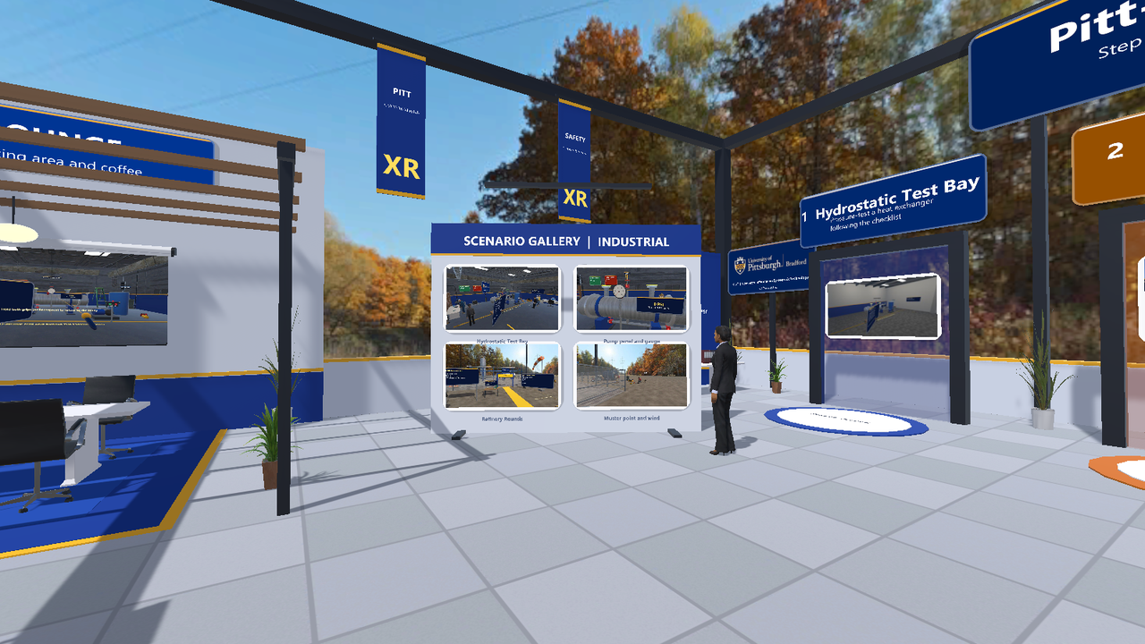
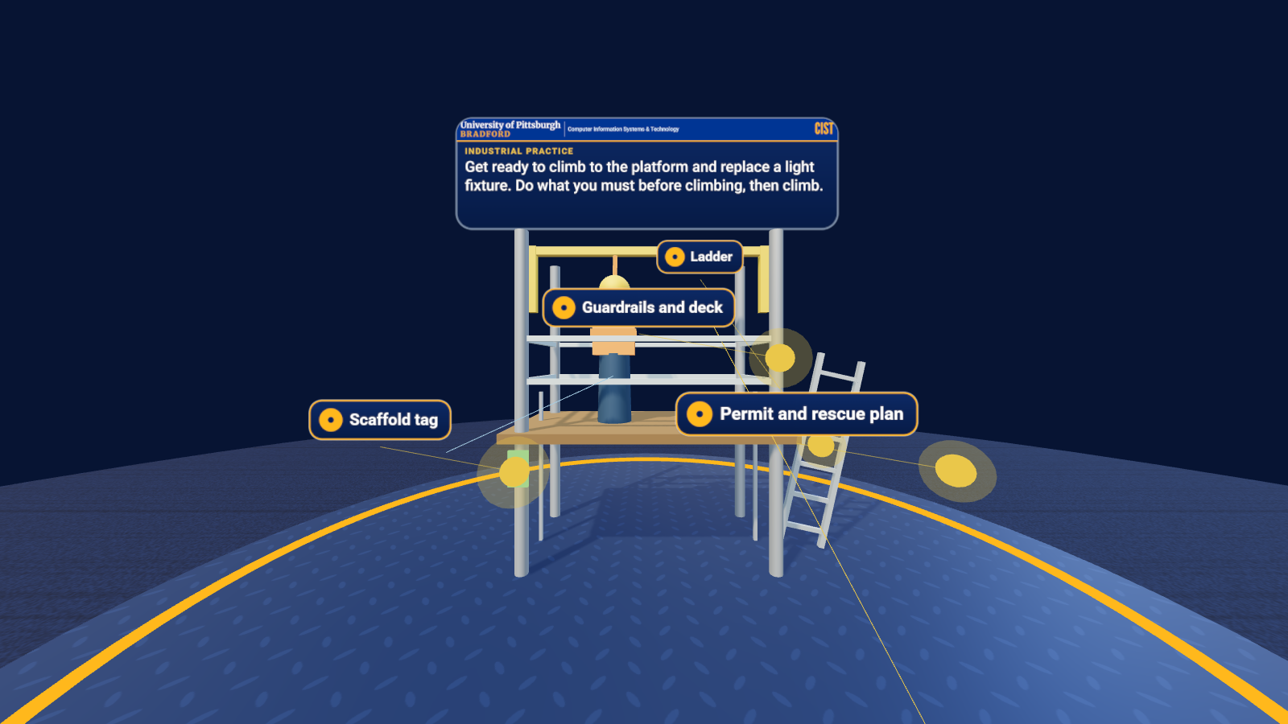
XR training
repository
REPOSITORY GUIDE / 2026
Hub lobby (desktop editor render, local assets)
A tour of every folder: browser demos, multiplayer WebXR, an 11-scenario Practice Lab, four Unity projects and a lobby hub, native SDK samples, tools, tests, research and documentation.
University of Pittsburgh at Bradford
Demo: Nov 13, 2026
Practice Lab task in an emulated Quest 3 session

Slide 2
What the system is
01 / THE SYSTEM
WEB PRACTICE LAB
MULTIPLAYER WEBXR
UNITY PROJECTS
RESEARCH
11 hands-on safety-awareness scenarios
Runs in any browser, and in Quest Browser
Works offline from one lab PC
Circuit Lab, Site Safety Layout, Hydrostatic Test Rig
One small relay; people join by room name
Other users appear as characters in hard hats
Four scenario projects and a lobby hub
Built for Vive Pro 2 on SteamVR (OpenXR)
Plays in a desktop window with no headset
Bibliography of 77 references
Three draft study designs
Nothing has been measured yet
All of it is general safety-awareness practice, not a procedure or certification. Scenarios are inspired by regional industry in general terms. Nothing here has been run on a physical Quest or Vive Pro 2 yet.

Slide 3
What is in each folder
02 / REPOSITORY MAP
training-simulations/
Fieldwork XR Practice Lab: 11 short scenarios in the browser, optional WebXR view.
multi-player/
WebSocket relay and the shared Circuit Lab, Site Safety Layout and hydrostatic test.
a-frame/ threejs/ babylonjs/ webxr/
One small browser demo per library, each with its own README and screenshot.
brand-kit/ vendor/
Web brand kit (bar, fonts, panels, sky) and offline copies of the libraries.
launcher/ index.html
The main menu that opens every example and guide, offline.
vive-steamvr/
Unity projects 01 to 04, the shared kit package, and the hub lobby project.
unity-xri/ openxr/ steamvr/ meta-xr/
Native SDK samples, one per toolchain (source and notes).
arcore-android/ apple-spatial/
Mobile AR and visionOS samples; they need their own toolchains.
tools/ scripts/
Capture, deck builder, status dashboard, docs check, demo launch scripts.
docs/ assets/
Guides, research, demo-day packet, credits, models, skies and images.
Every folder has its own README that says what was run and what was not. The index is docs/README.md.

Slide 4
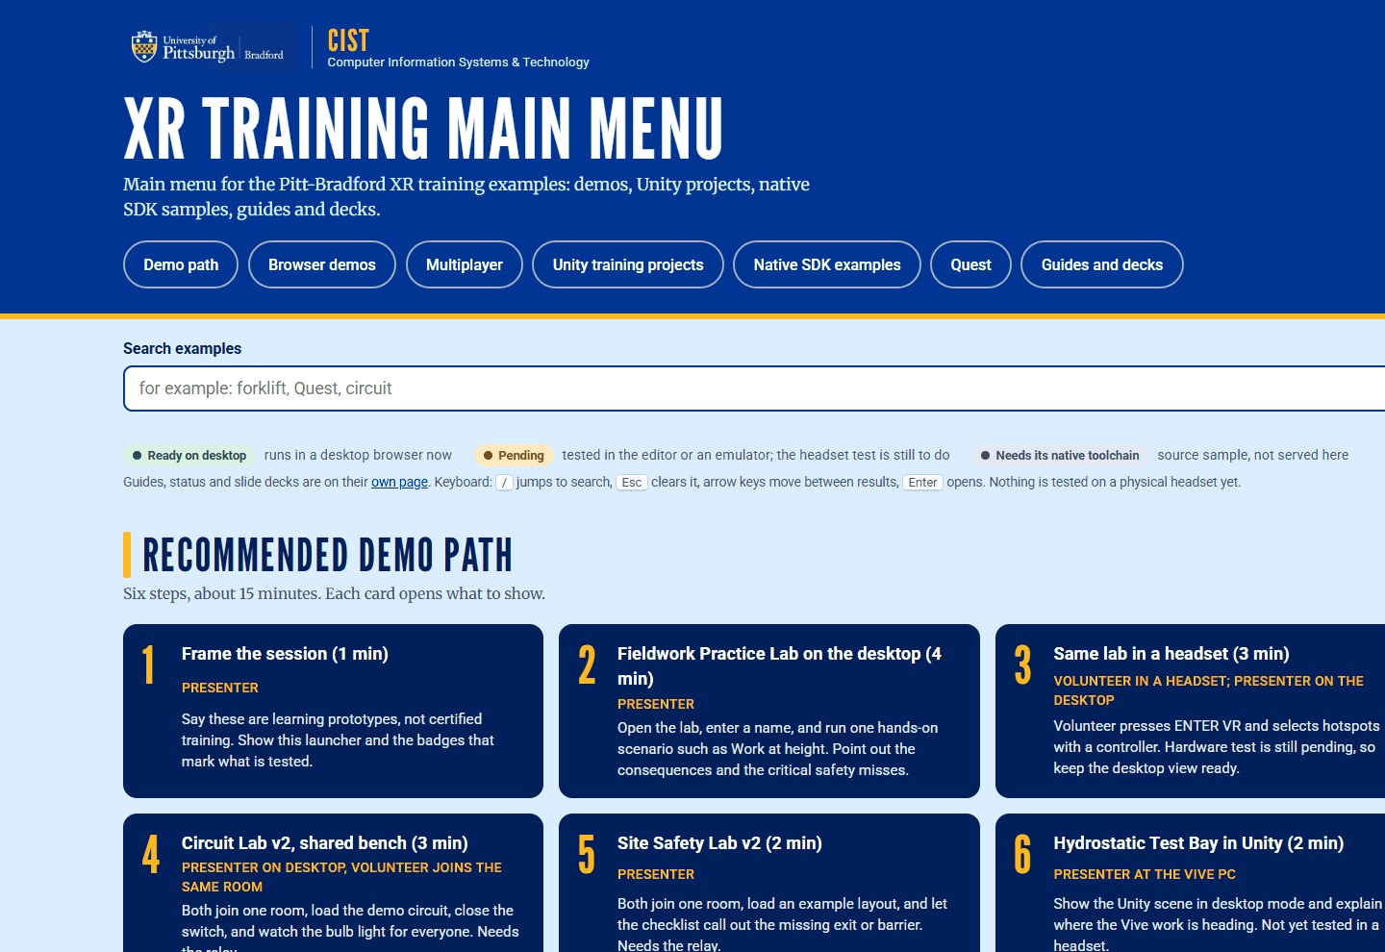
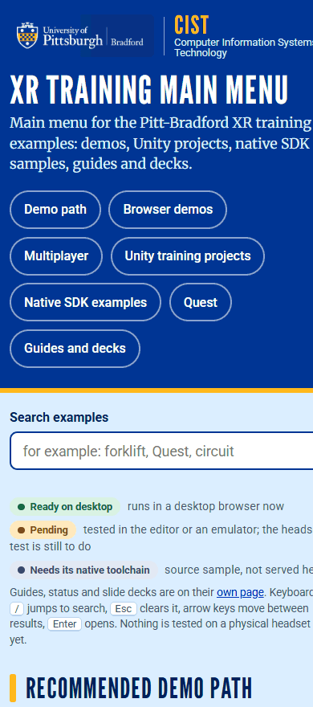
One launcher page for every example
03 / THE MAIN MENU
Tiles for browser demos, multiplayer, the Unity projects, native SDK samples, Quest pages, guides and decks, built from launcher/examples.json.
Search box and keyboard navigation (press / to search).
Runs offline: libraries are vendored.
Desktop and phone layouts checked in a browser; not opened in a headset.
Launcher, wide layout (top of page)
Narrow (phone)

Slide 5
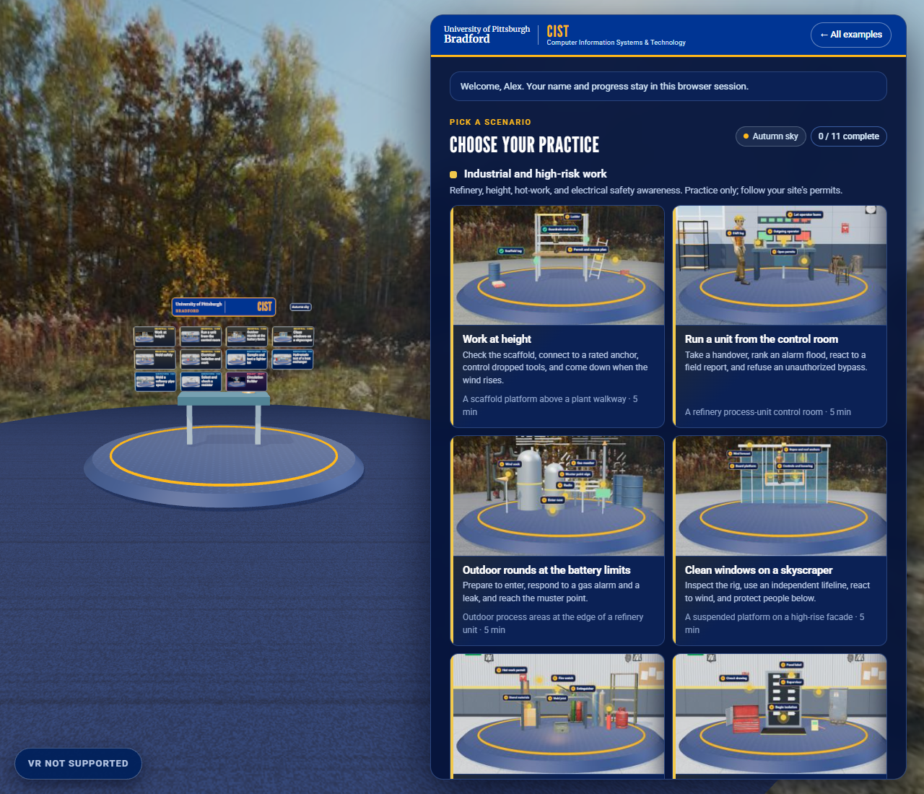
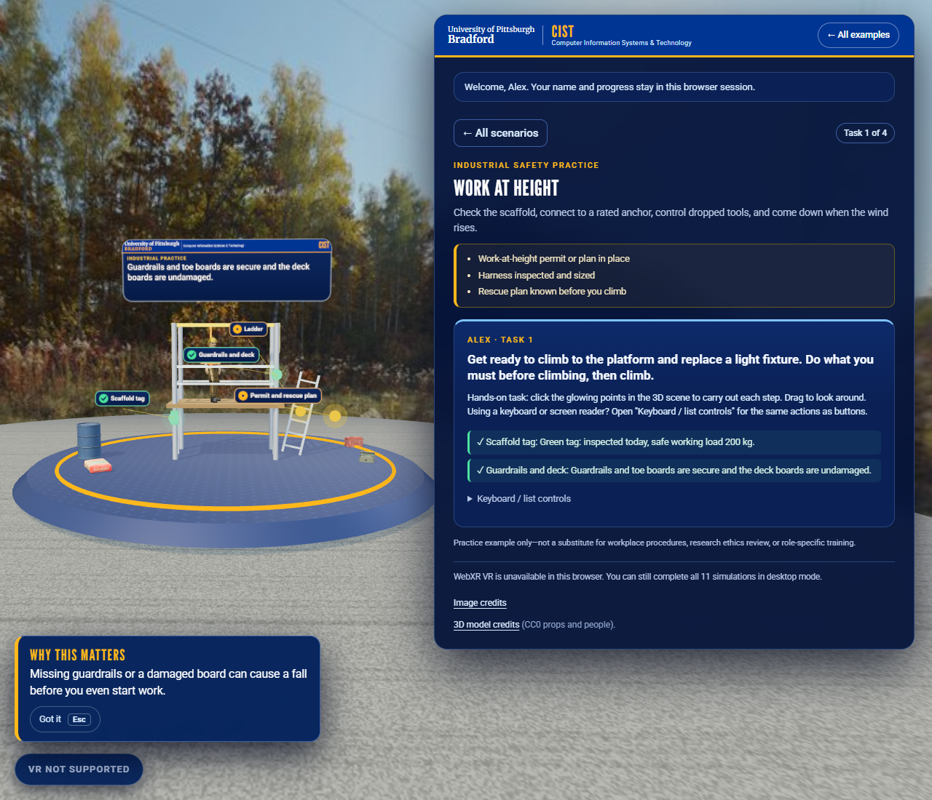
Eleven short scenarios in the browser
04 / FIELDWORK XR PRACTICE LAB
Three groups, all hands-on and mechanical: high-risk industrial, manufacturing quality, and a draft life-science scenario.
Click glowing points in a 3D scene to do each step. Every option has feedback; critical mistakes are flagged.
'Why this matters' panels and a reasoning question are scored apart from the procedure.
Optional WebXR view with a controller; checked in an emulated Quest 3, not on a headset.
Props and people are CC0 models; the scene runs offline.
Scenario catalogue
Work at height, hands-on task
Notes:
Desktop and emulated Quest 3 captures. Scenarios are general safety awareness, not procedures. The manufacturing scenarios have not been reviewed by an industry expert; the Circulation Builder is a draft for faculty review.

Slide 6
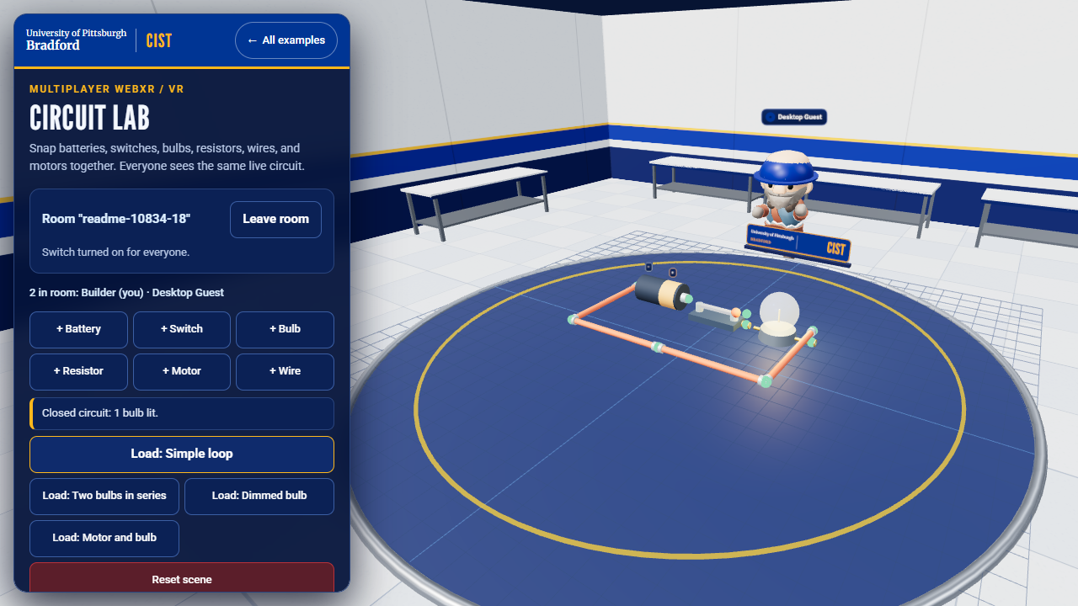
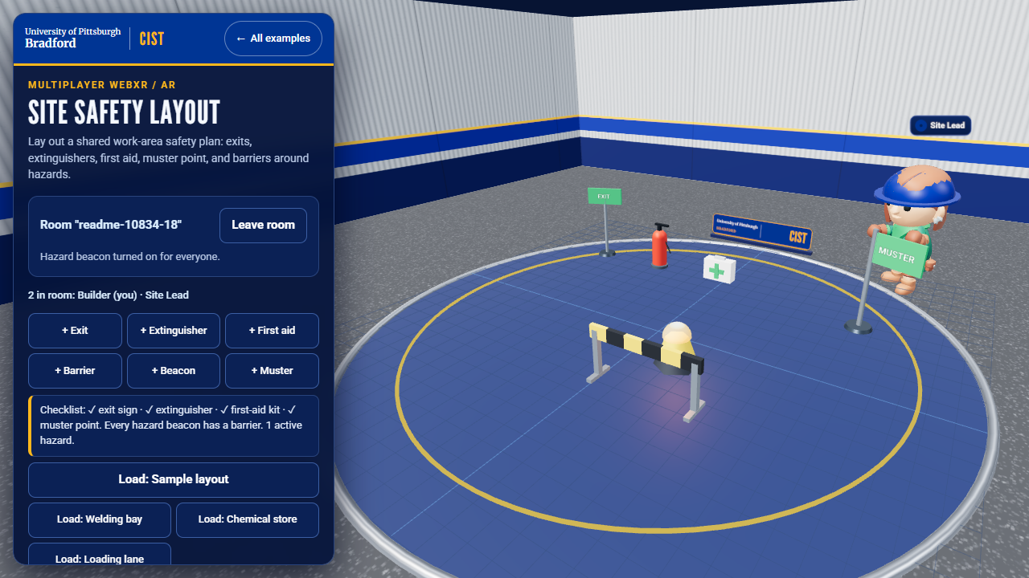
Shared rooms through a small relay
05 / MULTIPLAYER WEBXR
A Node WebSocket relay serves the pages and keeps each room's shared state (HTTPS on the lab PC, port 8443).
Circuit Lab (VR): snap batteries, switches, bulbs and motors together with others in one room.
Site Safety Layout (AR): place exits, extinguishers, first aid, muster point and barriers; a live checklist flags gaps.
Hydrostatic test: a shared multi-user version of the Unity bay.
Phones, desktop browsers and headsets join the same room; people see each other's head and hands.
Circuit Lab, desktop view
Site Safety Layout with the sample layout
Notes:
Verified with 2 to 3 browser contexts on one PC (81 end-to-end checks) and 40 relay unit tests. A real two-device session has not been run.

Slide 7
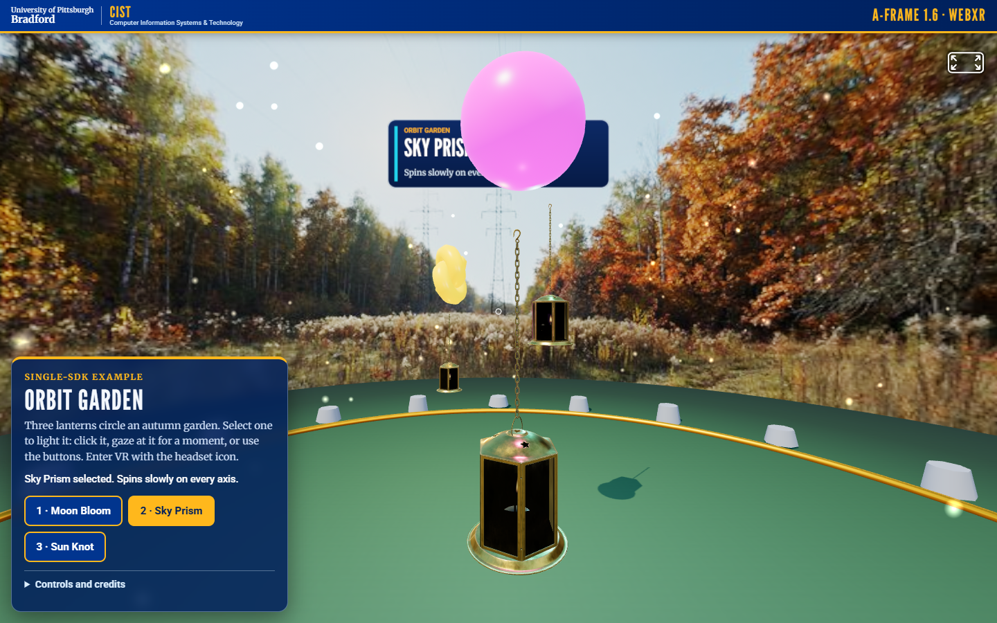
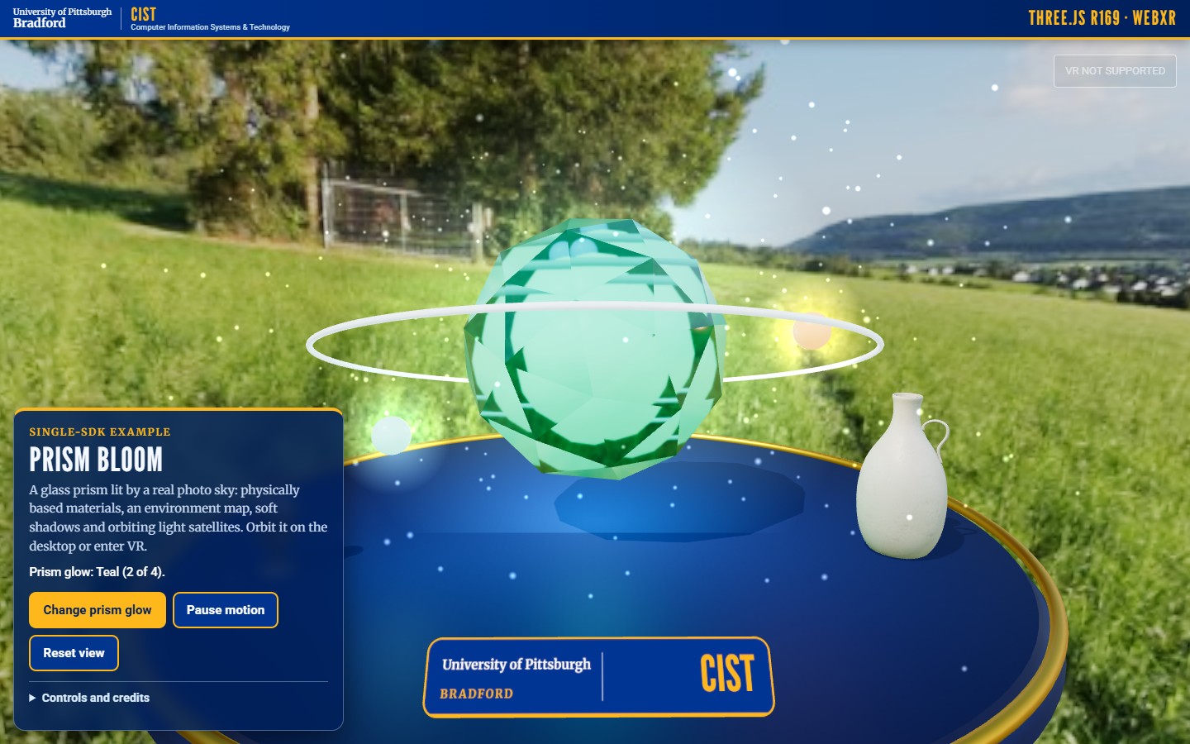
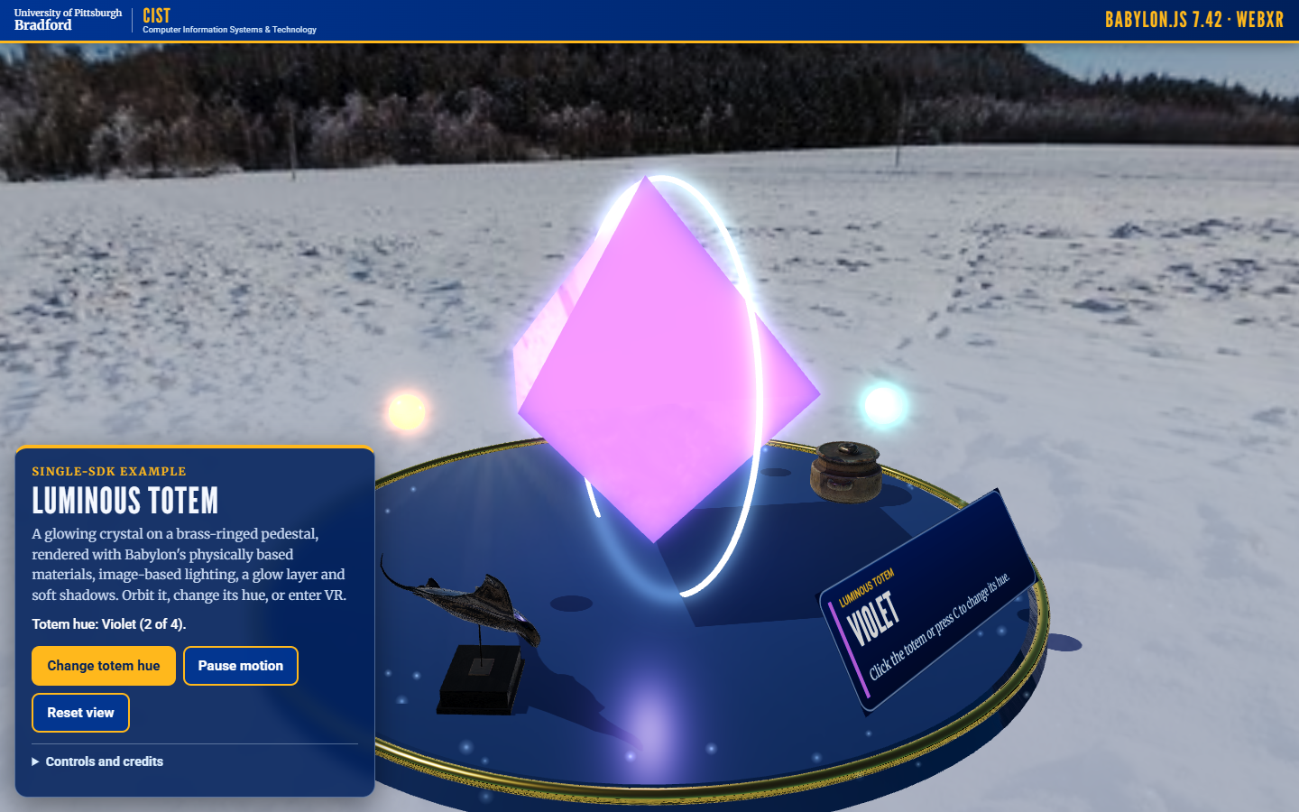
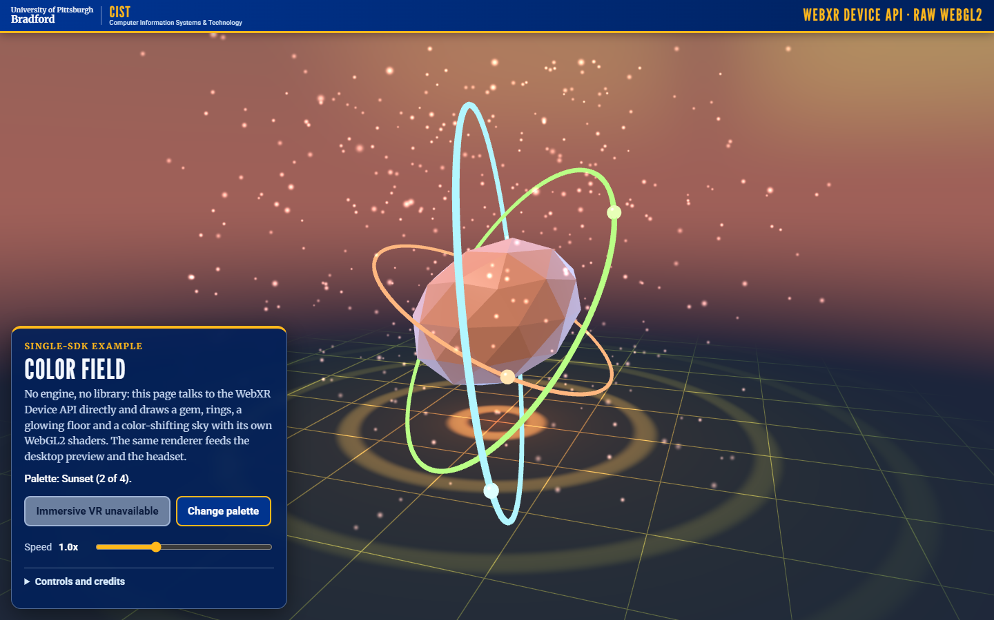
Four libraries, one idea each
06 / THE SINGLE-LIBRARY DEMOS
A-Frame: gaze-selectable lantern shapes in declarative HTML
Three.js: animated prism with orbiting lights and a VR entry button
Babylon.js: glowing totem with built-in beacon effects
Raw WebXR Device API: a colour-changing immersive scene
Each has a desktop fallback, runs offline from vendor/, and a README with what was tested. The ENTER VR button works only with a supported headset or an emulator.

Slide 8
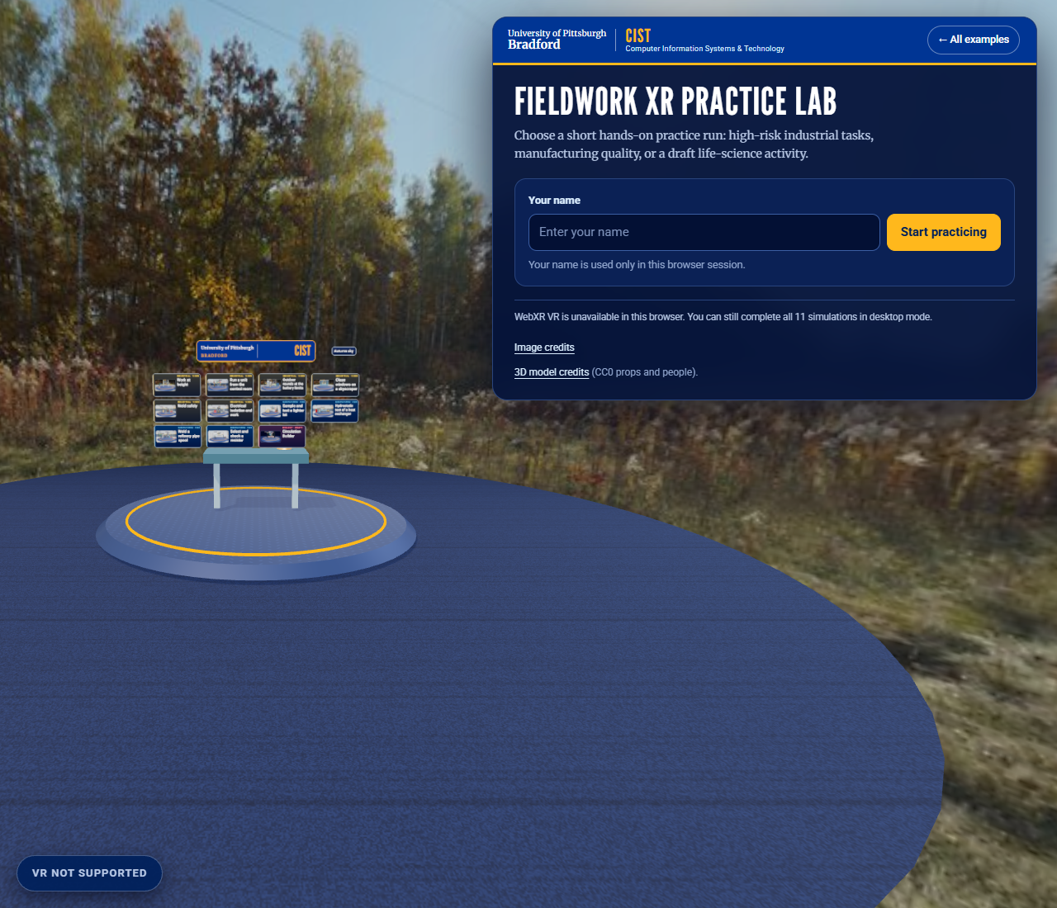
One look, no internet needed
07 / BRAND KIT AND OFFLINE
Brand kit
The brand bar, fonts, panels and sky shader for every page. League Gothic, Merriweather and Roboto are bundled; University of Pittsburgh palette.
Offline by design
Three.js, Babylon.js, A-Frame and a QR library live in vendor/. An automated check loads every page with the network blocked.
Accessibility
Keyboard control for the 3D tasks, 44 px targets, reduced-motion support, a list view of the same actions.
Checks
36 Practice Lab tests, 16 brand-kit tests, 48 layout checks, and a test that no scene code draws bare text.
Practice Lab welcome page

Slide 9
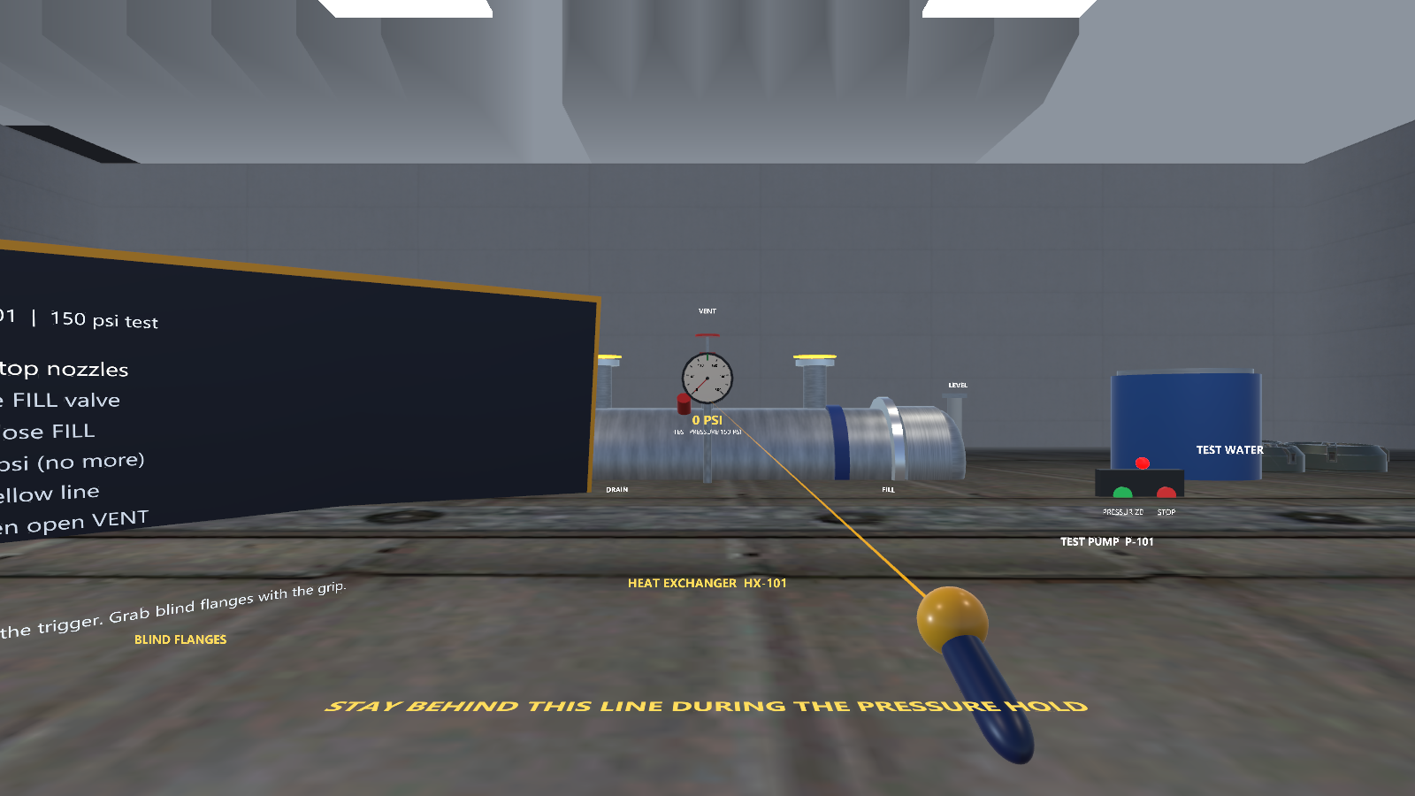
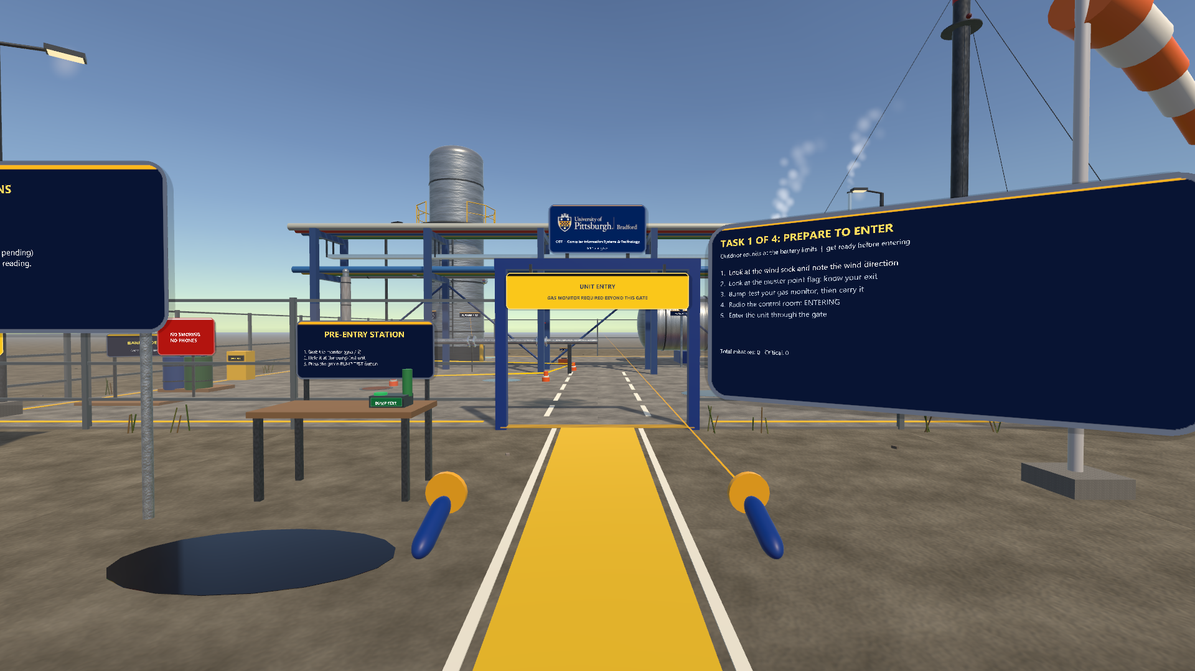
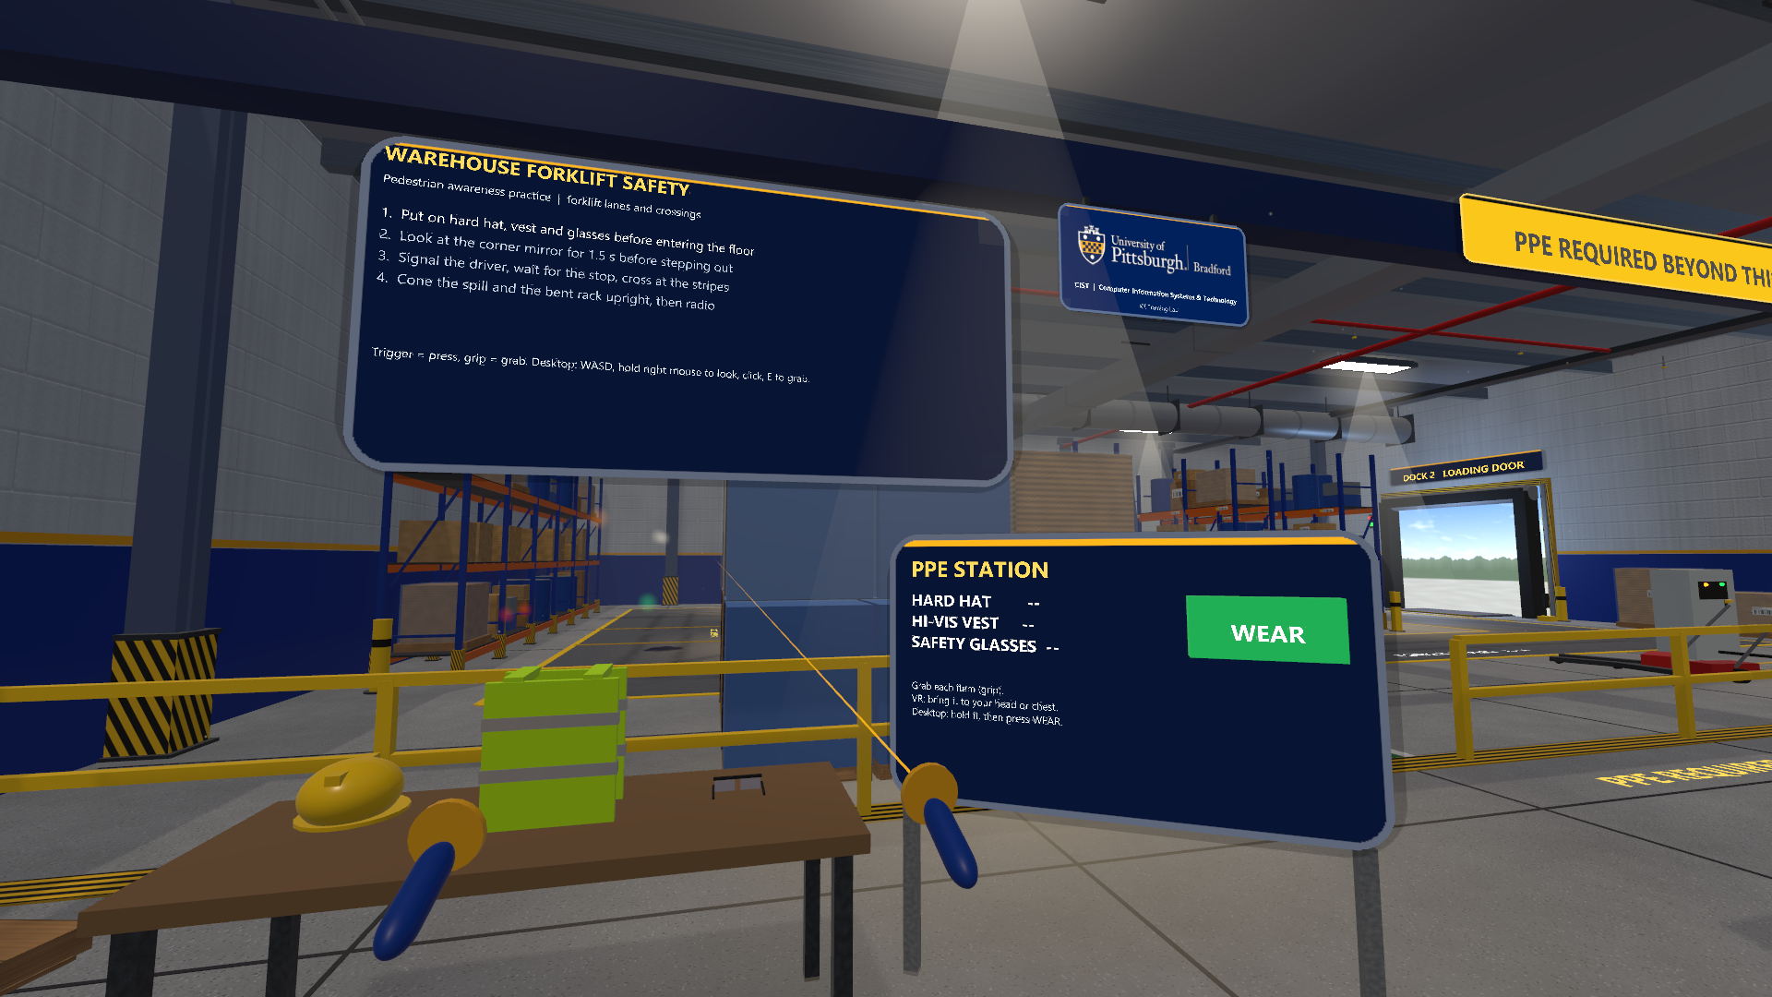
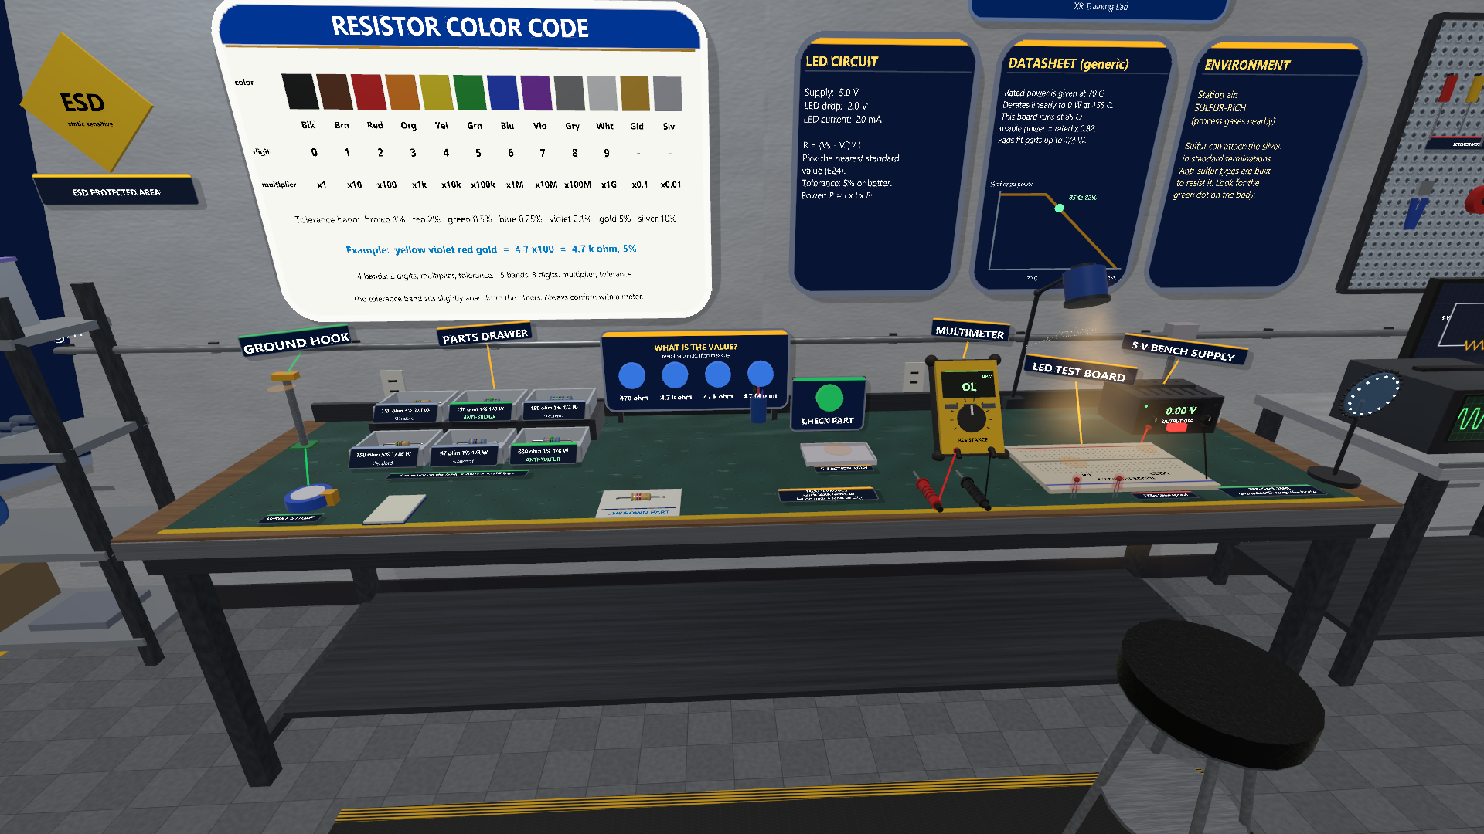
Four Unity training projects for Vive Pro 2 / SteamVR
08 / UNITY PROJECTS
01 Hydrostatic Test Bay
Fit blind flanges, vent and fill, raise to 150 psi, hold from behind the line, drain.
02 Refinery Rounds
Gas alarm, flange weep, muster point. Live weather sets the wind (Open-Meteo).
03 Warehouse and forklift
PPE, convex mirror, eye contact, striped crossing, near-miss feedback.
04 Resistor bench
ESD strap, color code, Ohm's law, E24 value, derating. Generic component bench.
01 in the hub project. Desktop editor
02 Refinery Rounds. Desktop editor render
Verified: compiles and plays in the Unity 6000.3.20f1 editor, desktop mode. Not tested on a Vive Pro 2 or any headset.
03 Warehouse. Desktop editor render
04 Resistor bench. Desktop editor
Notes:
Unity editor Game view (desktop, not a headset). Projects 02 to 04 were not played through to the end. General safety-awareness practice, not a procedure or certification.

Slide 10
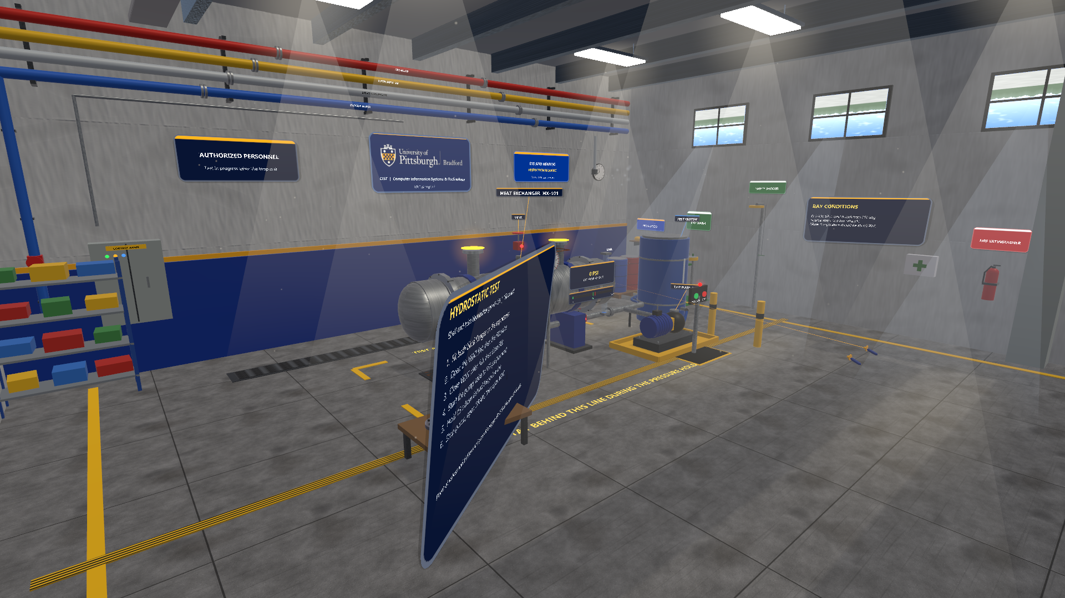
One package behind all four projects
09 / THE SHARED KIT
Signage and UI
Rounded panels, brand plate, task board, 'why this matters' cues and a rationale question.
Bake and adopt
Scenes are built in code, then saved as real GameObjects you can edit in the Hierarchy.
Procedural materials
Concrete, steel, wood, paint, rubber and glass made in code, so no art files are needed.
Audio and effects
Being added in round 3: a sound library (CC0 recordings plus synthesis) and cheap particle and lighting helpers.
Rig and input
A desktop and OpenXR rig: wands or mouse and keyboard, same scenes.
Projects 01 to 04 contain no Asset Store art, so they can be committed. Compiles in the Unity 6000.3.20f1 editor; nothing here has run on a headset.
01 Hydrostatic Test Bay (desktop editor render)

Slide 11
Open a project, set up, press Play
10 / OPEN A PROJECT
1
Open vive-steamvr/0N-... in Unity Hub with Unity 6000.3.20f1. The shared kit loads from a file: path.
CONTROLS: WANDS / DESKTOP
Move: left stick / W A S D
Look: head, snap-turn / hold right mouse
Press: point and trigger / crosshair and click
Grab: grip / look at it and press E
2
Run the menu Pitt-Bradford > Set up project. It configures OpenXR and the Input System and builds the scene.
3
For a headset: set SteamVR as the OpenXR runtime, start SteamVR, press Play. With no headset it runs in desktop mode.
4
Optional: Pitt-Bradford > Build Windows player.
HUB PROJECT
A lobby with four portals and five scenes, dressed with Asset Store props and animated people. That art stays on the lab PC and is not committed. Desktop editor screenshots only; frame rate on a headset is untested.

Slide 12
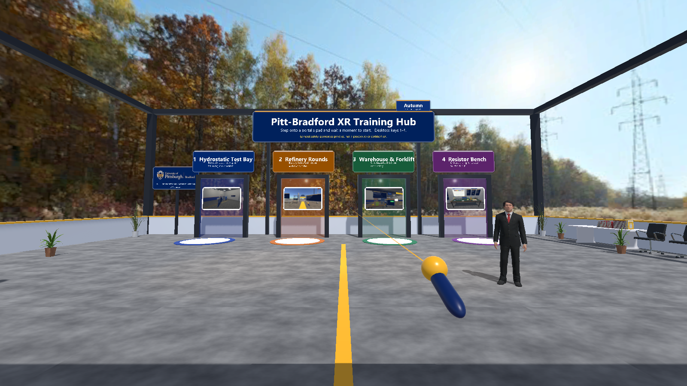
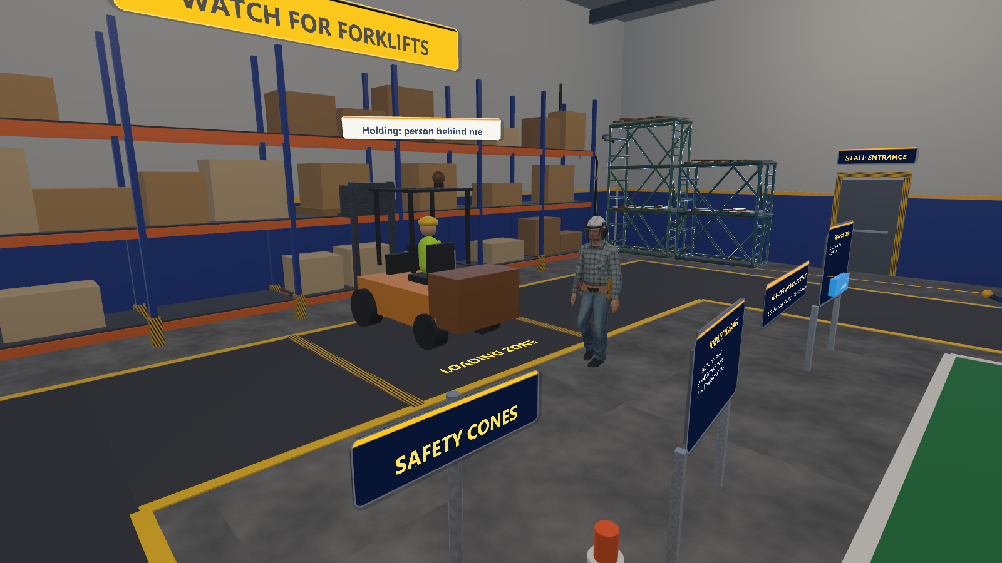
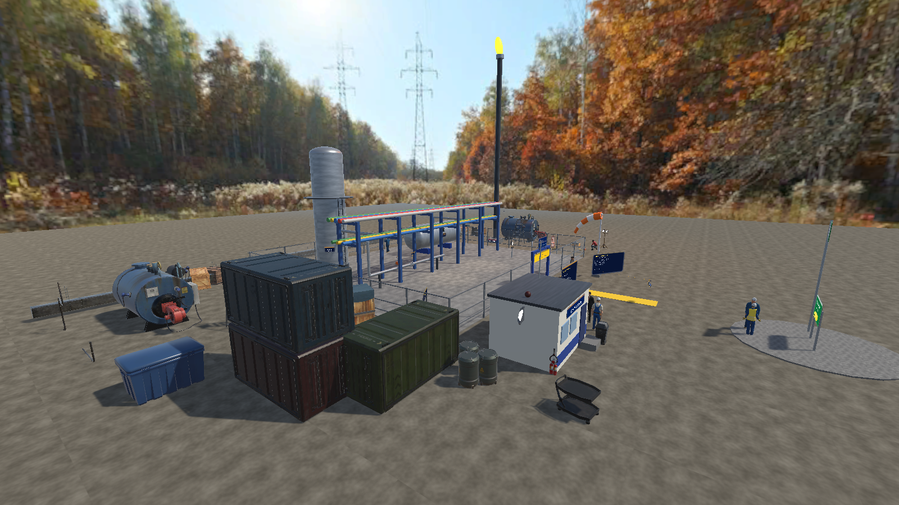
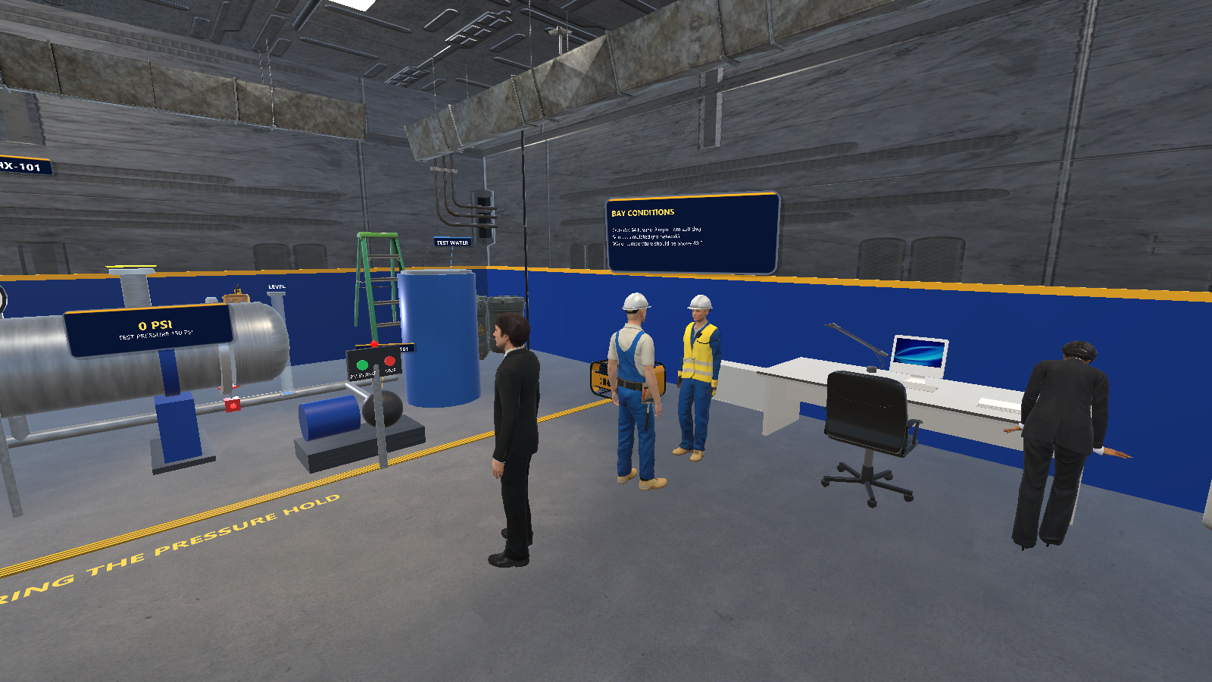
Unity hub: lobby with portals to each scenario
11 / THE HUB LOBBY
Step on a portal pad to load a scenario; hold both grips to return.
Scenes are dressed from code with Asset Store props and Microsoft Rocketbox people (MIT licence). These files stay on the lab PC and are not in the repository.
Triangle counts per scene are 77k to 189k. Frame rate on a Vive Pro 2 is not measured.
Checked in the editor with scripted self-tests. Not played in a headset.
Lobby. Unity editor, desktop
Warehouse with a walking co-worker. Unity editor, desktop
Refinery. Unity editor, desktop
Hydrostatic test bay. Unity editor, desktop

Slide 13
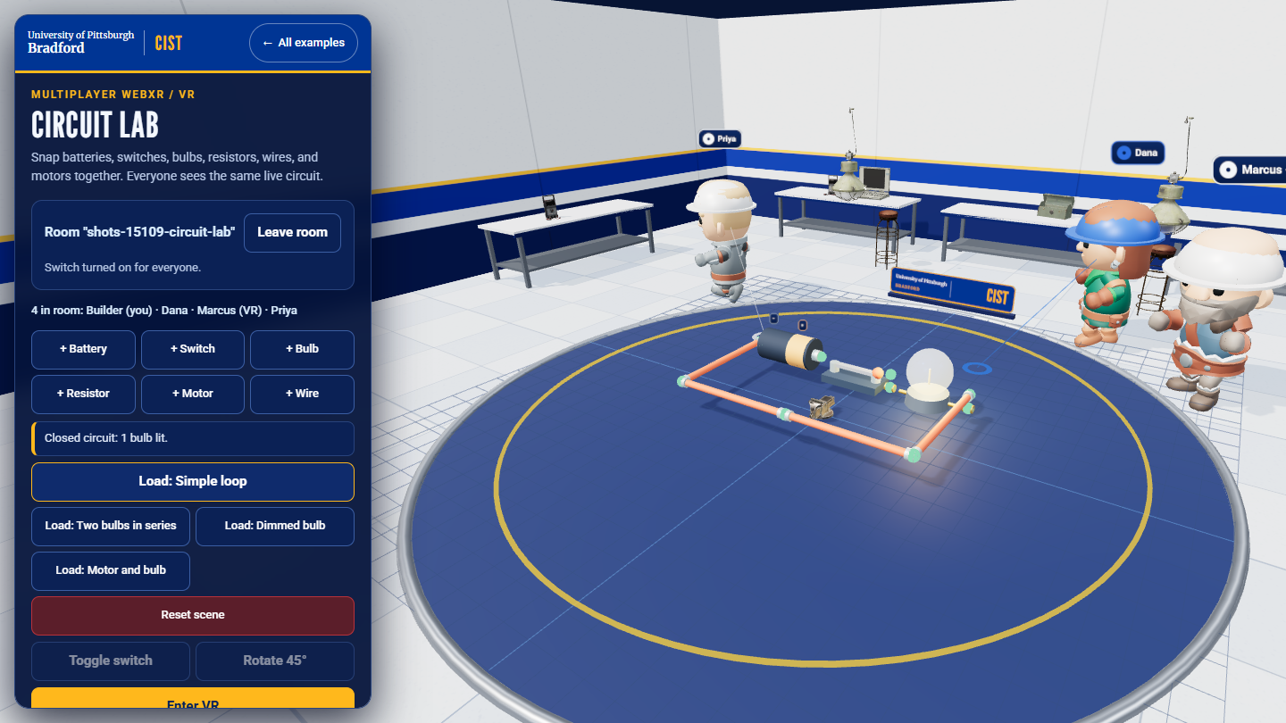
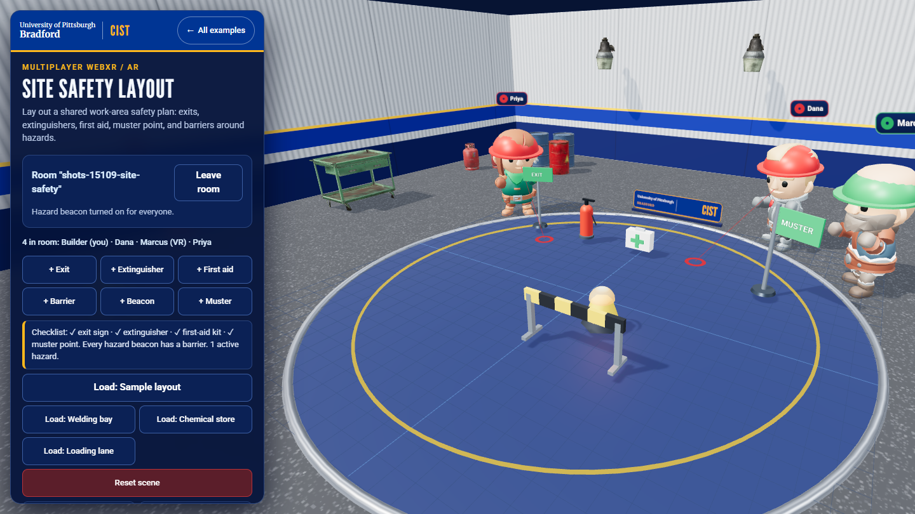
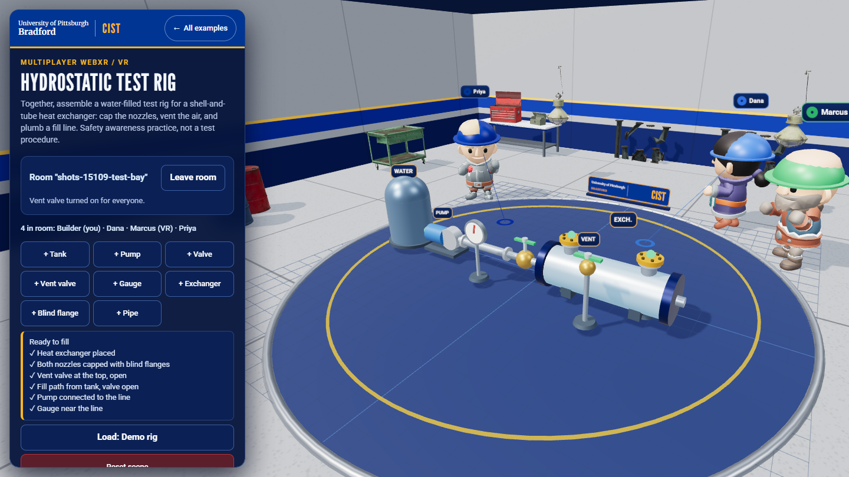
Multiplayer rooms with props and people
12 / PEOPLE IN THE SCENES
Circuit Lab, three other participants (desktop browser)
Site Safety Layout (desktop browser)
Hydrostatic Test Rig (desktop browser)
Each theme has its own room built from CC0 props. Every other participant is a character in a hard hat; VR users send head and hand positions.
If models cannot load, the page falls back to plain shapes. On a computer with no GPU it starts in a lighter mode.
Seen on a desktop browser and in an emulated Quest 3 only. Credits: multi-player/CREDITS.md (Poly Haven, KayKit, both CC0).

Slide 14
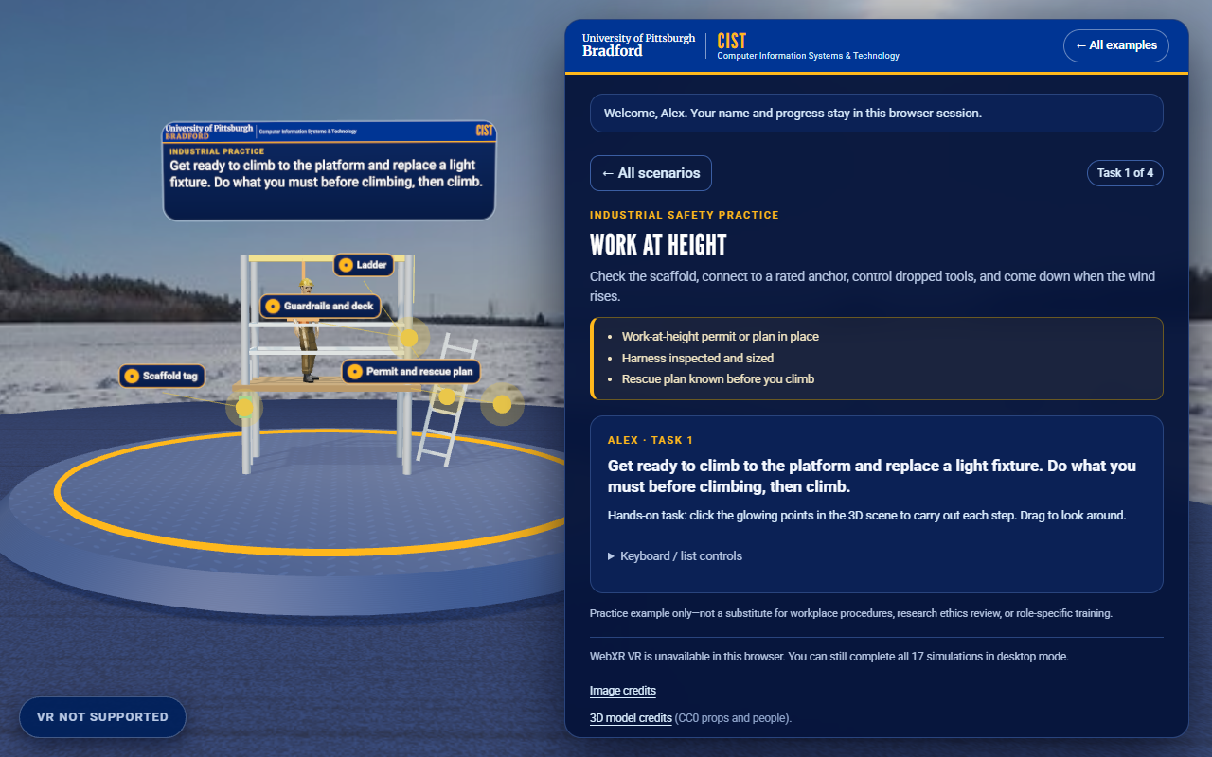
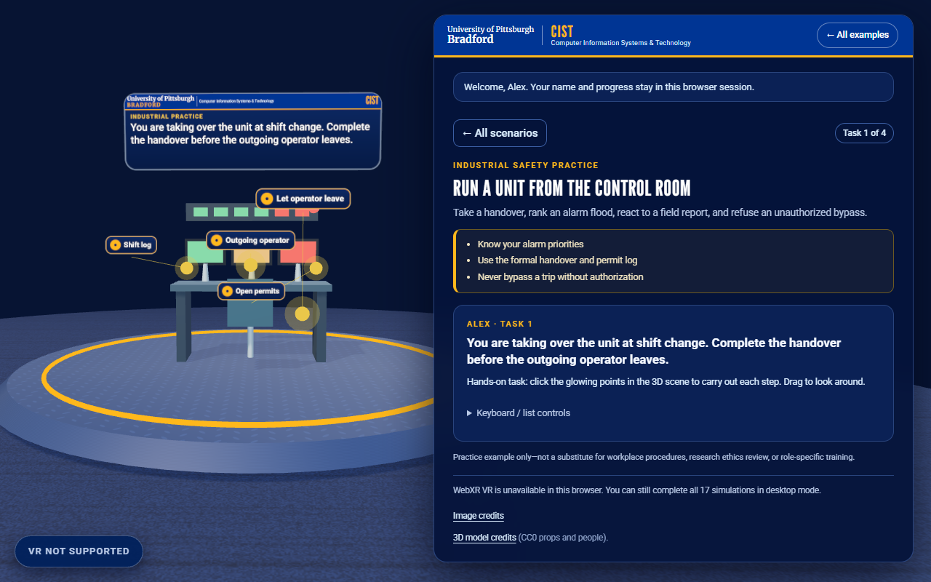
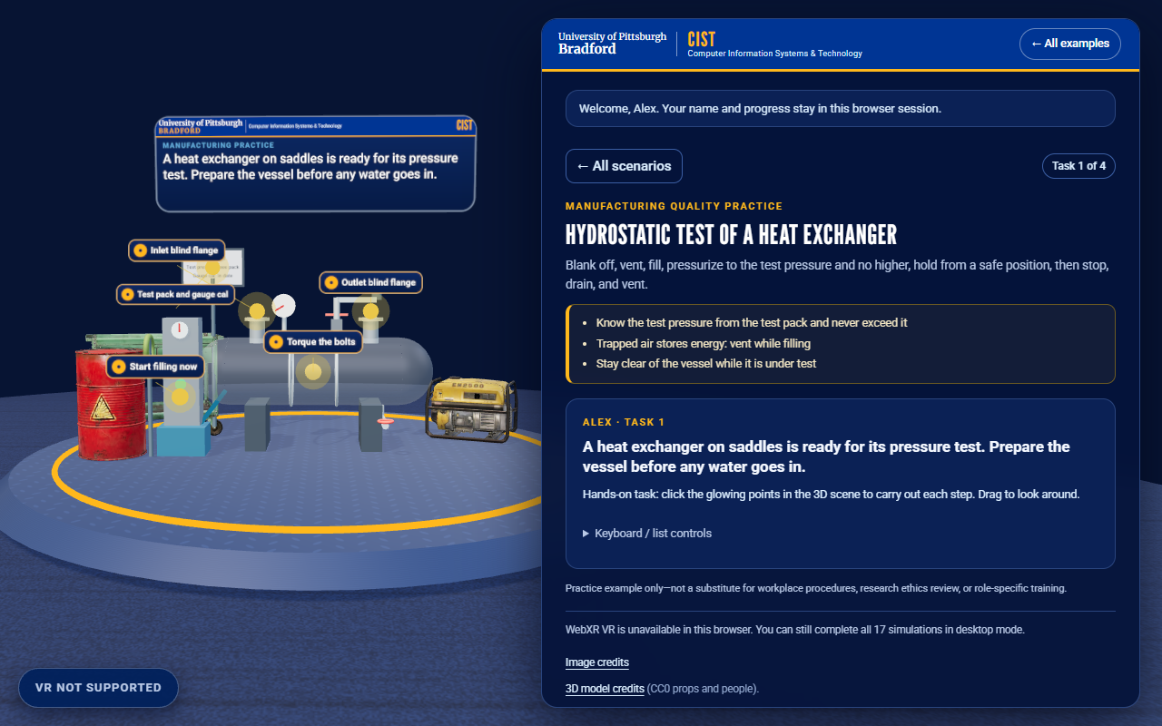
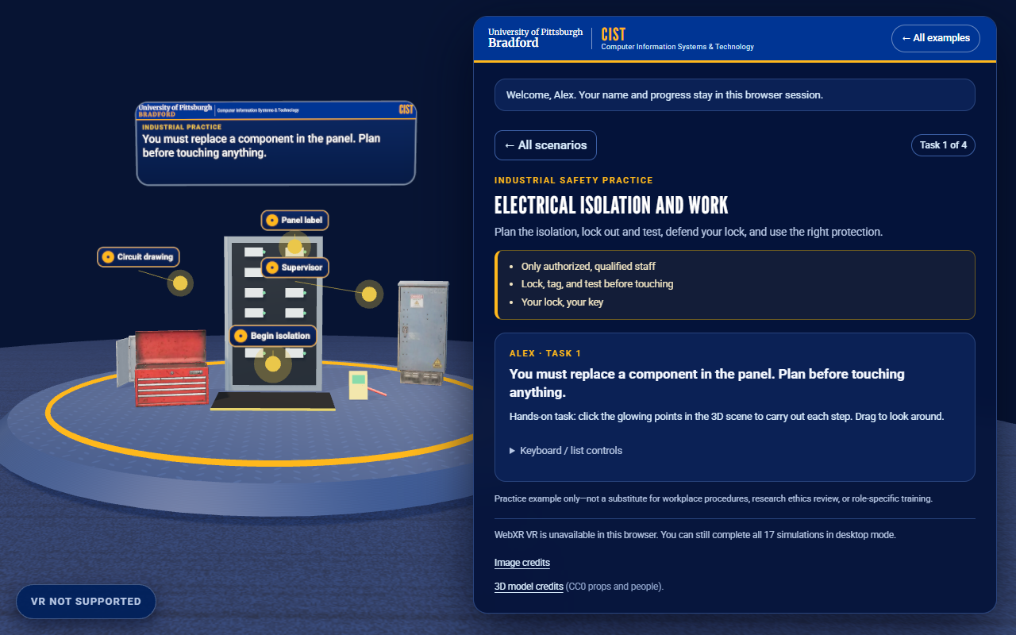
Practice Lab scenes with real props and people
13 / REALISM AND ASSET RULES
Props are CC0 glTF models from Poly Haven; animated people are CC0 models from Quaternius.
Everything loads offline. If a model fails, a plain shape takes its place and the scenario still works.
Credits are in assets/models/CREDITS.md.
Frame rate on a Quest has not been measured.
Work at height (desktop browser)
Refinery control room (desktop browser)
Heat-exchanger hydrostatic test (desktop browser)
Electrical isolation (desktop browser)

Slide 15
Third-party material and its licences
13b / CREDITS AND LICENCES
Fonts
League Gothic and Merriweather (SIL OFL 1.1), Roboto (Apache 2.0), bundled.
3D models, textures, skies
CC0: Poly Haven, Quaternius, KayKit. Each file is listed with its source.
People in the hub scenes
Microsoft Rocketbox avatars, MIT licence; imported locally, not committed.
Unity Asset Store packs
Used only in the local hub project. Their licences forbid redistribution, so they are never committed.
Live weather
Weather data by Open-Meteo.com, CC BY 4.0.
Sounds (being added, round 3)
CC0 recordings plus our own synthesis; every file will be credited. Not finished yet.
Everything is listed in CREDITS.md. Only CC0 or public-domain files are added to the repository.
The University of Pittsburgh at Bradford logo is published with approval; the brand guidelines are not.

Slide 16
Six samples, each from its own toolchain
14 / NATIVE SDK SAMPLES
unity-xri/
Unity XR Interaction Toolkit: grab an object, change its colour.
openxr/
Unity OpenXR: a small sample that reacts to the runtime.
steamvr/
SteamVR plugin: a boolean action toggles a material.
meta-xr/
Meta XR: passthrough camera stream in a Unity UI image.
arcore-android/
Google ARCore: detect a floor plane and place a cube on tap.
apple-spatial/
Apple Vision Pro: SwiftUI and RealityKit anchored content.
Source and setup notes only. None was built or run here: each needs its own toolchain (Android Studio, Xcode, or a Meta or SteamVR setup). The READMEs say so.

Slide 17
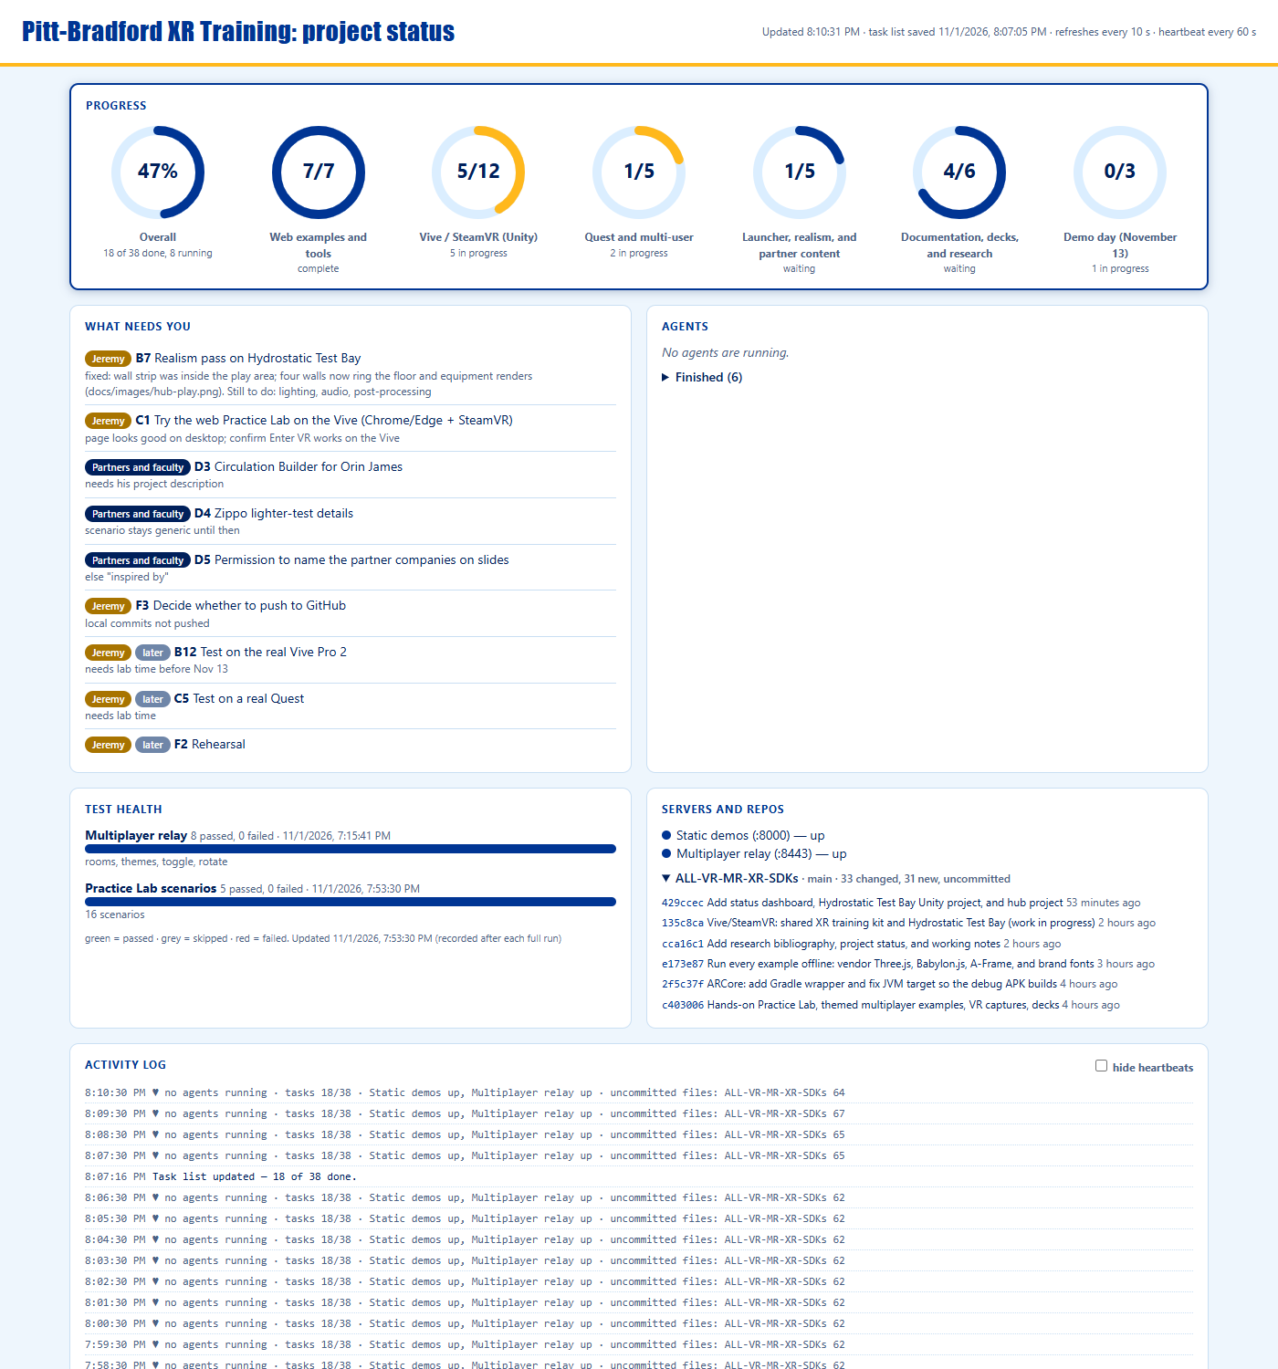
Tools that keep the repository honest
15 / TOOLS
tools/vr-capture
Playwright captures, including an emulated Quest 3 session; UI, offline, launcher and multiplayer checks.
tools/decks
Rebuilds these PowerPoint decks from the READMEs and current screenshots.
tools/status
A local live dashboard: task list, agents, test results, servers, uncommitted work.
tools/docs-check
Fails on a broken link, a guide missing from the index, or a quoted test count that is out of date.
Status dashboard (npm run status)
Notes:
The dashboard reads docs/Task-Status.md. Screenshots are desktop captures.

Slide 18
What the automated checks cover
16 / AUTOMATED CHECKS
Practice Lab unit tests
36 pass
All on a development PC: desktop Chrome, an emulated Quest 3, and the Unity editor. None on a headset.
Brand kit unit tests
16 pass
Multiplayer relay unit tests
40 pass
Web layout checks
48 of 48
Counts are checked by docs-check, so a slide or README that quotes an old number fails the build.
Multiplayer end to end (2 to 3 browser contexts)
81 pass
Demo SDK correctness
26 pass
Demos check, offline check, launcher check, docs-check
all pass
Emulated Quest 3 demos
4 of 4

Slide 19
What is verified, and what is not
17 / VERIFIED AND NOT
RUN AND CHECKED
NOT VERIFIED
Browser demos and the Practice Lab (11 scenarios) on a desktop browser
Automated suites pass on a development PC: Practice Lab 36, brand kit 16, relay 42, web layout checks 48
Multiplayer relay with automated tests; two-client rooms
Unity projects 01 to 04 and the five hub scenes compile and run in the editor (desktop mode); scripted self-tests pass
Emulated Quest 3 captures (Meta IWER in Chrome)
HTTPS start script, certificates, and QR page on a development PC
Anything on a real Quest or Vive Pro 2, including controllers and comfort
Unity projects 02 to 04 played to the end
Frame rate of the hub scenes on a Vive Pro 2
Practice Lab VR captures for the four newest scenarios
Learning outcomes: no study has been run
Safety content against any real site procedure
Scenarios are general safety awareness, not a procedure or certification. No company names appear in these materials; the content is generic and inspired by regional industry.

Slide 20
Research basis: 77 references, checked against records
18 / RESEARCH
WHAT THE REVIEWS SUGGEST
THREE DRAFT STUDY DESIGNS
Kaplan et al. (2021): XR training performs about as well as common methods overall, with a likely edge where danger or cost limits conventional training.
Makransky et al. (2019): in one study of 52 students, immersive VR raised presence but lowered learning scores.
Scorgie et al. (2024) and Stefan et al. (2023): retention and behavior-level outcomes are rarely measured.
A: hands-on 3D tasks versus choose-a-response.
B: low versus high visual realism, same scenario.
C: desktop, Vive, and Quest comparison.
Hypotheses, not results. No sample sizes proposed. Needs IRB review before any data collection.
A working bibliography, not a literature review. Records were checked (mostly Crossref); 40 newer entries come from a survey of other universities and were read at abstract level only. Read the full text before citing.

Slide 21
Where to read what
19 / DOCUMENTATION
docs/README.md
The documentation index: every guide, by purpose.
HOW-TO-RUN, TESTING
Run the demo, a project, the hub or a headset; the suites and hands-on check tables.
demo-day/
Checklist, talk track, Vive and Quest setup, backup plan, troubleshooting.
research/
Bibliography (re-checked against Crossref), study designs, content review.
GLOSSARY, CREDITS
Plain terms for the advisory board; every third-party credit.
HOLOLENS-AR-NOTES
Why content can look small on a HoloLens and how to fit it (untested there).

Slide 22
Local status dashboard
20 / STATUS DASHBOARD
Progress and what needs you
Rings per section of docs/Task-Status.md; tasks waiting on the owner, partners, or faculty.
Agents and test health
Which helpers are running and the last recorded result of each test suite.
Servers and repos
Whether the demo servers answer, uncommitted files, recent commits.
Start: npm run status. Node.js only, bound to 127.0.0.1, no cloud, no database.
Status dashboard, light theme

Slide 23
Demo day: one command starts everything over HTTPS
21 / DEMO DAY, NOV 13
DOUBLE-CLICK scripts\start-demo.cmd
WHO OPENS WHAT
1
Checks Node.js; first run does npm install (needs internet once).
Quest Browser: https://<lab-PC>:8443/ (accept the certificate warning once)
QR codes: /multi-player/qr.html on the PC
Vive Pro 2 PC: desktop browser or the Unity project
Everyone in an activity uses the same room name
2
Starts one server on port 8443 over HTTPS: launcher, multiplayer pages, Practice Lab, and the relay.
3
Makes a self-signed certificate on first run (cached, never committed).
Kit in docs/demo-day/: CHECKLIST, HARDWARE-TEST-SESSION, QUEST-SETUP, VIVE-SETUP, BACKUP-PLAN, TROUBLESHOOTING, and a 15-minute TALK-TRACK.
4
Prints every URL and opens the launcher on the PC.
Run on a development PC (Node 22, Windows 11). No Quest or Vive used in any test: every hardware step is verify at rehearsal.

Slide 24
HoloLens: why content looks small
22 / AR ON SMALL DISPLAYS
The HoloLens 2 shows about 43 x 29 degrees, less than half a Quest's width.
It is additive: dark colours are transparent, so dark scenes seem to shrink.
Fit content to the real field of view, 1.3 m ahead, 0.8 m wide, bright colours.
A two-minute headset measurement tells us which cause is real.
CAUSES, MOST LIKELY FIRST
The display is small (not a bug)
Dark colours turn transparent
Content too wide or too far away
Near clipping at arm length
Frame rate on a mobile GPU
Read: docs/HOLOLENS-AR-NOTES.md. Code: multi-player/shared/ar-fit.mjs
Tested: the field-of-view and fit maths in unit tests only. Not tested on a HoloLens.

Slide 25
Status and next steps
23 / NEXT STEPS
BEFORE NOVEMBER 13
AFTER THE DEMO
Run the hardware test session on a Vive Pro 2 and a Quest (docs/demo-day/HARDWARE-TEST-SESSION.md).
Rehearse the one-command start on the lab PC and Wi-Fi.
Measure hub frame rate; reduce detail if needed.
Faculty review of the draft life-science scenario.
Subject-matter review of the reasons and questions in the scenarios.
Ask partners which scenarios would be useful to them.
Study designs need ethics review before any data is collected.
Possible later work: Unity multi-user and Quest builds.
Every status in this deck is about a desktop browser, the Unity editor, or an emulated Quest 3 unless it says otherwise.

