Slide 1
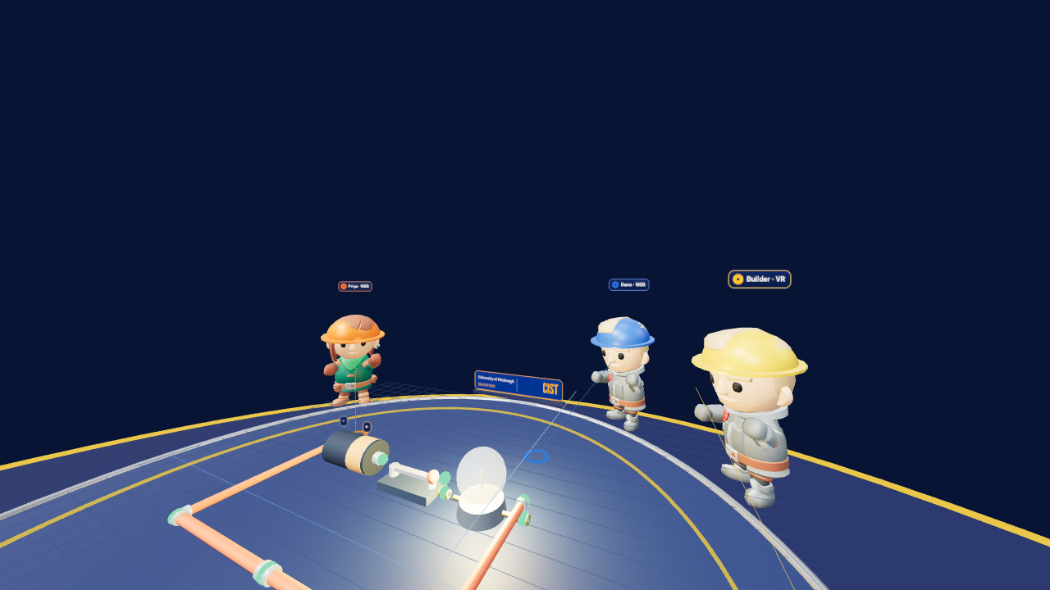
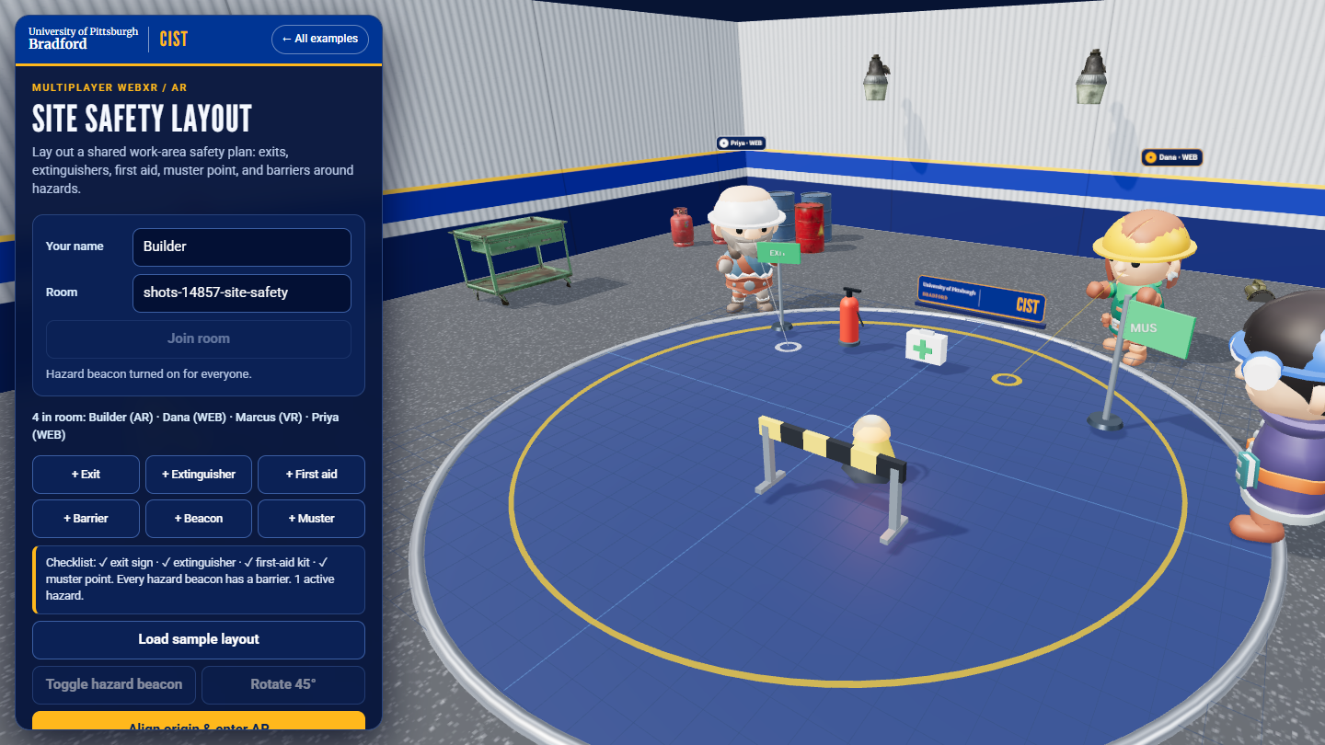
Build together
in VR and AR
MULTIPLAYER WEBXR / VR + AR
Circuit Lab in an emulated Quest 3 session
Three compact WebXR themes share one WebSocket relay: Circuit Lab (VR), Site Safety Layout (AR), and a Hydrostatic Test Rig.
Circuit Lab · VR
Site Safety Layout · AR
Desktop fallback
Site Safety Layout, desktop fallback

Slide 2
A shared room, not just shared discovery
01 / THE IDEA
1
Rooms
2
Presence
Join a named room. A small WebSocket relay keeps the latest snapshot so late joiners see what is already there.
Names, connection counts, and remote participant positions and modes are visible to everyone.
3
Ownership
4
Shared state
Only one person can hold a part. Competing grabs are denied and a part is released if its owner leaves.
Placement, transforms, rotation, switch and beacon state, and removal are broadcast to every client.
Themes: each example has its own part catalog and its rooms are namespaced by theme. A room called lab in Circuit Lab is separate from lab in Site Safety Layout.

Slide 3
Start the relay and join the same room
02 / RUN IT
1 START THE SERVER (multi-player/)
HEADSET OR PHONE ON THE LAN
npm install
npm test
npm start
WebXR needs HTTPS off localhost; create a trusted certificate with mkcert.
Set TLS_KEY and TLS_CERT, then open https://<host>:8443/multi-player/...
Immersive VR needs a headset browser; AR needs a phone with WebXR hit testing.
The relay has no accounts and keeps rooms in memory only. Do not expose it publicly.
2 OPEN THE EXAMPLES
http://localhost:8443/multi-player/vr/
http://localhost:8443/multi-player/ar/
Use the same room name on each client. Add ?theme=circuits or ?theme=safety to put either page in either theme.

Slide 4
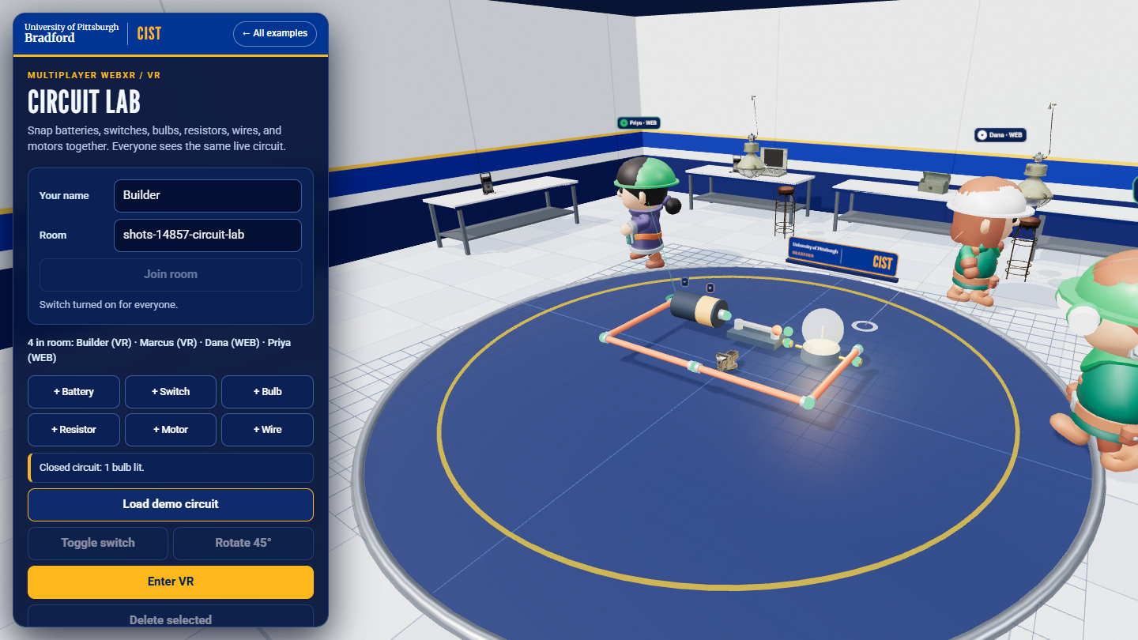
Snap parts together and power a live circuit
03 / CIRCUIT LAB
1
Add a battery, switch, bulb, resistor, motor, or wire from the palette, or press Load demo circuit.
2
Drag parts so their gold terminal ends touch (they turn green). R rotates the selected part.
3
Select the switch and press T. A closed loop lights the bulb and spins the motor for everyone.
4
A resistor dims the bulb; a wire straight across the battery shows a short-circuit warning.
CHECK: "Closed circuit: 1 bulb lit" appears on every client.
Two participants in room "showcase", demo circuit with the switch closed

Slide 5
Every client computes the same result from shared state
04 / HOW THE CIRCUIT WORKS
1
2
3
4
Terminals
A loop
Live parts
Short circuit
Each part has two terminals. Terminals within about 0.3 board units are joined.
Open switches are removed. Dead-end branches are pruned. The battery must sit on a closed loop.
Bulbs and motors on that loop are live. Each resistor on the loop reduces brightness and speed.
If the battery's terminals touch with no load, the model reports a short circuit instead.
A simplified teaching model: it counts resistors rather than solving a full electrical network. The relay only shares part positions and switch state.
Rotation, toggle, and delete are shared messages; nothing about the circuit result is stored on the server.

Slide 6
Plan a work-area layout and watch the checklist
05 / SITE SAFETY LAYOUT
1
Place exit signs, extinguishers, first-aid kits, a muster point, hazard beacons, and barriers, or load the sample layout.
2
Select a beacon and press T to mark an active hazard; it flashes amber for everyone.
3
The checklist shows which essentials are missing and warns about any beacon with no barrier within about a meter.
4
Fix the warnings together; another participant's grab is denied while you hold a part.
A teaching aid, not a code-compliant safety plan.
Sample layout, flashing beacon behind a barrier, checklist passing

Slide 7
Two devices, one board: calibrate to the same two points
06 / AR ALIGNMENT
CALIBRATE EACH DEVICE
WHAT THIS DOES NOT DO
1
Use the same visible physical origin marker.
No cloud anchors or saved world maps.
No automatic room scan, occlusion, or collision detection.
WebXR gives each device its own tracking space; sharing one is up to the app.
Immersive AR needs HTTPS (except localhost) and a phone with hit testing.
2
Tap a second point that defines the +Z direction.
3
The app maps the shared virtual board to that device's local tracking space.
4
Build: edits stay in sync even if alignment differs, but the board will not line up physically.

Slide 8
A small JSON protocol over one WebSocket
07 / THE RELAY
join
Enter a room (name, mode, theme). The server replies with a snapshot.
place · delete
Add or remove a part. Part names are validated against the theme's catalog.
grab · move · release
Single-owner dragging. Moves are accepted only from the holder.
rotate
Turn a part unless someone else is holding it.
toggle
Switch or hazard beacon state; accepted only on toggleable parts.
cursor
Presence: each participant's position on the board.
Limits protect the relay: 24 clients per room, 64 rooms, 250 parts per room, 16 KB messages, validated coordinates.

Slide 9
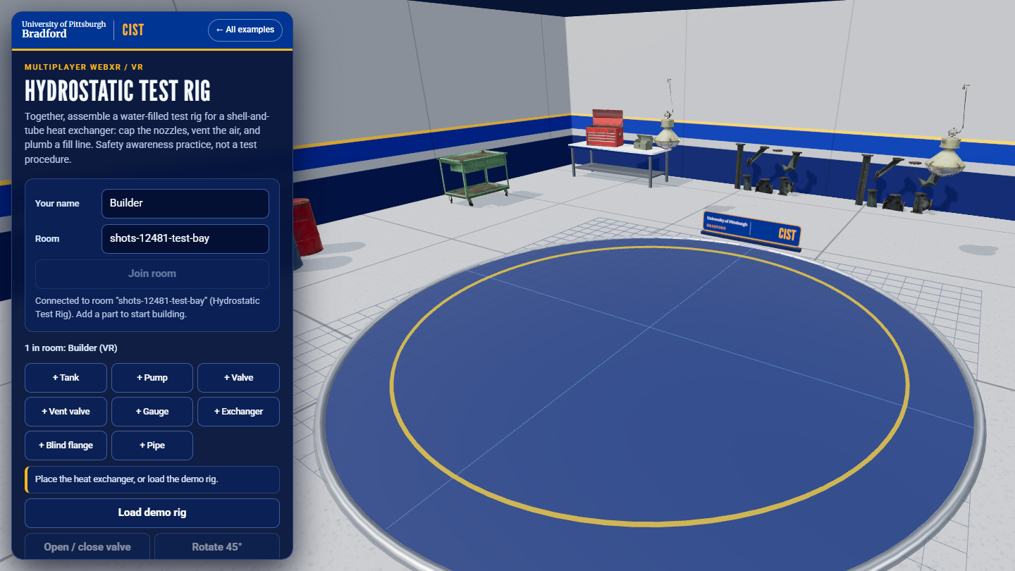
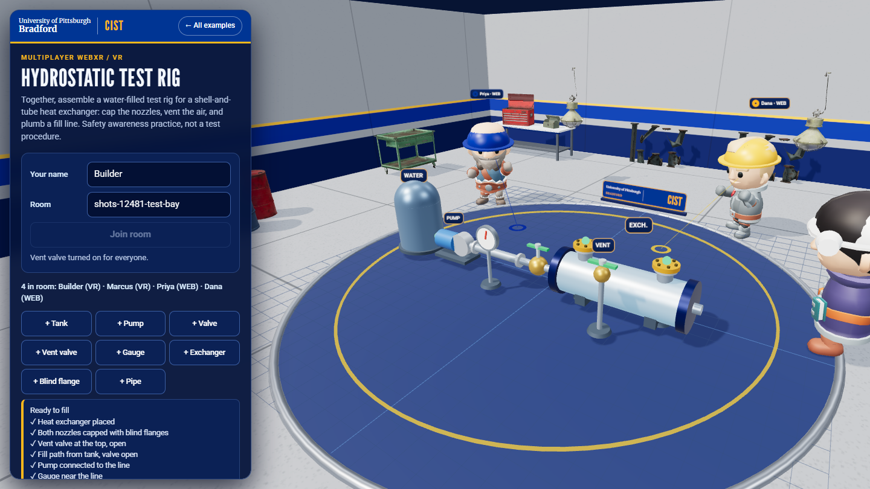
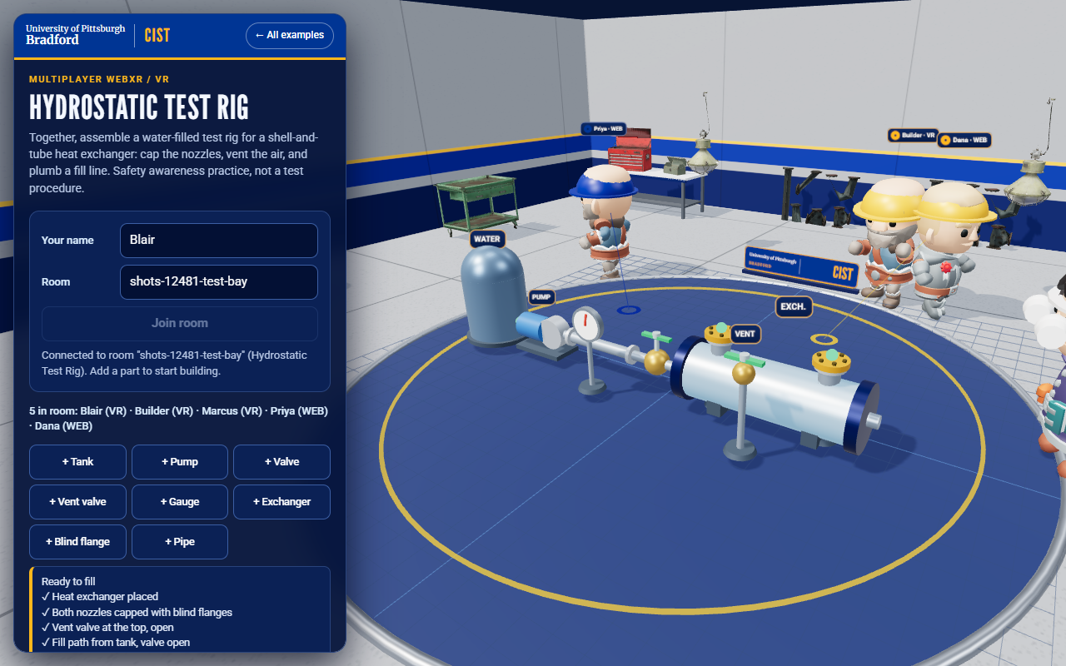
Third theme: build a hydrostatic test rig together
NEW / THIRD THEME
Empty room (desktop browser)
Completed rig (desktop browser)
Second client (desktop browser)
Page: /multi-player/hydrotest/. Tank, pump, valve, vent, gauge, exchanger, blind flanges, pipe; touch port dots to connect.
Same one-holder-per-part rule and separate rooms as the other themes. The web counterpart of the Unity Hydrostatic Test Bay.
Desktop and emulator only; not tried on a real headset. General safety awareness, inspired by heat-exchanger makers, generic parts.

Slide 10
Demo day: one command starts everything over HTTPS
DEMO DAY / HTTPS START
DOUBLE-CLICK scripts\start-demo.cmd
WHO OPENS WHAT
1
Checks Node.js; first run does npm install (needs internet once).
Quest Browser: https://<lab-PC>:8443/ (accept the certificate warning once)
QR codes: /multi-player/qr.html on the PC
Vive Pro 2 PC: desktop browser or the Unity project
Everyone in an activity uses the same room name
2
Starts one server on port 8443 over HTTPS: launcher, multiplayer pages, Practice Lab, and the relay.
3
Makes a self-signed certificate on first run (cached, never committed).
Kit: CHECKLIST, QUEST-SETUP, VIVE-SETUP, BACKUP-PLAN, TROUBLESHOOTING, and a 15-minute TALK-TRACK in docs/demo-day/.
4
Prints every URL and opens the launcher on the PC.
Run on a development PC (Node 22, Windows 11). No Quest or Vive used in any test: every hardware step is verify at rehearsal.

Slide 11
What is tested, and what still needs a headset
08 / TESTS AND VR CHECKS
AUTOMATED RELAY TESTS (npm test)
Mixed VR and AR clients share a room
Snapshots for late joiners; rooms stay isolated
Theme separation and part catalogs
Single-owner grabs; disconnect cleanup
Toggle and rotate rules
Invalid input and path traversal are rejected
Emulated Quest 3 (Meta IWER) with a scripted session
Headset sessions and AR camera hit testing still need physical hardware.
In VR the board becomes a table-height model in front of you instead of a floor you stand inside. Captured with tools/vr-capture.

Slide 12
A teaching sample, not a production networking stack
09 / SCOPE
No accounts or moderation
In-memory state
Anyone who can reach the server can join a room. Use non-sensitive names.
Rooms and parts reset when everyone leaves or the server restarts.
No prediction or voice
Local deployment
No lag compensation, reconnect-with-state, or voice chat.
No hosting automation. Use HTTPS with a trusted certificate for devices.
Repository: multi-player/README.md · vr/README.md · ar/README.md · screenshots/README.md

