Slide 1
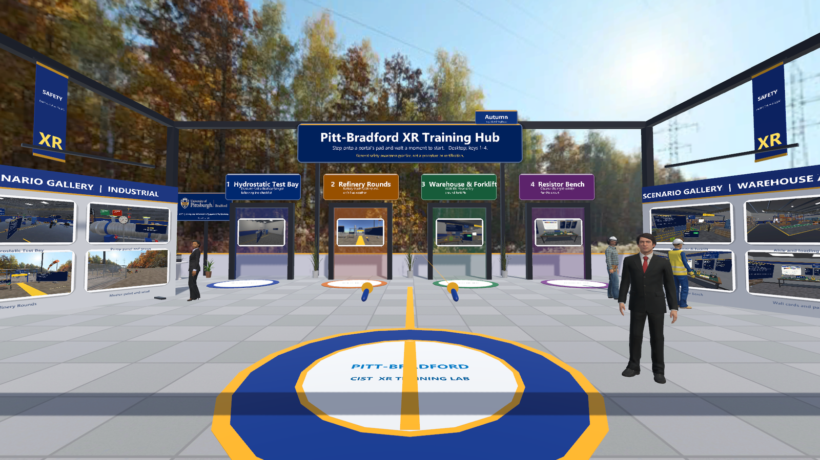
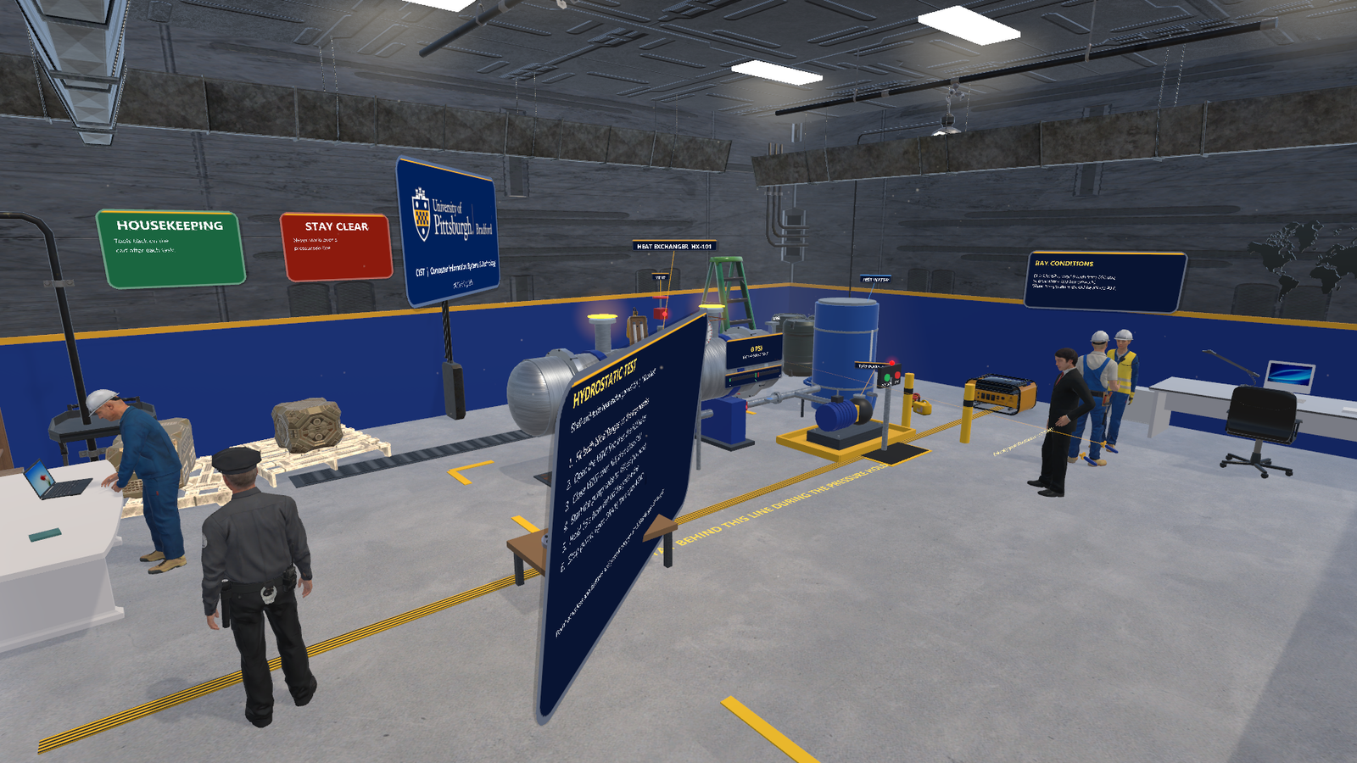
How to run
every training
scene
UNITY HUB / STEP-BY-STEP WALKTHROUGH
The lobby: four portals, one per scene
From the lobby to the last step of each scenario: which portal to take, what to do in which order, and where each valve, button and station is.
1 Hydrostatic
2 Refinery
3 Warehouse
4 Resistor
Hydrostatic Test Bay, as loaded from portal 1

Slide 2
Four actions cover every scene
CONTROLS
ACTION
VIVE / STEAMVR CONTROLLERS
DESKTOP (KEYBOARD AND MOUSE)
Move
Push a thumbstick or trackpad forward, aim the arc, let go (green = allowed)
Hold T and let go to teleport, or walk with W A S D
Look and turn
Turn your head; flick the stick left or right to turn 45 degrees
Hold the right mouse button and move the mouse
Press
Point at a valve, button or answer and pull the trigger
Aim the centre of the view at it and left-click (about 4 m)
Grab
Squeeze the grip near the object; let go to drop it
Aim at it and hold E (about 3 m); release E to drop
On the desktop there is no crosshair: the centre of the view is the pointer. Click once in the Game view first, and Esc frees the mouse.

Slide 3
Start in the lobby and pick a portal
THE HUB / GETTING TO A SCENE
THE FOUR PORTALS (LEFT TO RIGHT)
1
Hydrostatic Test Bay
Pressure-test a heat exchanger
1
2
3
4
Refinery Rounds
Walk-round with gas alarms and live wind
2
3
Warehouse & Forklift
Cross a forklift floor safely
5
4
Resistor Bench
Choose the right resistor for an LED
5
You start here
Follow the gold line to the portals
Lobby start view: you stand on the medallion facing the four portals
To enter: stand on the portal's floor pad for about 1.4 s, or point at the doorway and pull the trigger. Desktop: press 1, 2, 3 or 4.
Notes:
Open vive-steamvr/hub in Unity 6000.3.20f1, open the Lobby scene and press Play (or run the built player). The pad shows 'Starting n%' while you stand on it.

Slide 4
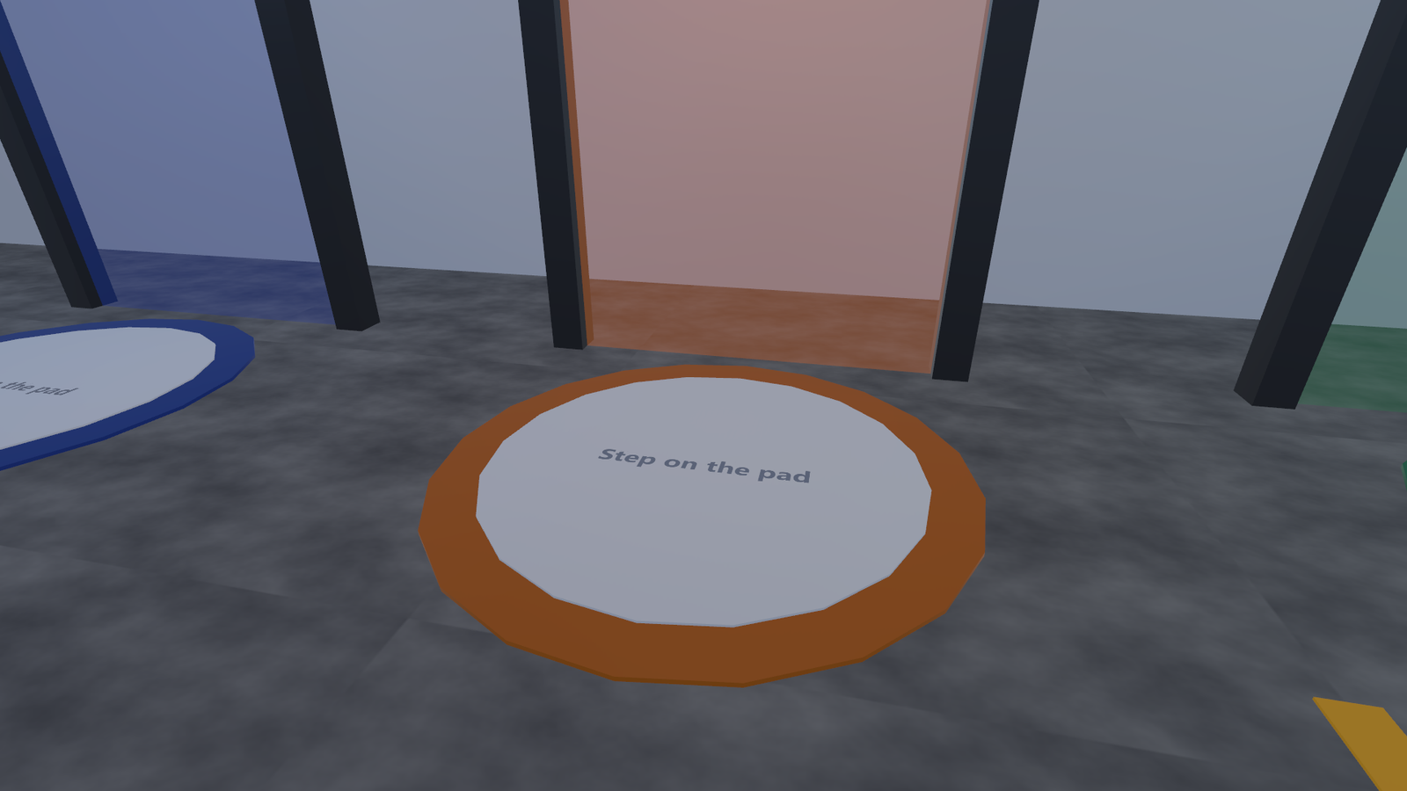
Three ways back to the lobby from any scene
THE HUB / COMING BACK
Lobby panel
A small "Lobby" panel floats above your left controller. Point at it with the right hand and pull the trigger. Desktop: aim at it and click.
1
Both grips
Hold both grip buttons together for 1.5 seconds.
2
Backspace
On the desktop, press Backspace.
3
A portal pad: stand on it until it reaches 100%
A hint with these options shows for the first 10 seconds of every scene.
Every scene has a floating task board. It ticks off each step, counts mistakes, and ends with a summary and a short "why" question.

Slide 5
Pressure-test heat exchanger HX-101 to 150 psi
SCENE 1 / HYDROSTATIC TEST BAY
Portal 1
About 3 to 5 minutes
THE TASK BOARD (DO THEM IN THIS ORDER)
1
Fit both blind flanges on the top nozzles
2
Open the VENT first, then the FILL valve
3
Close VENT when full, then close FILL
4
Start the pump; raise to 150 psi (no more)
5
Hold 15 s from behind the yellow line
6
Stop pump, open DRAIN, then open VENT
What you see when the scene loads (hub version)
Valves show a red lamp when closed and a green lamp when open. Click a valve once to toggle it.

Slide 6
Map of the test bay
SCENE 1 / WHERE THINGS ARE
KEY LOCATIONS
1
Blind-flange table
Two flanges wait here (walk round the board)
2
VENT valve
On top of the vessel, under the VENT tag
3
2
4
5
3
Pressure readout
Big psi number and a bar; 150 is the target
1
4
Pump panel
Green PRESSURIZE and red STOP buttons
5
Yellow line
Stand behind it (your side) during the hold
Start view in the hub. The flange table is behind the task board.
FILL and DRAIN are the low valves on the pipe under the vessel: FILL on the right (pump side), DRAIN on the left.

Slide 7
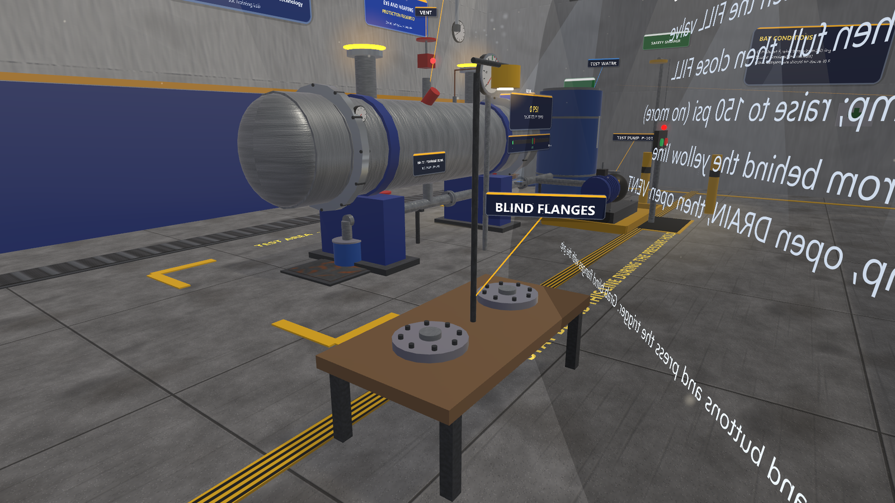
Fit both blind flanges on the top nozzles
SCENE 1 / STEP 1
2
2
DO THIS
1
Pick up a flange
Grip it (desktop: aim and hold E)
1
2
Drop it on a nozzle
Carry it to a glowing yellow disc on top of the vessel and let go: it snaps on
1
3
Repeat for the second
The step ticks when both are fitted
The flange table beside the vessel; yellow discs mark the nozzles
Critical miss: pressing PRESSURIZE with an open nozzle. The flanges keep the water and pressure inside the vessel.

Slide 8
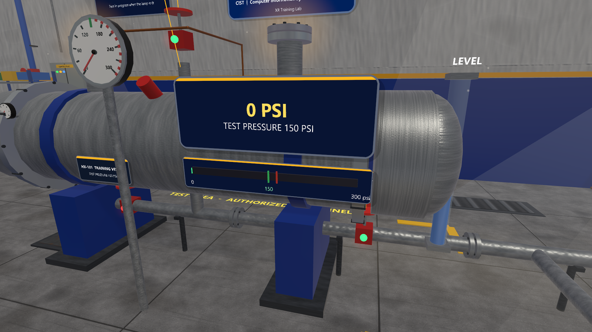
Open the VENT first, then FILL; close both when full
SCENE 1 / STEPS 2 AND 3
1
3
DO THIS
1
VENT (top) first
Click it: the lamp turns green. Air can now escape
2
Then FILL (low right)
Water flows in; the level rises for about 8 s
4
2
3
Wait for LEVEL full
Then close VENT, then close FILL
4
Leave DRAIN shut
Low left valve; it is for the last step
Filling: VENT and FILL both open (green lamps), DRAIN closed (red)
Why vent first: air trapped in the shell squeezes and stores energy under pressure. Opening FILL before VENT counts as a mistake.

Slide 9
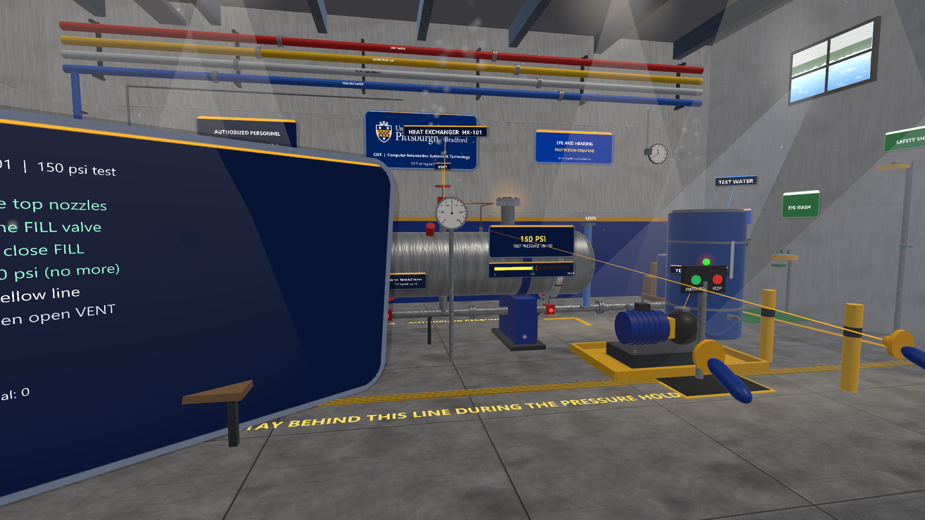
Pump to 150 psi, then hold from behind the yellow line
SCENE 1 / STEPS 4 AND 5
DO THIS
1
Press PRESSURIZE
Green button on the pump panel
2
Watch it climb to 150
About 14 s; it holds there by itself
2
1
3
Step back behind the line
Stay on your side for 15 s; the board counts "Holding n / 15 s"
3
4
Leave STOP for now
Red button, used in step 6
At 150 psi, standing behind the line; the pump panel is to the right
Critical miss: standing in front of the line during the hold (the count restarts). Pressing PRESSURIZE with VENT open or before full is a mistake.

Slide 10
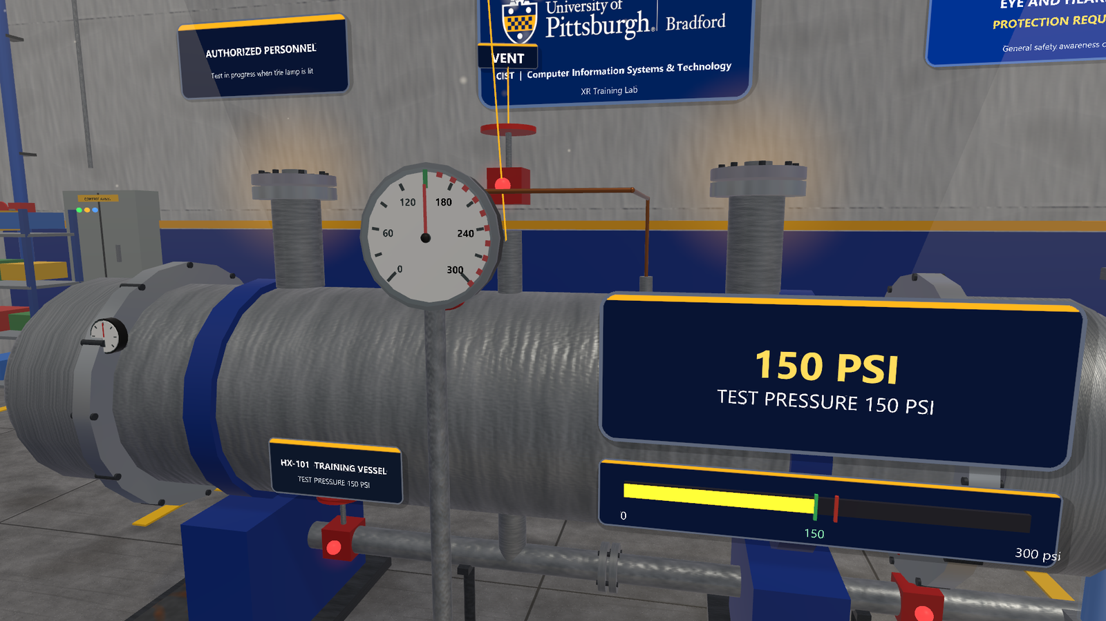
Stop the pump, open DRAIN, then open VENT
SCENE 1 / STEP 6 AND THE QUESTION
DO THIS
1
Press STOP
Red button on the pump panel
3
2
Open DRAIN
Pressure falls to zero as water leaves
3
Open VENT last
Air comes back in so the shell drains without a vacuum
2
4
Answer the question
Point and trigger, or press 1, 2 or 3
Close-up of the vessel: VENT on top, DRAIN low on the left
Opening VENT above 20 psi, or DRAIN before the hold is done, is a mistake. Finish: "STRONG PRACTICE: no mistakes."

Slide 11
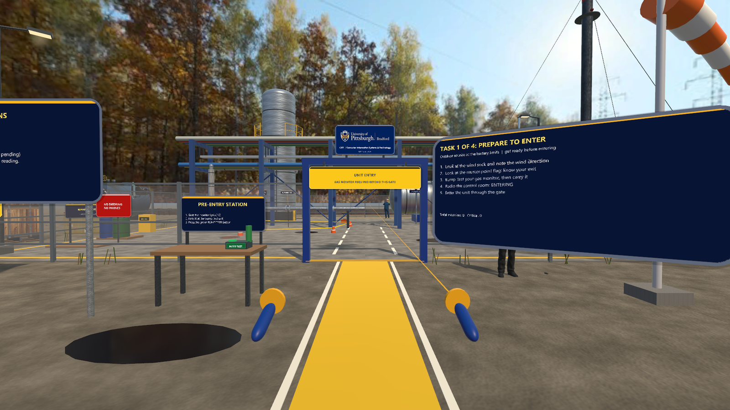
Outdoor rounds: enter safely, then handle three alarms
SCENE 2 / REFINERY ROUNDS
Portal 2
About 6 to 8 minutes
THE TASK BOARD (DO THEM IN THIS ORDER)
1
Prepare to enter: wind, muster point, bump test, radio, gate
2
Gas alarm: move upwind or crosswind, WARN, REPORT
3
Flange weep: phone off, stay clear, 3 cones, REPORT
4
Site alarm: safe route to the muster point, CHECK IN
Start view in the hub: pre-entry station, gate and wind sock
Your chest radio (ENTERING, WARN, REPORT, PHONE OFF, monitor reading) follows you. Look down to see it.

Slide 12
Prepare to enter the unit
SCENE 2 / TASK 1 OF 4
1
DO THIS
1
Look at the wind sock
About 1 s: it points downwind
5
6
2
Look at the muster flag
Green flag on the upwind side; turn to find it
3
Bump-test the monitor
Hold the monitor at the pre-entry station, press BUMP TEST, then let go (it clips on)
3
4
Radio ENTERING
Chest radio, after steps 1 to 3
5
Walk through the gate
Not over the fence
Start view: everything for task 1 is in front of you
Critical miss: entering before the checks, or without the gas monitor. Board (6) lists the steps and ticks them.

Slide 13
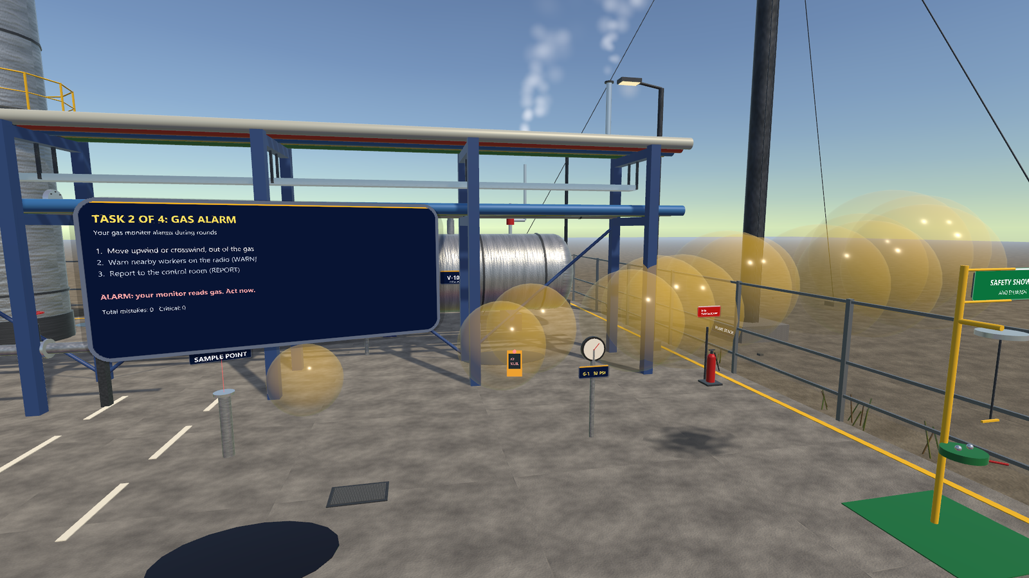
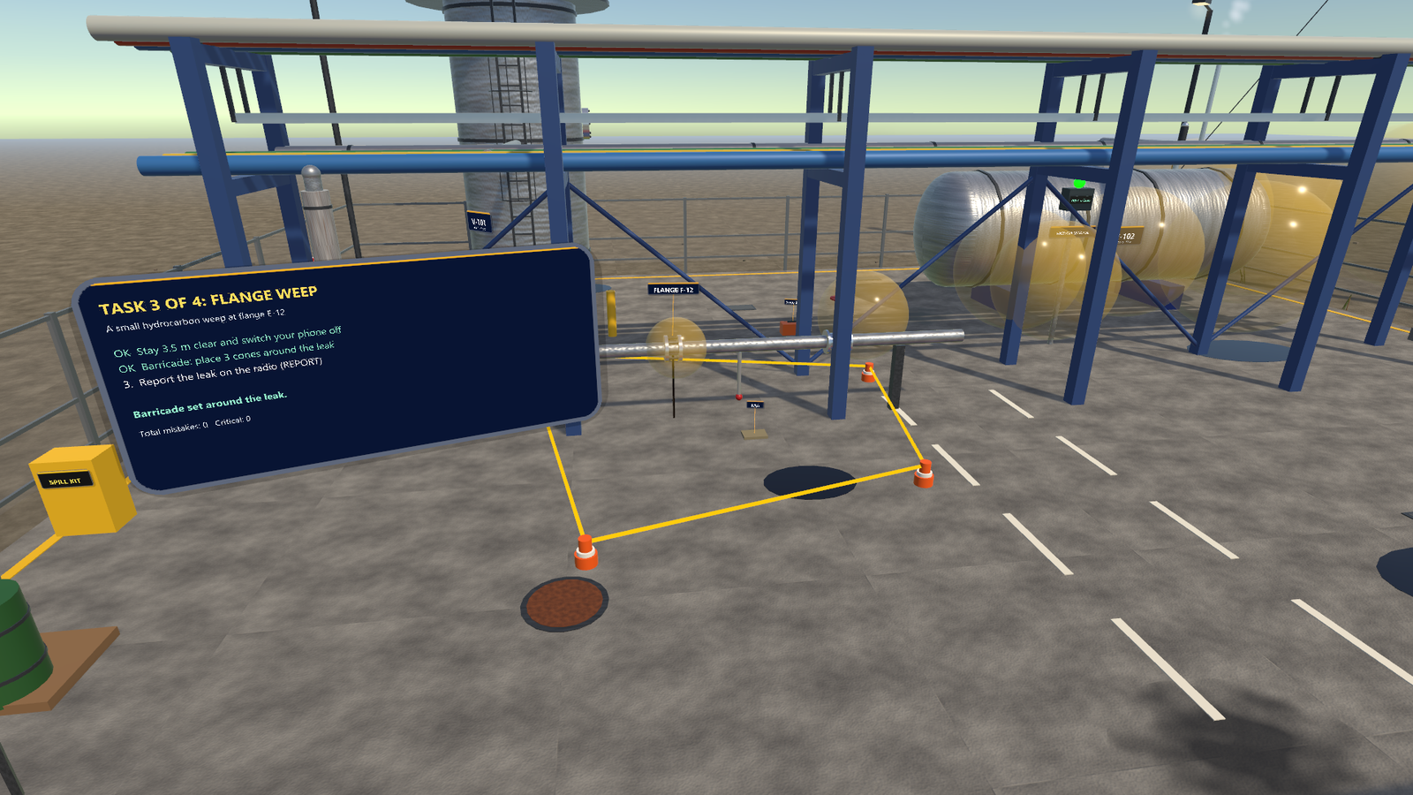
Gas alarm, then a leaking flange
SCENE 2 / TASKS 2 AND 3
2
1
1
2
2
Task 2: gas drifts with the wind; gauge G-1 is the gold marker
Task 3: flange F-12 with three cones around it
Task 2 Gas alarm
Walk to gauge G-1 (1). Gas (2) starts upwind and drifts at you: move upwind or crosswind at least 10 m into clean air. Then press WARN, then REPORT on the radio.
Task 3 Flange weep
Press PHONE OFF and stay 3.5 m from F-12 (1). Carry 3 cones from the barricade station and drop them around the leak (2), 2 to 7 m away and spread out. Then REPORT.
Critical misses: walking toward the release, clicking the flange to tighten it, or a phone on near the leak.

Slide 14
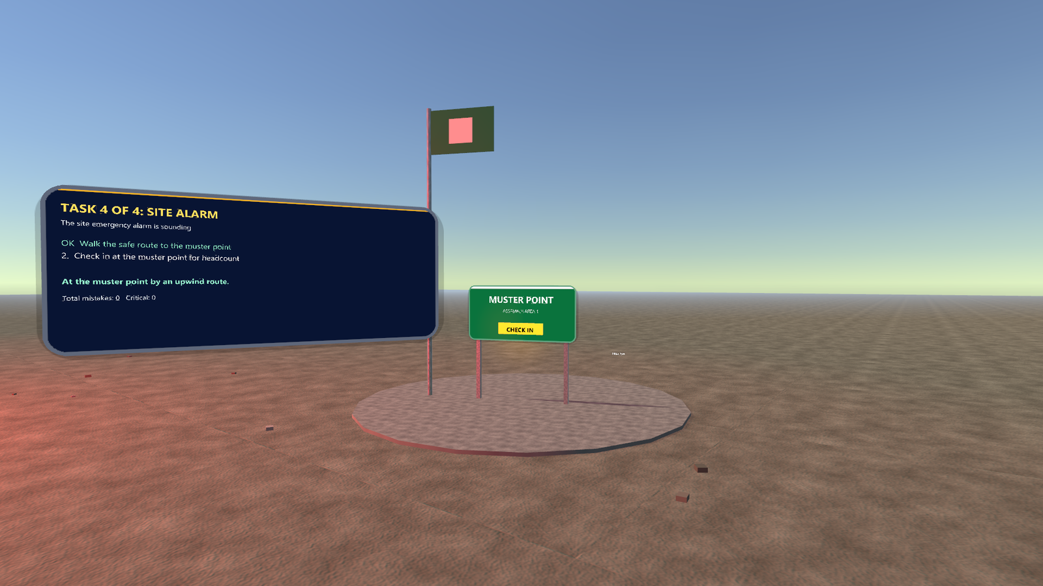
Site alarm: walk upwind to the muster point and check in
SCENE 2 / TASK 4 OF 4
DO THIS
1
1
Walk to the green flag
A siren sounds and a large release starts. Go round the gas, not through it; get within 3.5 m
2
2
Press CHECK IN
On the muster sign: the headcount
3
Answer the question
Why bump-test a monitor that reads 0?
The muster point: flag, sign and CHECK IN button
Critical miss: going back to the orange tool bag during the alarm. Waiting more than 45 s before moving is a mistake.

Slide 15
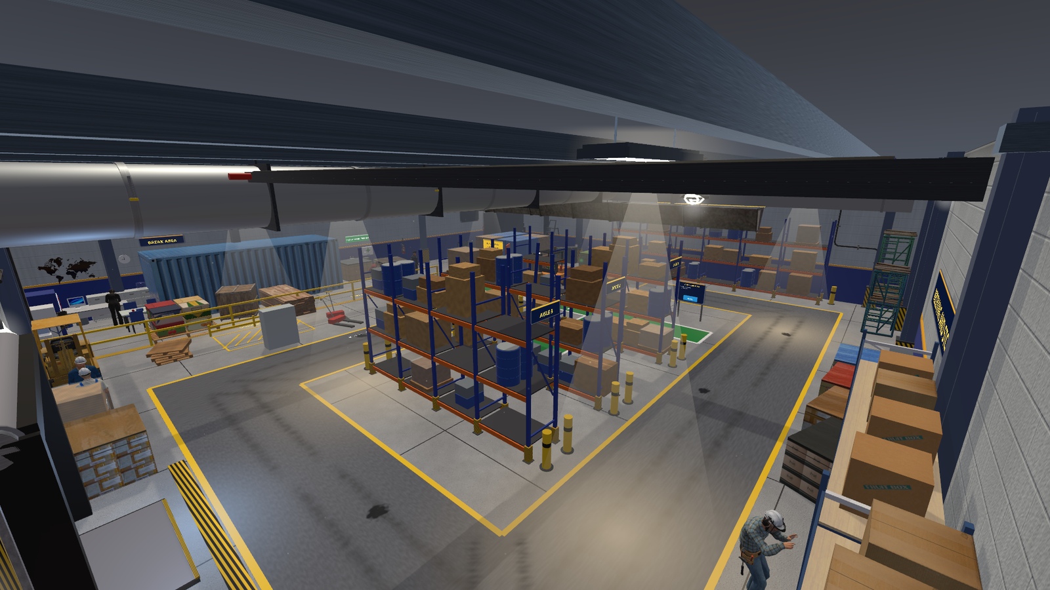
Cross a working forklift floor as a pedestrian
SCENE 3 / WAREHOUSE & FORKLIFT
Portal 3
About 4 to 6 minutes
THE TASK BOARD (DO THEM IN THIS ORDER)
1
Put on hard hat, vest and glasses before entering the floor
2
Look at the corner mirror for 1.5 s before stepping out
3
Signal the driver, wait for the stop, cross at the stripes
4
Cone the spill and the bent rack upright, then radio
The warehouse floor in the hub: racking, lanes, crossing and dock
Stay on the green walkways. The forklift drives a loop the whole time; an awareness check pauses the world after the crossing.

Slide 16
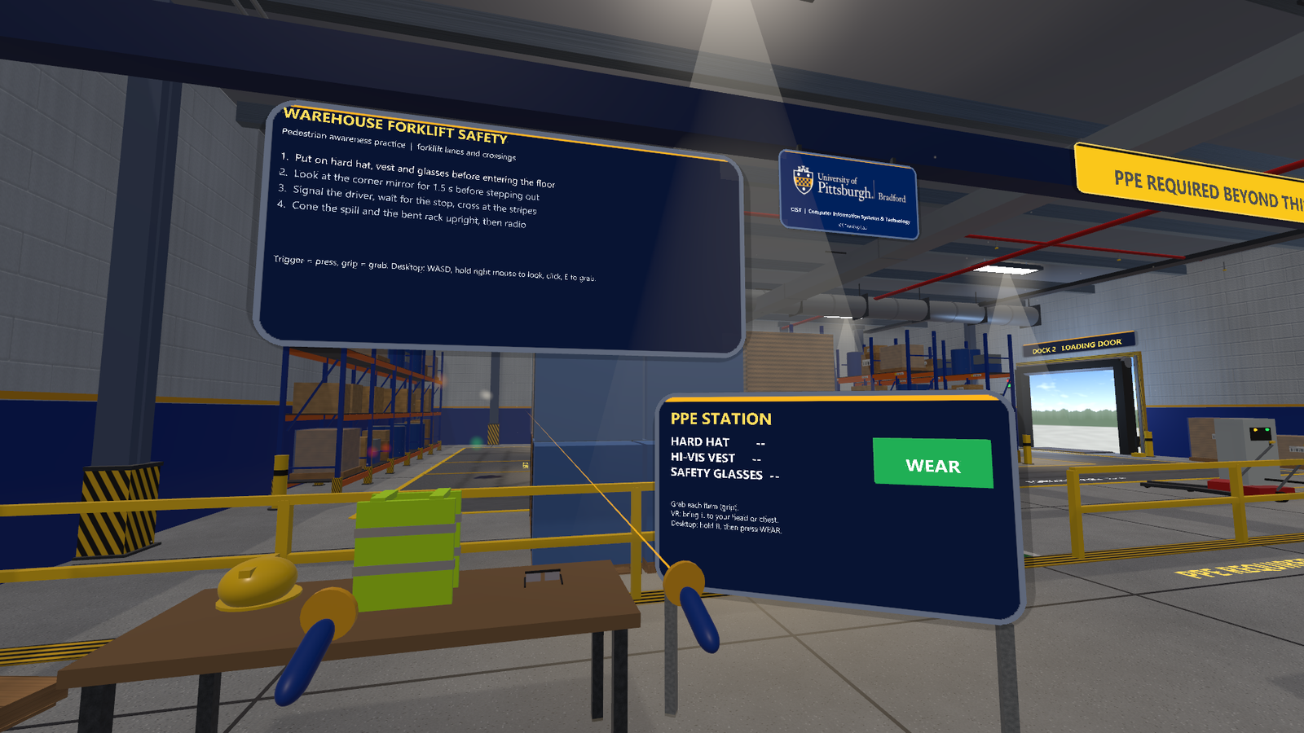
Put on all three PPE items before the yellow line
SCENE 3 / STEP 1
DO THIS
3
1
Pick up an item
Hard hat, hi-vis vest, safety glasses on the table
2
Wear it
VR: bring it to your head or chest and let go. Desktop: keep E held and click WEAR
2
1
1
3
Then cross the line
Only when all three show on the PPE station
Start view: PPE table and station, with the entry line beyond
Entering the floor without full PPE is a mistake: PPE only protects if it is on before you reach the hazard.

Slide 17
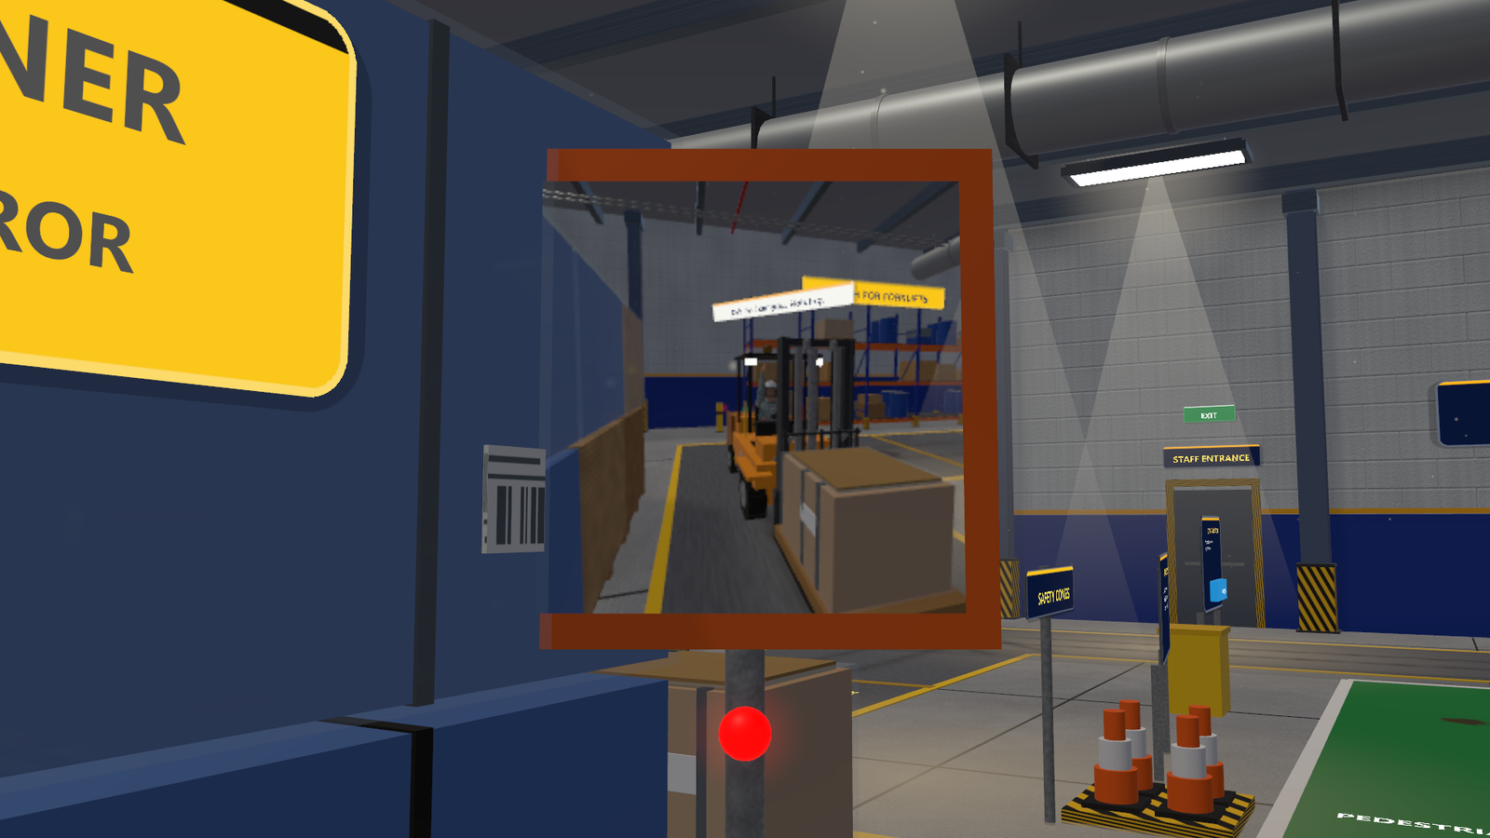
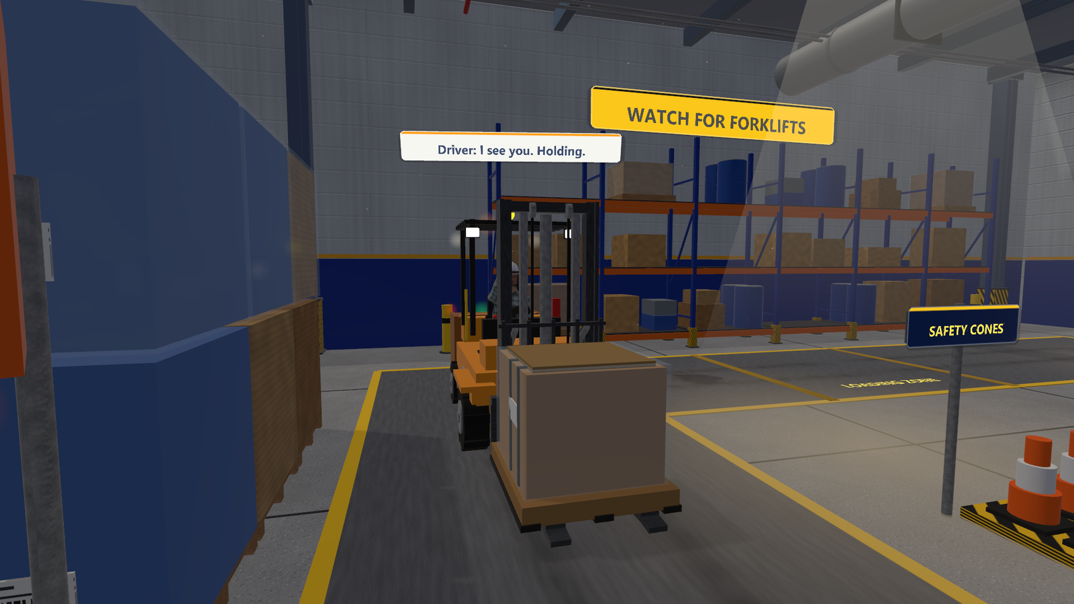
Check the mirror, then signal and cross at the stripes
SCENE 3 / STEPS 2 AND 3
2
1
3
Step 2: the convex mirror on the cargo stack shows the hidden lane
Step 3: the driver has seen you and is holding
Step 2 Corner mirror
From the entry walkway, keep the mirror (1) near the centre of your view for about 1.5 s. Looking away resets the count.
Step 3 Signal and cross
Look at the driver, press SIGNAL on the "SIGNAL THE DRIVER" post. Wait until the forklift stops (2), then cross at the striped crossing (3) to the north side.
Critical miss (near miss): stepping into a lane with the forklift within 6 m and not stopped for you.

Slide 18
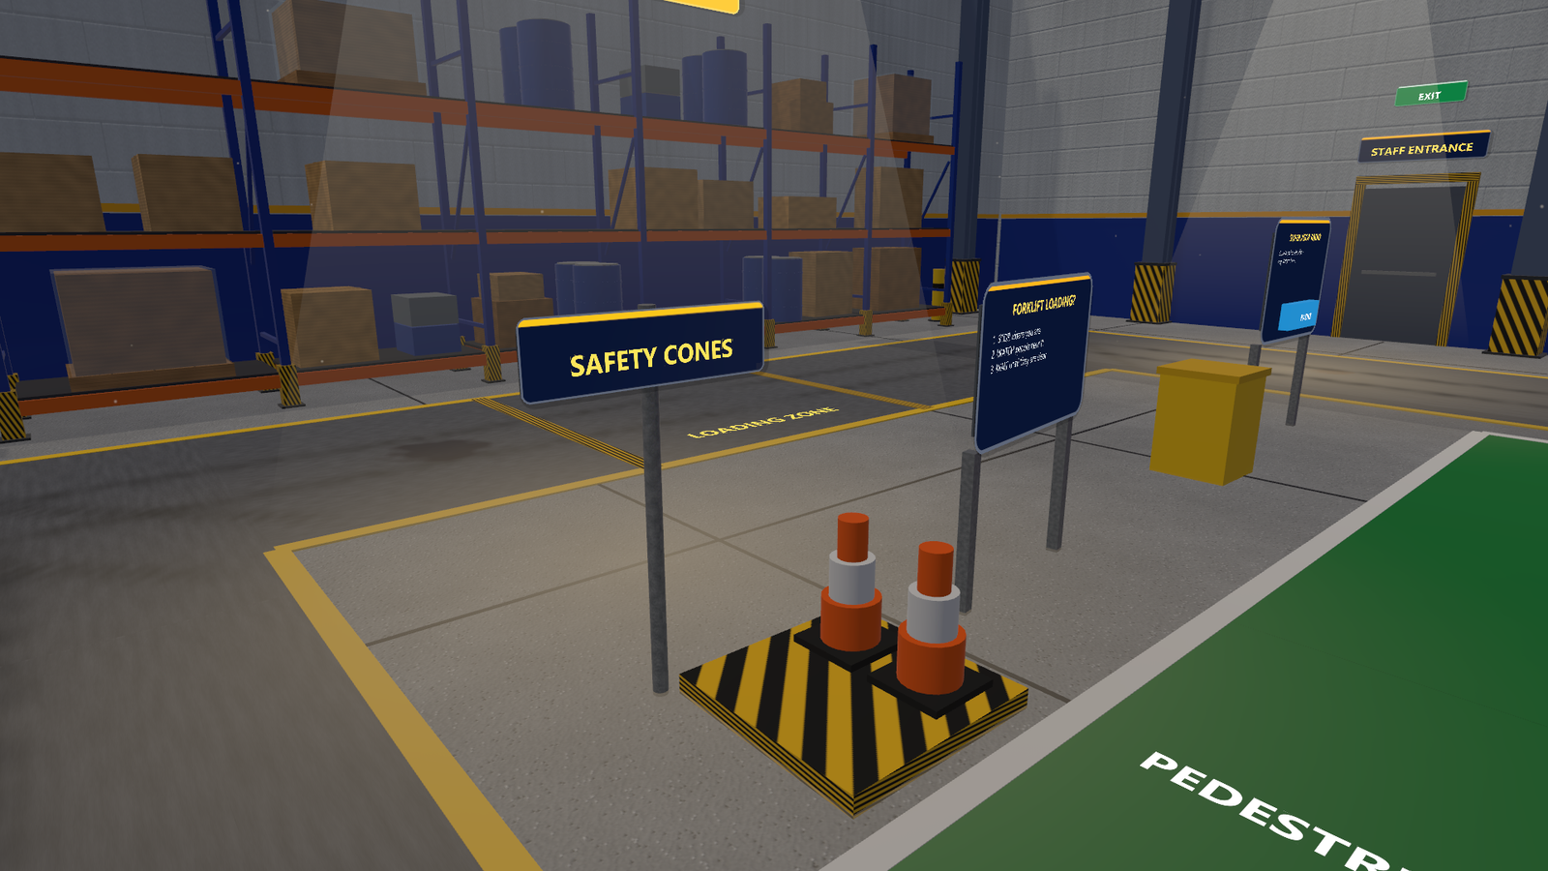
Cone the spill and the bent upright, then radio
SCENE 3 / STEP 4
DO THIS
1
Take cones here
Grip a cone from the tray (desktop: hold E)
2
Cone the spill
Drop one within 2 m of the dark spill on the floor
1
3
Cone the bent upright
Drop one within 2 m of the damaged rack leg
4
Press RADIO
At the SUPERVISOR RADIO station, after both cones
The cone station by the loading zone
Radioing before both hazards are coned is a mistake. Marking warns others; the report gets it fixed.

Slide 19
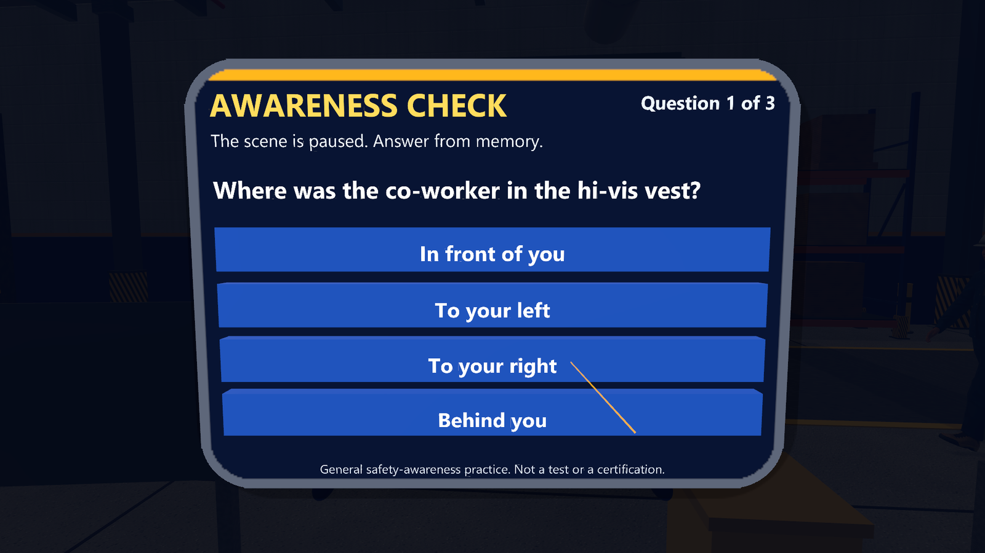
Watch the co-worker: the scene pauses and asks
SCENE 3 / AWARENESS CHECK
WHAT HAPPENS
About 8 s after you cross, the forklift goes to load the west rack and a co-worker walks out of the STAFF ENTRANCE past it.
4.5 s later the scene freezes. Answer from memory: where were they, which way were they walking, how far was the forklift?
Then: STOP where you are, WATCH them, WAIT until they are clear.
The summary shows the board result and, separately, the awareness score out of 3.
The world freezes and three questions appear, one at a time
Tip: keep looking around while you work. Nothing warns you before the co-worker appears.

Slide 20
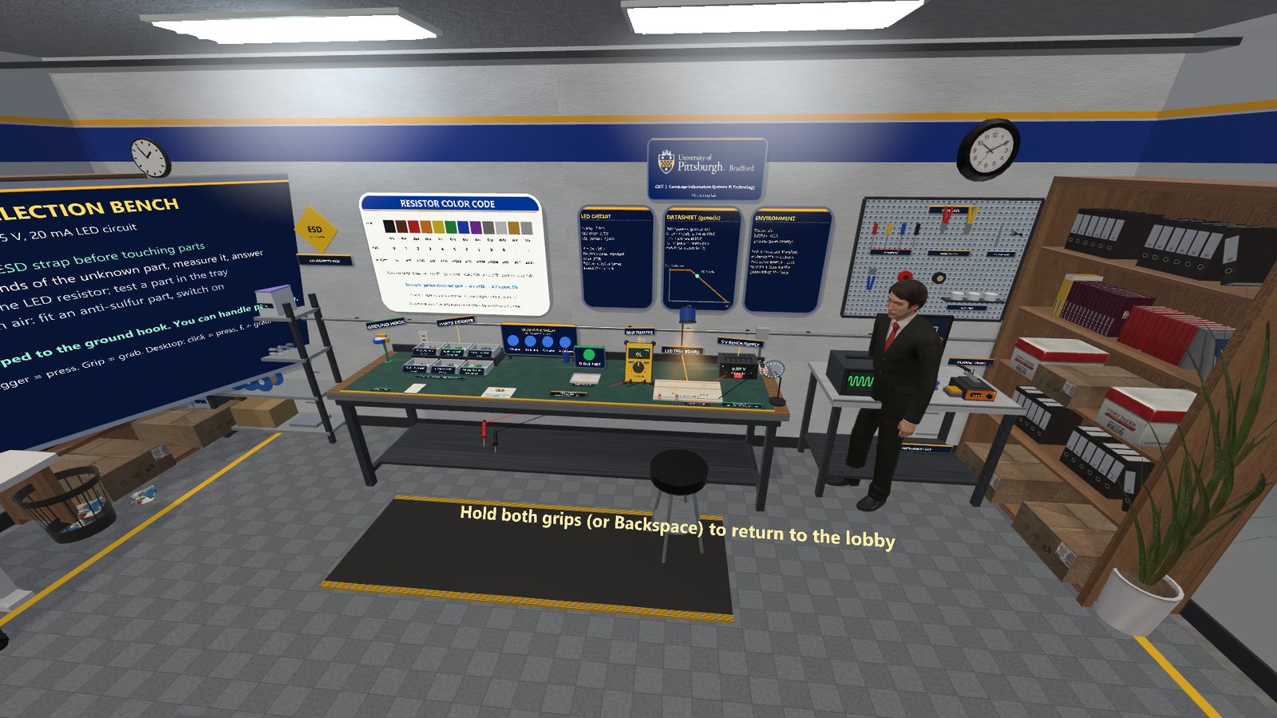
Pick and fit the right resistor for an LED
SCENE 4 / RESISTOR BENCH
Portal 4
About 5 to 8 minutes
THE TASK BOARD (DO THEM IN THIS ORDER)
1
Clip on the ESD strap before touching parts
2
Read the bands of the unknown part, measure it, answer
3
Work out the LED resistor; test a part in the tray
4
Sulfur-rich air: fit an anti-sulfur part, switch on
The bench in the hub: wall cards above, bench tools below
The wall cards hold everything you need: the colour code, the LED circuit, the datasheet and the environment.

Slide 21
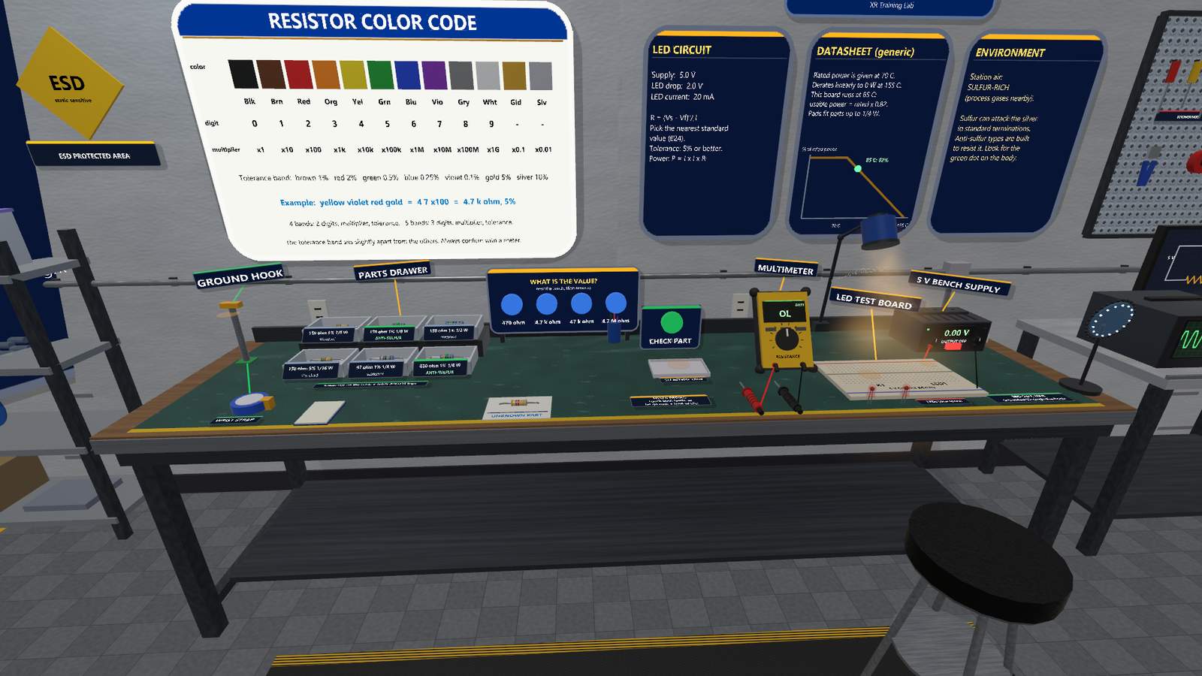
Map of the bench
SCENE 4 / WHERE THINGS ARE
KEY LOCATIONS
1
Wrist strap and ground hook
Step 1
2
2
Parts drawer
Six labelled bins; green dot = anti-sulfur
3
5
4
7
3
"What is the value?"
Four answer buttons
1
6
4
Selection tray and CHECK PART
5
Multimeter and probes
6
LED test board
R1 and LED1 sockets
7
5 V bench supply
Its switch powers the board
Bench overview (standalone project; the hub bench is the same)
The unknown part lies on the white card at the front edge of the bench.

Slide 22
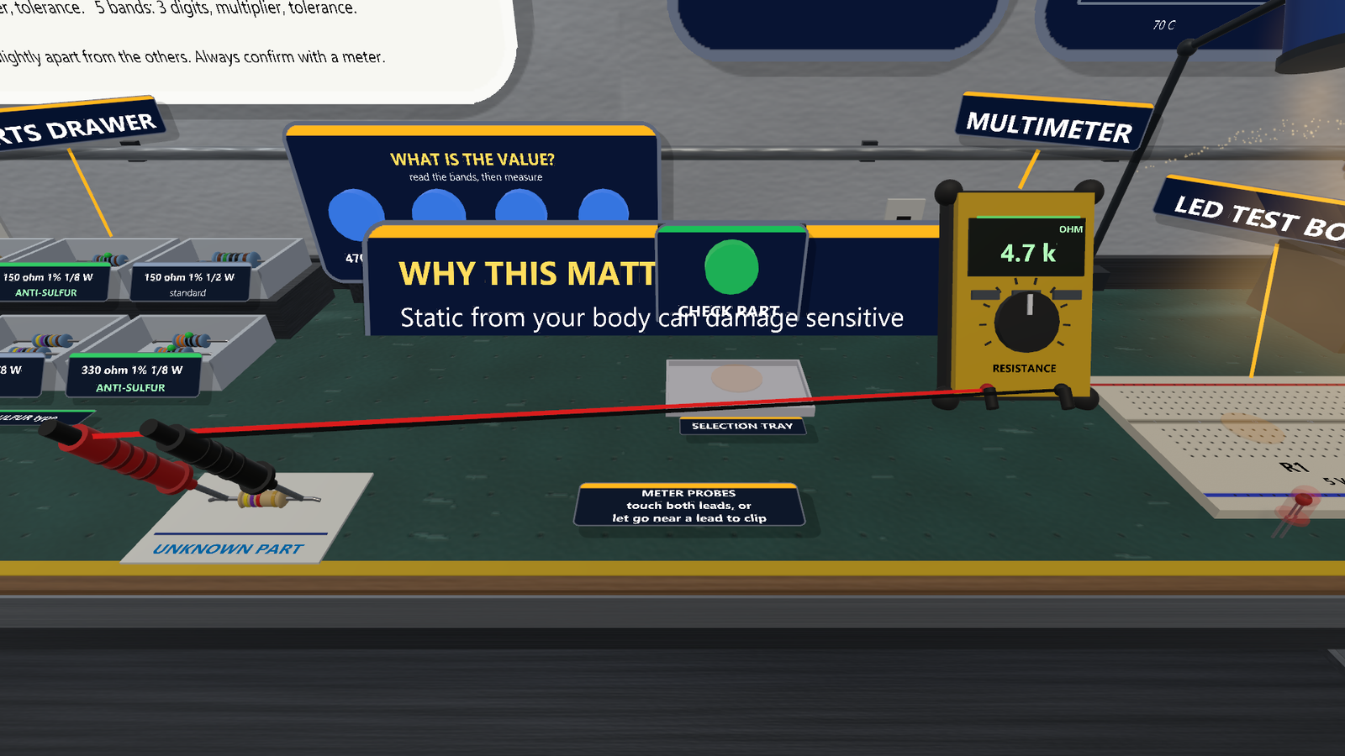
Ground yourself, then read and measure the unknown part
SCENE 4 / STEPS 1 AND 2
DO THIS
2
1
Clip on the ESD strap
Grab the strap, let go near the ground hook. Touching a part first is a mistake
4
2
Answer the value
Yellow-violet-red-gold = 4.7 k ohm, 5%
3
3
Probe the part
One probe on each lead (desktop: let go near a lead and it clips on)
4
Read the meter
The step ticks when answer and reading agree
Both probes on the leads: the meter confirms 4.7 k ohm
Always confirm with a meter: the colour code gives the nominal value, the meter shows what the part really is.

Slide 23
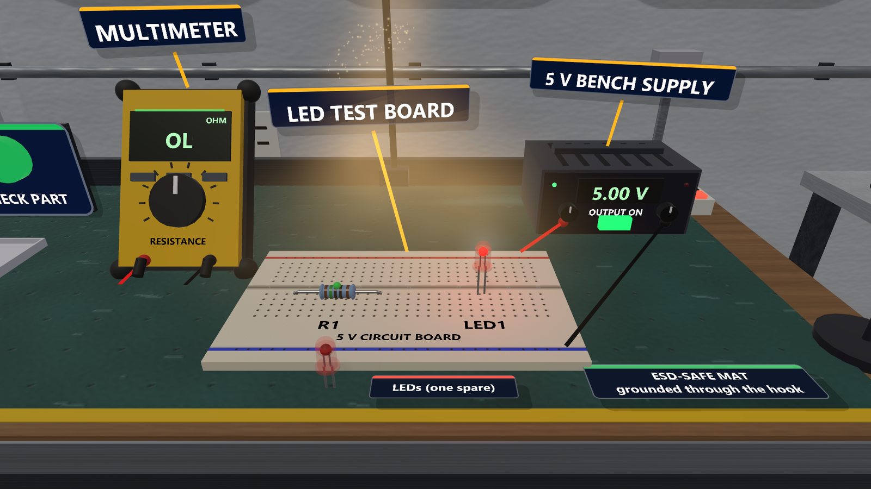
Choose 150 ohm, test it, fit an anti-sulfur part, switch on
SCENE 4 / STEPS 3 AND 4
DO THIS
1
Work it out
(5 V - 2 V) / 20 mA = 150 ohm, 1/8 W. Put a part in the selection tray and press CHECK PART
4
2
Fit an anti-sulfur part in R1
150 ohm 1% 1/8 W, the bin with the green label
3
2
3
Put an LED in LED1
A spare LED is on the bench
4
Switch on the 5 V supply
The LED lights; then answer the question
Done: anti-sulfur 150 ohm in R1, LED lit at about 20 mA
Critical miss: powering with the 47 ohm part or no resistor burns the LED out. 1/16 W is too weak; 1/2 W is too big for the pads.

Slide 24
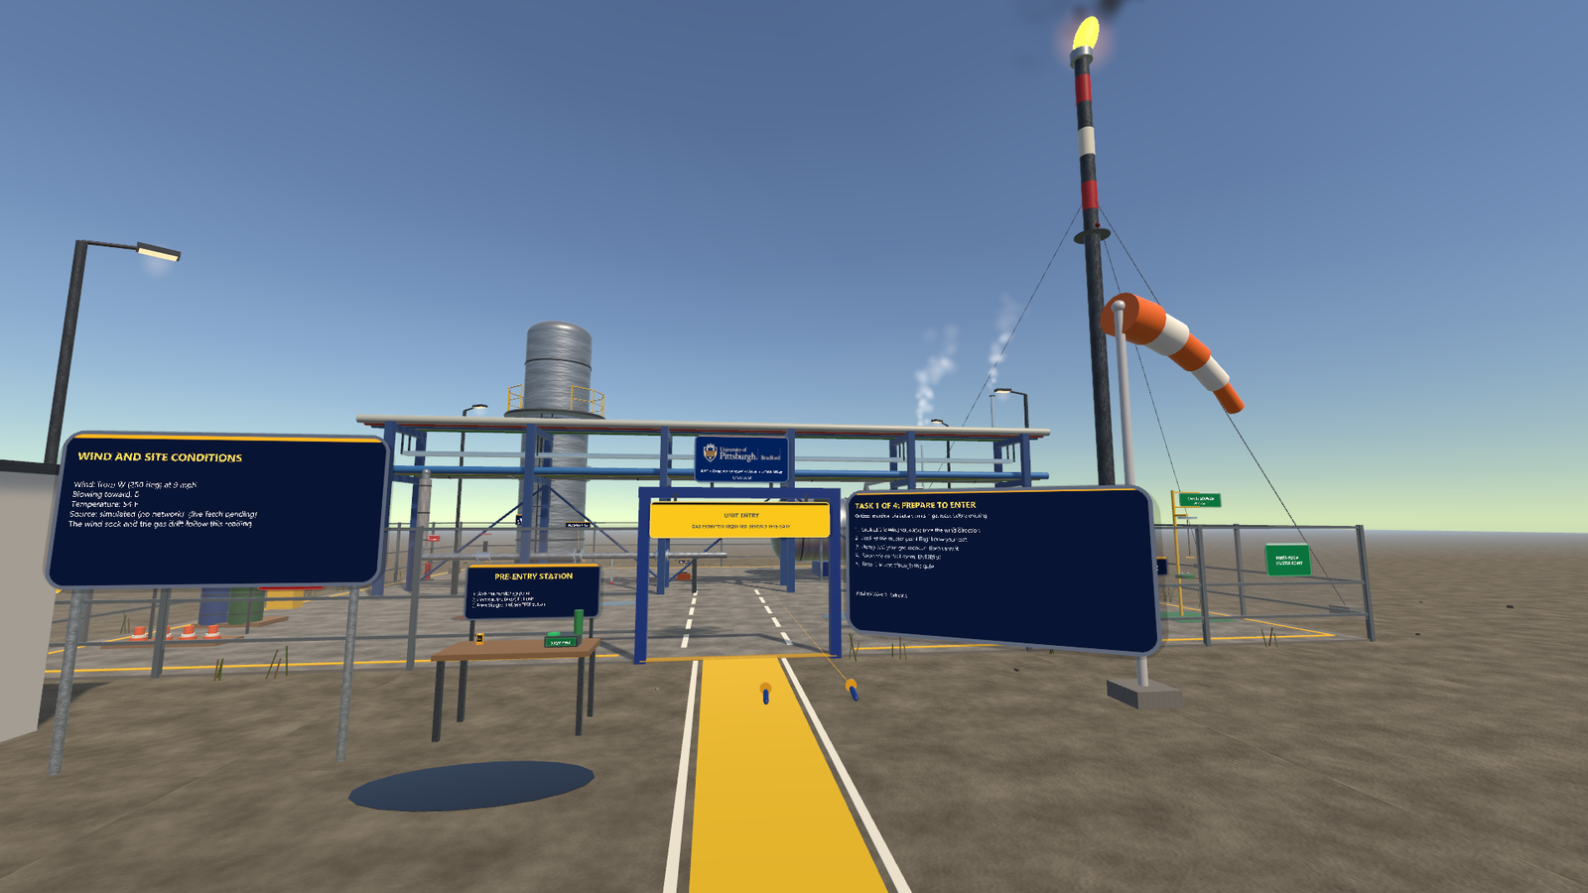
The one thing to get right in each scene
QUICK REFERENCE
1 Hydrostatic
2 Refinery
3 Warehouse
4 Resistor
VENT before FILL, both flanges on, and stand behind the yellow line during the 15 s hold.
Bump-test the monitor before the gate, and always move upwind or crosswind of the gas.
PPE first, mirror next, and cross only once the driver has stopped for you.
Strap on first, measure what you read, and fit the anti-sulfur 150 ohm part.
General safety-awareness practice, not a procedure, permit or certification. Return to the lobby any time: Lobby panel, both grips, or Backspace.

