Slide 1
Where to eat Italian food in San Francisco during the Coronavirus Pandemic

Slide 2
introduction
The coronavirus has and will bring on consumer behavior changes in many industries including the food industry. Consumers will be taking various health safety points such as hygiene scores, inspection scores, virus scores and others.

Slide 3
Data sources
[San Francisco Neighborhood Covid-19 Data](#Covid_Data) - To get all the confirmed coronavirus cases in the different neighborhoods of San Francisco
[San Francisco Government Restaurant Health Inspection Data]- Using the San Francisco's LIVES restaurant inspection data leverages the LIVES Flattened Schema (https://goo.gl/c3nNvr), which is based on LIVES version 2.0, cited on Yelp's website (http://www.yelp.com/healthscores).
[FourSquare API]- Used the location coordinates of the districts we received from the Covid19 API and pass it as input to the FourSqaure API to retrieve 100 venues within 4 kms for each Neighborhood of San Francisco.
[Zomato API] - Used the coordinates of the neighborhoods we receive from the FourSquare Venue Dataset, pass it to the Zomato API to retrieve Pricing for Two, Pricing Tier and Customer Rating. Note: Hygiene Ratings were NOT available for any of the restaurants.

Slide 4
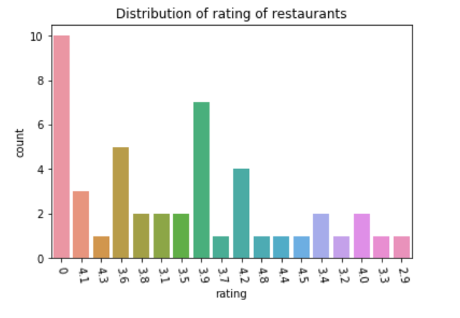
Count of ratings
Ratings range from 0 to 4.8.

Slide 5
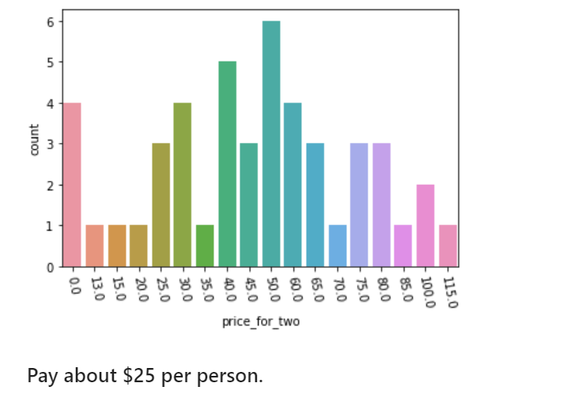
Price for 2 people
Average price paid is roughly $25 per person. 4 Restaurants did NOT have any price data.

Slide 6
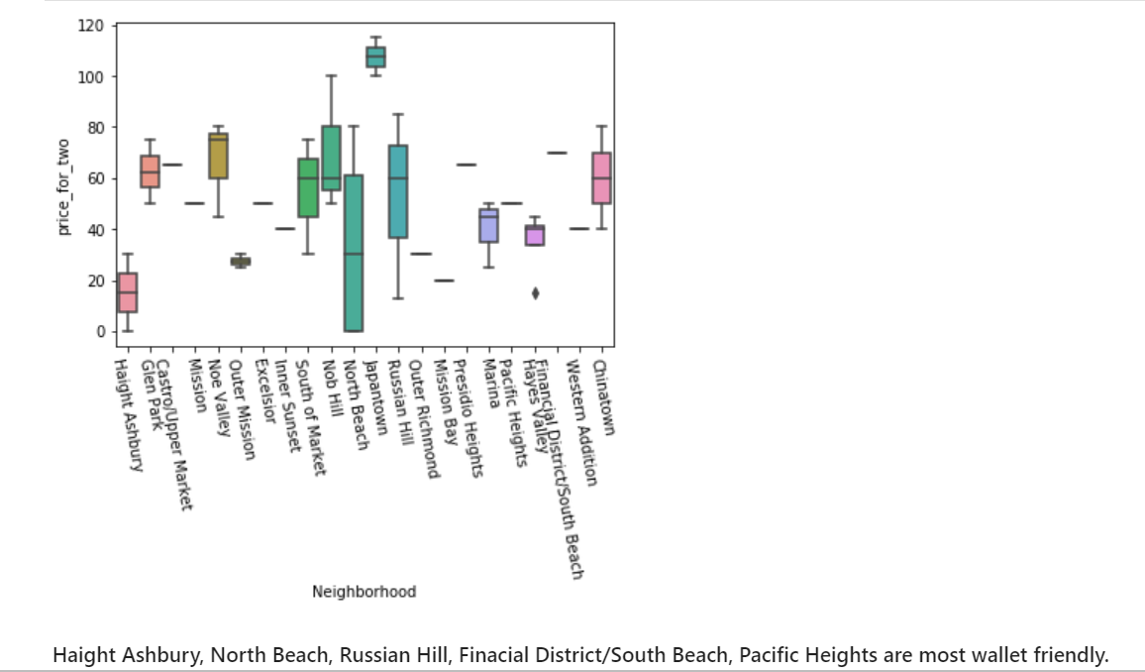
Neighborhood prices per 2 people
Haight/Ashbury, Nob Hill, Presidio Heights, Financial District/South Beach, Glen Park and Russan Hill are top rated sections

Slide 7
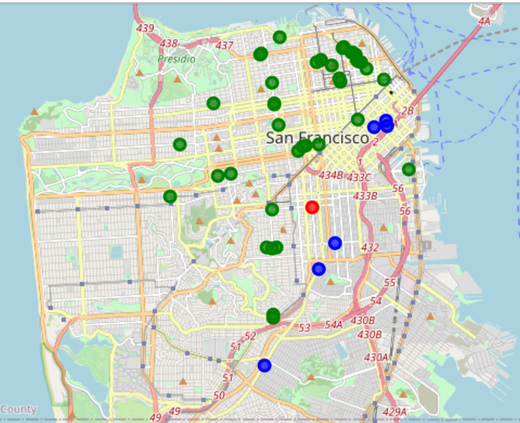
Clusters of neighborhoods
Green Clusters are neighborhood restuarants with overall good pricess (for San Francisco), low cornovirus counts and very good restaurant ratings. The Red and Blud neighborhoods have high cornonavirus cases, some low ratings and low to moderate pricing.

Slide 8
Conclusion
The clustering exercise revealed that restaurants in San Francisco neighborhoods of HaightAshbury, Glenn Hill, Nob Hill, The Financial District, Presidio Heights and Russian HIll are safe to order from and also provide the best quality food while resturants in Mission, Outer Mission, Excelsior, Bayview Hunters Point and Tenderloin in areads of higher case counts and generally low rated restaurant. Based on the visitor's choice of rating, price and other requirements, he/she can choose amongst different food outlets located in these three clusters.

