Slide 1
Fisheries
File created on: 2026-04-01 4:37:35 p.m. ADT

Slide 2
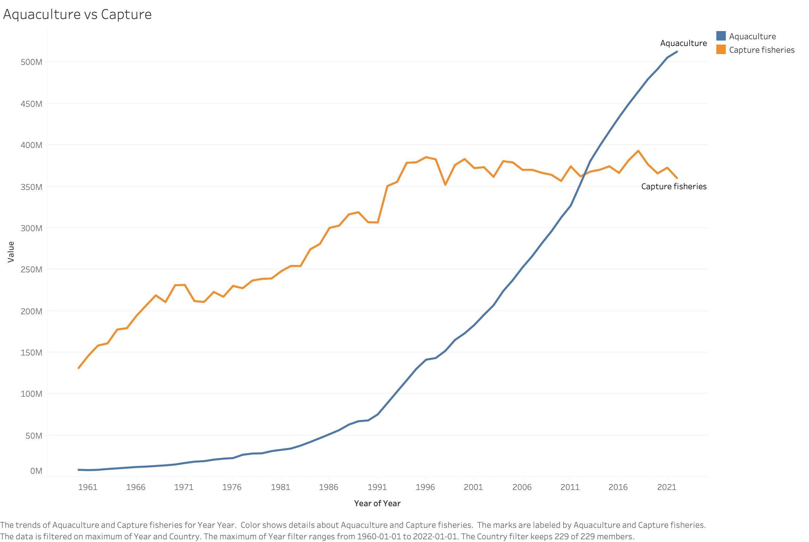

Slide 3
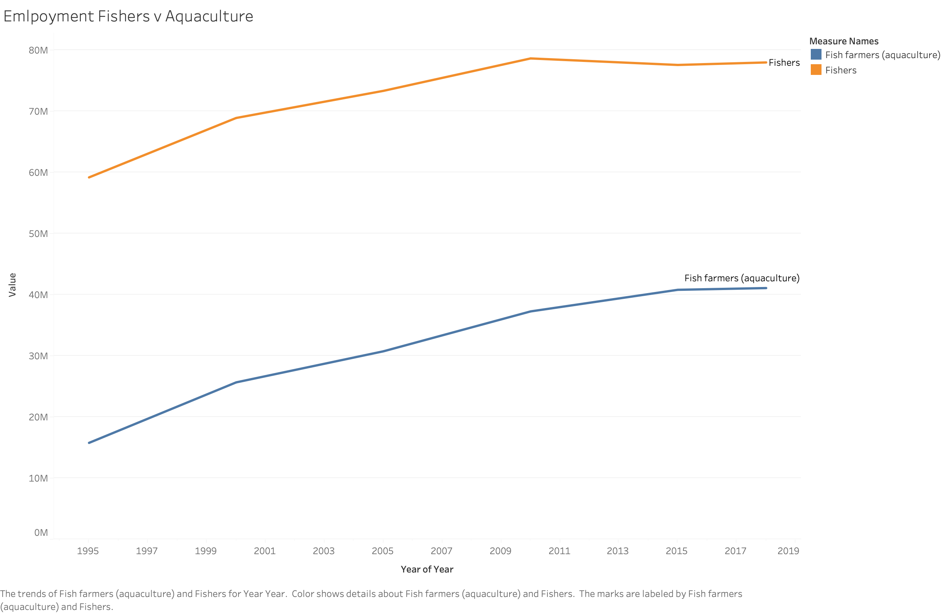

Slide 4
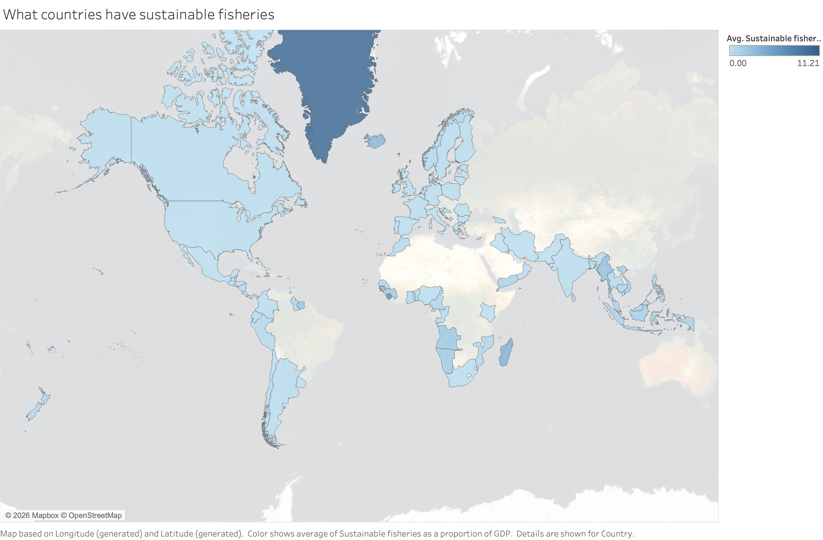

Slide 5
