Slide 1

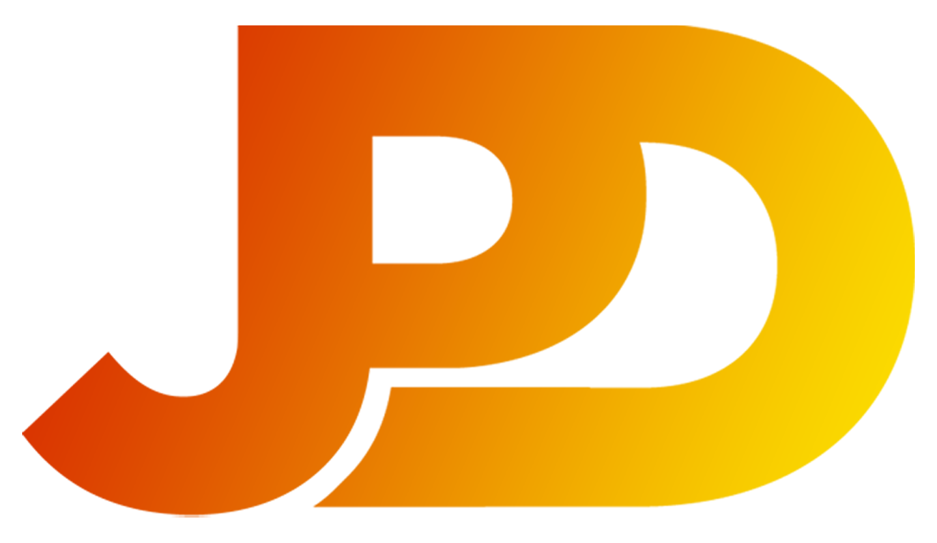
JAN PHILLIP M. DACALLOS

Slide 2
SYSTEM INTEGRATION AND ARCHITECTURE

Slide 3
Grading System
Attendance
Quiz
Performance Output
Midterm/Finals
Project
15%
10%
20%
30%
25%
100%

Slide 4
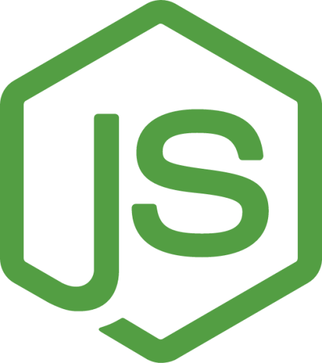
JavaScript
JavaScript is a programming language used to create dynamic and interactive content on websites. It runs in the browser and on servers, enabling features like animations, form validation, and real-time updates.

Slide 5
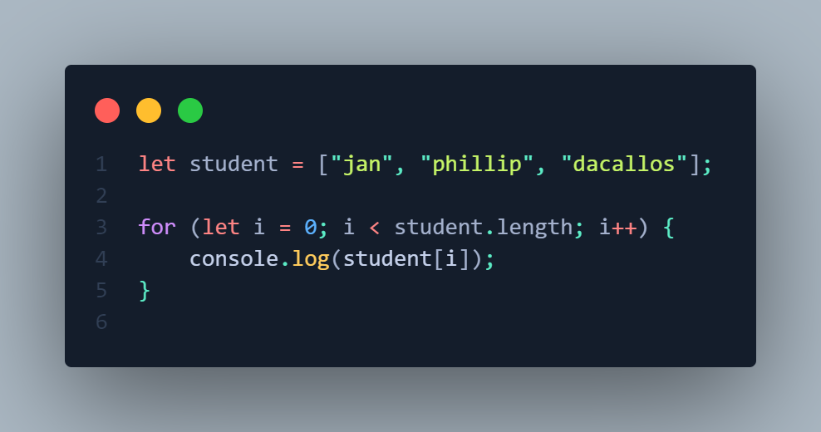

Slide 6

Node JS
Node.js is a server-side runtime that runs JavaScript, ideal for building fast, scalable apps. It’s event-driven, non-blocking, and great for handling multiple requests efficiently.

Slide 7
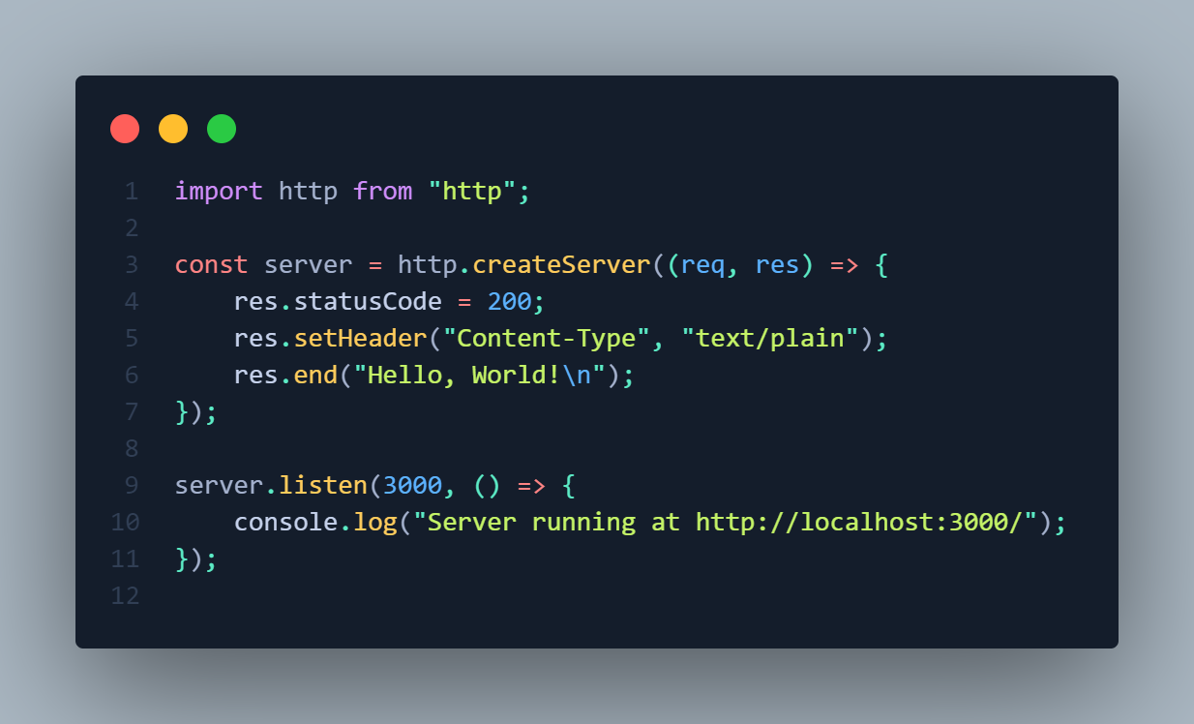

Slide 8

Node Package Manager (NPM)
NPM is a tool that helps manage and install JavaScript libraries and packages for Node.js projects. It simplifies dependency management and allows developers to share and reuse code.

Slide 9

Express.js
Express.js is a lightweight web framework for Node.js that simplifies building web applications and APIs. It provides tools for handling routes, middleware, and HTTP requests, making development faster and more organized.

Slide 10
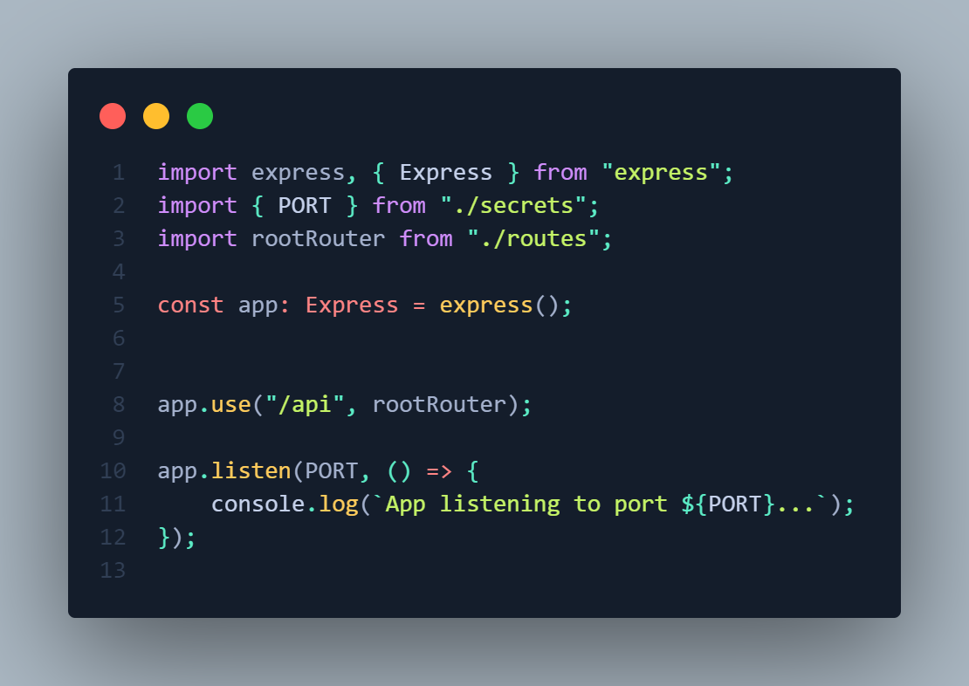

Slide 11
Postman
Postman is a tool used for testing APIs. It allows developers to send HTTP requests, inspect responses, and automate API testing, making it easier to debug and collaborate on API development.

Slide 12
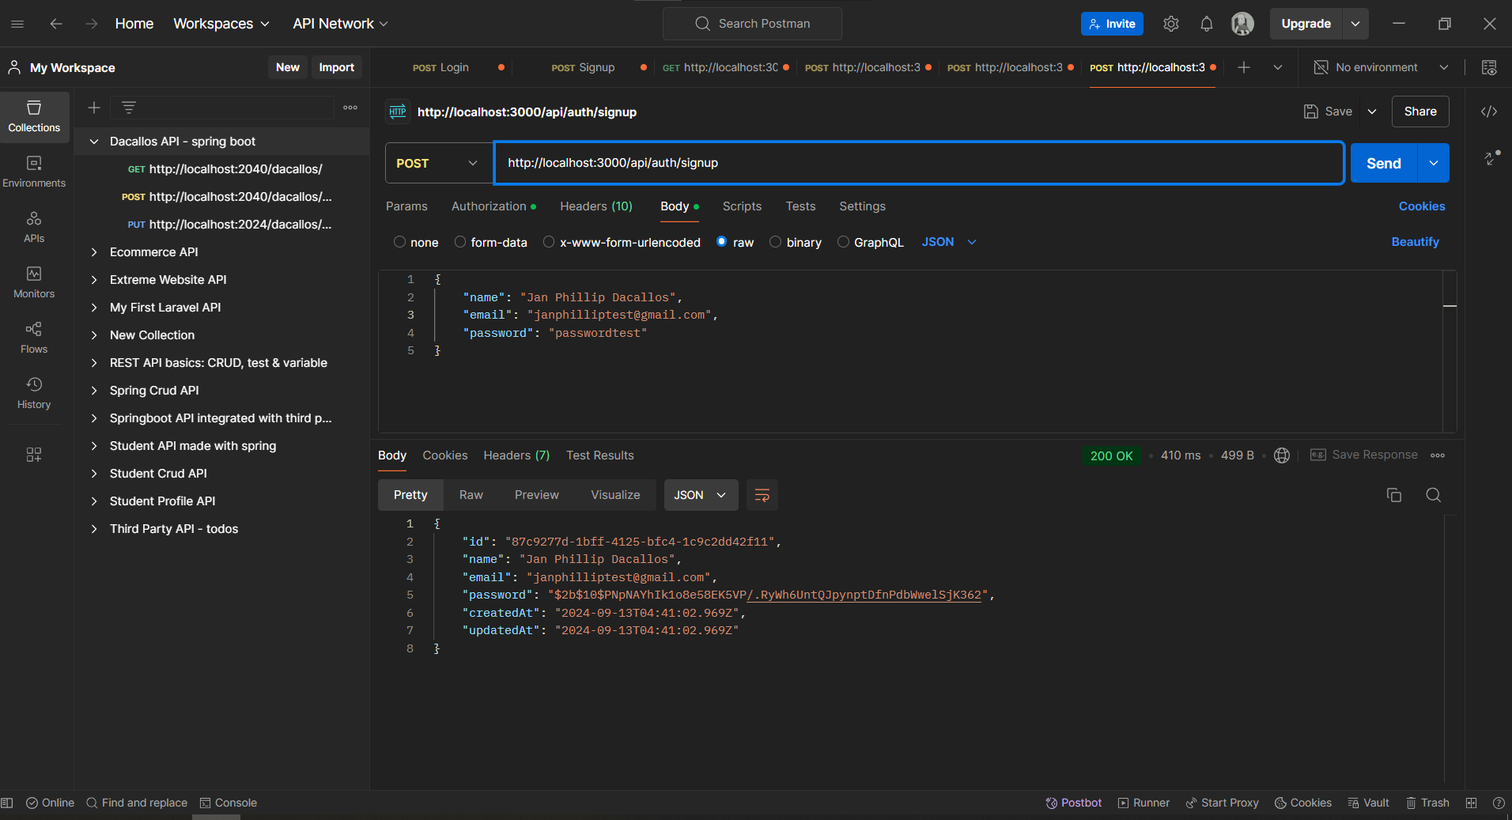

Slide 13
Data Formats
JSON (JavaScript Object Notation)
JSON is lightweight, human-readable, and commonly used in web applications for data transfer
XML (eXtensible Markup Language)
XML is more complex, uses tags to define structure, and is often used in document exchange and configuration files.

Slide 14
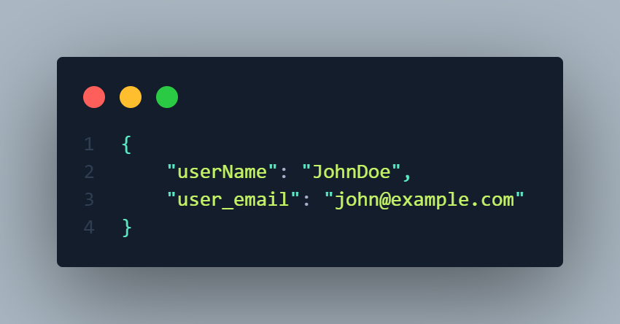
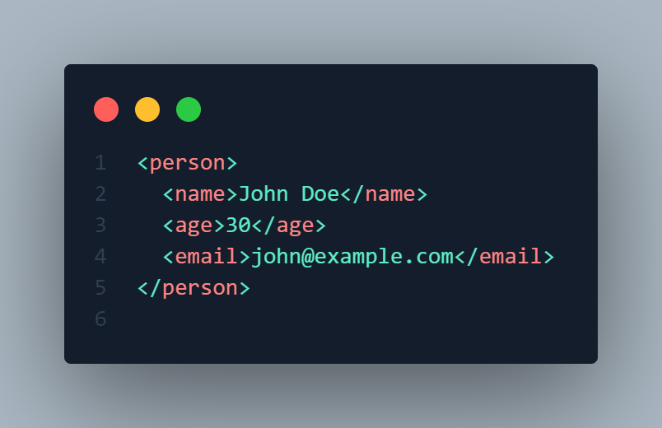

Slide 15
< >

Slide 16
WEB SERVICES BEST PRACTICES
Versioning
Security
Error Handling
Status Codes
Documentation
Testing
Microservice Architecture
Deployment and Maintenance

Slide 17
Model-Driven Architecture (MDA)
MDA emphasizes separating business logic from technology concerns, allowing for more flexible, reusable, and maintainable software by using models as the primary artifacts in the development process.

Slide 18
MDA Key Concepts
Platform-Independent Model (PIM): Represents the system’s functionality and business logic without specifying the technology used to implement it.
Platform-Specific Model (PSM): Transforms the PIM into a model that includes technology-specific details (e.g., database schema, programming language constructs).
Code Generation: Automatically generates code from the PSM to implement the system on a specific platform.

Slide 19
WHAT IS AN
API?

Slide 20
Application Programming Interface (API)
API stands for Application Programming Interface. It allows two or more applications to communicate with each other. APIs define the methods and data structures needed for this interaction.

Slide 21
HTTP Methods
GET
For retrieving data from server
POST
Adding data to be processed on the server
PUT
Update existing data on the server
DELETE
Remove data from the server
Notes:
REST: For lightweight api | socmed, e-commerce
SOAP: Enterprise level system (secured) | payment gateways
gRPC: microservices, real-time comm | chat apps, video streams (for speed)
GraphQL: minimal data transfer |

Slide 22
API Architectures
REST (Representational State Transfer)
REST is an architectural style for building scalable, stateless web services, offering lightweight and flexible APIs widely used for web applications.
SOAP (Simple Object Access Protocol)
A more rigid protocol that requires strict formats (XML) and offers more built-in security features.
gRPC (gRPC Remote Procedure Call)
gRPC uses Protocol Buffers, which is more efficient for communication between services.
SOAP (Simple Object Access Protocol)
GraphQL allows clients to specify exactly what data they need, improving efficiency.
Notes:
REST: For lightweight api | socmed, e-commerce
SOAP: Enterprise level system (secured) | payment gateways
gRPC: microservices, real-time comm | chat apps, video streams (for speed)
GraphQL: minimal data transfer |

Slide 23
REST API

Slide 24
Key Concepts of REST APIs
Statelessness
Client-Server Architecture
Cacheability
Uniform Interface
Notes:
REST: For lightweight api | socmed, e-commerce
SOAP: Enterprise level system (secured) | payment gateways
gRPC: microservices, real-time comm | chat apps, video streams (for speed)
GraphQL: minimal data transfer |

Slide 25
REST API Structure
BASE URL
Root endpoint of the API
https://api.example.com/
PARAMETERS
Query Parameter
Filtering or sorting data
/users?sort=name
Path Parameter
To identify specific resources
/users/{id}
ENDPOINTS
Paths to resources
/users
HTTP Headers
Additional request information
Content-Type/Authorization
Notes:
REST: For lightweight api | socmed, e-commerce
SOAP: Enterprise level system (secured) | payment gateways
gRPC: microservices, real-time comm | chat apps, video streams (for speed)
GraphQL: minimal data transfer |

Slide 26
Limitations of REST APIs
Statelessness
Each request must include all relevant information, which can sometimes increase the size of requests.
Overfetching or Underfetching
REST APIs may return more data than needed or less, requiring multiple requests.
Lack of Built-in Security
You need to add layers like OAuth, API keys, or tokens for secure access.
Notes:
REST: For lightweight api | socmed, e-commerce
SOAP: Enterprise level system (secured) | payment gateways
gRPC: microservices, real-time comm | chat apps, video streams (for speed)
GraphQL: minimal data transfer |

Slide 27
</>

