Slide 1


JAN PHILLIP M. DACALLOS

Slide 2

Encryption
Encryption is the process of converting data into a coded format, called ciphertext, to prevent unauthorized access. Only those with the decryption key can revert the data back to its original form. It's used to secure sensitive information like passwords, messages, or transactions.
Notes:
Hash Generation
Random Number Generation
Asymmetric Key Cryptography (for public key)
Public key for encryption
Private key for decryption
Encrypt – convert plain text to unreadable format
Decrypt – convert encrypted text into readable format

Slide 3


Bcrypt
Bcrypt is a password-hashing algorithm that securely stores passwords by converting them into a hash with added salt and multiple computational rounds. It’s designed to resist brute-force attacks and is commonly used in web applications for password protection.
Notes:
Access Token: often used in OAuths
Security Token: used for authentication/authorization
Session Token: a session of specific authenticated user. Allow to stay logged in

Slide 4
INSTALLATION /
INTEGRATION

Slide 5
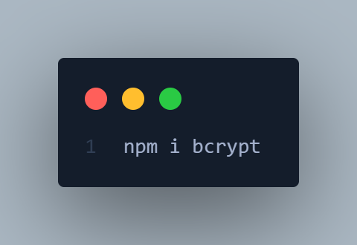
Notes:
Access Token: often used in OAuths
Security Token: used for authentication/authorization
Session Token: a session of specific authenticated user. Allow to stay logged in

Slide 6
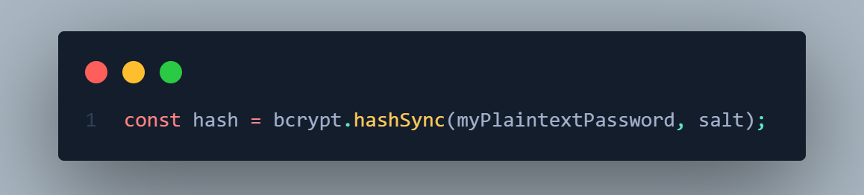
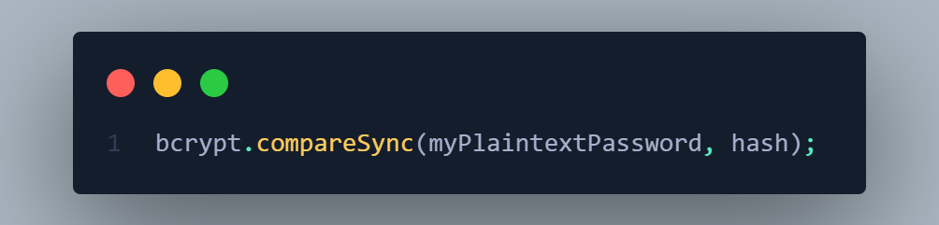
Notes:
Access Token: often used in OAuths
Security Token: used for authentication/authorization
Session Token: a session of specific authenticated user. Allow to stay logged in

Slide 7
</>

