Slide 1


JAN PHILLIP M. DACALLOS

Slide 2
INFORMATION ASSURANCE AND SECURITY 2

Slide 3
Grading System
Attendance
Quiz
Performance Output
Midterm/Finals
Project
15%
10%
20%
30%
25%
100%

Slide 4

JavaScript
JavaScript is a programming language used to create dynamic and interactive content on websites. It runs in the browser and on servers, enabling features like animations, form validation, and real-time updates.

Slide 5
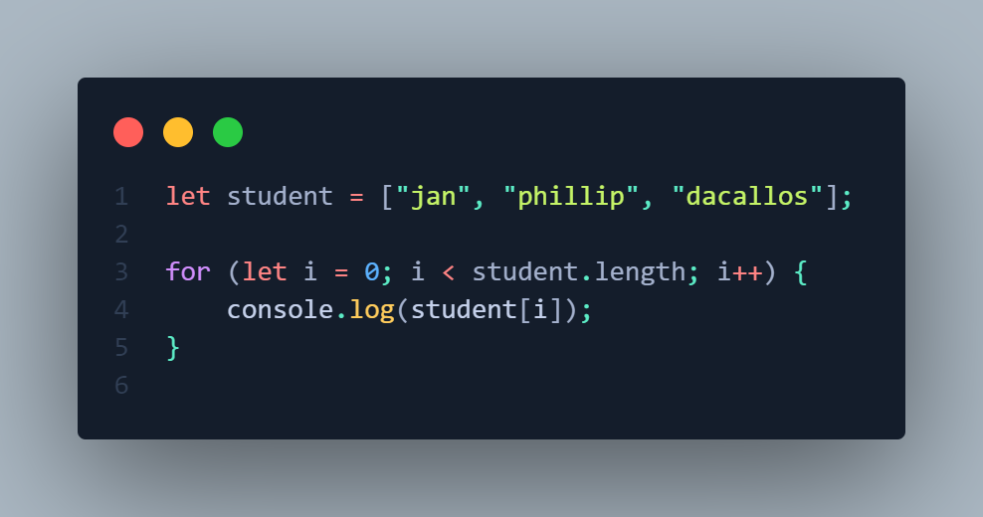

Slide 6

Node JS
Node.js is a server-side runtime that runs JavaScript, ideal for building fast, scalable apps. It’s event-driven, non-blocking, and great for handling multiple requests efficiently.

Slide 7
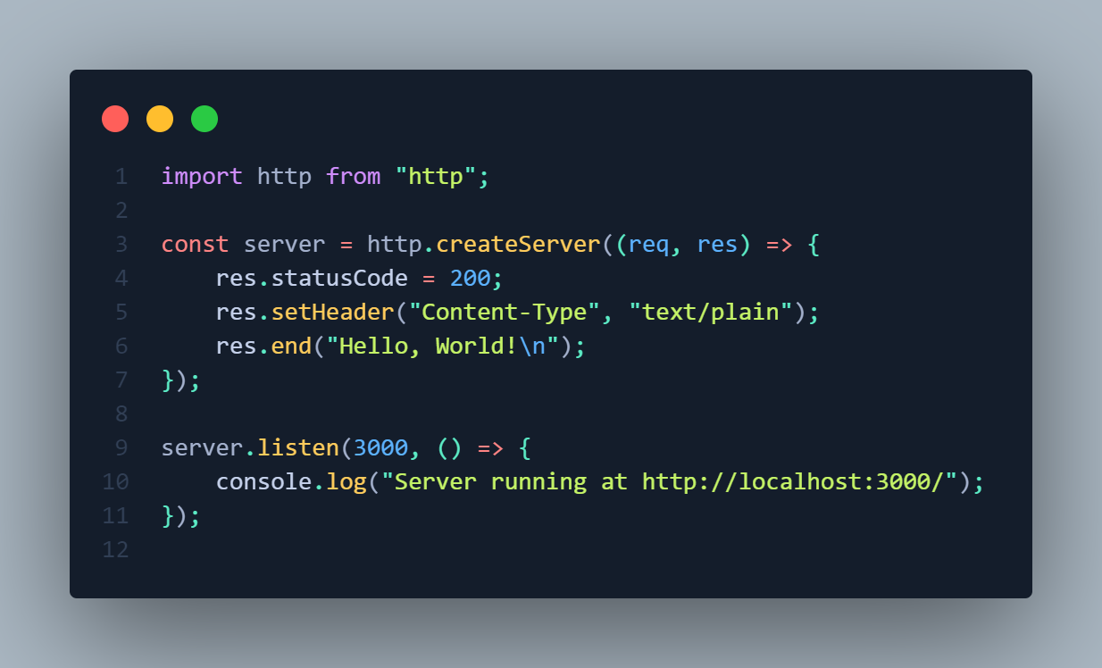

Slide 8

Node Package Manager (NPM)
NPM is a tool that helps manage and install JavaScript libraries and packages for Node.js projects. It simplifies dependency management and allows developers to share and reuse code.

Slide 9

Express.js
Express.js is a lightweight web framework for Node.js that simplifies building web applications and APIs. It provides tools for handling routes, middleware, and HTTP requests, making development faster and more organized.

Slide 10
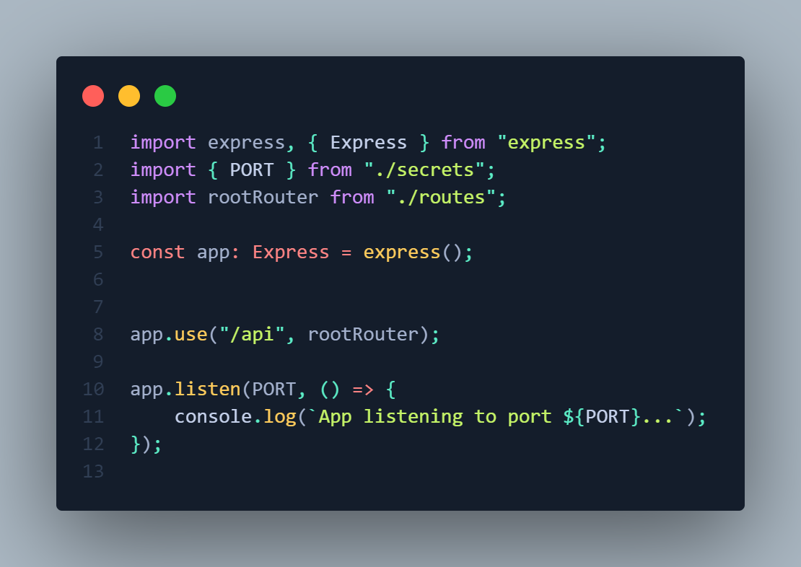

Slide 11
Postman
Postman is a tool used for testing APIs. It allows developers to send HTTP requests, inspect responses, and automate API testing, making it easier to debug and collaborate on API development.

Slide 12
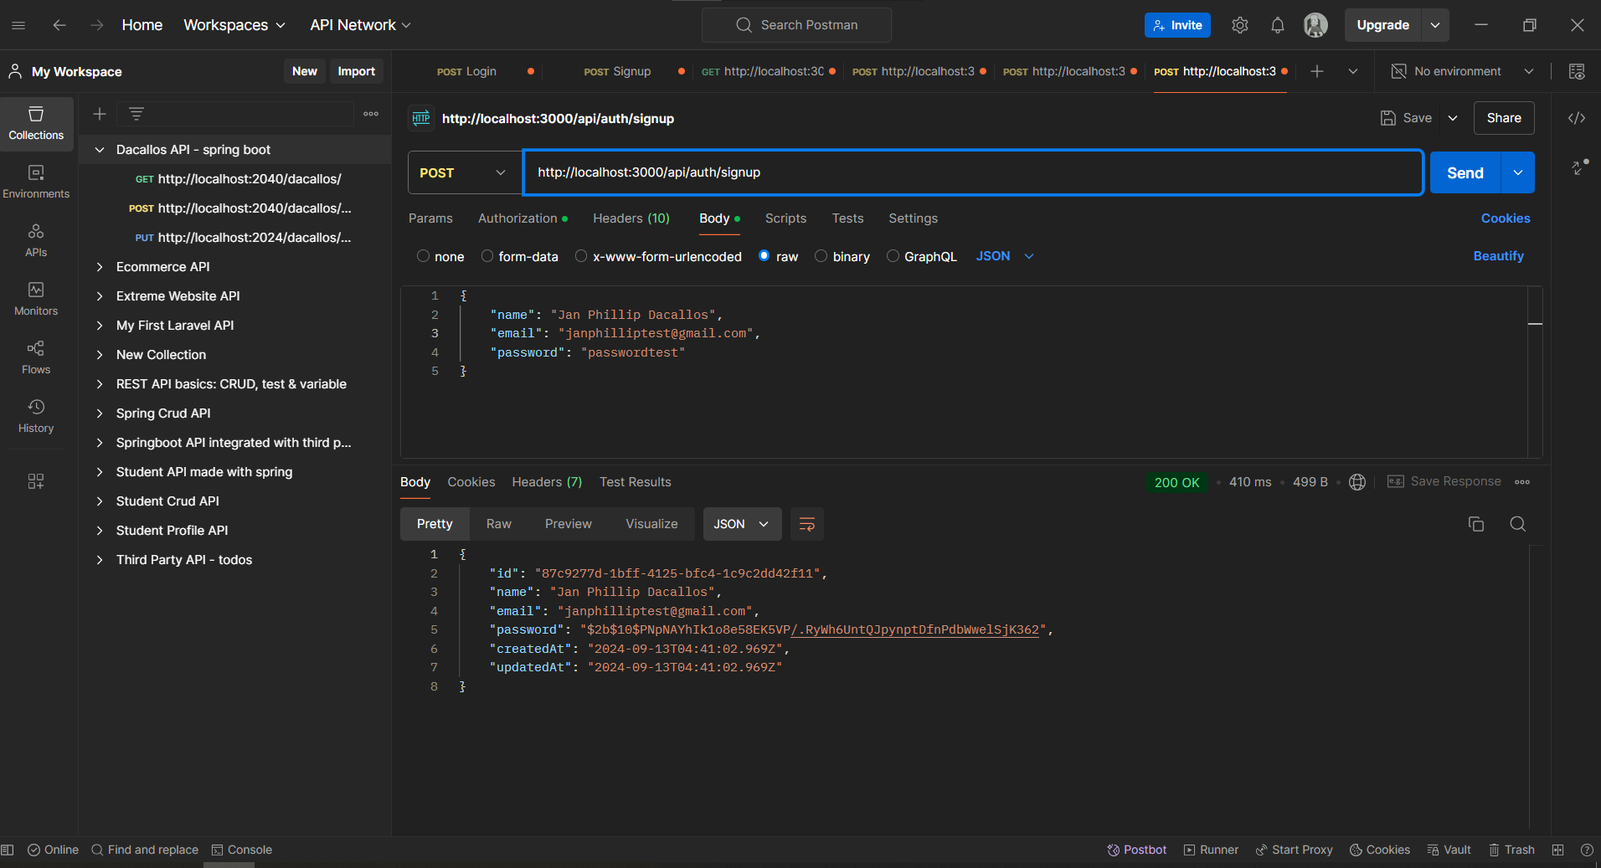


Slide 13
< >

Slide 14
Information Security
Information Security involves protecting data from unauthorized access and threats to ensure it remains confidential, accurate, and available.

Slide 15
Security Architecture
Security Architecture is the design and implementation of security measures to protect information and systems, aligning policies and technologies with business goals.
Notes:
For example:
Authentication
Authorization
Encryption
Input Validation
Request Limiting
Logging and Monitoring

Slide 16
Security Architecture Examples
Authentication
Authorization
Encryption
Input Validation
Request Limiting
Logging and Monitoring
Notes:
Authentication
Verifying user identity
Authorization
Determining user access/permission

Slide 17
Cryptography
The practice of securing information by transforming it into an unreadable format for unauthorized users. It uses algorithms and keys to encrypt and decrypt data, ensuring confidentiality and integrity during transmission and storage.
Notes:
Hash Generation
Random Number Generation
Asymmetric Key Cryptography (for public key)
Public key for encryption
Private key for decryption
Encrypt – convert plain text to unreadable format
Decrypt – convert encrypted text into readable format

Slide 18
Token
A token is a digital credential that represents identity or authorization, used to access resources or systems. It can be an access token, security token, or session token.
Notes:
Access Token: often used in OAuths
Security Token: used for authentication/authorization
Session Token: a session of specific authenticated user. Allow to stay logged in

Slide 19
Types of Token
Access Token
Grants access to specific resources or APIs.
Security Token
Used for both authentication and authorization.
Session Token
Maintains a user's session after authentication.
Notes:
Access Token: often used in OAuths
Security Token: used for authentication/authorization
Session Token: a session of specific authenticated user. Allow to stay logged in

Slide 20
</>

