Slide 1


JAN PHILLIP M. DACALLOS

Slide 2
INTEGRATIVE PROGRAMMING TECHNOLOGIES 2

Slide 3
Grading System
Attendance
Quiz
Performance Output
Midterm/Finals
Project
15%
10%
20%
30%
25%
100%

Slide 4

JavaScript
JavaScript is a programming language used to create dynamic and interactive content on websites. It runs in the browser and on servers, enabling features like animations, form validation, and real-time updates.

Slide 5
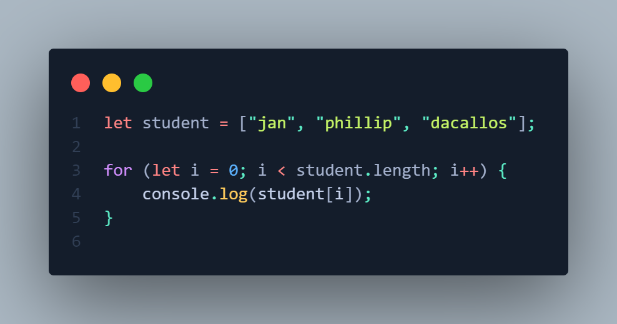

Slide 6

Node JS
Node.js is a server-side runtime that runs JavaScript, ideal for building fast, scalable apps. It’s event-driven, non-blocking, and great for handling multiple requests efficiently.

Slide 7
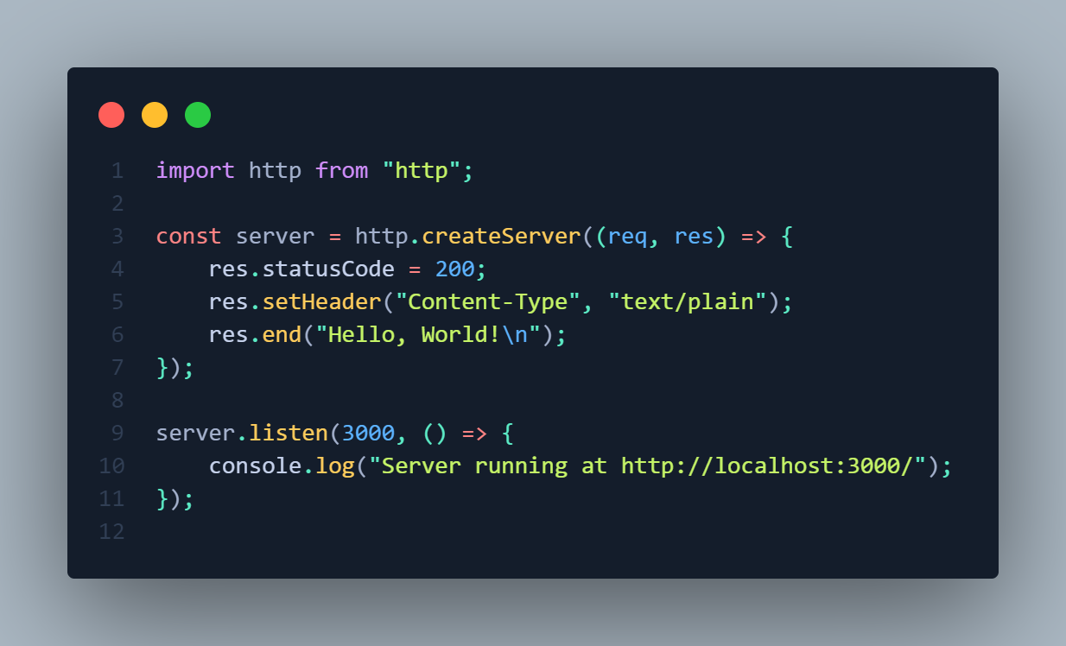

Slide 8

Node Package Manager (NPM)
NPM is a tool that helps manage and install JavaScript libraries and packages for Node.js projects. It simplifies dependency management and allows developers to share and reuse code.

Slide 9

Express.js
Express.js is a lightweight web framework for Node.js that simplifies building web applications and APIs. It provides tools for handling routes, middleware, and HTTP requests, making development faster and more organized.

Slide 10
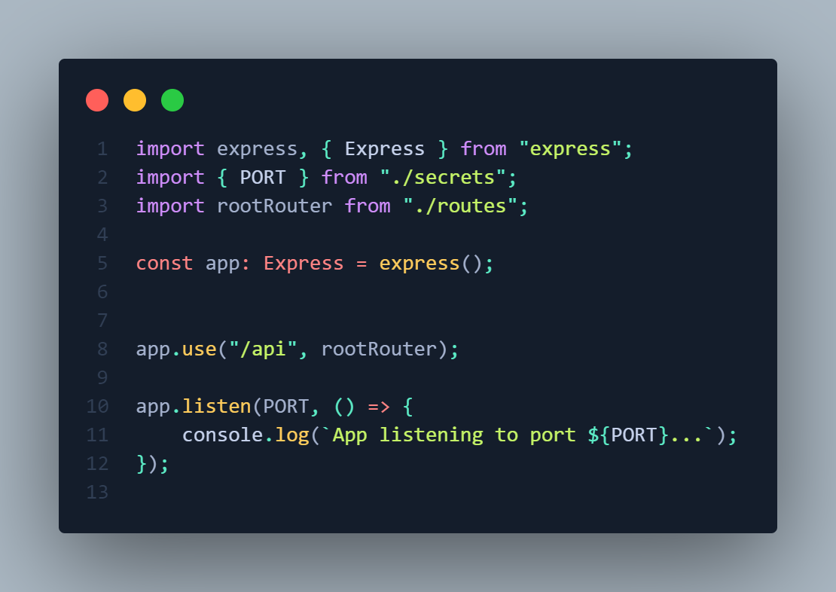

Slide 11
Postman
Postman is a tool used for testing APIs. It allows developers to send HTTP requests, inspect responses, and automate API testing, making it easier to debug and collaborate on API development.

Slide 12
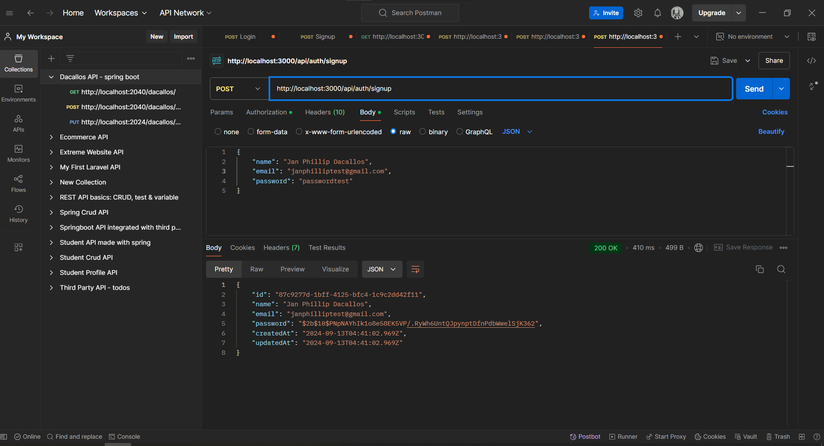

Slide 13
< >

Slide 14
Software Design Pattern
A software design pattern is a reusable solution to common design problems, offering a proven approach to improve code structure and maintainability.

Slide 15
Three Main Types of
Design Patterns
Creational Patterns: Deal with object creation mechanisms, aiming to create objects in a way that is flexible and efficient.
Structural Patterns: Focus on how objects and classes are composed to form larger structures, ensuring that they work together effectively.
Behavioral Patterns: Concern the interaction and responsibility between objects, defining how they communicate and collaborate.
Notes:
Creational: Singleton
Logging service wherein create one instance and access it globaly
Structural: Adapter
You create a parent function that is being adopted by another instance
Behavioral: Observer
Notification System
Parts of application (observer) receive update with event in system (subject)

Slide 16
Architectural Pattern
An architectural pattern is a high-level design framework that outlines the structure and organization of a software system.

Slide 17
Examples of Architectural Pattern
MVC (Model-View-Controller): Organizes code into Model, View, and Controller components.
MVVM (Model-View-ViewModel): Separates the representation of information from the user interaction.
Microservices: Structures an application as a collection of loosely coupled services.

Slide 18
Design Pattern
vs
Architectural Pattern

Slide 19

Design Pattern
Architectural Pattern
Design patterns broadly cover solutions for common design problems.
Architectural patterns specifically address the high-level structure and organization of software systems.

Slide 20
WHAT DESIGN PATTERN SHOULD WE USE?
Notes:
MVC
Separation of concerns
Easier to test, maintain, and read the codes.

Slide 21

MVC
MODEL-VIEW-CONTROLLER
Notes:
MVC
Separation of concerns
Easier to test, maintain, and read the codes.

Slide 22
</>

