Slide 1


Slide 2
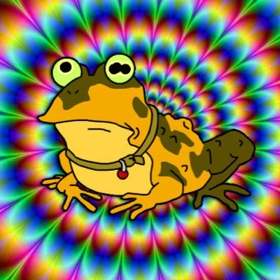
Your attention Please

Slide 3
GIT
What is Git?
Why Git?
How ?

Slide 4
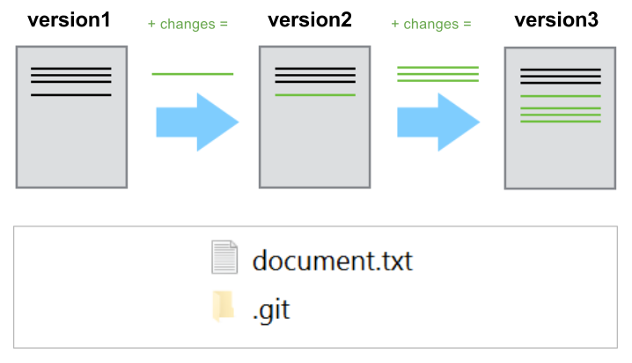
What is Git?
Git is a version-control system for tracking changes in source code during development. It is designed for coordinating work among programmers, but it can be used to track changes in any set of files.

Slide 5
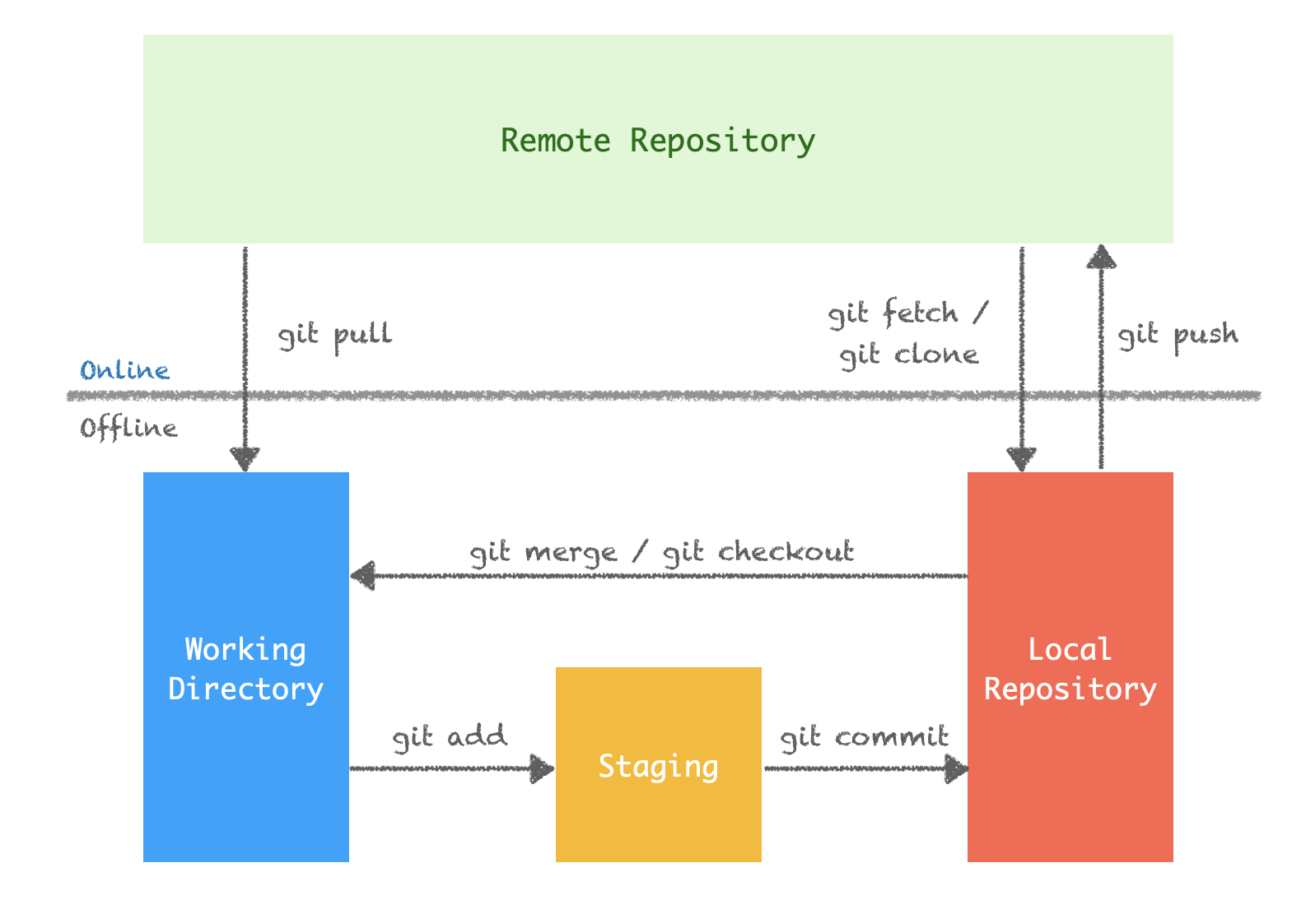
What is Git?

Slide 6
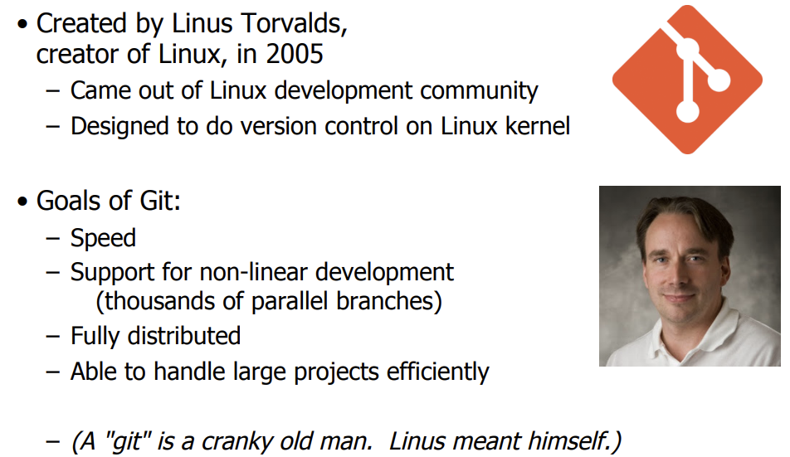
EXTRA CRANKY SLIDE

Slide 7
Why Git?

Slide 8
Vocabulary
Git = in English: “unpleasant person” , wiki: Git is a term of insult with origins in English denoting an unpleasant, silly, incompetent, annoying, senile, elderly or childish person. As a mild oath it is roughly on a par with prat and marginally less pejorative than berk.
Torvalds sarcastically quipped about the name git (which means "unpleasant person" in British English slang): "I'm an egotistical bastard, and I name all my projects after myself. First 'Linux', now 'git'."The man page describes Git as "the stupid content tracker".
Cranky = bad-tempered or irritable
Repo (short for repository)
“commit” in Git: A commit, or "revision", is an individual change to a file (or set of files). It's like when you save a file, except with Git, every time you save it creates a unique ID (a.k.a. the "SHA" or "hash") that allows you to keep record of what changes were made when and by who.
“commit” in English: perpetrate or carry out ( a mistake, crime or an inmmoral act
a.k.a = also known as
“Kernel” = in English: the central or most important part of something. The Linux kernel is the main component of a Linux operating system and is the core interface between a computerś hardware and its processes.

Slide 9


Slide 10
Sauce:
https://product.hubspot.com/blog/git-and-github-tutorial-for-beginners
https://www.youtube.com/watch?v=USjZcfj8yxE (15 mins video, super nice)
https://courses.cs.washington.edu/courses/cse403/13au/lectures/git.ppt.pdf

