Slide 1

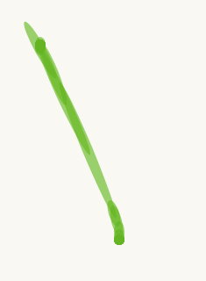

1. Marker
2. Toothpick
3. Fountain Pen
3. Fountain Pen V2
4. Spray Paint

Slide 2
1. Marker
2. Toothpick
3. Fountain Pen
3. Fountain Pen V2
4. Spray Paint

