Slide 1
Multidimensional Scaling and Diversities

Slide 2
Diversities
  Alpha diversity: diversity in individual sample units
  Beta diversity: amount of compositional variation in a sample (a collection of sample units)
  Gamma diversity: overall diversity in a collection of sample units, often "landscape-level" diversity

Slide 3
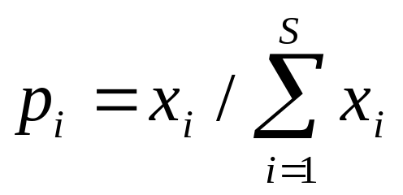
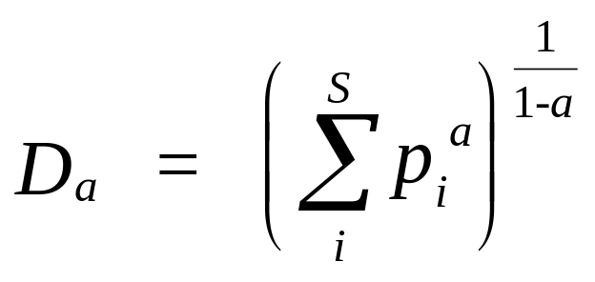
Proportionate diversity measures
For an observed abundance x_{i}, (numbers, biomass, cover, etc.) of species i in a sample unit, let
p_{i} = proportion of individuals belonging to species i:
  a = constant that can be assigned and alters the property of the measure
  S = number of species
  D_{a} = diversity measure based on the constant a. The units are "effective number of species"

Slide 4
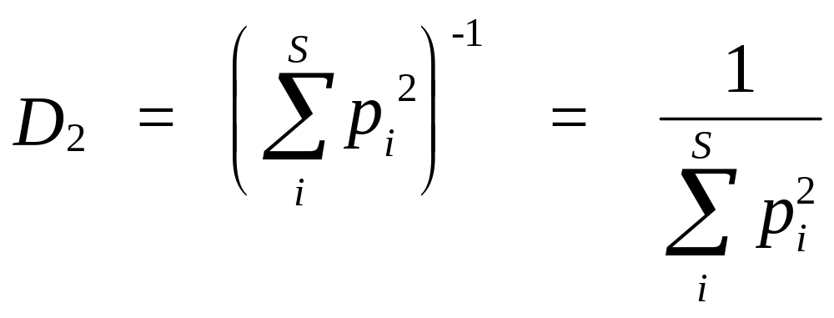
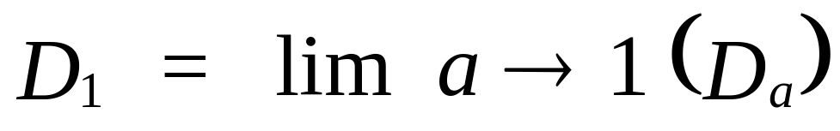
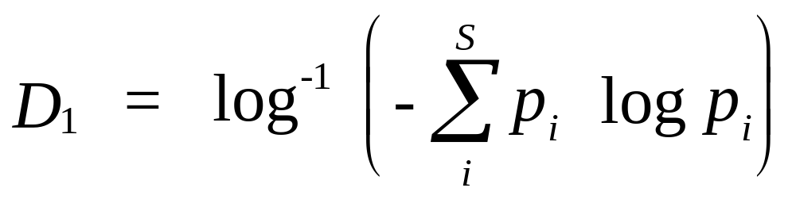
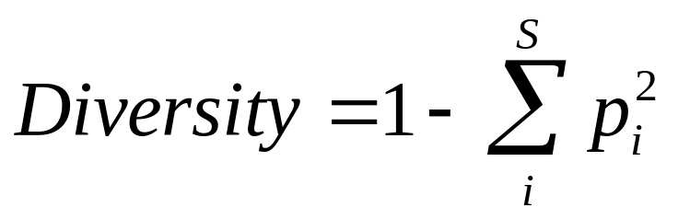
Simpson's and Shannon-Wiener index

Slide 5
Implementation
library(vegan)
mydata <- read.table('transposed_table',header=TRUE,row.names=1)
H <- diversity(mydata) #Shannon index
plot(H)
# alpha
alpha <- fisher.alpha(mydata)
plot(alpha)
location<-c("1","2","3","4","5","6","7","8","9","10")
gamma <- with(site, specnumber(site, location))

Slide 6
Implementation
d <- betadiver(mydata, "w")
plot(d)
d1<-betadiver(mydata, "w“, triangular=FALSE)
adipart(site,index=c("richness","shannon","simpson"),weights=c("unif","prop"),relative=FALSE,nsimul=99)

Slide 7
Introduction to MDS
MDS algorithm helps us in visualization of data.
MDS represents the similarities among pairs of objects as distances between points in low dimensional space(m-dimensional).
The dimensions of low dimensional space are explicitly chosen prior to analysis and the data are fitted to those dimensions

Slide 8
Algorithm
We start with matrix of data consisting of n rows of samples and p columns of variables(N*P)
(N*N) symmetrical matrix of all pairwise distances among samples is calculated with appropriate distance measure.
Various distance measures that can be used are Euclidean, Manhattan and Bray distance
MDS ordination is then performed on this distance matrix

Slide 9
Algorithm(continued)
Initial configuration of samples of low dimensional space can be random or based on another ordination
Distances(Euclidean, Bray) among these samples are calculated.
These distances are regressed against original distance matrix and predicted ordination distance for each pair of samples is calculated
The goodness of fit of regression is measured based on sum of squared differences called stress

Slide 10
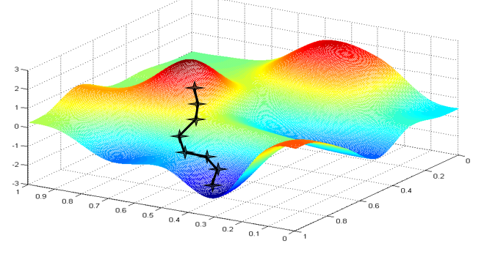
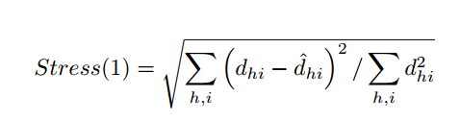
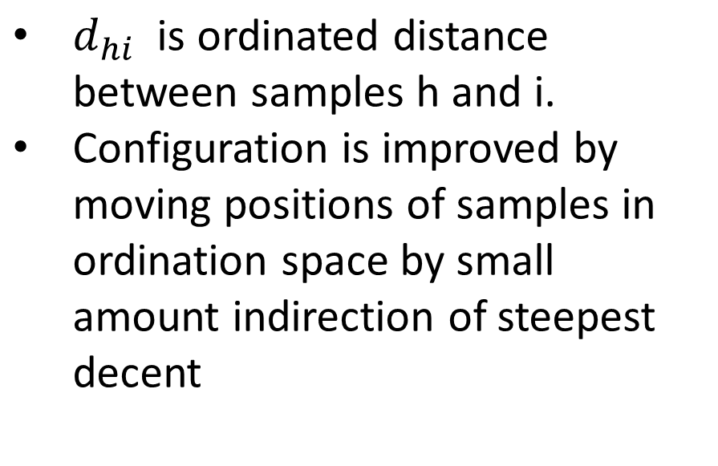

Slide 11
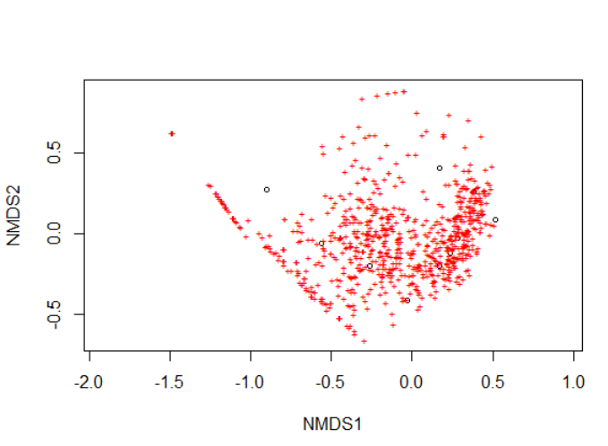
Implementation
library(vegan)
mydata <- read.table('transposed_table',header=TRUE,row.names=1)
mydata.mds<-metaMDS(mydata)
mydata.mds.ALT<-metaMDS(mydata,distance="euclidean",k=3,trymax=50,autotransform=FALSE)
plot(mydata.mds)

Slide 12
Considerations
The MDS ordination solution is not unique and subsequent MDS analysis on same data can give different ordination.
MDS ordinates data such that axis 1 explains greatest amount of variance, axis 2 next greatest variance while PCA uses Eigen vector technique.
MDS makes no assumptions of data as PCA assumes linear relationship, so suited for wide variety of data.
MDS is slow for large datasets are many computations are required, also can converge on local minima.

