Slide 2
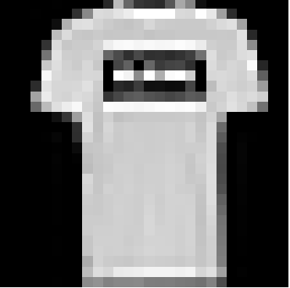
500 units
500 units
200 units
200 units
M units

Slide 3
Input
5x5 conv, 32 kernels + relu
2x2 max pool, stride 2
5x5 conv, 64 kernels + relu
2x2 max pool, stride 2
128 units + relu
10 units + softmax

