Slide 1
Ansible Final Labs

Slide 2
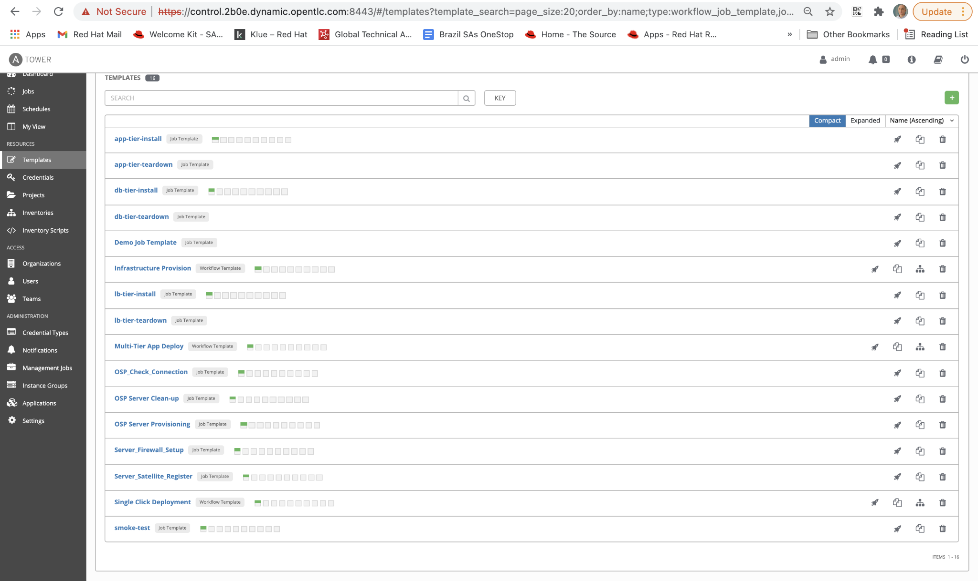
Snapshot - Templates

Slide 3
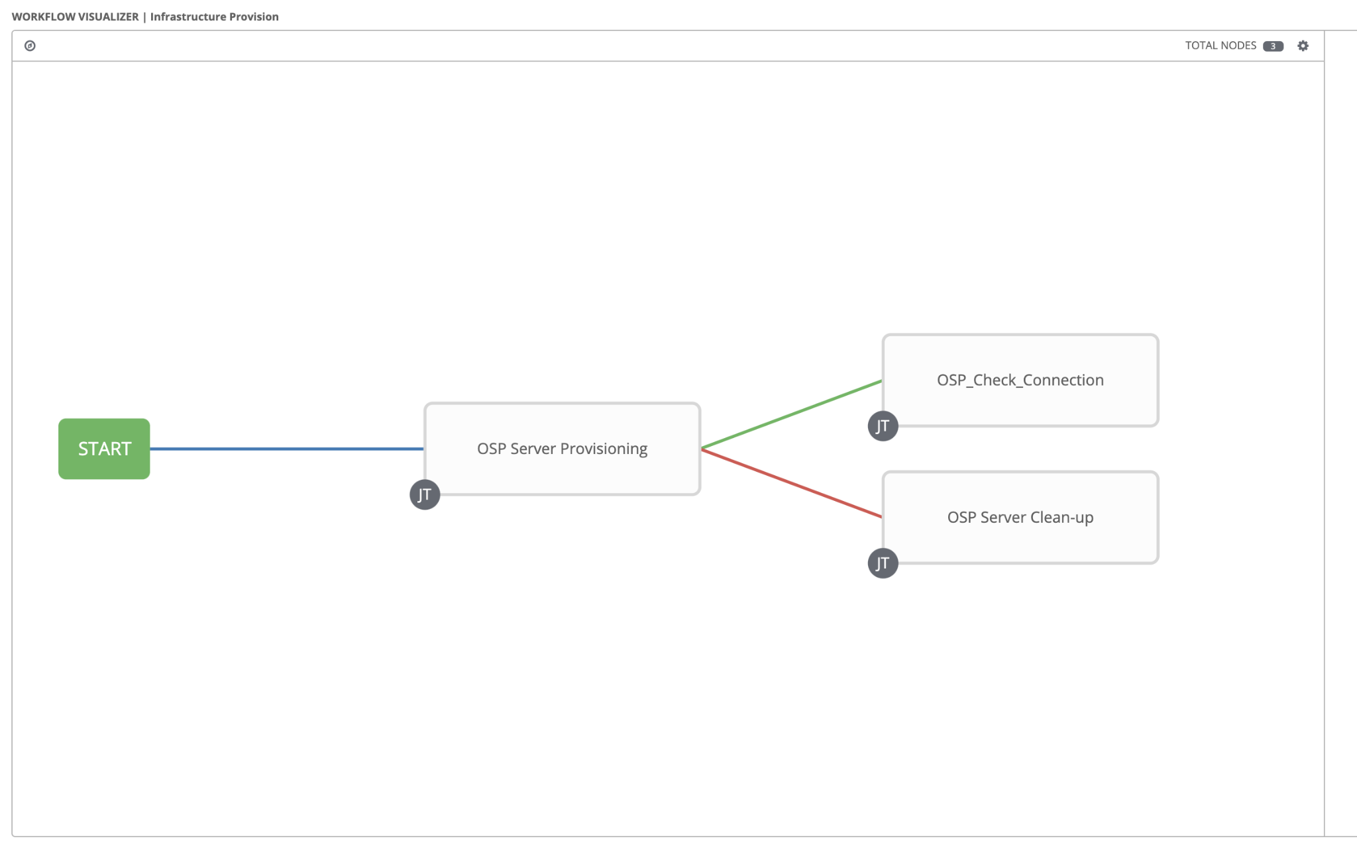
Workflow - Infrastructure Provision

Slide 4
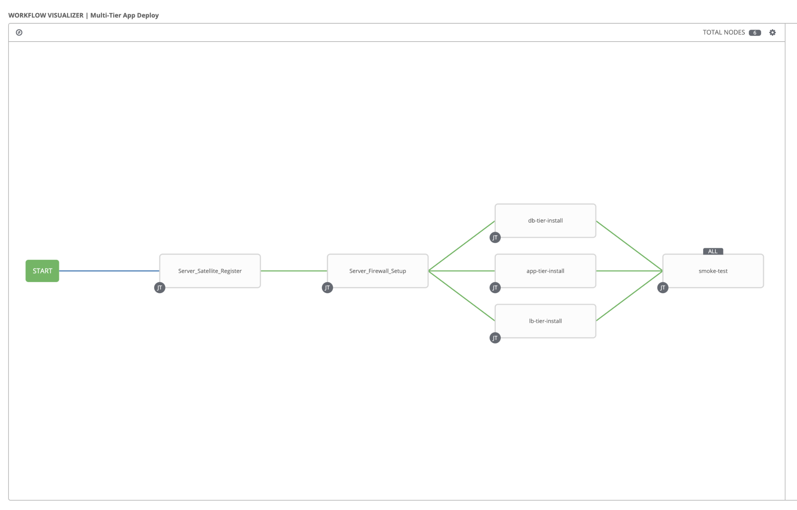
Workflow - Multi-tier Deploy

Slide 5
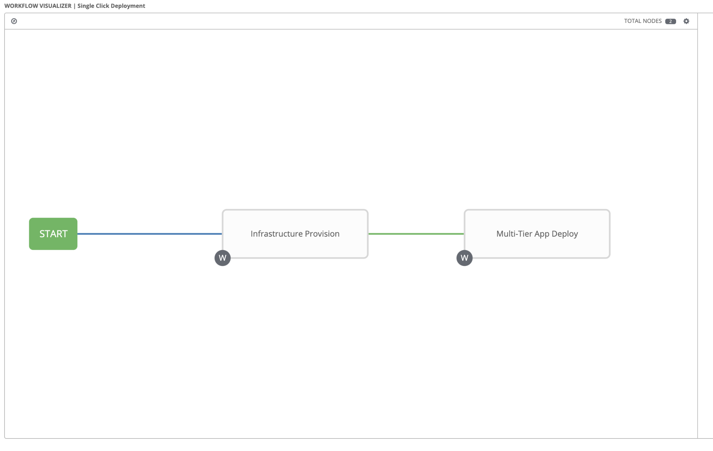
Workflow - Single Click deployments

Slide 6
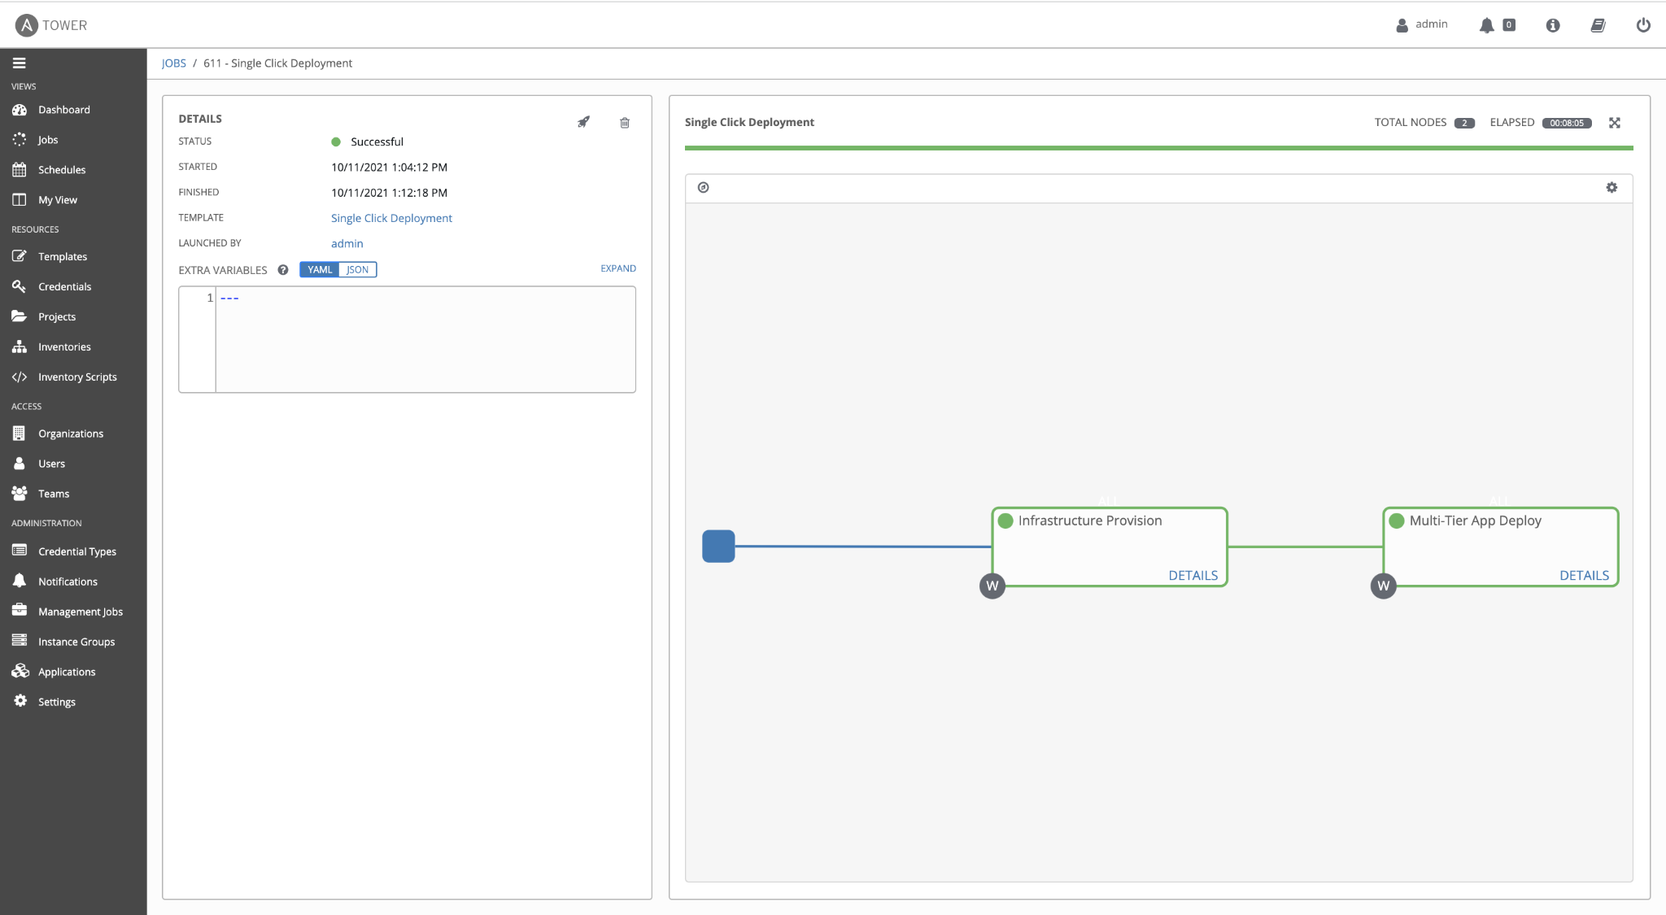
Workflow job - Single Click deployments

Slide 7
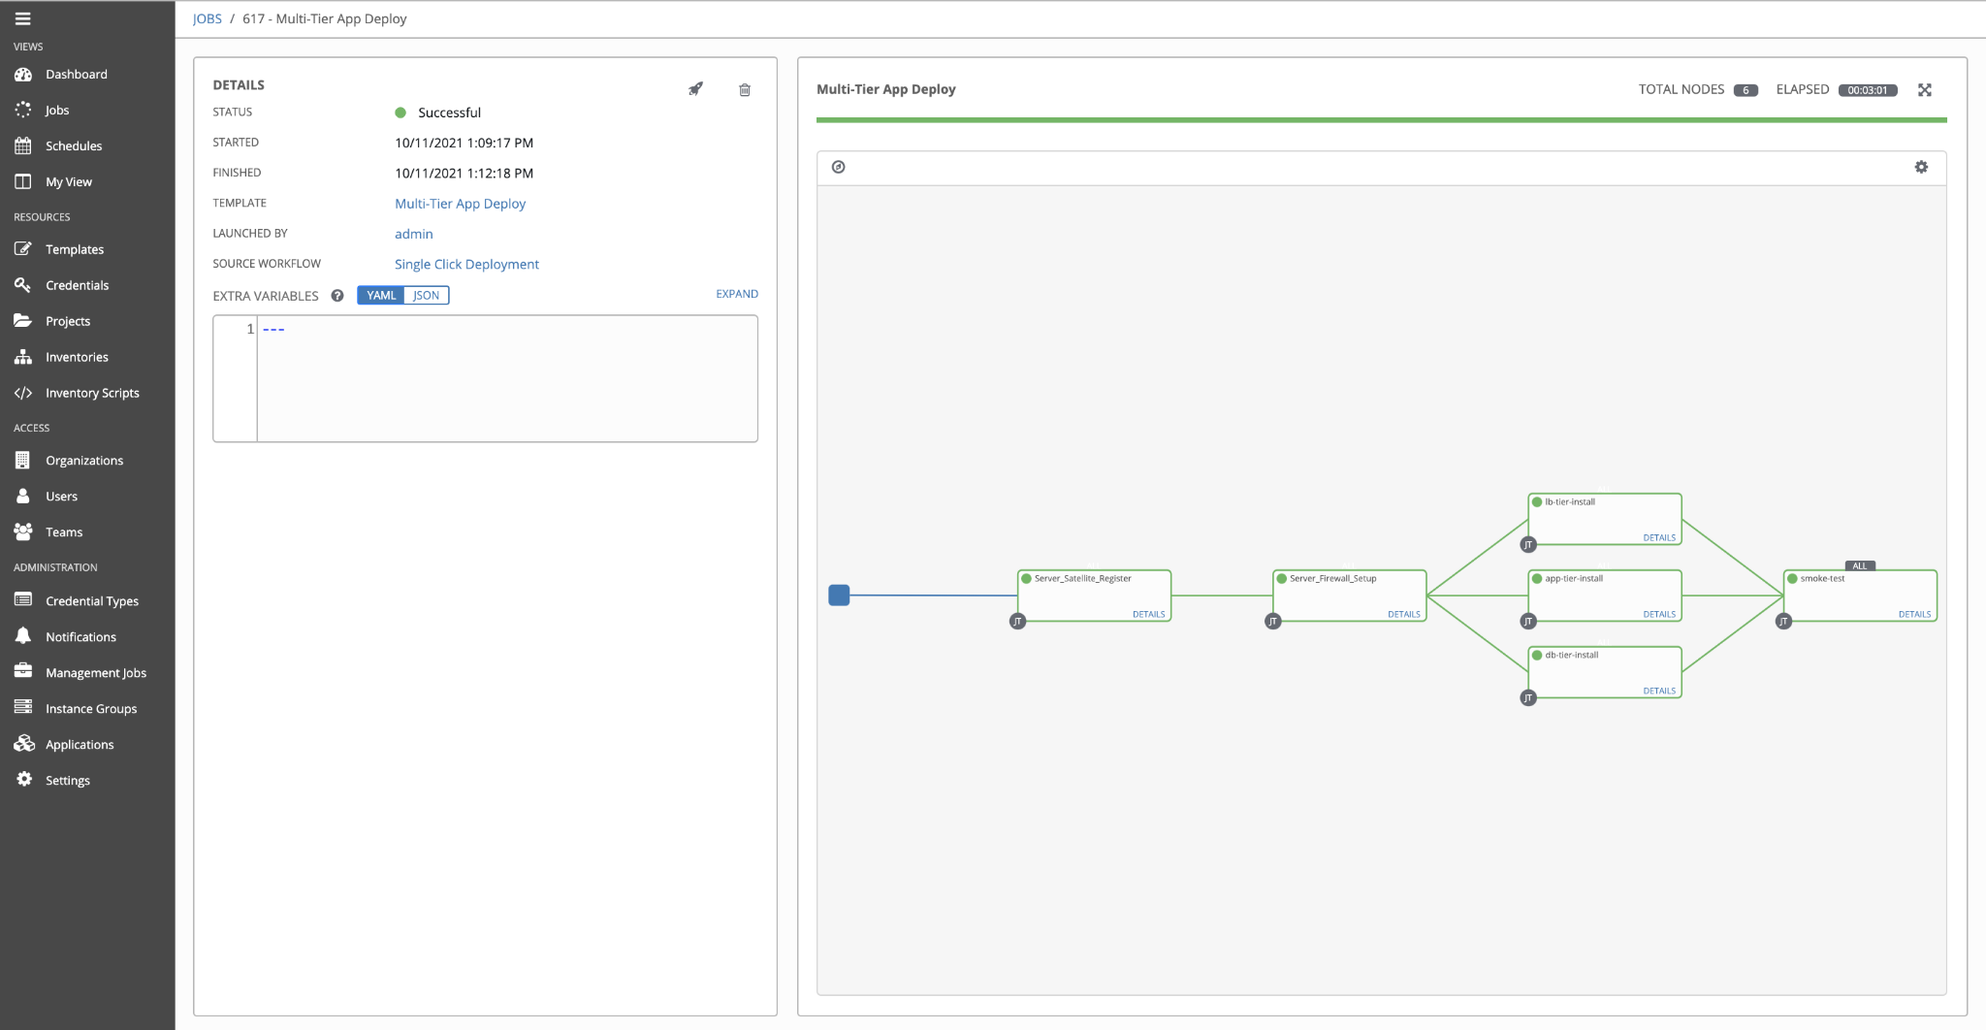
Workflow job - Multi-tier deploy

Slide 8
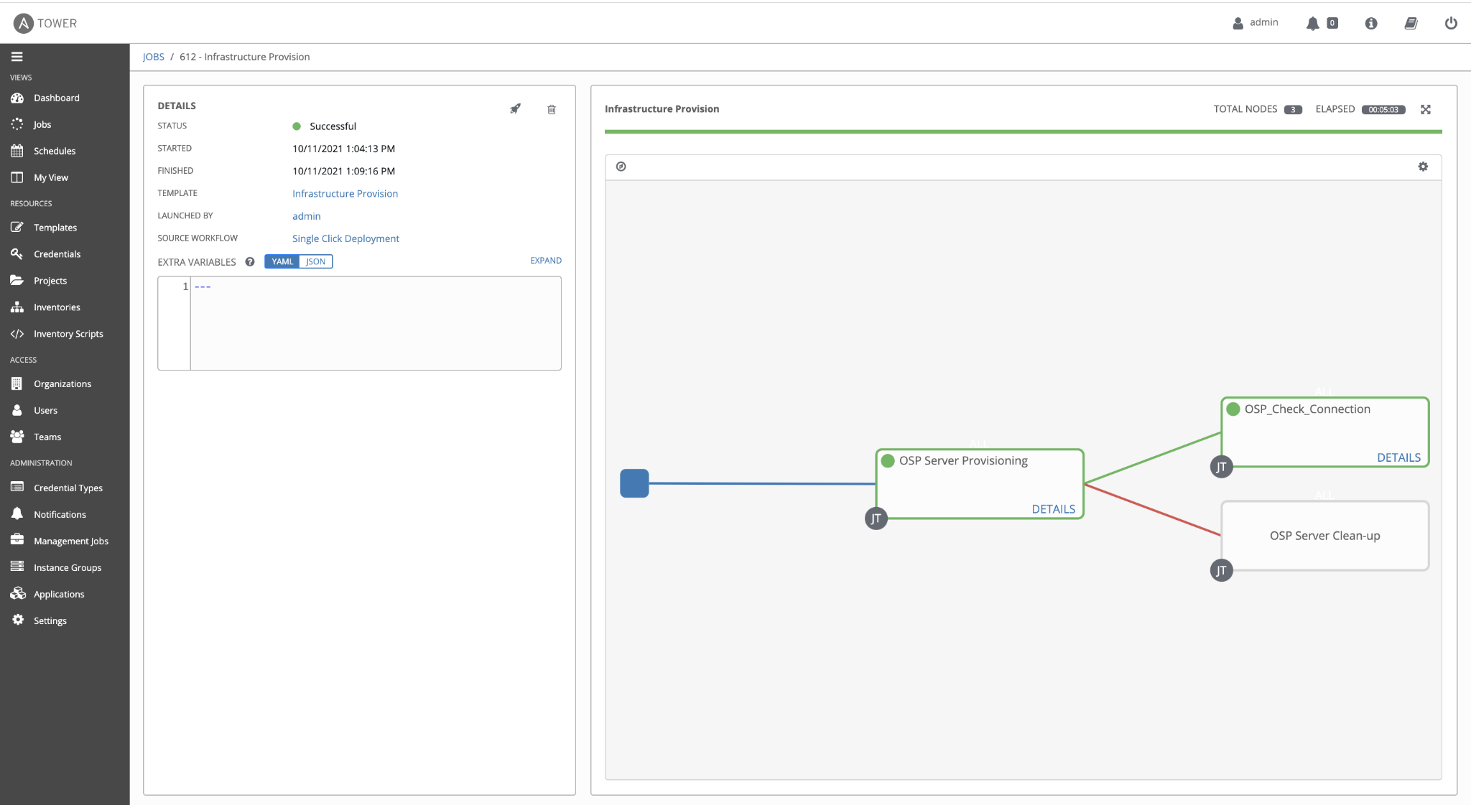
Workflow job - Infrastructure Provision

Slide 9
Workflow job - Multi-tier deploy

Slide 10
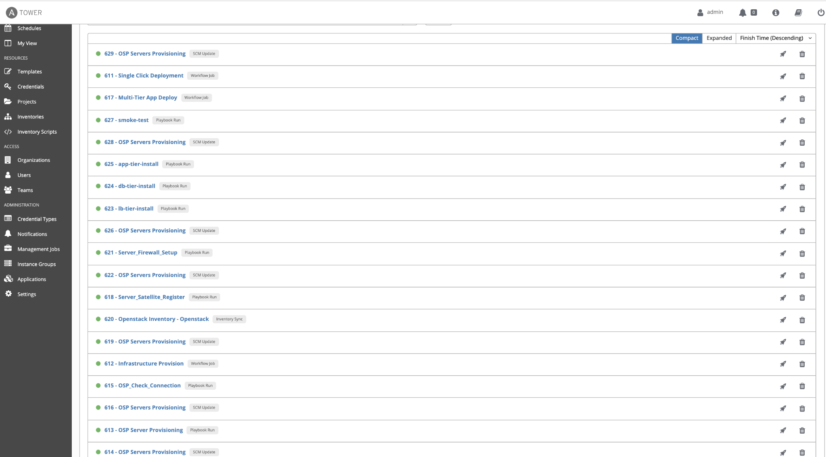
Tower Jobs

Slide 11
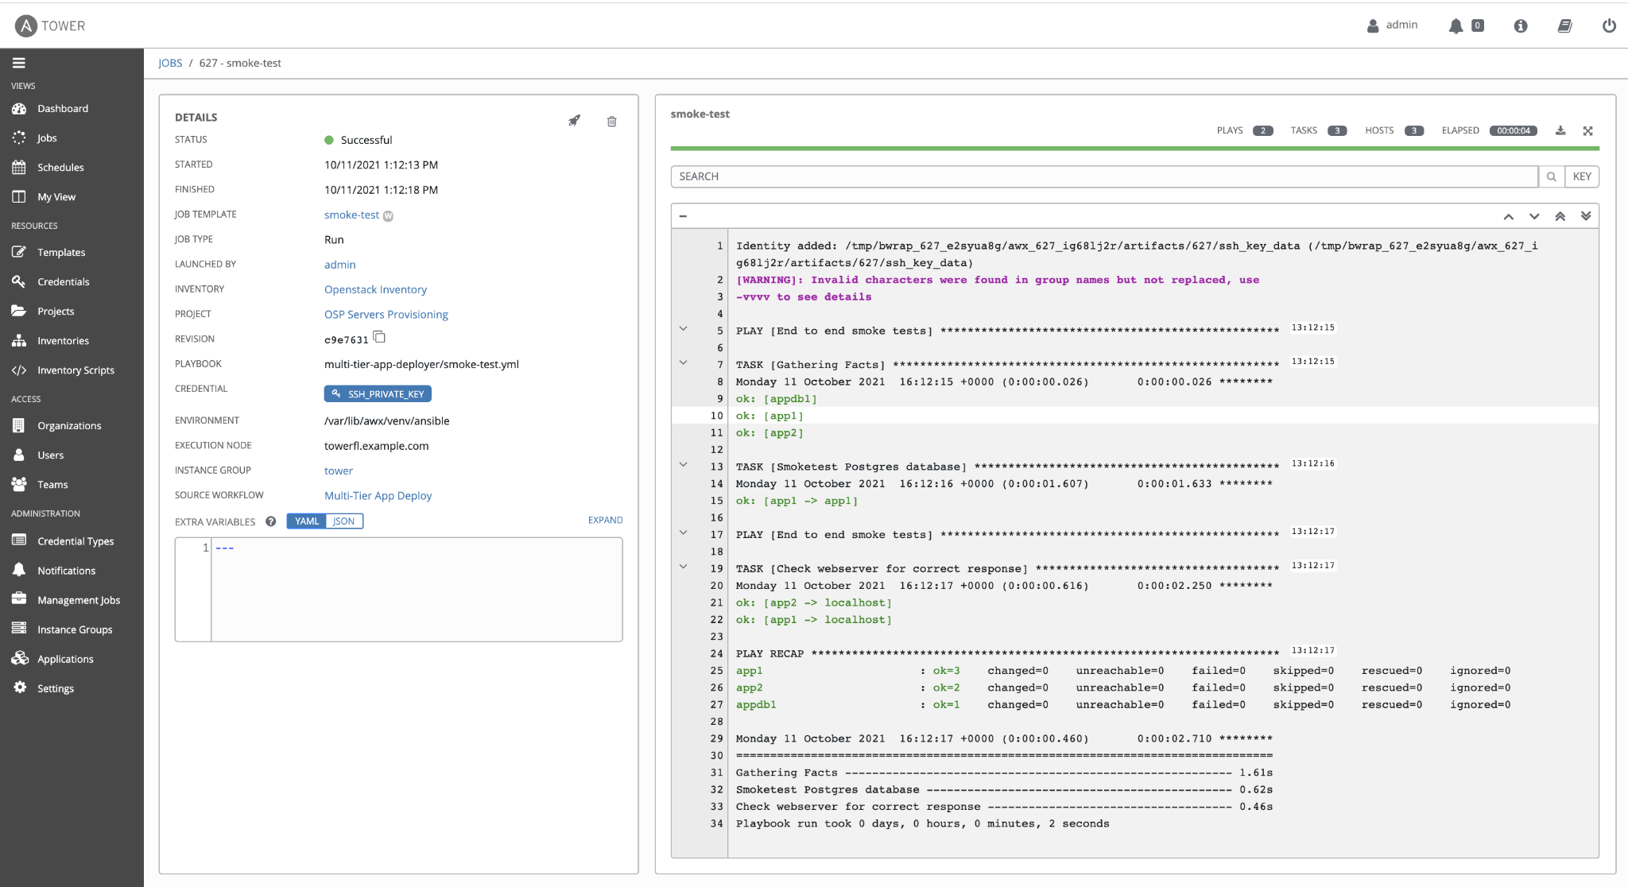
Log - Smoke Test

