Slide 1
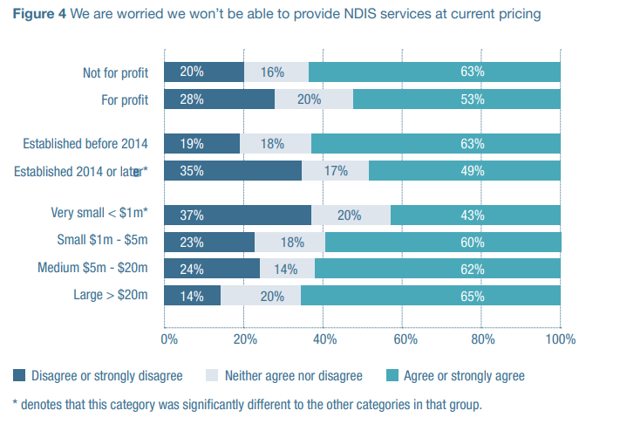
3.1 - API Gateway
High
RESTful endpoints for...

Slide 2
3.2 - Database Layer
Medium
MongoDB cluster with sharding...

