Slide 1
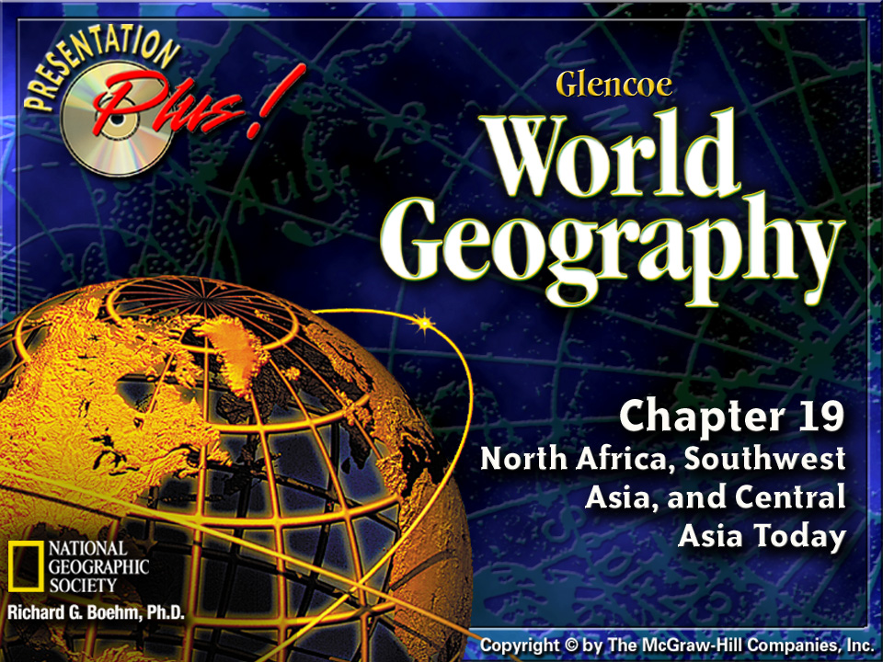


Splash Screen

Slide 2












Section 1-5
In 1999 the United States imported nearly $42 billion worth of petroleum products from the Organization of Petroleum Exporting Countries (OPEC). Most of the 11 OPEC countries are in Southwest Asia or North Africa. OPEC countries make an enormous profit from their trade with the United States; they imported only $20 billion worth of goods and services from the United States in 1999.

Slide 3
Section 1-6
Meeting Food Needs
Producing food for a rapidly growing population is a challenge in many parts of the region. ⇓
More developed countries, such as Saudi Arabia, use oil profits to import food. ⇓
Less developed countries, such
as Afghanistan, often grow their own food despite small yields.
(pages 463–465)
Click the mouse button or press the
Space Bar to display the information.

Slide 4
Section 1-7
Meeting Food Needs (cont.)
Agriculture Only a small part of the region’s land is farmable, but many people work in agriculture. ⇓
Grains and fruit are important crops. Livestock, cotton, silkworms, and tea are also important to certain areas.
(pages 463–465)
Click the mouse button or press the
Space Bar to display the information.

Slide 5
Section 1-8
Meeting Food Needs (cont.)
Fishing Fishing is a major industry that provides an important source of food. ⇓
The Persian Gulf has about 150 edible species of fish.
(pages 463–465)
Click the mouse button or press the
Space Bar to display the information.

Slide 6
Section 1-10
Industrial Growth
Oil, Natural Gas, and Mining North Africa, Southwest Asia, and Central
Asia supplies much of the world’s petroleum. ⇓
Iran and Saudi Arabia have developed oil-refining and oil-shipping facilities. ⇓
In some countries, natural gas supports manufacturing, and mining provides export income.
(pages 465–466)
Click the mouse button or press the
Space Bar to display the information.

Slide 7
Section 1-11
Industrial Growth (cont.)
Service Industries Service industries and tourism play a large part in some of the region’s economies. ⇓
North Africa and Southwest Asia are favorite tourist destinations. ⇓
Religious conflicts and political instability, however, have discouraged tourism in some countries.
(pages 465–466)
Click the mouse button or press the
Space Bar to display the information.

Slide 8
Section 1-13
Transportation and Communications
Roads, Railroads, and Airlines Iran, Turkey, and Egypt are crisscrossed by extensive highway systems. ⇓
Mountains and deserts in some countries pose obstacles to road construction. ⇓
Rapid transit systems are beginning
to appear in cities such as Istanbul. ⇓
Since the breakup of the Soviet Union, Central Asian countries have set up their own airlines.
(pages 466–468)
Click the mouse button or press the
Space Bar to display the information.

Slide 9
Section 1-14
Transportation and Communications (cont.)
Waterways and Pipelines The region’s economies depend heavily on water transportation. ⇓
Merchant traffic, such as oil tankers, enters and leaves through the Strait of Tiran, between the Gulf of Aqaba and the Red Sea, or the Strait of Hormuz, linking the Persian Gulf with the Arabian Sea.
(pages 466–468)
Click the mouse button or press the
Space Bar to display the information.

Slide 10
Section 1-15
Transportation and Communications (cont.)
The Suez Canal, lying between the Sinai Peninsula and the rest of Egypt, enables ships to pass from the Mediterranean Sea to the Red Sea. ⇓
Pipelines carry oil from its sources to various ports on the Mediterranean and Red Seas and the Persian Gulf.
(pages 466–468)
Click the mouse button or press the
Space Bar to display the information.

Slide 11
Section 1-16
Transportation and Communications (cont.)
Communications Television and radio broadcasting is expanding, and satellite technology is improving
communications. ⇓
Many people in major cities rely on cellular phones for communication.
(pages 466–468)
Click the mouse button or press the
Space Bar to display the information.

Slide 12
Section 1-17
Transportation and Communications (cont.)
Two New Silk Roads In 1998 over 16,000 miles of cable were laid along the route of the ancient Silk Road, providing digital access to 20 countries. ⇓
Plans are underway to build a network of road, rail, and air transportation systems tracing the Silk Road’s path.
(pages 466–468)
Click the mouse button or press the
Space Bar to display the information.

Slide 13
Section 1-20
Interdependence
Wealthier countries in the region, such
as Saudi Arabia, are helping developing countries, such as the Central Asian republics. ⇓
Aid includes trade deals and development loans. ⇓
The Organization of Petroleum Exporting Countries (OPEC) includes eight countries in the region. ⇓
OPEC has given its members control over oil prices and production rates.
(page 468 )
Click the mouse button or press the
Space Bar to display the information.

Slide 14
Section 1-21
Interdependence (cont.)
Because other countries depend heavily on the region’s oil, OPEC has considerable world power and
influence. ⇓
For example, when the United States aided Israel during the 1973 Arab-Israeli war, OPEC reduced shipments of oil to the United States.
(page 468 )
Click the mouse button or press the
Space Bar to display the information.

Slide 15
Section 1-22
Interdependence (cont.)
Industrialized countries like the United States depend on oil from the region,
and the region depends on the export
of this product. ⇓
Both sides recognize that, despite political and economic disagreements, they need to work together.
(page 468 )
Click the mouse button or press the
Space Bar to display the information.

Slide 16
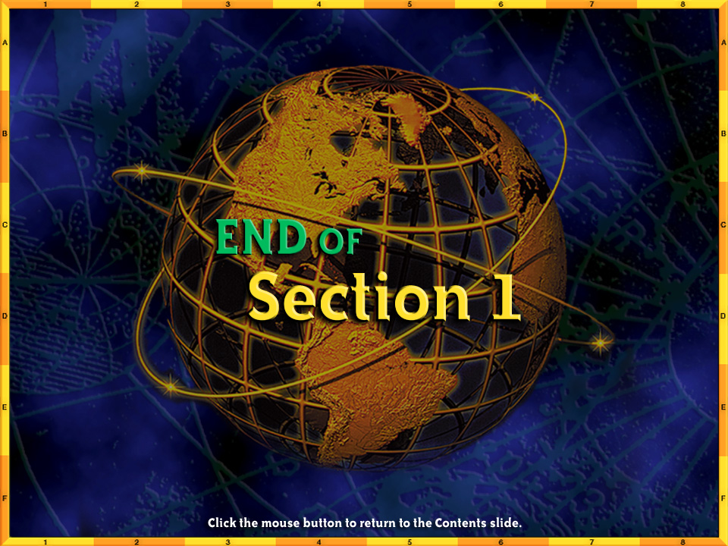

End of Section 1

Slide 17

Section 2-5
Egypt’s Suez Canal links the Mediterranean Sea and the Red Sea.
The canal is 121 miles (195 km) long
and was built by a French corporation, with Egyptian labor, between 1859 and 1869. Great Britain took over control of
the canal six years later. In 1956, the
last British troops departed, and Egypt now controls the Suez Canal.

Slide 18
Section 2-6
The Need for Water
Water Resources North Africa, Southwest Asia, and Central Asia
have limited sources of freshwater. ⇓
Much of it comes from rivers, oases, and aquifers. ⇓
Only a few countries have enough
water for irrigation.
(pages 469–472)
Click the mouse button or press the
Space Bar to display the information.

Slide 19
Section 2-7
The Need for Water (cont.)
Desalination One solution to limited water resources is desalination–the removal of salt from seawater. ⇓
The region’s desalination plants produce about 2.4 billion gallons
(9.1 billion liters) of water per day. ⇓
An Ancient Solution Ancient Nabataeans, who lived in what is now Jordan, “harvested” rainwater, storing
it in a system of pipes and cisterns
for use throughout the year.
(pages 469–472)
Click the mouse button or press the
Space Bar to display the information.

Slide 20
Section 2-8
The Need for Water (cont.)
The “Great Man-Made River” Libya’s “great man-made river” is an ambitious project to supply freshwater. ⇓
Two pipelines carry water from large aquifers beneath the Sahara to farms near the Mediterranean coast.
(pages 469–472)
Click the mouse button or press the
Space Bar to display the information.

Slide 21
Section 2-10
Environmental Concerns
The Aswan Dam The Aswan High Dam, 600 miles south of Cairo, irrigates
3 million acres (1.2 million ha) of land and provides nearly half of Egypt’s electric power. ⇓
It also has created the world’s largest artificial lake. ⇓
The dam, however, has blocked the Nile’s natural process of depositing fertile soil and washing salt from the
soil when it floods each year.
(pages 472–473)
Click the mouse button or press the
Space Bar to display the information.

Slide 22
Section 2-11
Environmental Concerns (cont.)
Farmers now must fertilize the soil by other means. ⇓
Egypt is working to overcome these problems.
(pages 472–473)
Click the mouse button or press the
Space Bar to display the information.

Slide 23
Section 2-13
Environmental Concerns (cont.)
The Persian Gulf War War in the
region has had a negative effect on
the environment. ⇓
During the Persian Gulf War of 1991, Iraqi troops retreating from Kuwait set fire to oil wells and dumped about 250 million gallons (947 million liters) of oil into the Persian Gulf. ⇓
The long-term effects of the smoke
and oil pollution are still unknown.
(pages 472–473)
Click the mouse button or press the
Space Bar to display the information.

Slide 24
Section 2-14
Environmental Concerns (cont.)
Nuclear and Chemical Dangers Central Asian countries have inherited the Soviet era’s environmental
problems. ⇓
For example, radiation leaks from
Soviet nuclear testing have contaminated areas of Kazakhstan.
(pages 472–473)
Click the mouse button or press the
Space Bar to display the information.

Slide 25
Section 2-15
Environmental Concerns (cont.)
Three Troubled Seas The Caspian, Dead, and Aral Seas face environmental challenges. ⇓
Pollution and overfishing threaten fish in the Caspian Sea. ⇓
The Dead Sea’s water level has dropped drastically over the past 40 years because water has been diverted for irrigation and hydroelectric plants.
(pages 472–473)
Click the mouse button or press the
Space Bar to display the information.

Slide 26
Section 2-16
Environmental Concerns (cont.)
The Aral Sea has had water diverted from feeder rivers to irrigate cropland. ⇓
People living by the Aral Sea are now working to revive the sea as a chain
of lakes that can support fish.
(pages 472–473)
Click the mouse button or press the
Space Bar to display the information.

Slide 27
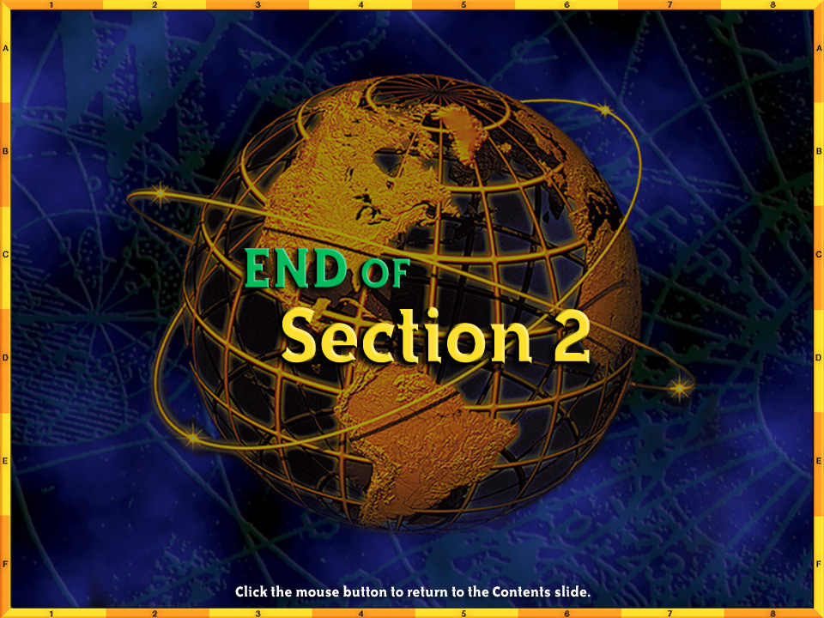
End of Section 2

