Slide 1
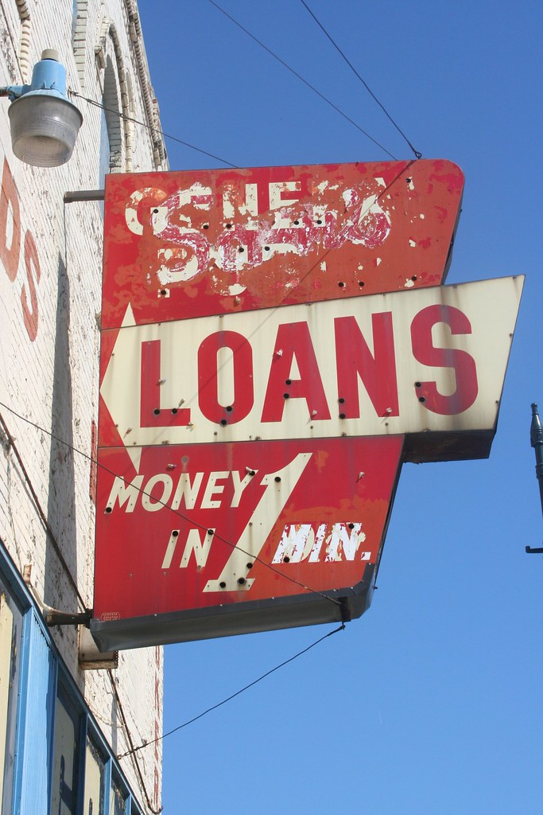
Loan Approval Screener
Jim Petoskey
Flatiron School
Phase 3 Project

Slide 2

Outline
Business Problem
Summary
Data
Methods
Results
Conclusions

Slide 3
Business Problem
Banks want an easy way to screen loan applications.
Make strong inferences with data from prior applications about likelihood of approval.

Slide 4

Business Opportunity
Reduce human-hours for banks
Use model to select applications that are highly likely to be approved.
Improve pipeline for customer experience by automating questions and providing likelihood of approval for customer.

Slide 5

Data Loan Application Data
307,511 Applications
122 Features
Type of Loan:
90% Cash Loans
10% Revolving Loans
Application Results:
8% Approved
92% Rejected

Slide 6
Data Manipulation
Replaced missing numerical and categorical data with mean and mode, respectively.
100 % of data from 39 features and 1 target feature used for model.

Slide 7
Class Imbalance Issue
Initial data set had an 8% prevalence of Loan Approval.
Ideally, a classification model will have a 50% prevalence of each class.
Solutions for class imbalance:
Under-sample Majority Class (Loan Rejection)
Randomly selected 40,000 applications that were rejected.
Over-sample Minority Class (Loan Approval)
Used Synthetic Minority Oversampling (SMOTE) to increase loan approvals from 24,825 values to 40,000 values.

Slide 8
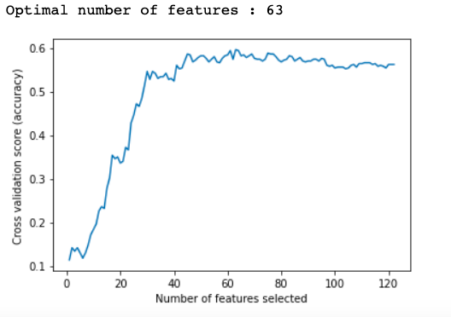
Feature Selection
Optimal number of features to include was 63.
I chose 39 features, and after encoding the categorical features, the final models included 61 columns.
I would have added more features, but I was limited in computational power on my machine.

Slide 9
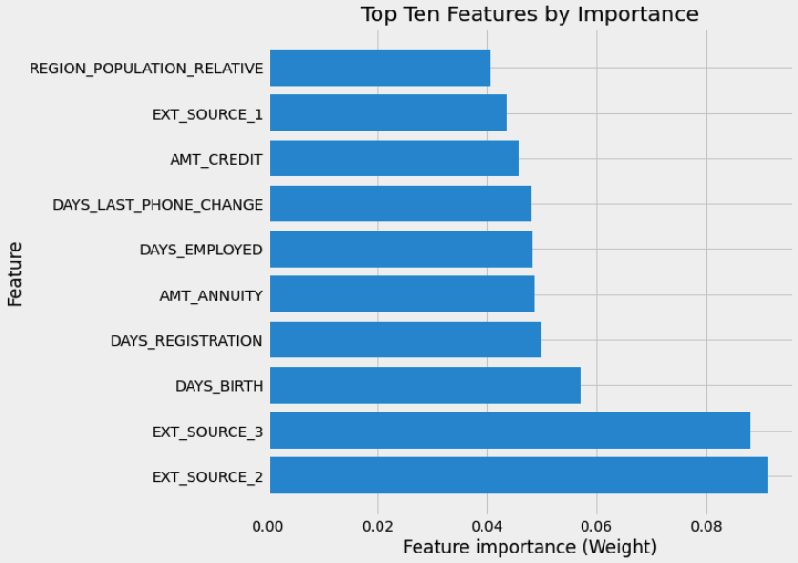
Feature Importance
Top Ten Features by importance in the 6th Random Forest Model.
Top singular model produced
EXT_SOURCE not defined, but could be a form of credit score.
Important to note these features so they are included on future loan applications:
Birth Date
Employment start date
Amount of Credit Available
Common Annuities

Slide 10
Methods
Classification Modeling
Main Models:
Random Forest
Gradient Boost
Voting Classifier
Alternative Models:
Linear Regression
K-Nearest Neighbors
Decision Trees
Bagged Trees
Boosted Trees
XG Boost
Optimize for Loan Approval, or True Positive Rate
Value high True Negative Rate, as well.
Identify features with most influence on Loan Approval

Slide 11
Final Model Methods
Voting Classifier
Used 3 models:
Top Random Forest optimized for True Positive Rate
Top Random Forest optimized for True Negative Rate
Top Gradient Boost Model optimized for True Positive Rate
Combination of these models yielded better results than any one of the models alone.
This is called an ensemble model.

Slide 12
Results of Best Model
84% True Positive Rate
84/100 applications that the model flagged for approval, were approved.
Maintained a 40% True Negative Rate, which means many applications can be successfully filtered out.
Model as a Screener:
If an application is recommended to be seen by a person, there is an 84% chance it will be approved.
31% of applications can be filtered out, with an 84% chance that they would have been rejected.

Slide 13
Conclusions
This model could save banks time and money by accurately filtering loan applications.
Could reduce applications read by people by over 30%
84% likely that loan application a person reads will be approved
Makes loan officer’s job simpler.
Top features for banks to follow in this model:
Birth Date
Employment start date
Amount of Credit Available
Common Annuities

Slide 14
Further Studies Recommended

