Slide 1

Loan Approval Screener
Jim Petoskey
Flatiron School
Phase 3 Project

Slide 2

Outline
Business Problem
Summary
Data -
Methods
Results
Conclusions
Overview, Manipulation, Feature Selection, Feature Importance

Slide 3
Business Problem
Banks want an easy way to screen loan applications.
Make strong inferences with data from prior applications about likelihood of approval.

Slide 4

Business Opportunity
Reduce human-hours for banks
Use model to select applications that are highly likely to be approved.
In future:
Improve pipeline for customer experience by automating questions and providing likelihood of approval for customer.
Increase likelihood of repayment.

Slide 5

Data - Overview Loan Application Data
307,511 Applications
122 Features
Type of Loan:
90% Cash Loans
10% Revolving Loans
Application Results:
8% Approved
92% Rejected

Slide 6
Data Manipulation
Class Imbalance Issues:
Improve balance of Approval/Refusal ratio
Used under-sampling and over-sampling techniques to improve balance
Replaced missing numerical and categorical data with mean and mode, respectively.
100 % of data from 39 features and 1 target feature used for model.

Slide 7
Data Manipulation, continued Improving Class Balance
Initial data set had an 8% prevalence of Loan Approval.
Ideally, a classification model will have a 50% prevalence of each class.
Solutions for class imbalance:
Under-sample Majority Class (Loan Rejection)
Randomly selected 40,000 applications that were rejected.
Over-sample Minority Class (Loan Approval)
Used Synthetic Minority Oversampling (SMOTE) to increase loan approvals from 24,825 values to 40,000 values.

Slide 8
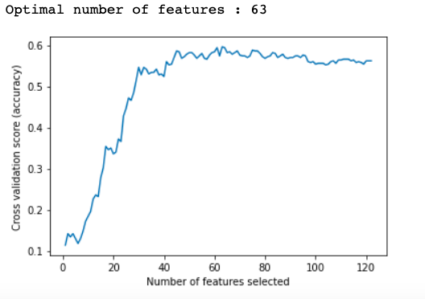
Feature Selection
Optimal number of features to include was 63.
I chose 39 features, and after encoding the categorical features, the final models included 61 columns.
I would have added more features, but I was limited in computational power on my machine.

Slide 9
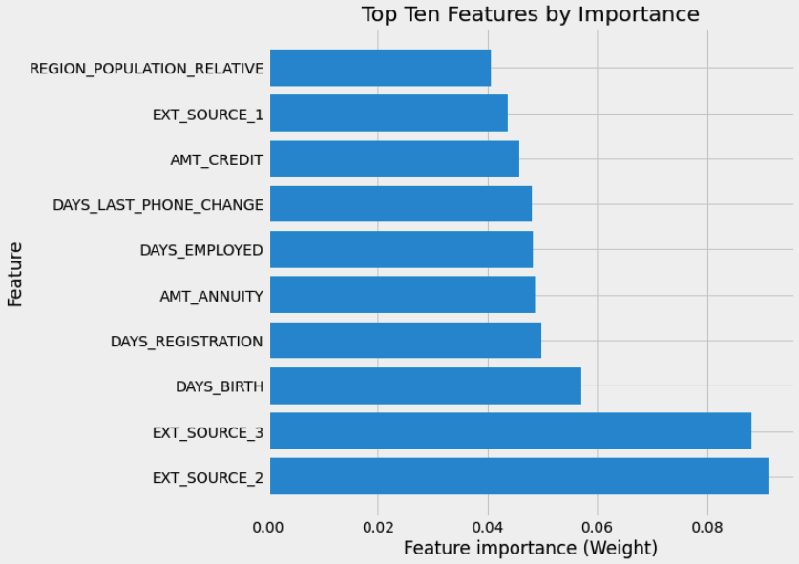
Feature Importance
Top Ten Features by importance in the 6th Random Forest Model.
Top singular model produced
EXT_SOURCE not defined, but could be a form of credit score.
Important to note these features so they are included on future loan applications:
Birth Date
Employment start date
Amount of Credit Available
Common Annuities

Slide 10
Indiv Features

Slide 11
Methods
Classification Modeling
Main Models:
Random Forest
Gradient Boost
Voting Classifier
Optimize for Loan Approval, or True Positive Rate
Value high True Negative Rate, as well.
Best scores for True Positive Rate valued because that means the model will have a high likelihood of flagging a
Identify features with most influence on Loan Approval

Slide 12
Final Model Methods
Voting Classifier
Used 3 models:
Top Random Forest optimized for True Positive Rate
Top Random Forest optimized for True Negative Rate
Top Gradient Boost Model optimized for True Positive Rate
Combination of these models yielded better results than any one of the models alone.
This is called an ensemble model and optimizes the best parts of each model.
2x heavier weight was applied to the top Random Forest model for True Positive Rate

Slide 13
Results – Ease of Approval Process
Model as a Screener:
84% of applications suitable for approval, will be recommended for viewing by a person.
31% of applications can be filtered out
Application Pool Improvements:
46% of applications in filtered pool were approved.
Unfiltered pool – only 8% of applications were approved

Slide 14
Conclusions
This model could save banks time and money by accurately filtering loan applications.
Could reduce applications read by people by over 30%
84% likely that approved loans will be recommended for review by a person
Makes loan officer’s job simpler and faster.
Top features for banks to follow in this model:
Birth Date
Employment start date
Amount of Credit Available
Common Annuities

Slide 15
Further Studies Recommended
Gather data on more relevant features
Credit Score
Cash and Invested Savings
Retirement Savings
Debt to Income Ratio
Test model on other samples of market data
Iterate and improve model for these samples or market segments
Improve pipeline for loans by developing digital questionnaire
Attain data inexpensively – directly from consumer
Tailor questions to garner data from most relevant features

