Slide 1
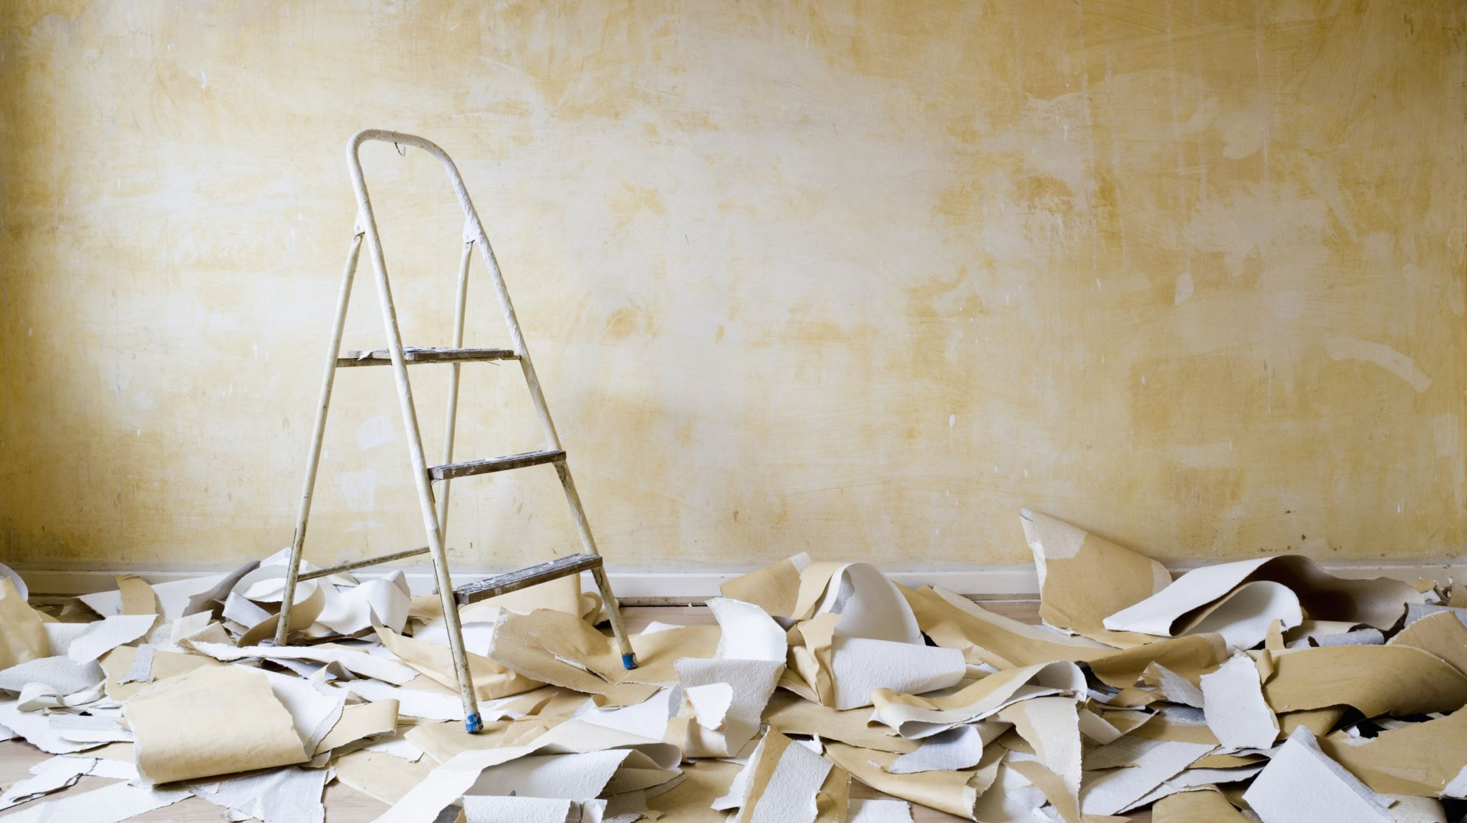
Return on Renovation
Jim Petoskey
Flatiron School
Phase 2 Project

Slide 2

Outline
Business Problem
Summary
Data
Methods
Results
Conclusions

Slide 3
Business Problem
Home-owners want to know: will renovations increase the price of their home, and by how much?
Make strong inferences with home sale data.

Slide 4

Business Opportunity
Build app within real-estate tech company
Zillow, Redfin, Opendoor, Flip, etc.
Users visit to learn how renovations will increase their home price
Increases revenue via product suite
Funnel more users to platform

Slide 5

Summary
Top 5 Recommendations:
Improve the Condition
Improve the Grade
Increase Square Footage
Improve the View
Add a Bathroom

Slide 6
Data Housing Data from King County, Washington
Meaning of Residential Terms:
Condition – Interior and Exterior
Fair – Badly worn, much repair needed.
Very Good – All items well maintained, many overhauled and repaired.
Grade – Architecture and Design Quality
Good(8): Just above average in construction and design, ex. older subdivisions
Better(9): Better architectural design, extra interior and ext. design quality.

Slide 7
Data Manipulation
6 iterations of modelling completed
Used model with lowest RMSE that met linearity assumptions
98.9 % of data set was used for model
Represents 21,366 house sales from the years 1900 – 2015
1.1% trimmed to reduce outliers, improve predictions for ~99% of houses
Missing values changed in the waterfront and view categories
Changed to median value
Waterfront(2376 changed to NO), view(63 changed to NONE)

Slide 8
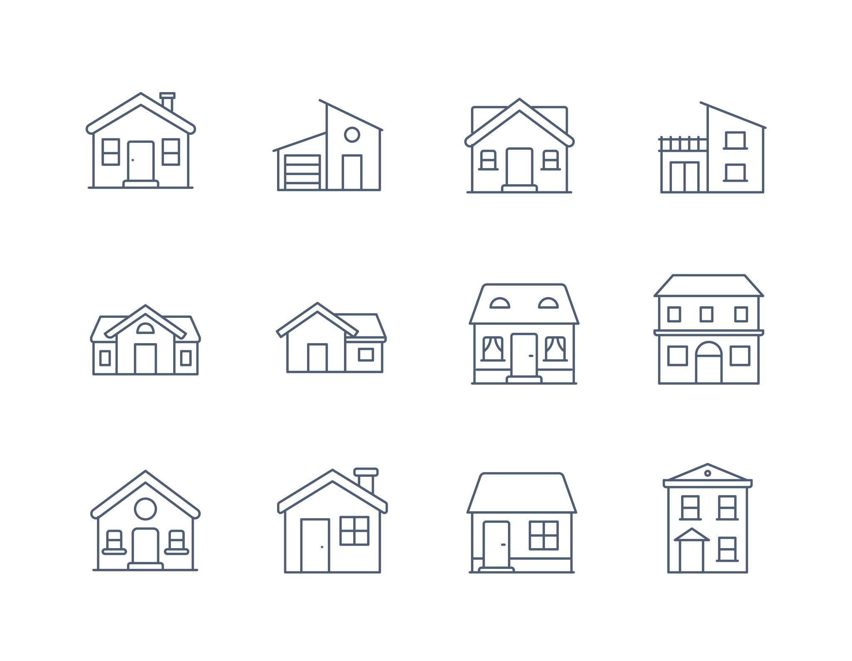
Methods
Linear Modeling
Multiple Features in the same mode
Features Included:
Square feet of living space
Number of Bathrooms, Bedrooms, and Floors
Year Built
Measures of Condition, Grade, and View
Waterfront (yes/no)
Identify features with most influence on Price
Calculate how much features influence Price

Slide 9
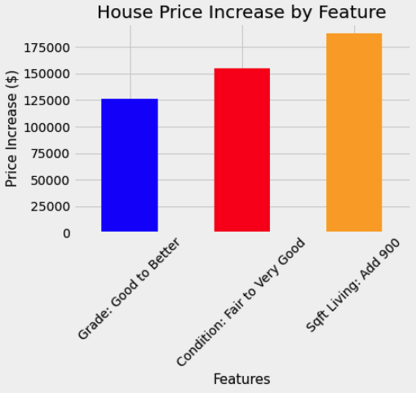
Results – Top Features
Condition: Improve from Fair to Very Good
Increased price by $155,000
Grade: Improve from Good(8) to Better(9)
Increased price by $125,000
Livable Square Footage: Increase of ~900 square feet
Increased price by $190,000

Slide 10
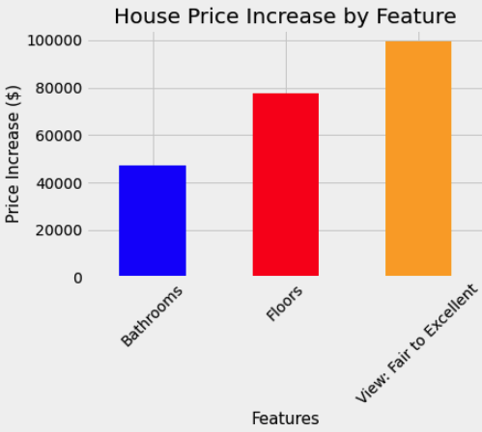
Results – Secondary Features
Add a Bathroom
Increased ~$45,000
Add a Floor
Increased ~$80,000
Improve View: Fair to Excellent
Increased $100,000

Slide 11
Conclusions
There are excellent opportunities to increase home price for home-owners planning to renovate their property.
Top priorities to increase price:
Improve condition of home – update to modern fixtures and appliances
Improve grade of home – structural renovation and improved craftsmanship
Add livable square footage – convert garage, build guest house, expand
Other options exist -
Improving or adding a view – rooftop deck, patio, bigger window, landscaping
Add a Floor or Bathroom – more livable space increases price

Slide 12
Further Studies Recommended
Examine other housing data sets to determine if they contain similar trends to predictors in the King County Data Set.
Find additional predictors to better estimate how much certain home changes alter sale price.
Type of remodel or home additions.
Ex. Kitchen, Garage, Patio, additional Bedrooms/Bathrooms.
Estimate return on investment for renovations.
How do certain projects increase sale price?
What amount of spending that reaps a higher gain for a given project?

