Slide 1
E-Commerce Business Performance & Customer Insights
End-to-End BI Project: From Relational Database to Executive Presentation
Data Scientist & BI Analyst
E-Commerce BI Project

Slide 2
Data Pipeline & Project Architecture
1. Data Source • Analysis of real Olist e-commerce orders. 2. SQL (PostgreSQL) • Relational schema (DDL) • CSV import • Creation of view_master_sales (delivered orders only) 3. Excel Analysis • Pivot Tables for quick business insights 4. Power BI Dashboard • Calendar Table • DAX Measures • Interactive Executive Dashboard
E-Commerce BI Project

Slide 3
Key Performance Indicators (KPIs)
Total Sales: $1,962.79 Total Orders: 10 Average Order Value (AOV): $196.28 Business Insight: Customers tend to place relatively high-value orders, indicating either premium products or multi-item baskets.
E-Commerce BI Project

Slide 4
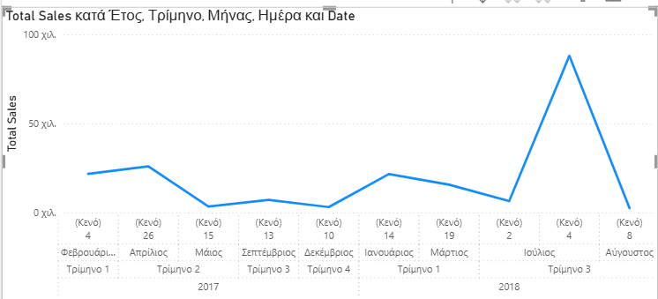
Sales Evolution & Seasonality Analysis
Monthly Sales: • Jul-2018: $946.14 (Peak Month) • Strong months: Feb-2017, Apr-2017, Jan-2018 • Low activity: May-2017, Aug-2018 Strategic Recommendation: Launch promotional campaigns during low-demand periods.
E-Commerce BI Project

Slide 5
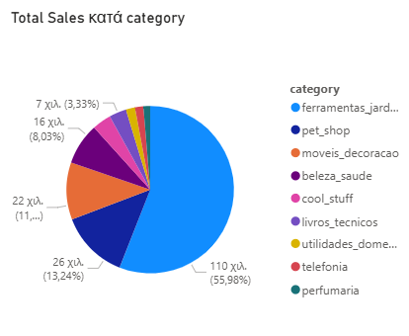
Product Performance & Payment Methods
Top Categories: • Ferramentas Jardim: $1,098.79 • Pet Shop: $259.83 • Moveis Decoracao: $216.87 Payment Distribution: • Credit Card: 98.2% • Boleto: 1.8% Recommendation: Develop loyalty campaigns around card payments.
E-Commerce BI Project

Slide 6
Strategic Takeaways & Next Steps
• Focus inventory investment on Garden Tools. • Negotiate lower transaction fees with card providers. • The PostgreSQL → Power BI pipeline is fully scalable. • New records can automatically refresh dashboard analytics.
E-Commerce BI Project

