Slide 1
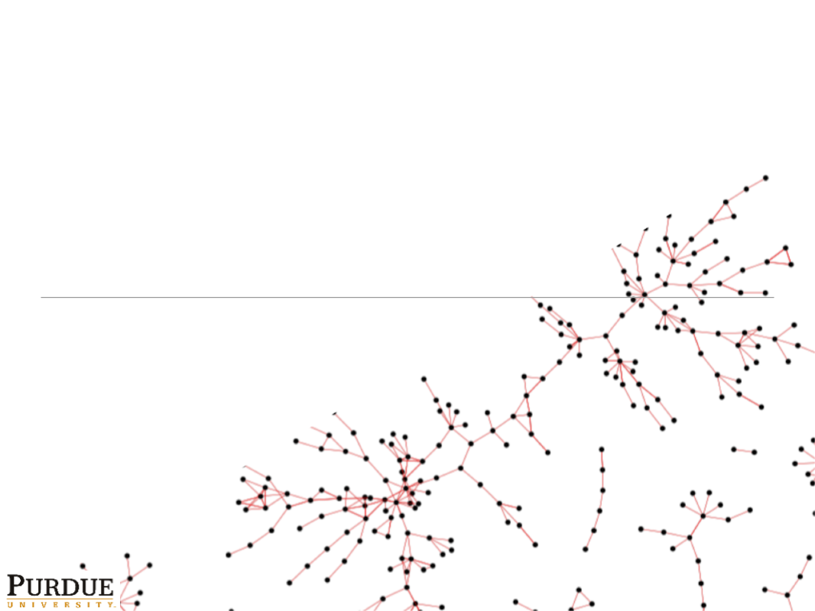
Active Sampling of Networks
Joseph J. Pfeiffer III¹
Jennifer Neville¹
Paul N. Bennett²
Purdue University¹
Microsoft Research²
July 1, 2012
MLG, Edinburgh

Slide 2
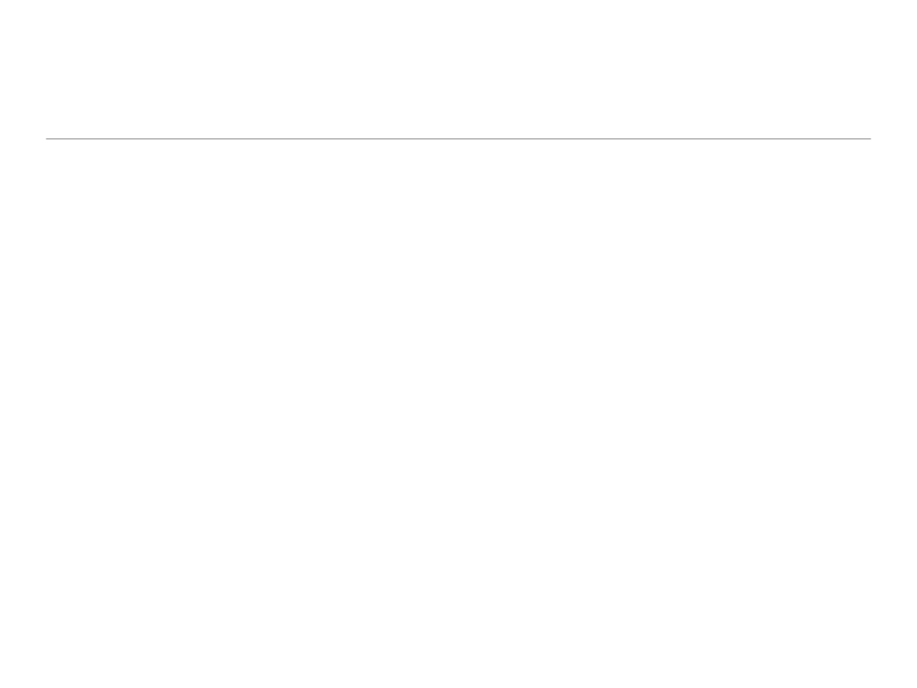
Population

Slide 3






Population - Labels

Slide 4
Underlying Social Network

Slide 5
Population – No Labels, No Edges

Slide 6


Active Sampling

Slide 7
Active Sampling

Slide 8

Active Sampling

Slide 9



Active Sampling
Node Subsets
  Labeled Nodes
  Border Nodes
  Separate Nodes
Acquire Positive instances into Labeled set
  Minimize acquisitions
Labeled set used to estimate Border set
  Network structure should improve estimates
Choose node(s) to investigate from Border and Separate sets

Slide 10
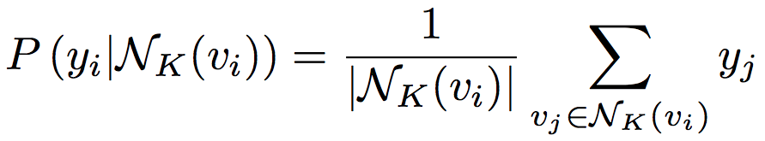




Estimating Border Likelihoods
weighted vote Relational Neighbor¹ (wvRN)
  Utilize only known edges
Utilize collective inference usefully?
¹Macskassy & Provost, 2007

Slide 11



Estimating Border Likelihoods – Collective Inference
Utilize the known 2-hop paths
Weight based on the number of 2-hop paths
Collective Inference becomes useful
  Gibbs Sampling

Slide 12
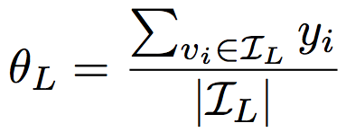
Handling Uncertainty
Border nodes with 1 or 2 observed edges
Early Separate draws may not represent overall population
Utilize the Labeled set to create priors for both Border and Separate

Slide 13
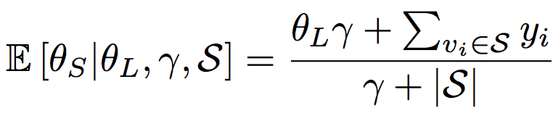
Handling Uncertainty - Separate
Define a Beta prior based on the Labeled set
  (Gamma) is used to weight the prior
Use the expected value of the posterior
Apply to each instance in Separate set

Slide 14
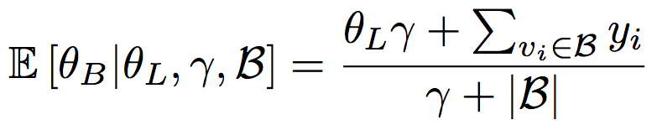
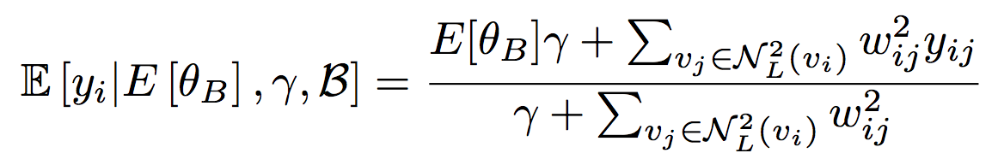
Handling Uncertainty - Border
Use Beta prior from Labeled
Create posterior using previous Border draws
Use posterior
as prior for
individual
Border instances

Slide 15
Evaluation
Datasets
Methods
AddHealth School 1:
635 Students, 24% Heavy Smokers
AddHealth School 2:
576 Students, 15% Heavy Smokers
Rovira Email Dataset:
1,133 Participants
Oracle – Always choose positive instance from Border nodes, if one is available
Random – Randomly choose from the unlabeled instances
Gibbs or NoGibbs – Proposed method using collective Inference or not
Prior or NoPrior – Proposed method using a prior from previously acquired nodes, or not

Slide 16
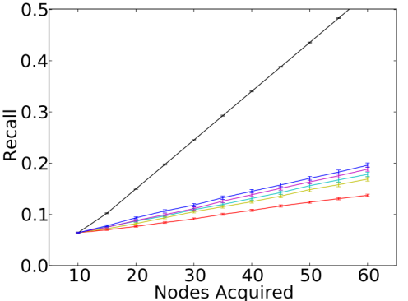
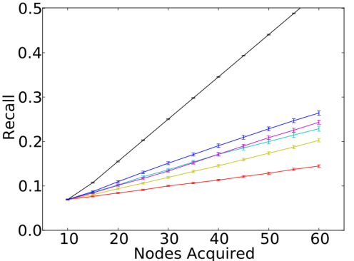
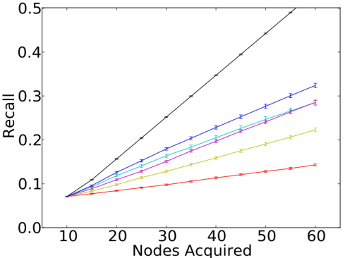
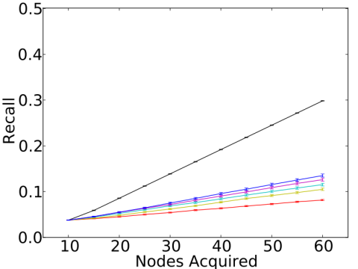
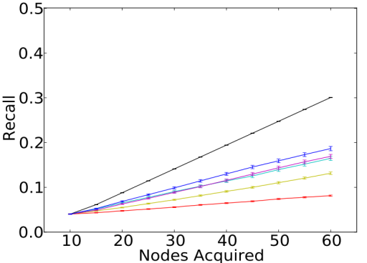
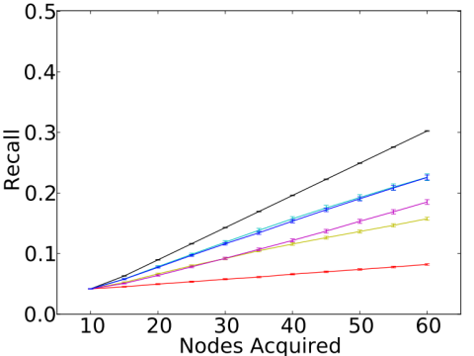
Evaluation - Synthetic
AddHealth School1
Rovira Email

Slide 17
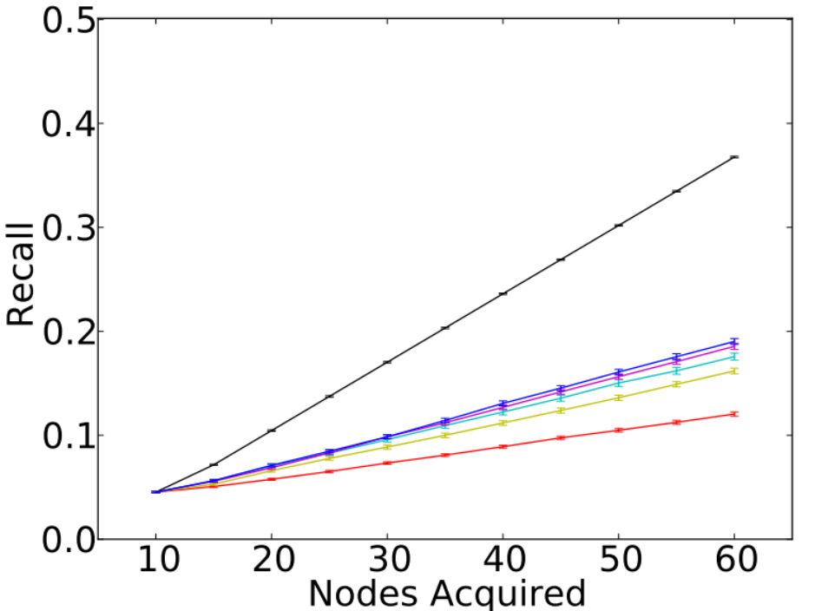
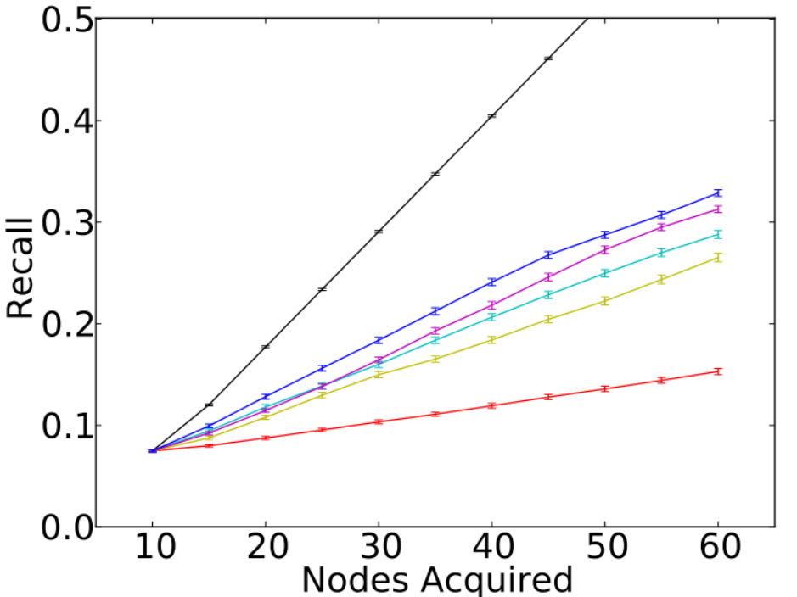
Evaluation – AddHealth Schools
School1
School2

Slide 18
Conclusion and discussion
Experimental results indicate that the network structure can be acquired actively, in order to improve identification of positive nodes and prediction of class labels collectively
  Using 2-hop network for Gibbs Sampling facilitates more accurate node predictions
  Priors, based on previously acquired instances, account for uncertainty associated with Border
Future work: balance short term gain and long term gain; incorporate attributes to predict node labels

Slide 19
Questions? jpfeiffer@purdue.edu neville@cs.purdue.edu paul.n.bennett@microsoft.com

