Slide 1
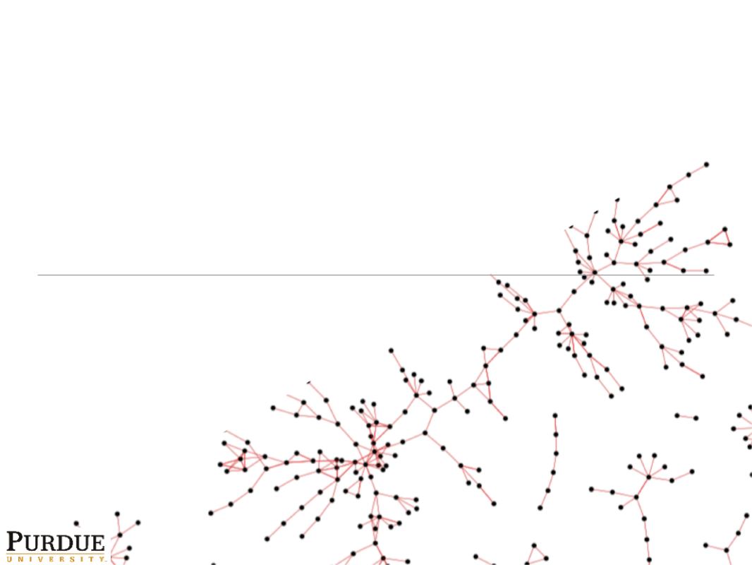
Probabilistic Paths and Centrality in Time
Joseph J. Pfeiffer, III
Jennifer Neville

Slide 2

a
b
c
d
e
f

Slide 3
Betweenness Centrality
a
b
c
d
e
f

Slide 4
Time Varying Graphs
Aggregate
Time 1
Time 2
Time 3
Time 4
Time 5
a
b
a
b
a
b
a
b
a
b
a
b
c
d
=
c
d
c
d
c
d
c
d
c
d
e
f
e
f
e
f
e
f
e
f
e
f

Slide 5
Time Varying Graphs
Aggregate
Time 1
Time 2
Time 3
Time 4
Time 5
a
b
a
b
a
b
a
b
a
b
a
b
c
d
=
c
d
c
d
c
d
c
d
c
d
e
f
e
f
e
f
e
f
e
f
e
f
Represent Current Graph

Slide 6
Time Varying Graphs
Aggregate
Time 1
Time 2
Time 3
Time 4
Time 5
a
b
a
b
a
b
a
b
a
b
a
b
c
d
=
c
d
c
d
c
d
c
d
c
d
e
f
e
f
e
f
e
f
e
f
e
f
Represent Current Graph
Betweenness Centrality

Slide 7
Time Varying Graphs
Aggregate
Time 1
Time 2
Time 3
Time 4
Time 5
a
b
a
b
a
b
a
b
a
b
a
b
c
d
=
c
d
c
d
c
d
c
d
c
d
e
f
e
f
e
f
e
f
e
f
e
f
Represent Current Graph
Betweenness Centrality

Slide 8
Time Varying Graphs
Aggregate
Time 1
Time 2
Time 3
Time 4
Time 5
a
b
a
b
a
b
a
b
a
b
a
b
c
d
=
c
d
c
d
c
d
c
d
c
d
e
f
e
f
e
f
e
f
e
f
e
f
Messages are irregular – large changes in metric values between slices

Slide 9
Related Work
Betweenness centrality through time (Tang et al. SNS ’10)
Vector clocks for determining edges with minimum time-delays (Kossinets et al. KDD ’08)
Finding patterns of communication that occur in time intervals (Lahiri & Berger-Wolf, ICDM ’08)

Slide 10
a
b
Time 1
Time 2
Time 3
Time 4
Time 5
a
b
a
b
a
b
a
b
a
b
c
d
c
d
c
d
c
d
c
d
c
d
e
f
e
f
e
f
e
f
e
f
e
f

Slide 11
Probabilistic Graphs
a
b
Time 1
Time 2
Time 3
Time 4
Time 5
.65
a
b
a
b
a
b
a
b
a
b
.95
.8
.8
c
d
c
d
c
d
c
d
c
d
c
d
.95
e
f
e
f
e
f
e
f
e
f
.65
.8
.8
.8
e
f

Slide 12
Probabilistic Shortest Paths
a
b
Time 1
Time 2
Time 3
Time 4
Time 5
.65
a
b
a
b
a
b
a
b
a
b
.95
.8
.8
c
d
c
d
c
d
c
d
c
d
c
d
.95
e
f
e
f
e
f
e
f
e
f
.65
.8
.8
.8
e
f

Slide 13
Probabilistic Shortest Paths
a
b
Time 1
Time 2
Time 3
Time 4
Time 5
.65
a
b
a
b
a
b
a
b
a
b
.95
.8
.8
c
d
c
d
c
d
c
d
c
d
c
d
.95
e
f
e
f
e
f
e
f
e
f
.65
.8
.8
.8
a-c-b: .95*.65 = 0.61
e
f

Slide 14
Probabilistic Shortest Paths
a
b
Time 1
Time 2
Time 3
Time 4
Time 5
.65
a
b
a
b
a
b
a
b
a
b
.95
.8
.8
c
d
c
d
c
d
c
d
c
d
c
d
.95
e
f
e
f
e
f
e
f
e
f
.65
.8
.8
.8
a-c-b: .95*.65 = 0.61
a-d-b: .80*.80 = 0.64
e
f

Slide 15
Probabilistic Shortest Paths
a
b
Time 1
Time 2
Time 3
Time 4
Time 5
.65
a
b
a
b
a
b
a
b
a
b
.95
.8
.8
c
d
c
d
c
d
c
d
c
d
c
d
.95
e
f
e
f
e
f
e
f
e
f
.65
.8
.8
.8
a-c-b: .95*.65 = 0.61
a-d-b: .80*.80 = 0.64
a-c-d-b: .95*.95*.80 = 0.72
e
f

Slide 16
Probabilistic Shortest Paths
a
b
Time 1
Time 2
Time 3
Time 4
Time 5
.65
a
b
a
b
a
b
a
b
a
b
.95
.8
.8
c
d
c
d
c
d
c
d
c
d
c
d
.95
e
f
e
f
e
f
e
f
e
f
.65
.8
.8
.8
a-c-b: .95*.65 = 0.61
a-d-b: .80*.80 = 0.64
a-c-d-b: .95*.95*.80 = 0.72
(1-0.61)*(1-.64)*0.722
e
f

Slide 17
Probabilistic Shortest Paths
a
b
Time 1
Time 2
Time 3
Time 4
Time 5
.65
a
b
a
b
a
b
a
b
a
b
.95
.8
.8
c
d
c
d
c
d
c
d
c
d
c
d
.95
e
f
e
f
e
f
e
f
e
f
.65
.8
.8
.8
a-c-b: .95*.65 = 0.61
a-d-b: .80*.80 = 0.64
a-c-d-b: .95*.95*.80 = 0.72
(1-0.61)*(1-.64)*0.722
e
f

Slide 18
Probabilistic Shortest Paths
a
b
Time 1
Time 2
Time 3
Time 4
Time 5
.65
a
b
a
b
a
b
a
b
a
b
.95
.8
.8
c
d
c
d
c
d
c
d
c
d
c
d
.95
e
f
e
f
e
f
e
f
e
f
.65
.8
.8
.8
a-c-b: .95*.65 = 0.61
a-d-b: .80*.80 = 0.64
a-c-d-b: .95*.95*.80 = 0.72
(1-0.61)*(1-.64)*0.722
Shared Edges
e
f

Slide 19
Probabilistic Shortest Paths
a
b
Time 1
Time 2
Time 3
Time 4
Time 5
.65
a
b
a
b
a
b
a
b
a
b
.95
.8
.8
c
d
c
d
c
d
c
d
c
d
c
d
.95
e
f
e
f
e
f
e
f
e
f
.65
.8
.8
.8
a-c-b: .95*.65 = 0.61
a-d-b: .80*.80 = 0.64
a-c-d-b: .95*.95*.80 = 0.72
(1-0.61)*(1-.64)*0.722
Shared Edges
e
f

Slide 20
Probabilistic Shortest Paths
a
b
Time 1
Time 2
Time 3
Time 4
Time 5
.65
a
b
a
b
a
b
a
b
a
b
.95
.8
.8
c
d
c
d
c
d
c
d
c
d
c
d
.95
e
f
e
f
e
f
e
f
e
f
.65
.8
.8
.8
Intractable to Compute Exactly
e
f

Slide 21
Probabilistic Shortest Paths
a
b
Time 1
Time 2
Time 3
Time 4
Time 5
.65
a
b
a
b
a
b
a
b
a
b
.95
.8
.8
c
d
c
d
c
d
c
d
c
d
c
d
Approximate with Sampling
.95
e
f
e
f
e
f
e
f
e
f
.65
.8
.8
.8
Intractable to Compute Exactly
e
f

Slide 22
Probabilistic Shortest Paths
a
b
Time 1
Time 2
Time 3
Time 4
Time 5
.65
a
b
a
b
a
b
a
b
a
b
.95
.8
.8
c
d
c
d
c
d
c
d
c
d
c
d
.95
e
f
e
f
e
f
e
f
e
f
.65
.8
.8
.8
Sample each edge independently
e
f

Slide 23
Probabilistic Shortest Paths
a
b
Time 1
Time 2
Time 3
Time 4
Time 5
.65
a
b
a
b
a
b
a
b
a
b
.95
.8
.8
c
d
c
d
c
d
c
d
c
d
c
d
.95
e
f
e
f
e
f
e
f
e
f
.65
.8
.8
.8
Sample each edge independently
Distribution of graphs
e
f

Slide 24
Probabilistic Shortest Paths
a
b
Time 1
Time 2
Time 3
Time 4
Time 5
.65
a
b
a
b
a
b
a
b
a
b
.95
.8
.8
c
d
c
d
c
d
c
d
c
d
c
d
.95
e
f
e
f
e
f
e
f
e
f
.65
.8
.8
.8
Sample each edge independently
Distribution of graphs
Expected Betweenness Centrality
e
f

Slide 25
Most Likely Paths
a
b
Time 1
Time 2
Time 3
Time 4
Time 5
.65
a
b
a
b
a
b
a
b
a
b
.95
.8
.8
c
d
c
d
c
d
c
d
c
d
c
d
.95
e
f
e
f
e
f
e
f
e
f
.65
.8
.8
.8
Most Likely Path
e
f

Slide 26
Most Likely Paths
a
b
Time 1
Time 2
Time 3
Time 4
Time 5
.65
a
b
a
b
a
b
a
b
a
b
.95
.8
.8
c
d
c
d
c
d
c
d
c
d
c
d
.95
e
f
e
f
e
f
e
f
e
f
.65
.8
.8
.8
a-c-b: .95*.65 = 0.61
a-d-b: .80*.80 = 0.64
a-c-d-b: .95*.95*.80 = 0.72
e
f

Slide 27
Most Likely Paths
a
b
Time 1
Time 2
Time 3
Time 4
Time 5
.65
a
b
a
b
a
b
a
b
a
b
.95
.8
People with strong relationships are still unlikely to pass on all information…
.8
c
d
c
d
c
d
c
d
c
d
c
d
.95
e
f
e
f
e
f
e
f
e
f
.65
.8
.8
.8
a-c-b: .95*.65 = 0.61
a-d-b: .80*.80 = 0.64
a-c-d-b: .95*.95*.80 = 0.72
e
f

Slide 28
Most Likely Handicapped (MLH) Paths
a
b
Time 1
Time 2
Time 3
Time 4
Time 5
.65
a
b
a
b
a
b
a
b
a
b
.95
.8
.8
c
d
c
d
c
d
c
d
c
d
c
d
.95
e
f
e
f
e
f
e
f
e
f
.65
.8
.8
.8
a-c-b: 0.61*β²
a-d-b: 0.64*β²
a-c-d-b: 0.72*β³
e
f
Transmission Probability

Slide 29
MLH Paths
a
b
Time 1
Time 2
Time 3
Time 4
Time 5
.65
a
b
a
b
a
b
a
b
a
b
.95
.8
.8
c
d
c
d
c
d
c
d
c
d
c
d
.95
e
f
e
f
e
f
e
f
e
f
.65
.8
.8
.8
a-c-b: 0.61*.5² = 0.15
a-d-b: 0.64*.5² = 0.16
a-c-d-b: 0.72*.5³ = 0.09
e
f
Transmission Probability

Slide 30
MLH Paths
a
b
Time 1
Time 2
Time 3
Time 4
Time 5
.65
a
b
a
b
a
b
a
b
a
b
.95
.8
.8
c
d
c
d
c
d
c
d
c
d
c
d
.95
e
f
e
f
e
f
e
f
e
f
.65
.8
.8
.8
a-c-b: 0.61*.5² = 0.15
a-d-b: 0.64*.5² = 0.16
a-c-d-b: 0.72*.5³ = 0.09
e
f
Transmission Probability

Slide 31
MLH Paths
a
b
Time 1
Time 2
Time 3
Time 4
Time 5
.65
a
b
a
b
a
b
a
b
a
b
.95
.8
.8
c
d
c
d
c
d
c
d
c
d
c
d
.95
e
f
e
f
e
f
e
f
e
f
.65
.8
.8
.8
a-c-b: 0.61*.5² = 0.15
a-d-b: 0.64*.5² = 0.16
a-c-d-b: 0.72*.5³ = 0.09
e
f
Transmission Probability
Easy to Compute

Slide 32
MLH Paths
a
b
Time 1
Time 2
Time 3
Time 4
Time 5
.65
a
b
a
b
a
b
a
b
a
b
.95
.8
Use MLH Paths for Betweenness Centrality
.8
c
d
c
d
c
d
c
d
c
d
c
d
.95
e
f
e
f
e
f
e
f
e
f
.65
.8
.8
.8
a-c-b: 0.61*.5² = 0.15
a-d-b: 0.64*.5² = 0.16
a-c-d-b: 0.72*.5³ = 0.09
e
f
Transmission Probability
Easy to Compute

Slide 33


Link Probabilities: Relationship Strength
1
P(e)
0
Time

Slide 34
Link Probabilities: Relationship Strength
1
P(e)
0
Time
Probability of no message contributing to relationship

Slide 35
Link Probabilities: Relationship Strength
1
*
=
P(e)
0
Time
Probability of no message contributing to relationship

Slide 36
Link Probabilities: Relationship Strength
1
*
=
-
=
P(e)
0
Time
Probability of no message contributing to relationship

Slide 37
Link Probabilities: Relationship Strength
1
*
=
-
=
P(e)
Any Relationship Strength
0
Time
Probability of no message contributing to relationship

Slide 38
Evaluation
Enron Emails
151 Employees – 50,572 messages over 3 years
Known dates in time
10,000x for Sampling Method
Time slice length was 2 weeks
Evaluated all metrics at end of every two weeks
Aggregate, Slice, Sampling, MLH

Slide 39
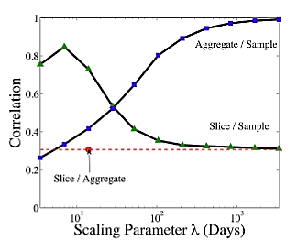
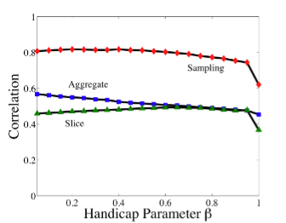
Method Correlations and Sample Size
Aggregate/Sampling
Sampling
Aggregate
Slice/Sampling
Slice
Aggregate/Slice

Slide 40
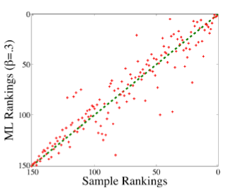
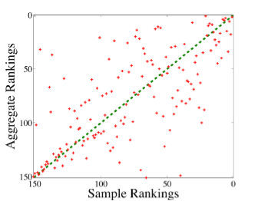
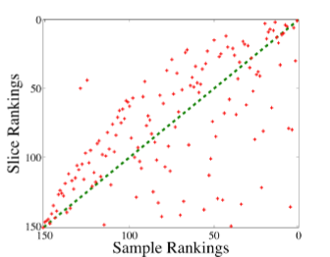
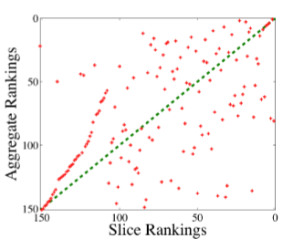
Correlations – August 24th, 2001

Slide 41
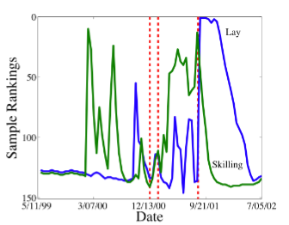
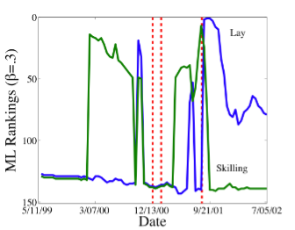
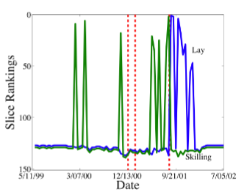
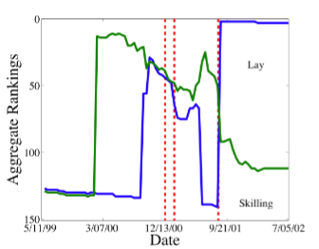
Lay and Skilling
Lay
Lay
Skilling
Skilling
Sampling
MLH
Lay
Lay
Skilling
Skilling
Slice
Aggregate

Slide 42
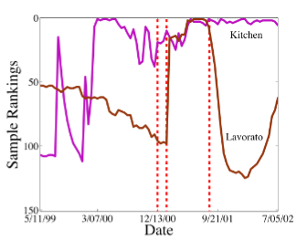
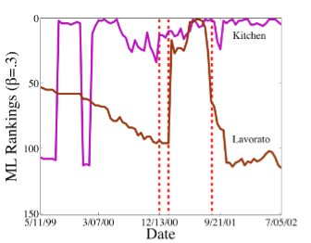
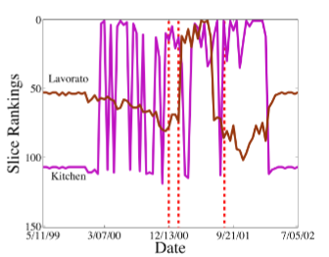
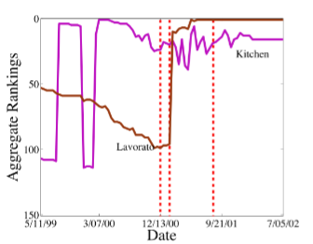
Lavorato and Kitchen
Kitchen
Kitchen
Lavorato
Lavorato
Sampling
MLH
Lavorato
Kitchen
Lavorato
Kitchen
Slice
Aggregate

Slide 43
Shortest Paths on Unweighted Discrete Graphs are a special case of Most Likely Handicapped Paths

Slide 44
Shortest Paths and Most Probable Handicapped Paths
Discrete
Probabilistic
1

Slide 45
Shortest Paths and Most Probable Handicapped Paths
Discrete
Probabilistic
1
Length: 1
Probability: β

Slide 46
Shortest Paths and Most Probable Handicapped Paths
Discrete
Probabilistic
…
…
1
Length: n
Probability: β^{n}

Slide 47
Shortest Paths and Most Probable Handicapped Paths
Discrete
Probabilistic
…
…
1
Length: n
n < n+1
Probability: β^{n}
β^{n} > β^{n+1}

Slide 48
Shortest Paths and Most Probable Handicapped Paths
Discrete
Probabilistic
…
…
1
Shortest Paths can be formulated as Most Probable Handicapped Paths
Length: n
n < n+1
Probability: β^{n}
β^{n} > β^{n+1}

Slide 49
Computation
MLH Paths: Modify Dijkstra’s. Rather than shortest path for expansion, choose
most probable path.
MLH Betweenness Centrality: Modify Brandes’. Rather than longest path for backtracking, choose
least probable path.

Slide 50
Conclusions
Developed sampling approach
Developed most probable paths formulation
Incorporated inherent transmission uncertainty
Evaluated on Enron email dataset
Aggregate representations of time evolving graphs are unable to detect changes with the graph
Slice samples of the graph have large variation from one slice to the next
Future Work: Additional metrics, such as probabilistic clustering coefficient
Notes:
In future work, we will explore this effect using bias/variance analysis

Slide 51
Questions? jpfeiffer@purdue.edu neville@cs.purdue.edu

