Slide 2
Hypothesis Testing: Classical Null and Alternative Hypotheses
First states the hypotheses to be tested
Distinguish between the null and the alternative hypothesis:
  Null hypothesis (H₀): the outcome that the researcher does not expect (almost always includes an equality sign)
  Alternative hypothesis (H_{A}): the outcome the researcher does expect
Example:
H₀: β ≤ 0 (the values you do not expect)
H_{A}: β > 0 (the values you do expect)
H₀: β = 0; H_{A}: β ≠ 0
© 2011 Pearson Addison-Wesley. All rights reserved.
5-<number>

Slide 3
Type I and Type II Errors
Two types of errors possible in hypothesis testing:
  Type I: Rejecting a true null hypothesis
  Type II: Not rejecting a false null hypothesis
© 2011 Pearson Addison-Wesley. All rights reserved.
5-<number>

Slide 4
Decision Rules of Hypothesis Testing
Decision rule is a procedure:
1) choose a critical value before regression estimates are
obtained (which is found in a statistical table)
2) calculate the sample statistic
3) compare this sample statistic to the critical value
The range of possible values of the estimates is divided into two regions, a rejection region and a non-rejection region, separated by the critical value.
© 2011 Pearson Addison-Wesley. All rights reserved.
5-<number>

Slide 5
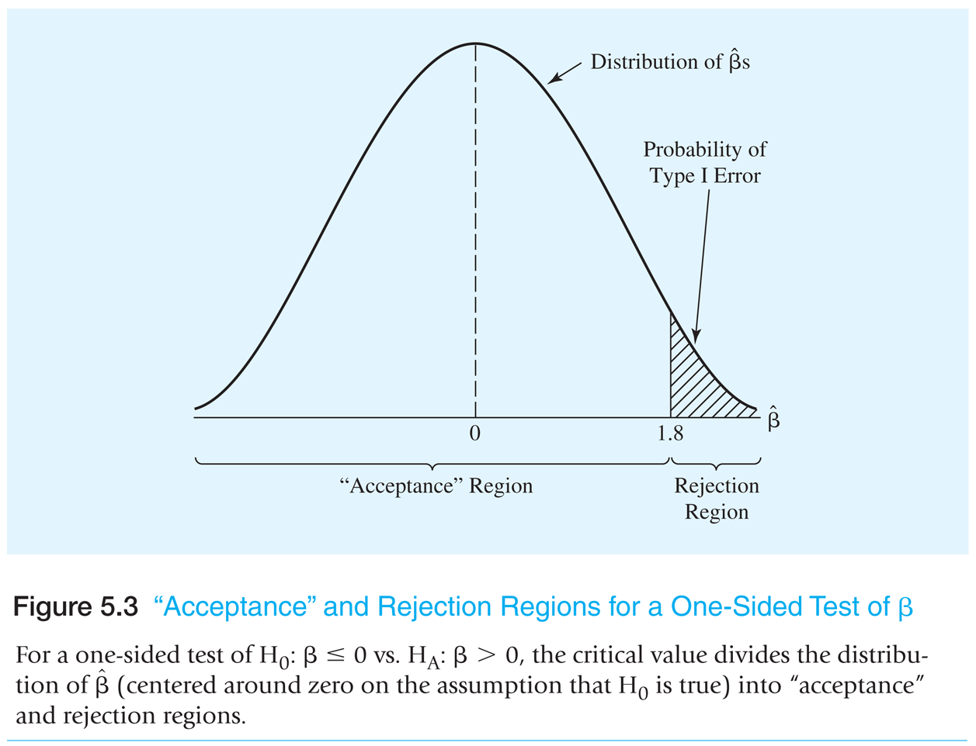
Figure 5.3 Non-Rejection and Rejection Regions for a One-Sided Test of β
© 2011 Pearson Addison-Wesley. All rights reserved.
5-<number>

Slide 6
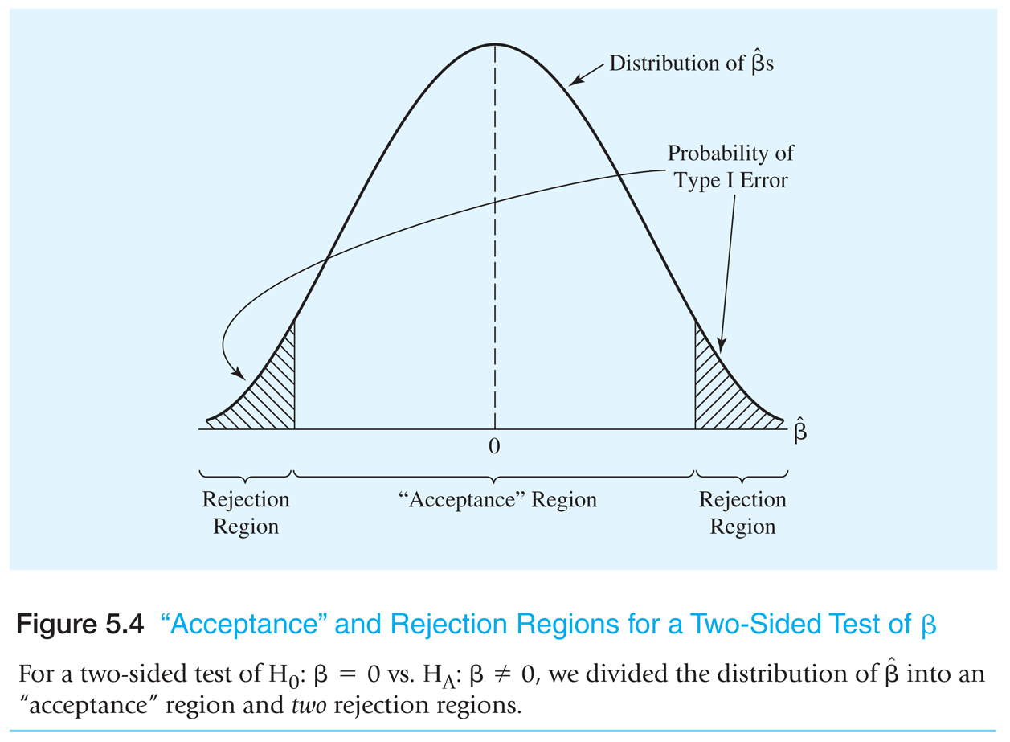
Figure 5.4 Non-Rejection and Rejection Regions for a Two-Sided Test of β
© 2011 Pearson Addison-Wesley. All rights reserved.
5-<number>

Slide 7
The t-Test
The t-test is the test used to test hypotheses about individual (i.e., one) regression slope coefficients
  Tests of more than one coefficient at a time (joint hypotheses) are typically done with the F-test, to be discussed later.
The appropriate test to use when the stochastic error term is normally distributed and when the variance of that distribution must be estimated
  Since these usually are the case, the use of the t-test for hypothesis testing has become standard practice in econometrics
© 2011 Pearson Addison-Wesley. All rights reserved.
5-<number>

Slide 8


The t-Statistic (sample statistic for t-test)
For a typical multiple regression equation:
we can calculate t-statistics for each of the estimated coefficients
  Usually these are only calculated for the slope coefficients
Specifically, the t-statistic for the kth coefficient is:
© 2011 Pearson Addison-Wesley. All rights reserved.
5-<number>

Slide 9
The Critical t-Value (critical value for t-test)
The critical t-value, t_{c}, is selected from a t-table (see Statistical Table B-1 (p. 585) in the back of the book) depending on:
  whether the test is one-sided or two-sided (from the null and alternative hypotheses)
  the level of significance (pre-selected) and
  the degrees of freedom (N – K – 1) (from the data)
© 2011 Pearson Addison-Wesley. All rights reserved.
5-<number>

Slide 10
The t-Test Decision Rule
Decision rule: for one-sided tests/hypotheses and for two-sided tests/hypotheses
Reject H₀ if |t_{k}| > t_{c} and if t_{k} also has the sign implied by H_{A}
Do not reject H₀ otherwise
© 2011 Pearson Addison-Wesley. All rights reserved.
5-<number>

Slide 11
Steps of t-Tests
This involves four steps:
1. Set up the null and alternative hypothesis
2. Choose a level of significance and therefore a critical t-value
3. Run the regression and obtain t-statistics
4. Apply the decision rule by comparing calculated t-statistic with the
critical t-value in order to reject or not reject the null hypothesis
© 2011 Pearson Addison-Wesley. All rights reserved.
5-<number>

Slide 12
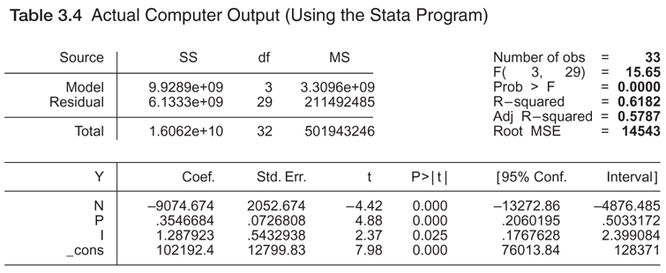
Table 3.4a
Actual Computer Output
(Using the Stata Program)
© 2011 Pearson Addison-Wesley. All rights reserved.
5-<number>

Slide 13
Limitations of the t-Test
        1. The t-Test Does Not Test Theoretical Validity
        2. The t-Test Does Not Test Economic “Importance”
        3. The t-Test Is Not Intended for Tests of the Entire
        Population
© 2011 Pearson Addison-Wesley. All rights reserved.
5-<number>

Slide 14
Level of Significance
The level of significance must be chosen before a critical value can be found, using Statistical Table B
Which level of significance is chosen?
  – 5 percent is recommended, unless you know something unusual about the relative costs of making Type I and Type II Errors
Level of significance indicates the probability of observing an estimated t-statistic greater than the critical t-value if the null hypothesis were correct
  It also measures the amount of Type I Error implied by a particular critical t-value
  From Statistical Table B-1 the critical t-value for a one-tailed test at a given level of significance is exactly equal to the critical t-value for a two-tailed test at twice the level of significance of the one-tailed test
© 2011 Pearson Addison-Wesley. All rights reserved.
5-<number>

Slide 15
© 2011 Pearson Addison-Wesley. All rights reserved.
5-<number>

Slide 16
© 2011 Pearson Addison-Wesley. All rights reserved.
5-<number>

Slide 17
p-Values
        A p-value is the probability of observing a t-statistic that size or larger (in absolute value) if the null hypothesis were true
        Graphically, it’s (two times) the area under the curve between the absolute value of the actual t-statistic and infinity (if two-sided test).
        The p-value decision rule:
        Reject H₀ if p-value_{K} < the level of significance and if has the sign implied by H_{A}
        This is an alternative to the t-test
        Stata automatically gives the p-values (for the null hypothesis that is zero) as part of the standard output
© 2011 Pearson Addison-Wesley. All rights reserved.
5-<number>

Slide 18
Table 3.4a
Actual Computer Output
(Using the Stata Program)
© 2011 Pearson Addison-Wesley. All rights reserved.
3-<number>

Slide 19

Confidence Intervals
A confidence interval is a range that contains the true value of a coefficient a specified percentage of the time (100% – level of significance)
It is calculated using the estimated regression coefficient, the two-sided critical t-value and the standard error of the estimated coefficient as follows:
The relationship between confidence intervals and two-sided hypothesis testing:
  If a hypothesized value falls within the confidence interval, then we cannot reject the null hypothesis
© 2011 Pearson Addison-Wesley. All rights reserved.
5-<number>

Slide 20
Table 3.4a
Actual Computer Output
(Using the Stata Program)
© 2011 Pearson Addison-Wesley. All rights reserved.
3-<number>

