Slide 1
SOLVING KENKEN PUZZLES
THROUGH COMPUTER VISION
AND DEEP LEARNING

Slide 2
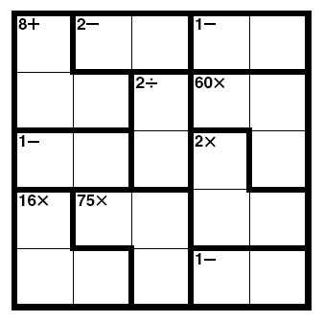
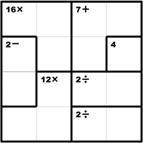
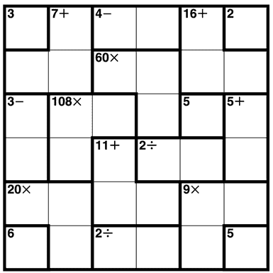
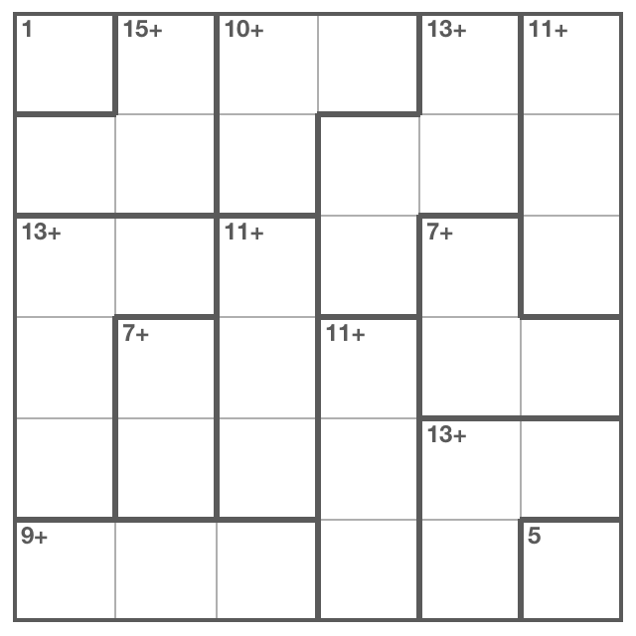
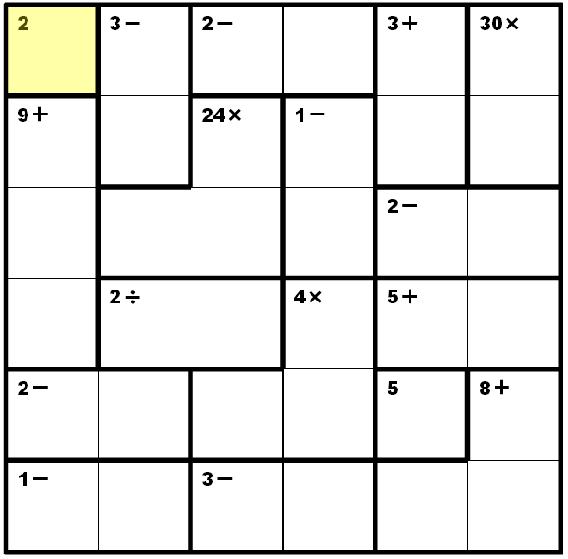
WHAT IS KENKEN?

Slide 3
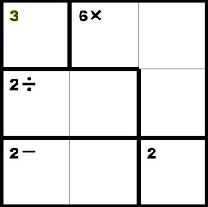
WHAT IS KENKEN?
3
2
1
2
1
3
1
3
2

Slide 4
WHY?
SEMI ORIGINAL
INTRO TO CV AND DEEP LEARNING TECHNIQUES

Slide 5
HOW?
START WITH AN IMAGE
JPG/PNG
CAGE IDENTIFICATION
SK-IMAGE
NUMBER/SYMBOL IDENTIFICATION
SK-IMAGE/TENSORFLOW
SOLVING ALGORITHM

Slide 6
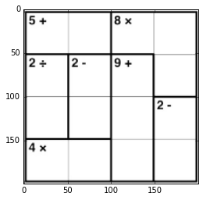
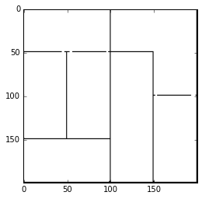
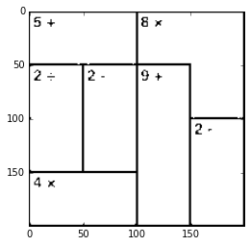
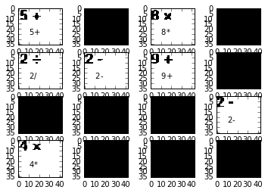
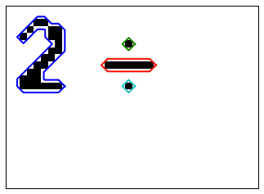
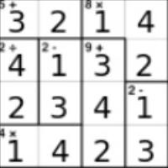
1
1
2
2
3
4
5
2
3
4
5
6
7
7
5
6
Cage Groupings
Operation Predictions

Slide 7
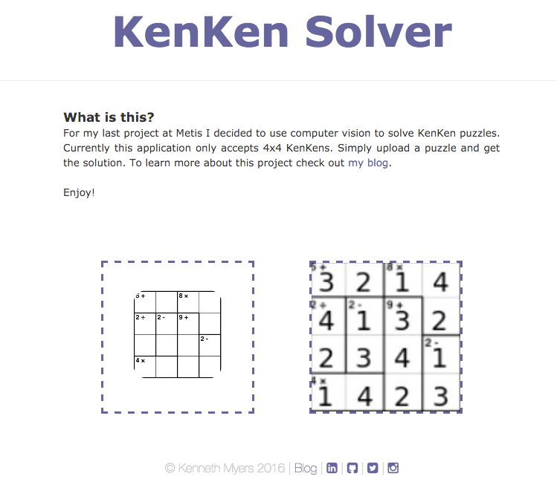

Flask
Application

Slide 8
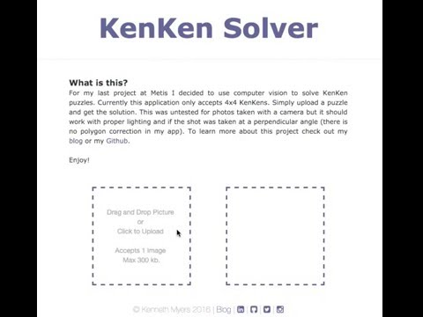

Slide 9




kennjamesmyers@gmail.com
github.com/kennmyers
kennmyers.github.io
linkedin.com/in/kennethjmyers
@kennethjmyers
kenkensolver.herokuapp.com

