Slide 1
Software and Energy-aware Computing Fundamentals of static analysis of software
John Gallagher
Roskilde University
ICT-Energy: Energy consumption in future ICT devices
Summer School, Aalborg, Denmark, August 13-16, 2016

Slide 2




Acknowledgements
The partners in the EU ENTRA project (2012-2015)
Kerstin Eder and team
Pedro López García and team
Henk Muller and team
Roskilde team
http://entraproject.eu

Slide 3
Whole-systems energy transparency
Energy is consumed by physical processes.
Yet, application programmers should be able to “see” through the layers and understand energy consumption at the level of code.
The same applies to designers at every level.
How is this possible?
Application Software
System Software
Architecture
Devices
Physics

Slide 4
Energy of software?
Energy is consumed by hardware
But in these lectures we attribute energy cost to software
Why?
(to summarise some of Kerstin’s points)

Slide 5
Reason 1
We take the application programmer’s viewpoint
programmers don’t know much about hardware
high-level languages hide the platform from the programmer
Which is usually a Good Thing, don’t you agree?

Slide 6
Reason 2
Energy efficiency as a design goal from the start
Get an energy profile for a program as early as possible
Analyse the code to find out how much energy a program will use
Deliver software with energy guarantees

Slide 7


Reason 2 - continued
Don’t wait to test energy efficiency on hardware, after the software is developed
It might be too late to fix “energy bugs”
Development
machine
Deployment
platform

Slide 8
Reason 3
You can save more energy at the software level than the hardware level
There are more energy optimisation opportunities higher up the system stack.
Much energy is wasted by application software

Slide 9
Energy transparency
Our aim is to let the programmer “see” the energy usage of the code
without executing it
so that the programmer can “see” where the program wastes energy
experiment with different designs

Slide 10
Software factors affecting energy
Important factors are
Computational efficiency
Quality of low-level machine code
Parallelism
Amount and rate of communication

Slide 11
Computational efficiency
There is a strong correlation between time and energy consumption (for a single thread)
Execute as few instructions as possible to achieve the given task, saving energy
Furthermore, the machine will return more quickly to an idle (low-energy) state

Slide 12
Computational efficiency (2)
Hence a large part of the energy-aware programmer’s job for sequential code is the same as for performance-awareness
Get the job done quickly, using efficient algorithms and data structures

Slide 13
Low-level code optimisation
Given the same high-level code (e.g. C++) there could be many different machine instruction programs.
Lower energy can be achieved e.g.
using VLIW (Very Long Instruction Word) instructions and vectorisation
exploitation of low-power processor states using frequency and voltage scaling (DVFS).
Energy-aware compiler’s responsibility

Slide 14
Parallelism
Is it more energy-efficient to parallelise a task?
The answer is not straightforward.
Execution time might be reduced but more energy might be consumed
e
SEQ
e₁
e > e₁ + e₂ + e₃ ???
e₂
PAR
e₃
If the processors for each process
are identical, then the parallel program
probably uses more energy.
There is some overhead for managing
threads and communication.

Slide 15
Parallelism and clock speed
Let f = processor clock frequency
Let P = power
Let V = voltage
P = cV²f (where c is a constant)
E = Pt (when we run the processor for t time units)
Hence e = e₁ + e₂ + ... + e_{n} for n processes, if the same total number of instructions is executed, at the same frequency f.
But if we reduce f, the total energy will reduce because V can also be reduced and P is proportional to V²!!!

Slide 16
Parallelism (cont’d)
Hence it is worth parallelising (to save energy) if
there is little or no idle time in each processor
a waiting processor is wasting energy
the clock speed can be reduced in some or all processors, compared to a single process execution

Slide 17
How can static analysis help?
Automatic complexity analysis
understand the best, worst and average cases
focus on optimising hot loops
Timing analysis in multi-threaded code
compare parallel algorithm performance, throughput, etc.
identify wait times, potential low-power states, etc.

Slide 18
How can static analysis help? (2)
Analysis of other energy-related resources
communication volume and frequency
analysis of cache behaviour
analysis of memory footprint

Slide 19
SW developer’s view
How do we visualise the results of analysis?
This is a difficult question in itself.
Here are some examples and thought experiments

Slide 20
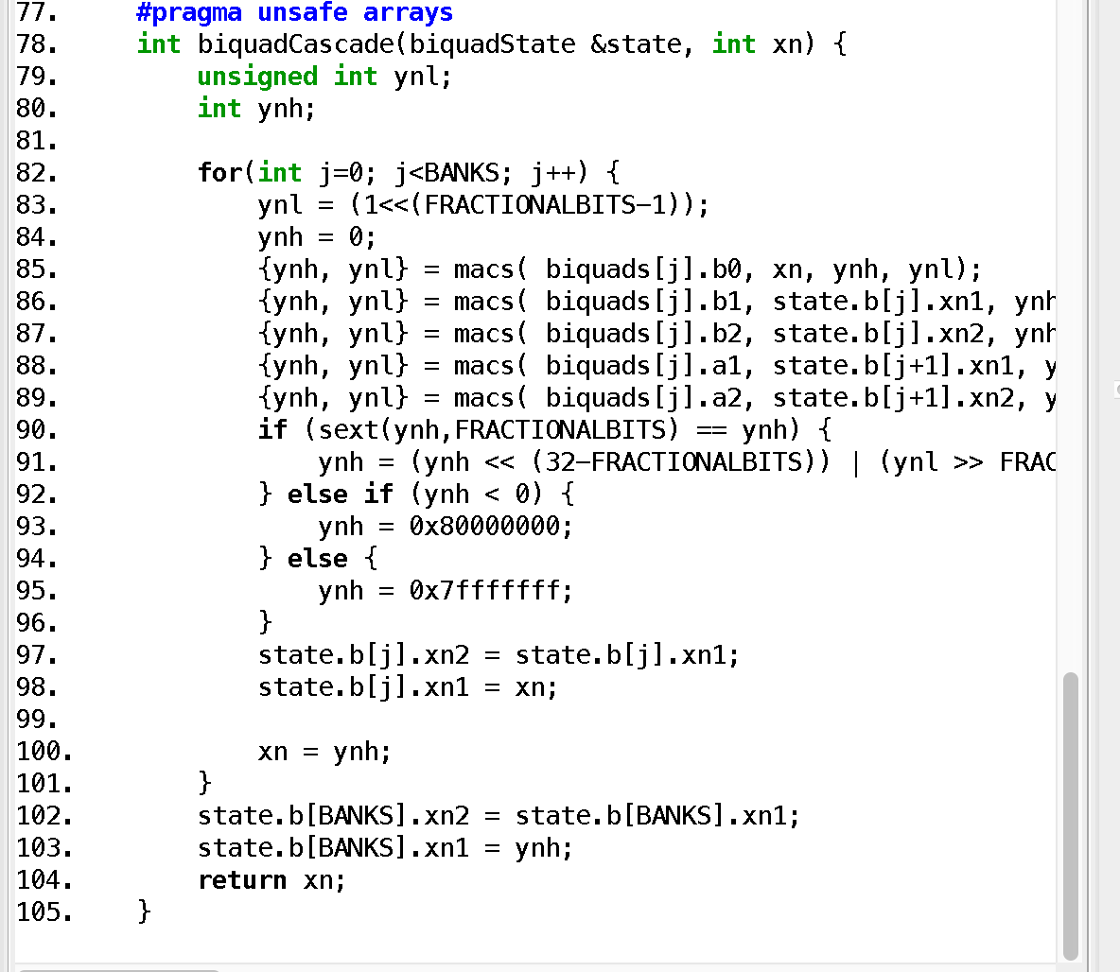
Example
biquadCascade(BANKS)
=
157 * BANKS + 51.7
nJoules
This is an estimate of
the energy used by the
function.
It is a linear function of
the value of BANKS

Slide 21
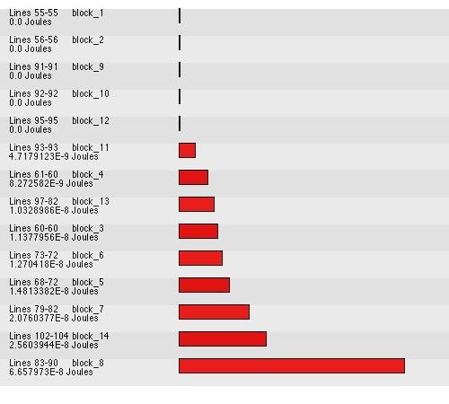
Visualise energy of program blocks

Slide 22
Which code blocks are hot?

Slide 23
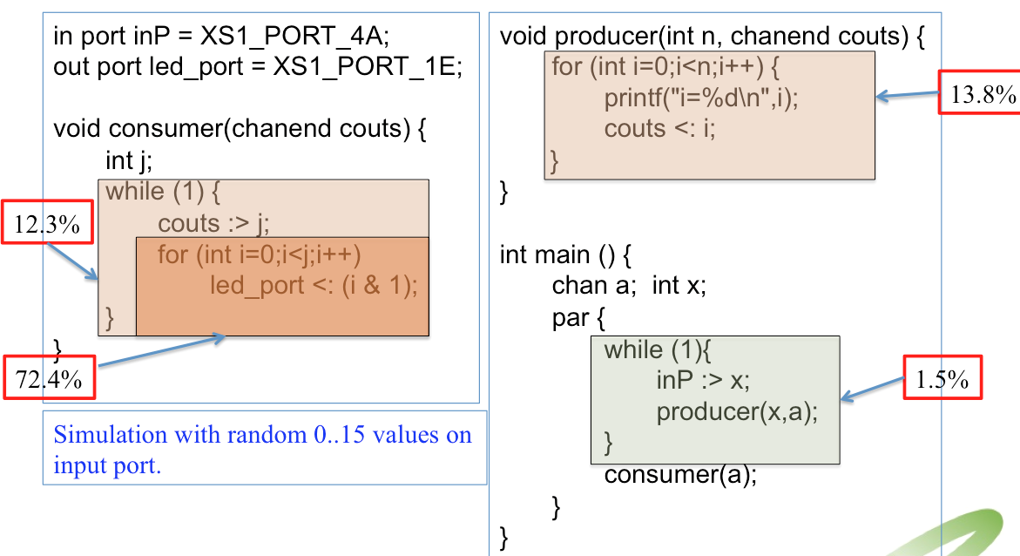
Example

Slide 24
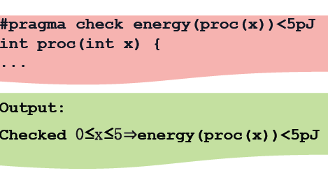
Energy a design goal for programmers

Slide 25
Summary of goals
Tools for the programmer
that give information about the energy usage of programs without running them (energy transparency)
that allow energy assertions to be checked (energy design goals)

Slide 26
Semantics and program analysis
To achieve the goals we need tools for program analysis
Program analysis is based on formal program semantics
the mathematical study of program meanings

Slide 27
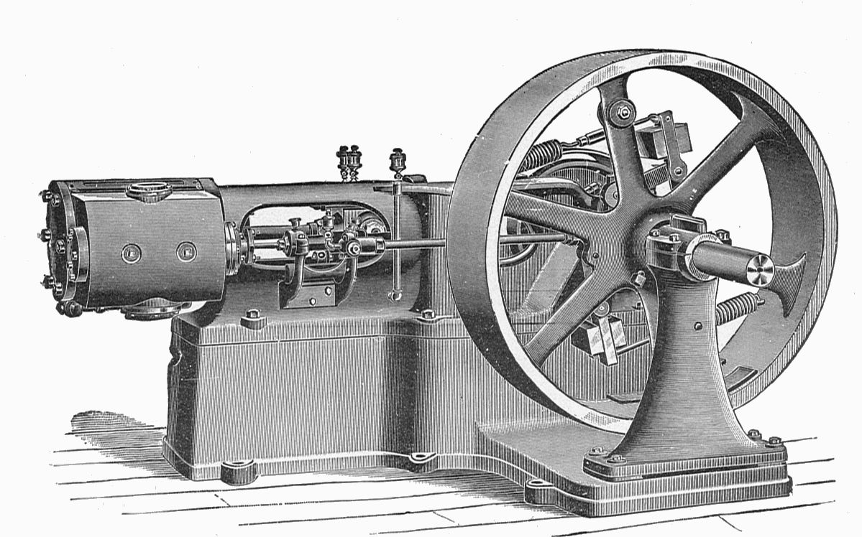
Programs are machines (that consume energy)
n = 4;
z = 1;
while (n > 0) {
z = z*n;
n = n-1;
}
print(z);
Semantics gives the “machine” defined
by a program.

Slide 28
Analysis of programs
A program is a physical object. e.g.
some symbols on paper
a pattern of bits in memory
But what is the meaning of a program?
This is program semantics.

Slide 29
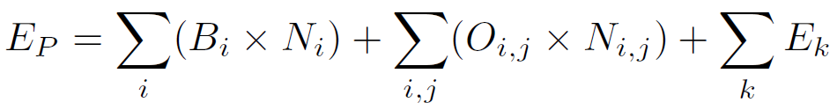
Tiwari’s Energy Equation (from Kerstin’s slides)
N_{i} is the number of times instruction i is executed.
N_{i,j} is the number of times instruction i is followed by instruction j in the program execution.
The aim of static analysis is to determine N_{i} and N_{i,j} for all possible program executions
29
Notes:
Short excurse into how this may be possible to do:
large loops of each instruction to determine the base costs
large loops of pairs of instructions to determine the switching costs
Which data should we use?

Slide 30
Program semantics
n = 4;
z = 1;
while (n > 0) {
z = z*n;
n = n-1;
}
print(z);
To execute or analyse
this program,
we need to understand
the meaning of teh symbols
such as “while”, “>”, “*”,
“;”, ”{”, “}”, etc.

Slide 31
Different styles of program semantics
Operational semantics
small steps (from one state to the next)
big steps (from the start to the end state)
Hoare-Floyd conditions
Denotational semantics
the mathematical function represented by a program
obtained by composing the functions representing its parts

Slide 32
Phases of semantic analysis
Syntax analysis (parsing)
breaking the program into is basic parts and determining its structure
Semantic translation
representation of the program in some suitable mathematical or logical form
Semantic interpretation
using the semantic representation to analyse the program execution

Slide 33
Program syntax tree (parsing)
Statement List
n = 4
z = 1
while
print(z)
n = 4;
z = 1;
while (n > 0) {
z = z*n;
n = n-1;
}
print(z);
n>0
Statement List
z = z*n
n = n-1

Slide 34
From syntax tree to flow graph
Grammar Rules Semantic Rules for flow of control
If → if E then S₁ else S₂ E.true := S_{l}
E.false := S₂
S₁.next := If.next
S₂.next := If.next
While → while E S₁ E.true := S₁
E.false := While.next
S₁.next := While
StatementList → S₁S₂ ..... S_{n} S_{j}.next = S_{j+1} (j = 1 to n-1) S_{n}.next := StatementList.next
S → StatementList | If | While | Print | Assign
StatementList.next := S.next
If.next := S.next
While.next := S.next
Print.next := S.next
Assign.next := S.next

Slide 35
From syntax tree to flow graph
Statement List
n = 4
z = 1
while
print(z)
false
n = 4;
z = 1;
while (n > 0) {
z = z*n;
n = n-1;
}
print(z);
n>0
Statement List
true
z = z*n
n = n-1

Slide 36
From flow graph to state automata
start
n = 4
z = 1
n z
n ≤ 0, print(z)
stop
n = n’
z = z’
n > 0
n’ = n-1
z’ = z * n
n’ z’

Slide 37
Exercise
Draw the syntax tree
Draw the control flow graph
Draw the state automaton
while (m != n) {
if (m > n) {
m = m-n;
}
else {
n = n-m;
}
}

Slide 38
Phases of semantic analysis
Syntax analysis (parsing)
breaking the program into is basic parts and determining its structure
Semantic translation
representation of the program in some suitable mathematical or logical form
Semantic interpretation
using the semantic representation to analyse the program execution

Slide 39
From automaton to predicate logic
Horn clauses
true → reachable₁
(reachable₁ ⋀ n=4 ⋀ z=1)
→ reachable₂(n,z)
(reachable₂(n,z) ⋀ n<0 ⋀ z’=z*n ⋀ n’=n-1)
→ reachable₃(n’,z’)
(reachable₃(n’,z’) ⋀ n=n’ ⋀ z=z’ )
→ reachable₂(n,z)
reachable₂(n,z) ⋀ n ≥ 0 ⋀ print(z) )
→ stop

Slide 40
Logical representation
program point j
transition constraint
program point k
x₁, x₂, ..., x_{n}
e(x₁, x₂, ..., x_{n}, x’₁, x’₂, ..., x’_{n})
x’₁, x’₂, ..., x’_{n}
(reachable_{j}(x₁, x₂, ..., x_{n}) ⋀ e(x₁, x₂, ..., x_{n}, x’₁, x’₂, ..., x’_{n}))
→ reachable_{k}(x’₁, x’₂, ..., x’_{n})

Slide 41
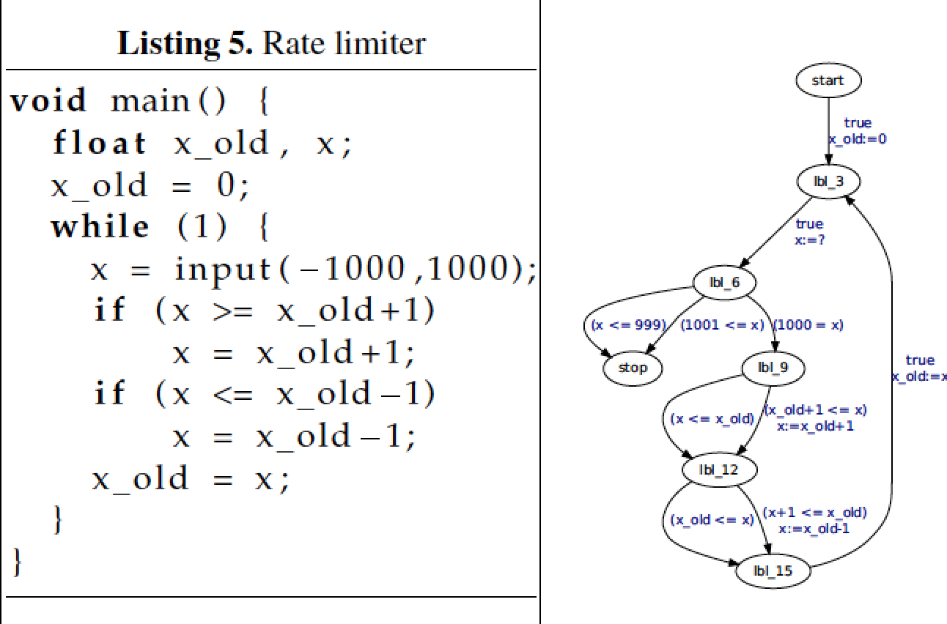
Example: A rate limiter*
*Example by Monniaux

Slide 42
Rate limiter – logic representation
r1(X,X_old) :-
X_old=0,
r0(_,_).
r1(X,X_old) :-
r5(X,X_old).
r2(X,X_old) :-
X >= -1000,
X =< 1000,
r1(_,X_old).
r3(X,X_old) :-
X1 >= X_old+1,
X = X_old+1,
r2(X1,X_old).
r3(X,X_old) :-
X < X_old+1,
r2(X,X_old).
r4(X,X_old) :-
X1 =< X_old-1,
X = X_old-1,
r3(X1,X_old).
r4(X,X_old) :-
X > X_old-1,
r3(X,X_old).
r5(X,X_old) :-
X_old=X,
r4(X,_).

Slide 43
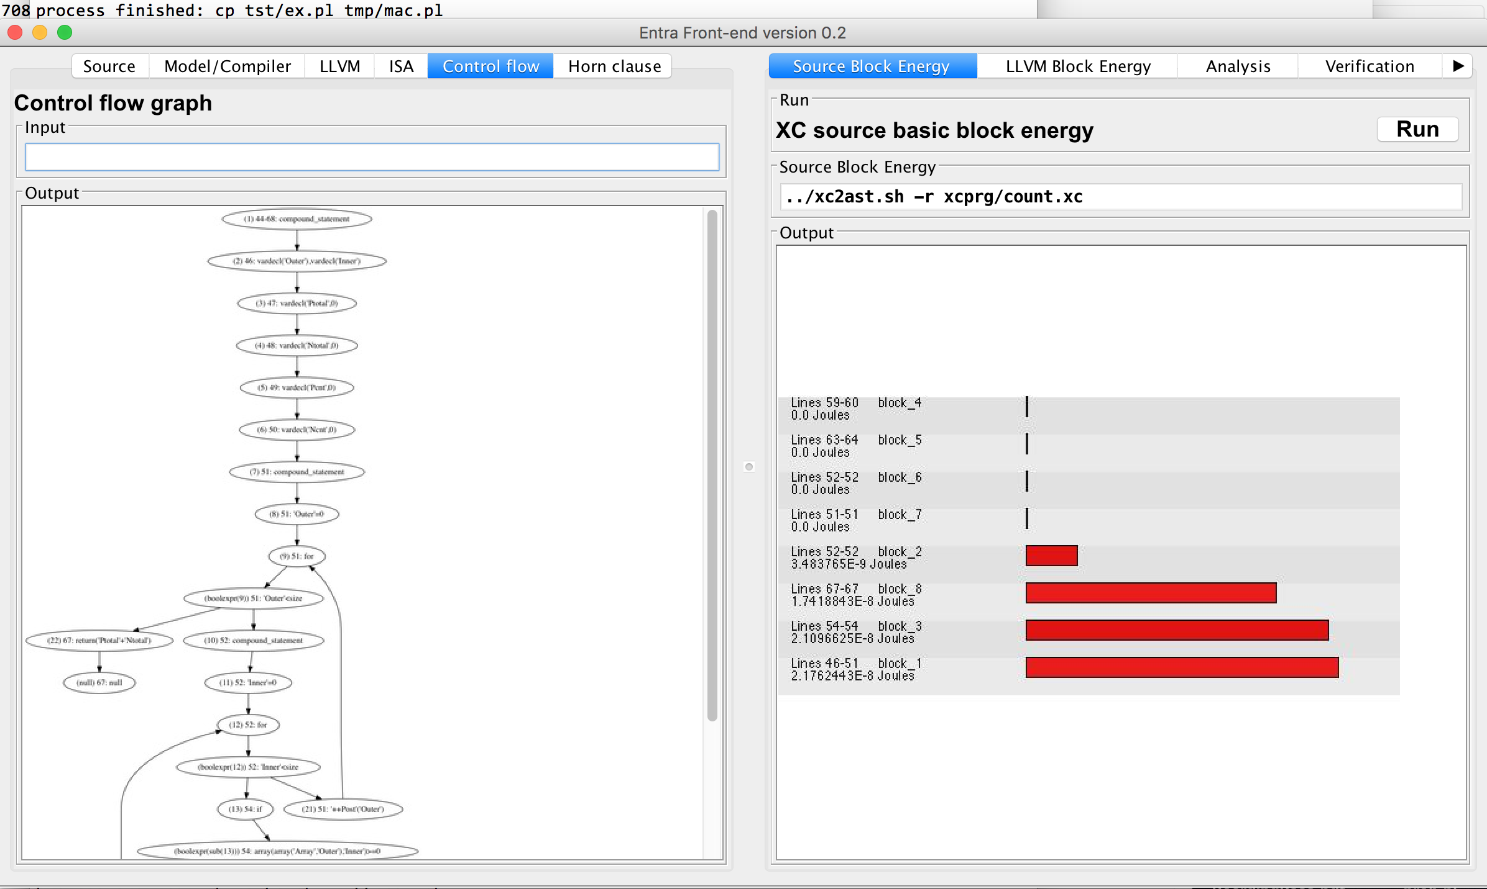
More examples from ENTRA tool

Slide 44
Identification of basic blocks
A basic block is a section of “straight-line” code.
The start of a block is a branch or merge point
The end of a block is a branch or jump
Basic blocks can be extracted from the control flow graph
Every statement in a basic block is executed the same number of times

Slide 45
Phases of semantic analysis
Syntax analysis (parsing)
breaking the program into is basic parts and determining its structure
Semantic translation
representation of the program in some suitable mathematical or logical form
Semantic interpretation
using the semantic representation to analyse the program execution

Slide 46
Program analysis
Program properties
Program invariants
Global properties that depend on summary of an infinite number of behaviours
Prove absence of bugs (verification) rather than presence (testing/simulation)

Slide 47
Invariants
Many program analysis and verification tasks involve proving invariants
An invariant is an assertion that is true at a given program point.
We consider invariants on energy usage.

Slide 48
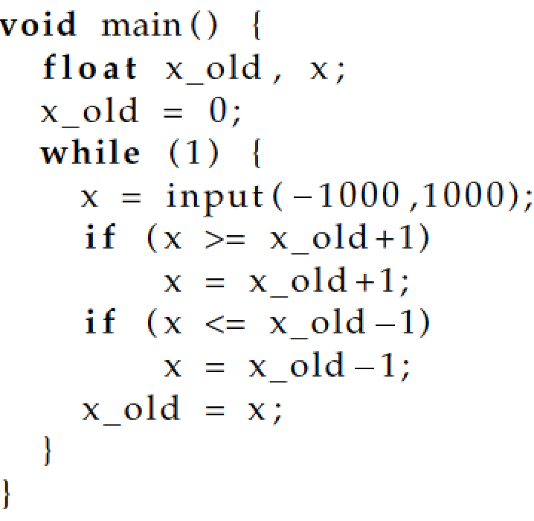
Example invariant
Check assertion
-1000 ≤ x_old ≤ 1000

Slide 49
Proving invariants
To prove that invariant P holds at program point j, prove the following implication
reachable_{j}(x₁,...,x_{n}) → P
which is equivalent to
¬( reachable_{j}(x₁,...,x_{n}) ⋀ ¬P)

Slide 50
Proof by approximation
Overapproximation
of the set of points
where
reachable_{j}(x₁,...,x_{n})
is true.
Contained
within P, hence
reachable_{j}(x₁,...,x_{n})→P
P
reachable_{j}(x₁,...,x_{n})

Slide 51
Energy invariants
The program state can contain resource counters.
reachable_{k}(x₁,...,x_{n},e) means that the total energy consumed is e, when the program reaches point k
So we can express and prove assertions about energy (or other resources)
More on this later...

Slide 52
Two basic techniques
How to capture all reachable states?
answer, fixpoint techniques
How to capture an infinite set of states?
answer, abstract interpretation
These two methods underlie much program analysis

Slide 53
Fixpoint computation
Sounds complicated, but it is a very simple procedure
It is a closure or saturation procedure

Slide 54
Fixpoint example
Consider a route network, with stations a,b,...,h
b
e
a
f
d
g
h
c

Slide 55
post(S) function
Let S be a set of stations.
post(S) is the set of stations reachable in one step from S. E.g. post({a,h}) = {b,c,d,g}
b
e
a
f
d
g
h
c

Slide 56
Reachability as a fixpoint
The set of stations reachable from an initial set S, called Reach(S) is defined as the smallest set Z such that Z = F(Z)
where F(Z) = S ∪ post(Z)
This can be computed as the limit of a sequence ∅, F(∅), F(F(∅)), ...

Slide 57
Example
Find the stations reachable from a.
b
e
F(Z) = {a} ∪ post(Z)
∅
F(∅) = {a}
F({a}) = {a,b,c,d}
F({a,b,c,d}) = {a,b,c,d,f}
F({a,b,c,d,f}) = {a,b,c,d,e,f}
F({a,b,c,d,e,f}) = {a,b,c,d,e,f}
fixpoint found {a,b,c,d,e,f}
a
f
d
g
h
c

Slide 58
Exercise
Using the same graph, compute the set of states reachable from e, using a fixpoint computation.

Slide 59
The reachable states of a program
We apply the same idea to find the reachable states of a program, starting with the initial state.
start
n = 4
z = 1
n z
n ≤ 0, print(z)
stop
n = n’
z = z’
n > 0
n’ = n-1
z’ = z * n
n’ z’

Slide 60
The reachable states of a program
start
2 3
{} {}
{(4,1)} {}
{(4,1)} {(3,4)}
{(4,1),(3,4)} {(3,4)}
{(4,1),(3,4)} {(3,4),(2,12)}
.... ....
{(4,1),(3,4), {(3,4),(2,12),(1,24)}
(2,12),(1,24),
(0,24) }
n = 4
z = 1
2
n z
n ≤ 0, print(z)
stop
n = n’
z = z’
n > 0
n’ = n-1
z’ = z * n
n’ z’
3
(n,z) represents the values of n and z at a given point

Slide 61
Infinite fixpoints
However, usually the set of reachable states of a program is infinite, and the sequence could keep on growing
We might never reach the fixpoint
In this case we use abstraction

Slide 62
Abstract interpretation
Example
476305 × -576 = 274351680
Is the above equation correct?

Slide 63
Rule of signs
The rule of signs is an abstraction of the multiplication relation
+ × + = +
+ × − = −
− × + = −
− × − = +
We can check incorrectness, but not correctness with the rule of signs.

Slide 64
The interval abstraction
The value of a variable is abstracted by an interval
The variable has any value within the interval
We can perform operations on intervals, as we did for signs
E.g. [3,10] + [-2,6] = [3+(-2), 10+6] = [1,16]
Exercise. What is [3,10] − [-2,6]?

Slide 65
Example: interval abstraction
The set of pairs of values {(4,1),(3,4), (2,12),(1,24),(0,24) } can be abstracted by the pair of intervals ([0,4], [1,24])
So n is between 0 and 4, z is between 1 and 24.
But information has been lost
the pair (3,19) is also consistent with the intervals.
the intervals give an over-approximation of the reachable states.

Slide 66
Convex polyhedra
A more precise abstraction than intervals is given by convex polyhedra
Convex polyhedra are linear inequalities among the state variables

Slide 67
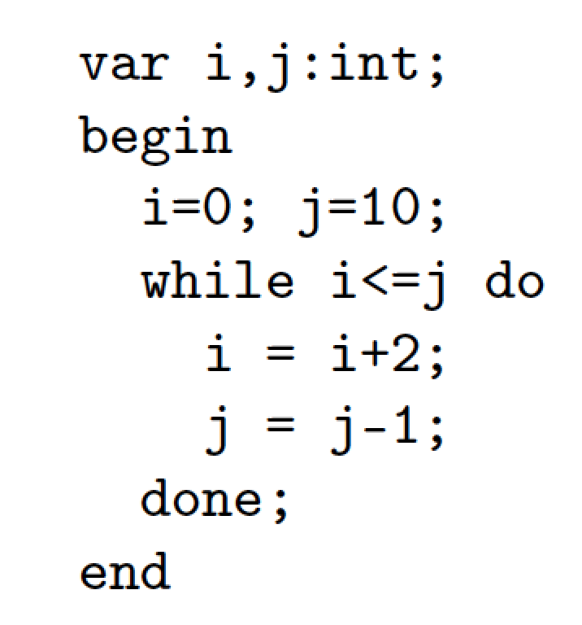
Example convex polyhedron abstraction
r1(I,J) :-
I=0,J=10.
r2(I,J) :-
r1(I,J).
r2(I,J) :-
I1 =< J1,
I = I1+2,
J = J1-1,
r2(I1,J1).
r3(I,J) :-
I >= J+1,
r2(I,J).

Slide 68
Approximate reachable states
r1(I,J) = [I=0,J=10].
r2(I,J) = [-I >= -16,I >= 0,I+2*J=20].
r3(I,J) = [-3*I >= -26,3*I >= 22,I+2*J=20].
This result is computed fast, using the
Parma Polyhedra Library to perform the
operations on convex polyhedra.

Slide 69
Summary so far....
We can translate a program to a state automaton
We can compute over-approximation of the reachable states of the program
using fixpoint computation and abstraction
We can use the approximation to check assertions about the program.

Slide 70
Software and Energy-aware Computing Static analysis and optimization
John Gallagher
Roskilde University
ICT-Energy: Energy consumption in future ICT devices
Summer School, Aalborg, Denmark, August 13-16, 2016

Slide 71
Energy models – block-based
start
n = 4
z = 1
n z
n ≤ 0, print(z)
stop
[e₁,e₂]
e_{LLVM}
n = n’
z = z’
n > 0
n’ = n-1
z’ = z * n
LLVM block
e_{ISA}
n’ z’
ISA block
ISA energy model

Slide 72
Adding energy to the model
e = 0
e is an “energy counter”
e
n = 4
z = 1
e’ = e+17
n z e’
n ≤ 0, print(z) e = e’+107
e
n = n’
z = z’
n > 0
n’ = n-1
z’ = z * n
e = e’+42
On each transition, increment the
energy counter by the amount of
energy required to execute the transition.
The numbers are obtained from a model
n’ z’ e
e’ = e+3

Slide 73
Estimating total energy
The total energy consumed by the program is given by the energy counter in the reachable “stop” state.
For this example, the analysis yields a value of 304 (initial value n=4)
However if the input data is unknown, we would get a relationship between input value n and energy e.
In the example, e = 17 + n*45 + 107

Slide 74
Beyond linear energy estimates
With polyhedron or interval abstractions, we are limited to linear expressions.
This is quite restrictive and approximate
A better approach is given by deriving cost functions from the automaton, and solving them

Slide 75
Deriving cost functions
1
start
n = ?
z = 1
2
n z
n ≤ 0, print(z)
stop
4
n = n’
z = z’
n > 0
n’ = n-1
z’ = z * n
Let cost₂(n) be the cost of
the loop starting at 2.
We can write a recurrence relation
cost₂(n) = cost₂(n-1) + 45 (if n > 0)
cost₂(n) = 0 (if n ≤ 0)
The cost of the whole computation
for input n is 17 + cost₂(n) + 107
n’ z’
3

Slide 76
Solving cost relations
Tools like Mathematica are capable of solving many recurrence relations.
cost₂(n) = cost₂(n-1) + 45 (if n > 0)
cost₂(n) = 0 (if n ≤ 0)
has a closed-form solution
cost₂(n) = 45*n

Slide 77
More complex cases
By solving energy recurrence equations we can get non-linear energy functions
E.g. a matrix multiplication program for matrices of size n
42.47 n³ + 68.85 n²+ 49.9 n + 24.22 nJoules

Slide 78
Some available tools for cost analysis
CiaoPP (IMDEA Software, Madrid)
a resource analysis tool based on solving cost relations (using Mathematica)
designed for Prolog programs, adapted to imperative languages
COSTA (UCM, Madrid).
Can analyse resources such as time and energy for Java and Java bytecode (uses the PUBS solver)
Termination analysis tools
several tools for proving termination of programs are being adapted for resource analysis

Slide 79
Trickier examples
Loops counters can have inter-dependencies
Complexity of example is O(2.m), not O(m²)
void main(int m) {
int i=m, n = 0; //stack = emptyStack();
l1 : while (i > 0) {
i--;
if (?) //push
n++; //stack.push(element);
else //popMany
l2 : while (n > 0 && ?)
n--; //element = stack.pop();
}
}

Slide 80
Analysis of communication and timing
We consider a language with synchronous channel communication
Usually, threads enter some periodic behaviour, synchronising among themselves
The programmer needs a model of how much work and time a thread uses between communications

Slide 81
Potential power optimisations (1)
Sometimes, threads should run as slowly as possible, while still meeting deadlines from other threads
thus analysis of timing and synchronisation is critical
Reducing clock frequency of cores saves power

Slide 82
Potential power optimisations (2)
Threads that communicate a lot should be close (take account of communication infrastructure).
Bottlenecks can be removed by shifting tasks or introducing more threads
Very inactive threads can be merged with other threads.

Slide 83
Parallel execution
Timing analysis is vital.
The left thread always
waits for the other.
Possible energy
optimisations:
1. slow down the left
thread
2. give it some more work
to balance the load
3. put in power-saving
mode while waiting
The threads run
until they reach a
synchronisation point.
After synchronising, they
continue to the next, etc.

Slide 84
Behaviour of a single thread
fork
Communication-free code
comm
Communication-free code
comm
comm
Communication-free code
comm
Communication-free code
join
Each thread is parsed into blocks of communication-free code, separated
by synchronous communications.
Assume that the communication channels are staticallly known.

Slide 85
Example thread behaviour
4
Q
1
2
3
6
7
8
c
e
P
S
a
b
g
h
d
f
R
5
8 threads in a pipeline with a split in the middle.
P,Q,R and S are some functions on the values passed along.

Slide 86
Analysis of the sequential components
We assume that we used the sequential techniques already mentioned
to get energy estimates for P,Q,R and S
to get execution time estimates for P,Q,R and S

Slide 87
Automata for the individual threads
start
start
start
start
C1
D1
A1
B1
b
c
a
a
C2
Q
a
A2
P
b
start
b
a
b
e
c
C3
B2
D2
F1
c
e
C4
start
F2
d
start
f
C5
E1
e
G1
F3
d
g
g
start
R
F4
S
f
h
g
H1
g
E2
F5
G2
h
d
h
H2

Slide 88
Energy and power estimates
The energy of the whole cycle consists of
the total energy for the tasks in the cycle
an overhead for the number of active threads (obtained from the critical path)
an estimate of the energy used while idling
The power (Watts) is E/T, where E is the energy and T is the time of the cycle

Slide 89
Task durations
Assume that each task has a duration
could be an interval [lower, upper]
or in general a constraint that could depend on data values
these can be obtained from a timing analyser and/or automatic complexity analysis
Let the duration of Task k be d_{k}

Slide 90
Synchronisation
Thread 1
Thread 2
Task 1
Task 3
Tasks 2 and 4
can start simultaneously as soon as both Tasks 1 and 3 have completed and the channel communication has been made.
channel c
Task 2
Task 4

Slide 91
Synchronisation constraints (1)
Thread 1
Thread 2
Let t_{k}^{m} be the time of the m^{th}
firing of task k.
Task 1
Task 3
n ≥ 0, m ≥ 0
t₂^{n} = max(t₁^{n} + d₁, t₃^{m} + d₃)
channel c
t₂^{n} = t₄^{m}
Task 2
Task 4
If Task 2 (or 4) is a loop header
then replace t₂^{n} (or t₄^{m})
with t₂^{n+1} (or t₄^{m+1})
(Inspired by SDF graphs)
loop counter n
loop counter m

Slide 92
Counting communications
Annotate the channel communications
so that they can be counted.
start
loop
prefix
Let c_{pre} be the number of channel communications on c in the loop prefix.
Number every channel communication,
for each channel c in the loop
c(1), ... c(k)
c_{pre} + n * k + j = the number of communications on c when
c(j) in the loop is encountered, when n iterations of the loop are completed.
T0
a(0)
T1
b(1)
loop
a(k)
b(2)
a(1)
Tm

Slide 93
Synchronisation constraints (2)
Thread 1
Thread 2
On a channel c, there is the same number of operations at each channel end.
Task 1
Task 3
We assume that each channel joins exactly two threads.
channel c
c_{pre1} + n*k₁ + j
=
c_{pre2} + m*k₂ + i
Task 2
Task 4
loop counter n
loop counter m

Slide 94
Example (logical encoding)
fires__B2(A,5+B) :-
1+C*2+1=0+A*1+1,
1+C*2+1>=0,
C>=0,
A>=0,
fires__C2(C,B),
fires__G(A,D),
5+B>=300+D.
fires__B2(A,300+B) :-
1+C*2+1=0+A*1+1,
1+C*2+1>=0,
C>=0,
A>=0,
fires__C2(C,D),
fires__G(A,B),
5+D<300+B.
start
C1
start
b
B1
5
C2
a
b
b
300
G
C3
b
a
c
B2
C4
d
C5
A and C are the loop counters og G and C2

Slide 95
Analysis of the constraints
Generate the complete set of synchronisation constraints
Solve them
more generally, obtain an approximate solution (abstract interpretation again!)
For each task, derive a relationship between n and t, where t is the task’s n^{th} firing time.

Slide 96
Transient and periodic behaviour
Typically, threads take a few iterations to reach a steady state.
First few firings
happen rapidly,
then there is a slowdown as delays from other threads take effect.
t
n

Slide 97
Approximation of throughput
Approximation using a finite union of convex polyhedra
t
n

Slide 98
Analysis results
For the 8-thread pipeline example
Given task durations
G = 300
Q = 334
R = 500
S = 250
all other tasks = 5
Derive period of threads = 610 or 305
Some threads loop twice as fast as others

Slide 99
Thread activity
Thread 1 = 5/305 (1.6%)
Thread 2 = 305/305 (100%)
Thread 3 = 20/610 (3.2%)
Thread 4 = 339/610 (56%)
Thread 5 = 505/610 (83%)
etc.
334
D
300
d
e
250
A
a
B
b
C
F
g
G
h
H
c
f
500
E

Slide 100
Other information
Throughput and thread activity obtained directly from the solution to the constraints
Other information that can be derived from earliest firing time includes
when one task definitely waits for another
which tasks can run simultaneously
which tasks on different threads do not run at the same time
frequency of each channel communication

Slide 101
Energy and power estimates
The energy of the whole cycle consists of
the energy for each task in the cycle
an overhead for the number of active threads (obtained from the critical path)
an estimate of the energy used while idling
The power (Watts) is E/T, where E is the energy and T is the time of the cycle

Slide 102
Possible transformations
D
A
B
C
F
G
H
E
B
D
G
D
A
C
F
H
A
B
C
F
G
H
B
E
G
c
f
E

Slide 103
Energy optimisation for Android game code case study
Work by Xueliang Li, Roskilde University (to appear in SCAM 2016)
Energy of game code is highly dependent on user interaction
We modelled the energy consumption the Cocos2d-Android game engine
Energy consumption of operations in the source code was estimated using machine learning techniques
based on a large number of test cases for different interaction scenarios.

Slide 104
A Source Code energy model
Android code is Java
What is the code’s energy cost? How can we measure it?
The compiler produces Dalvik bytecode, which itself is interpreted by the Java virtual machine
Is it realistic to attribute energy costs to source code?

Slide 105
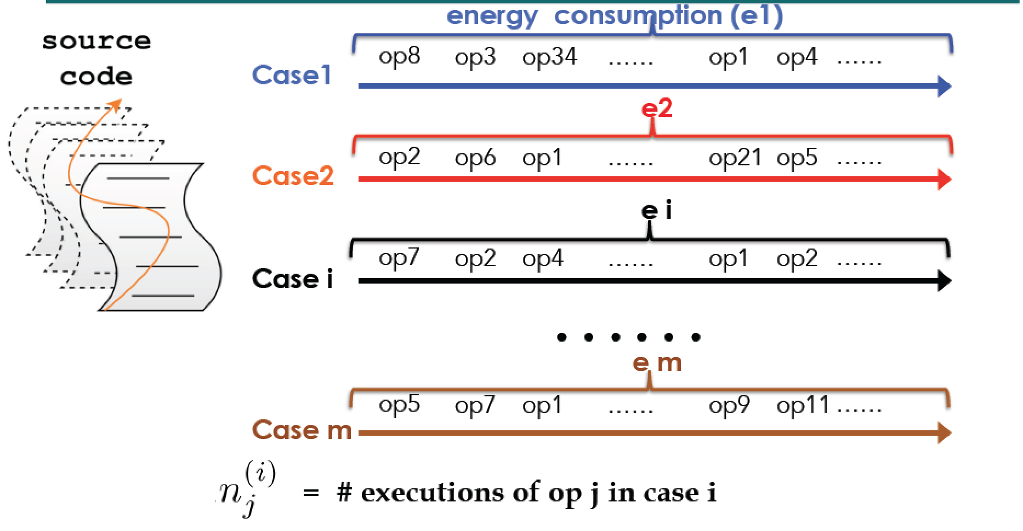
Energy measurement of test cases

Slide 106
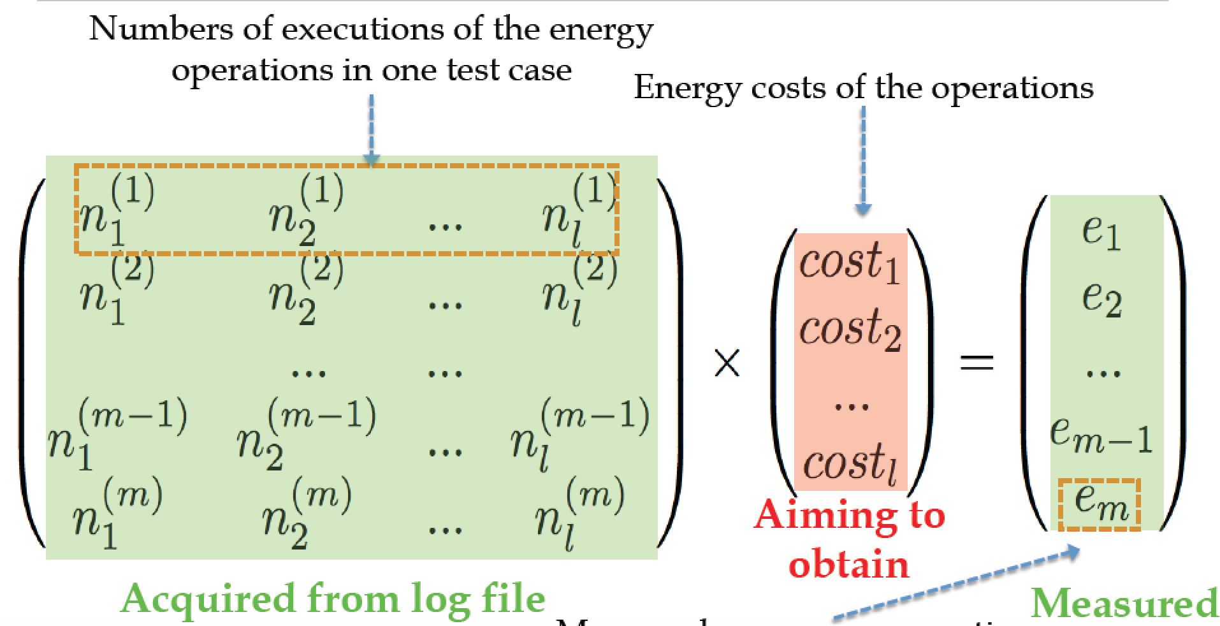
Learning source-code operation costs

Slide 107
Identifying which ops use most energy
Top 10 ops
account for
72.1% of
energy usage

Slide 108
Which code blocks use most energy?
A few blocks dominate energy usage. These are targets for energy optimisation

Slide 109
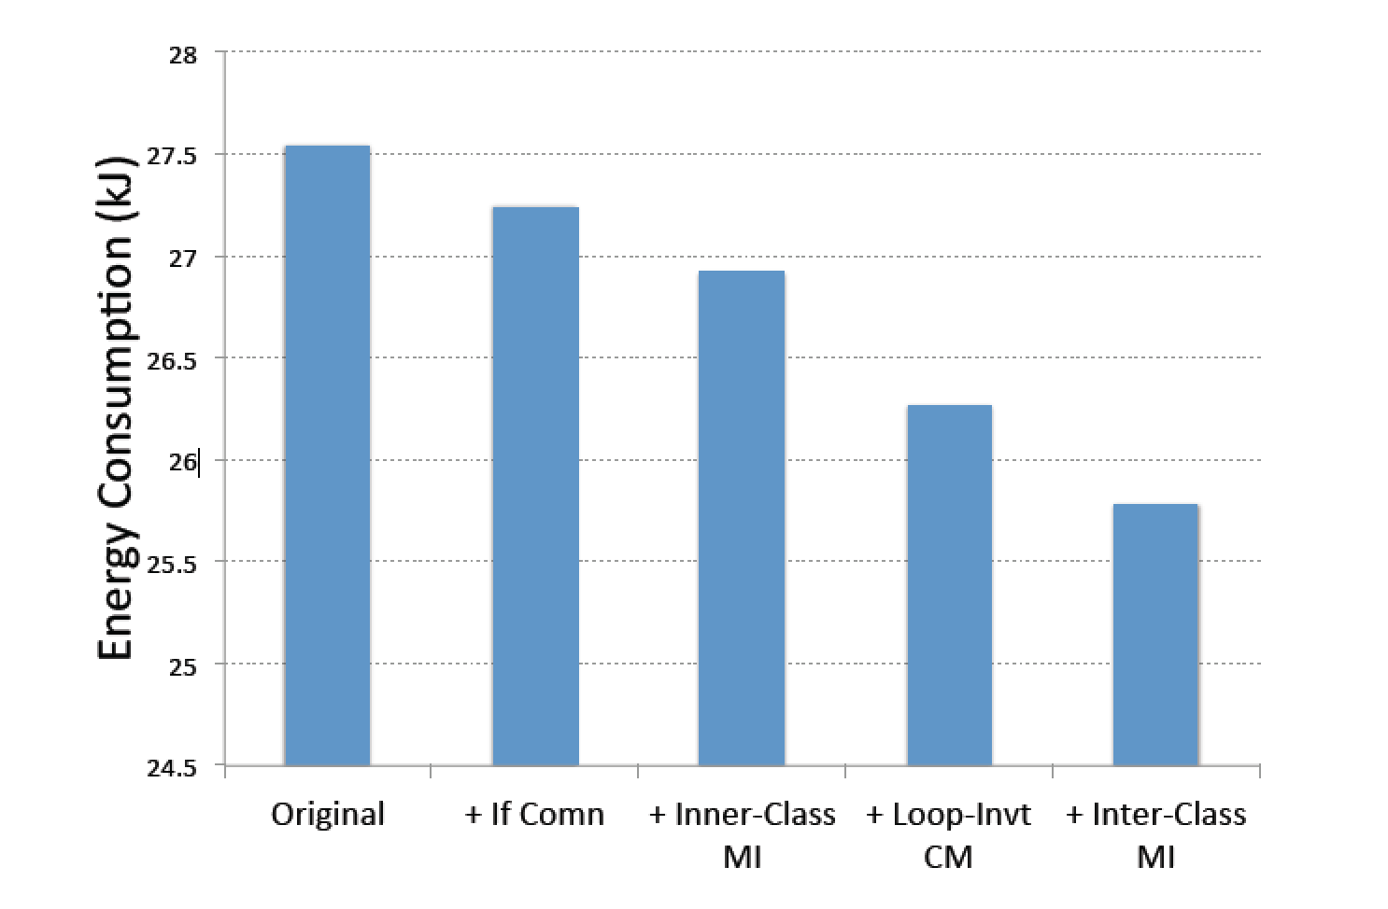
Optimisation. Example 1
Energy consumption of the code without and with the
changes in Click & Move.
Overall saving:
6.4%

Slide 110
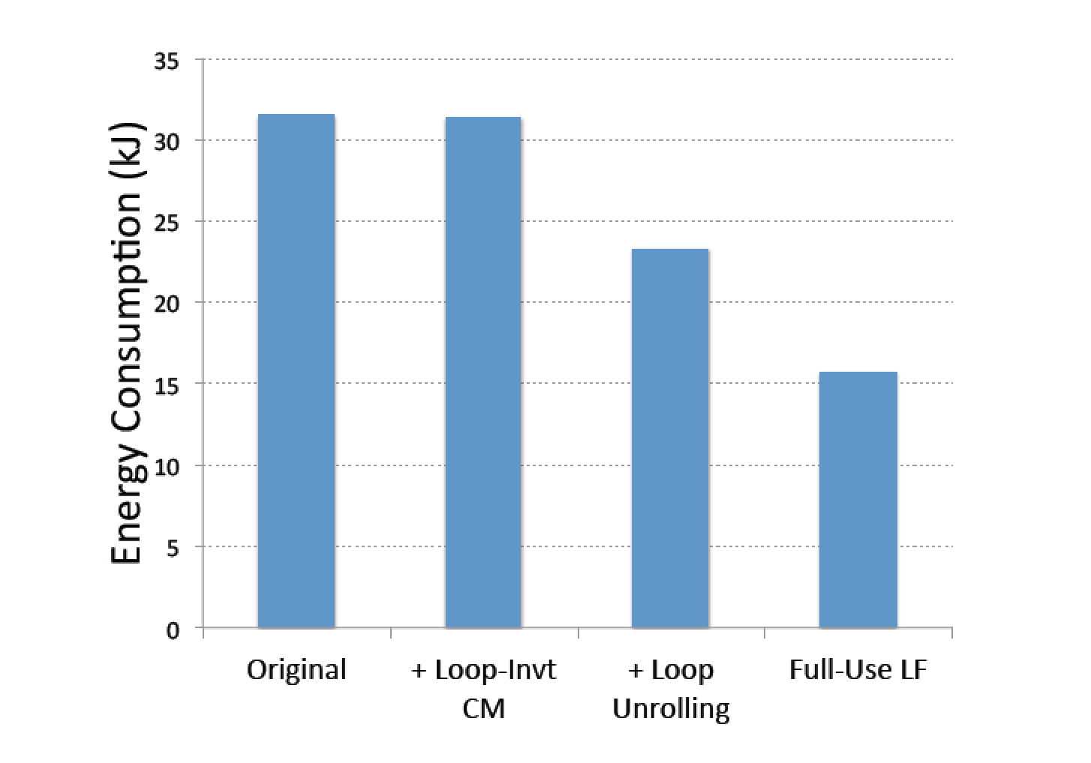
Optimisation. Example 2
Energy consumption of the code without and with the
changes in Orbit.
Overall saving:
50.2%

Slide 111
Energy optimisations through energy transparency
A thorough energy analysis of a suite of code enabled insight into where most energy was consumed
This enabled source-code transformations to be focussed on the most effective areas.

Slide 112
Useful references
B. Steigerwald and A. Agrawal. Green software. In San Murugesan and G. R. Gangadharan, editors, Harnessing Green IT : Principles and Practices, chapter 3. John Wiley & Sons, Hoboken, NJ, USA, 2012.
U. Liqat, K. Georgiou, S. Kerrison, P. Lopez-Garcia, M. V. Hermenegildo, J. P. Gallagher, and K. Eder. Inferring Parametric Energy Consumption Functions at Different Software Levels: ISA vs. LLVM IR. In M. Van Eekelen and U. Dal Lago, editors, Foundational and Practical Aspects of Resource Analysis. Fourth International Workshop FOPARA 2015, Revised Selected Papers , Lecture Notes in Computer Science. Springer, 2016. http://arxiv.org/abs/1511.01413

Slide 113
Thank you

