Slide 1
Software and Energy-aware Computing Fundamentals of static analysis of software
John Gallagher
Roskilde University
ICT-Energy: Energy consumption in future ICT devices
Summer School, Aalborg, Denmark, August 13-16, 2016

Slide 2




Acknowledgements
The partners in the EU ENTRA project (2012-2015)
Kerstin Eder and team
Pedro López García and team
Henk Muller and team
Roskilde team
http://entraproject.eu

Slide 3
ICT-Energy
Application Software
System Software
Architecture
Devices
Physics

Slide 4
Energy of software?
Energy is consumed by hardware
But in these lectures we attribute energy cost to software
Why?

Slide 5
Reason 1
We take the application programmer’s viewpoint
programmers don’t know much about hardware
high-level languages hide the platform from the programmer

Slide 6
Reason 2
Energy efficiency as a design goal from the start
Get an energy profile for a program as early as possible
Analyse the code to find out how much energy a program will use
Deliver software with energy guarantees

Slide 7


Reason 2 - continued
Don’t wait to test energy efficiency on hardware, after the software is developed
It might be too late to fix “energy bugs”
Development
machine
Deployment
platform

Slide 8
Reason 3
You can save more energy at the software level than the hardware level
There are more energy optimisation opportunities higher up the system stack.
Most energy is wasted by application software

Slide 9
Energy transparency
Our aim is to let the programmer “see” the energy usage of the code
without executing it
so that the programmer can see where the program wastes energy

Slide 10
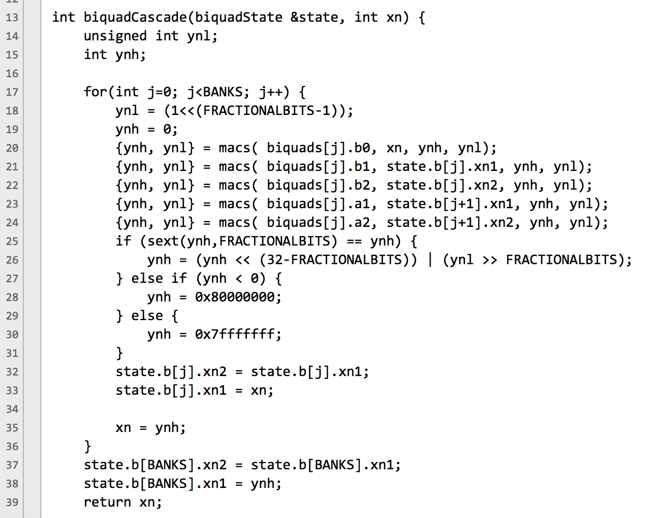
Example
biquadCascade(BANKS)
=
157 * BANKS + 51.7
nJoules
This is an estimate of
the energy used by the
function.
It is a linear function of
the value of BANKS

Slide 11
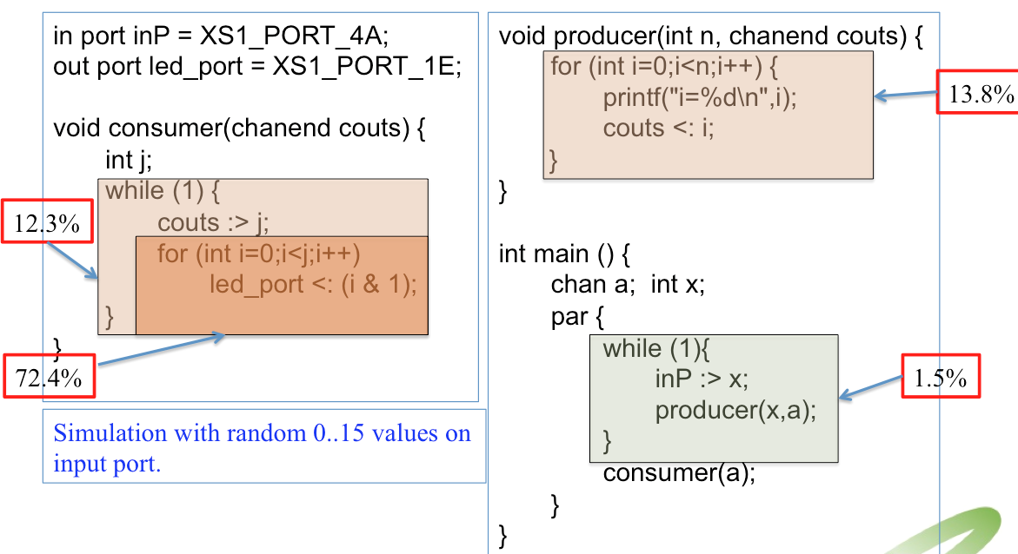
Example

Slide 12
New slide with block energy barchart

Slide 13
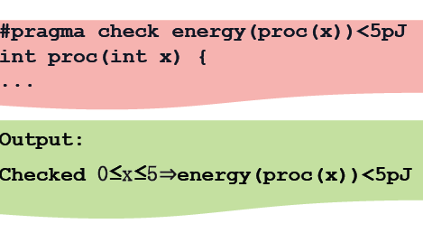
Energy a design goal for programmers

Slide 14
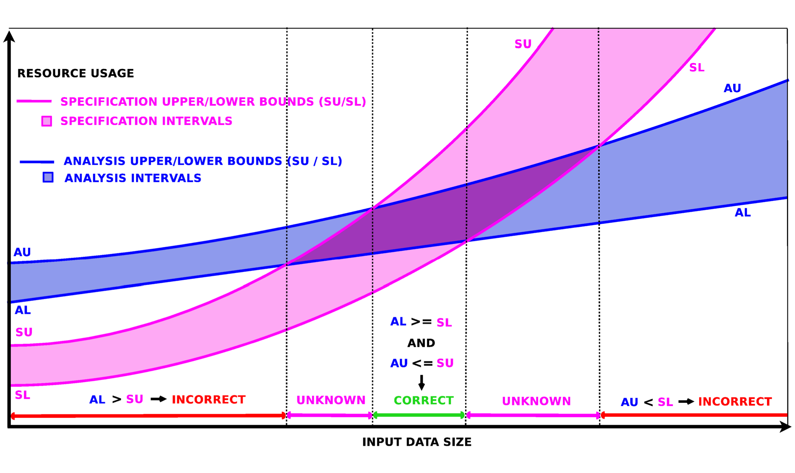
Verification of energy specifications

Slide 15
Summary of goals
We want tools for the programmer
that give information about the energy usage of programs without running them (energy transparency)
that allow energy assertions to be checked (energy design goals)

Slide 16
Analysis of programs
A program is a physical object
some symbols on paper
a pattern of bits in memory
But what is the meaning of a program?
This is program semantics.

Slide 17
Program semantics
n = 4;
z = 1;
while (n > 0) {
z = z*n;
n = n-1;
}
print(z);
To execute or analyse
this program,
we need to understand
the meaning of “while”,
“semicolon”, ”{”, “}”, etc.

Slide 18
Different styles of program semantics
Operational (small step)
Big-step (Hoare-Floyd pre- post- conditions
Denotational

Slide 19
Program syntax tree (parsing)
Statement List
n = 4
z = 1
while
print(z)
n = 4;
z = 1;
while (n > 0) {
z = z*n;
n = n-1;
}
print(z);
n>0
Statement List
z = z*n
n = n-1

Slide 20
From syntax tree to flow graph
Grammar Rules Semantic Rules for flow of control
If → if E then S₁ else S₂ E.true := S_{l}
E.false := S₂
S₁.next := If.next
S₂.next := If.next
While → while E S₁ E.true := S₁
E.false := While.next
S₁.next := While
StatementList → S₁S₂ ..... S_{n} S_{j}.next = S_{j+1} (j = 1 to n-1) S_{n}.next := StatementList.next
S → StatementList | If | While | Print | Assign
StatementList.next := S.next
If.next := S.next
While.next := S.next
Print.next := S.next
Assign.next := S.next

Slide 21
From syntax tree to flow graph
Statement List
n = 4
z = 1
while
print(z)
false
n = 4;
z = 1;
while (n > 0) {
z = z*n;
n = n-1;
}
print(z);
n>0
Statement List
true
z = z*n
n = n-1

Slide 22
From flow graph to state automata
start
n = 4
z = 1
n z
n ≤ 0, print(z)
stop
n = n’
z = z’
n > 0
n’ = n-1
z’ = z * n
n’ z’

Slide 23
Exercise
Small program → flow graph

Slide 24
From automaton to predicate logic
true → reachable₁
(reachable₁ ⋀ n=4 ⋀ z=1)
→ reachable₂(n,z)
(reachable₂(n,z) ⋀ n<0 ⋀ z’=z*n ⋀ n’=n-1)
→ reachable₃(n’,z’)
(reachable₃(n’,z’) ⋀ n=n’ ⋀ z=z’ )
→ reachable₂(n,z)
reachable₂(n,z) ⋀ n ≥ 0 ⋀ print(z) )
→ stop

Slide 25
Exercise
Draw the syntax tree
Draw the control flow graph
Draw the state automaton
while (m != n) {
if (m > n) {
m = m-n;
}
else {
n = n-m;
}
}

Slide 26
Logical representation
program point j
transition constraint
program point k
x₁, x₂, ..., x_{n}
e(x₁, x₂, ..., x_{n}, x’₁, x’₂, ..., x’_{n})
x’₁, x’₂, ..., x’_{n}
(reachable_{j}(x₁, x₂, ..., x_{n}) ⋀ e(x₁, x₂, ..., x_{n}, x’₁, x’₂, ..., x’_{n}))
→ reachable_{k}(x’₁, x’₂, ..., x’_{n})

Slide 27
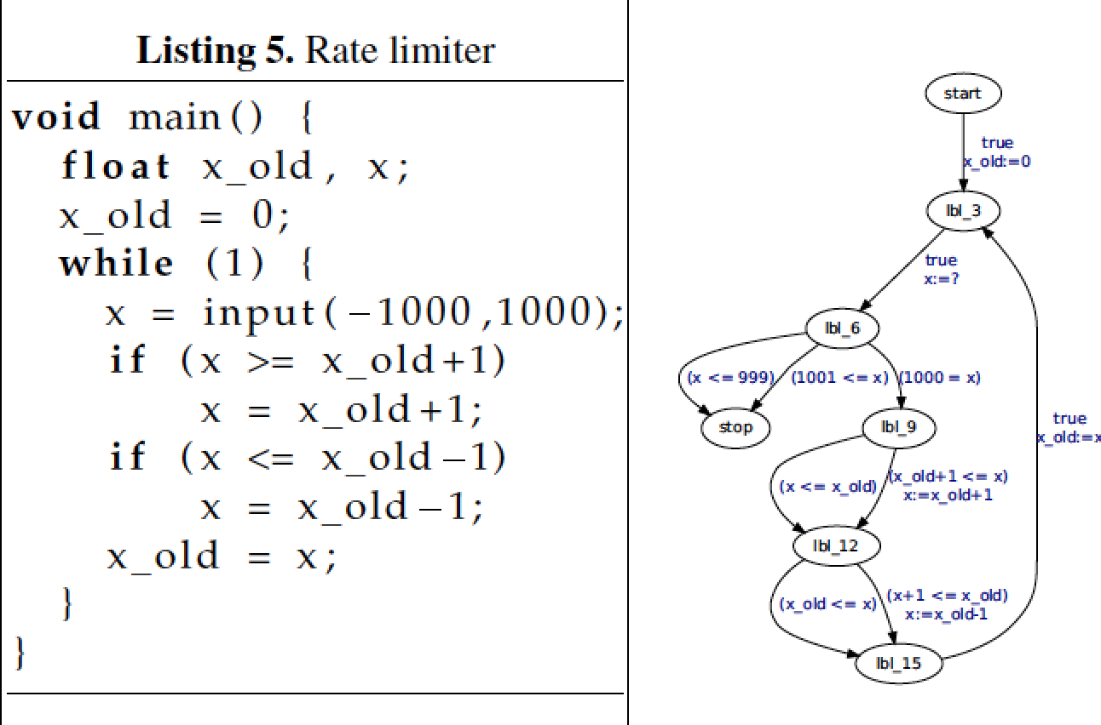
Example: A rate limiter*
*Example by Monniaux

Slide 28
More examples from ENTRA tool

Slide 29
Rate limiter – logic representation
r1(X,X_old) :-
X_old=0,
r0(_,_).
r1(X,X_old) :-
r5(X,X_old).
r2(X,X_old) :-
X >= -1000,
X =< 1000,
r1(_,X_old).
r3(X,X_old) :-
X1 >= X_old+1,
X = X_old+1,
r2(X1,X_old).
r3(X,X_old) :-
X < X_old+1,
r2(X,X_old).
r4(X,X_old) :-
X1 =< X_old-1,
X = X_old-1,
r3(X1,X_old).
r4(X,X_old) :-
X > X_old-1,
r3(X,X_old).
r5(X,X_old) :-
X_old=X,
r4(X,_).

Slide 30
Program analysis
Program properties
Program invariants
Global properties that depend on summary of infinite number of behaviours
Prove absence of bugs (verification) rather than presence (testing)

Slide 31
Invariants
Many program analysis and verification tasks involve proving invariants
An invariant is an assertion that is true at a given program point.

Slide 32
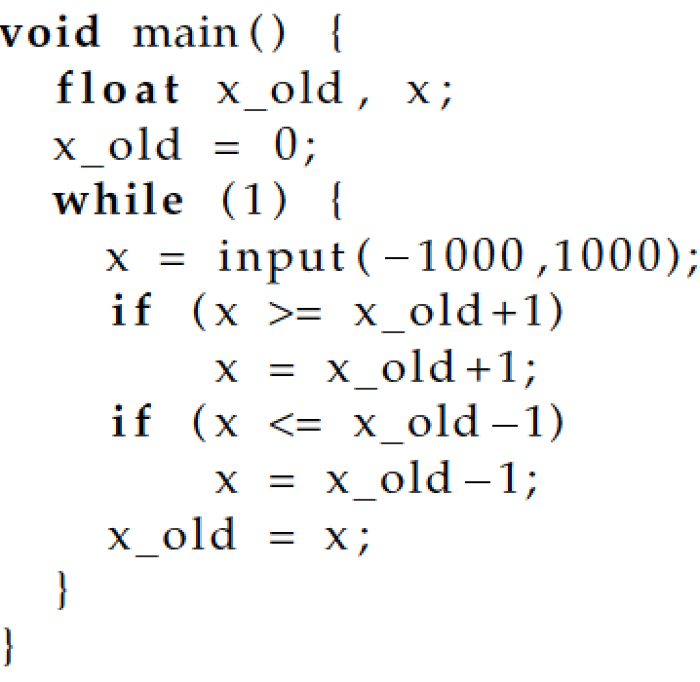
Example invariant
Check assertion
-1000 ≤ x_old ≤ 1000

Slide 33
Proving invariants
To prove that invariant P holds at program point j, prove the following implication
reachable_{j}(x₁,...,x_{n}) → P
which is equivalent to
¬(reachable_{j}(x₁,...,x_{n}) ⋀ ¬P)

Slide 34
Proof by approximation
Overapproximation
of the set of points
where
reachable_{j}(x₁,...,x_{n})
is true.
Contained
within P, hence
reachable_{j}(x₁,...,x_{n})→P
P
reachable_{j}(x₁,...,x_{n})

Slide 35
Energy invariants
The program state can contain resource counters.
reachable_{k}(x₁,...,x_{n},e) means that the total energy consumed is e, when the program reaches point k
So we can express and prove assertions about energy (or other resources)
More on this later...

Slide 36
Two basic techniques
How to capture all reachable states?
answer, fixpoint techniques
How to capture an infinite set of states?
answer, abstract interpretation
These two methods underlie much program analysis

Slide 37
Fixpoint computation
Sounds complicated, but it is a very simple procedure
It is a closure or saturation procedure

Slide 38
Fixpoint example
Consider a route network, with stations a,b,...,h
b
e
a
f
d
g
h
c

Slide 39
post(S) function
Let S be a set of stations. post(S) is the set of stations reachable in one step from S. E.g. post({a,h}) = {b,c,d,g}
b
e
a
f
d
g
h
c

Slide 40
Reachability as a fixpoint
The set of stations reachable from an initial set S, called Reach(S) is defined as the smallest set Z such that Z = F(Z)
where F(Z) = S ∪ post(Z)
This can be computed as the limit of a sequence ∅, F(∅), F(F(∅)), ...

Slide 41
Example
Find the stations reachable from a.
b
e
F(Z) = {a} ∪ post(Z)
∅
F(∅) = {a}
F({a}) = {a,b,c,d}
F({a,b,c,d}) = {a,b,c,d,f}
F({a,b,c,d,f}) = {a,b,c,d,e,f}
F({a,b,c,d,e,f}) = {a,b,c,d,e,f}
fixpoint found {a,b,c,d,e,f}
a
f
d
g
h
c

Slide 42
The reachable states of a program
We apply the same idea to find the reachable states of a program, starting with the initial state.
start
n = 4
z = 1
n z
n ≤ 0, print(z)
stop
n = n’
z = z’
n > 0
n’ = n-1
z’ = z * n
n’ z’

Slide 43
The reachable states of a program
start
2 3
{} {}
{(4,1)} {}
{(4,1)} {(3,4)}
{(4,1),(3,4)} {(3,4)}
{(4,1),(3,4)} {(3,4),(2,12)}
.... ....
{(4,1),(3,4), {(3,4),(2,12),(1,24)}
(2,12),(1,24),
(0,24) }
n = 4
z = 1
2
n z
n ≤ 0, print(z)
stop
n = n’
z = z’
n > 0
n’ = n-1
z’ = z * n
n’ z’
3

Slide 44
Infinite fixpoints
However, usually the set of reachable states of a program is infinite, and the sequence could keep on growing
We might never reach the fixpoint
In this case we use abstraction

Slide 45
Abstract interpretation
Example
476305 × -576 = 274351680
Is the above equation correct?

Slide 46
Rule of signs
The rule of signs is an abstraction of the multiplication relation
+ × + = +
+ × − = −
− × + = −
− × − = +
We can check incorrectness, but not correctness with the rule of signs.

Slide 47
The interval abstraction
The value of a variable is abstracted by an interval
The variable has any value within the interval
We can perform operations on intervals, as we did for signs
E.g. [3,10] + [-2,6] = [3+(-2), 10+6] = [1,16]
Exercise. What is [3,10] − [-2,6]?

Slide 48
Example: interval abstraction
The set of pairs of values {(4,1),(3,4), (2,12),(1,24),(0,24) } can be abstracted by the pair of intervals ([0,4], [1,24])
So n is between 0 and 4, z is between 1 and 24.
But information has been lost
the pair (3,19) is also consistent with the intervals.
the intervals give an over-approximation of the reachable states.

Slide 49
Convex polyhedra
A more precise abstraction than intervals is given by convex polyhedra
Convex polyhedra are linear inequalities among the state variables

Slide 50
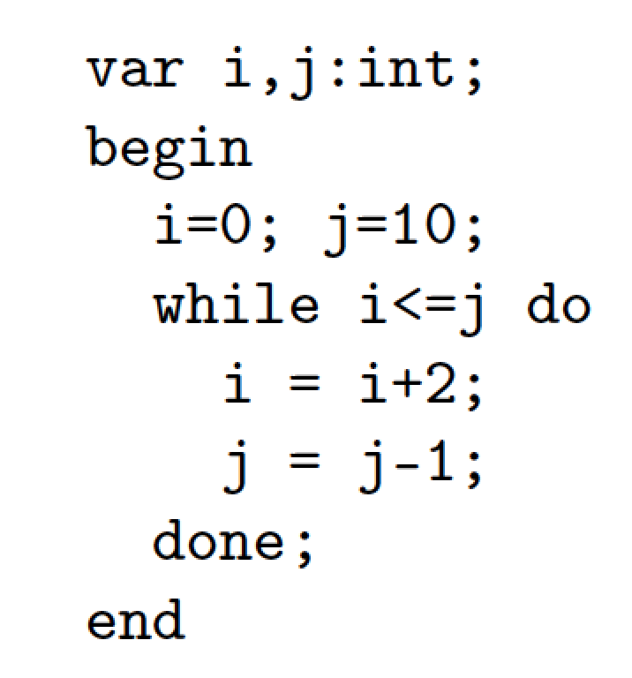
Example convex polyhedron abstraction
r1(I,J) :-
I=0,J=10.
r2(I,J) :-
r1(I,J).
r2(I,J) :-
I1 =< J1,
I = I1+2,
J = J1-1,
r2(I1,J1).
r3(I,J) :-
I >= J+1,
r2(I,J).

Slide 51
Approximate reachable states
r1(I,J) = [I=0,J=10].
r2(I,J) = [-I >= -16,I >= 0,I+2*J=20].
r3(I,J) = [-3*I >= -26,3*I >= 22,I+2*J=20].
This result is computed fast, using the
Parma Polyhedra Library to perform the
operations on convex polyhedra.

Slide 52
Summary so far....
We can translate a program to a state automaton
We can compute over-approximation of the reachable states of the program
using fixpoint computation and abstraction
We can use the approximation to check assertions about the program.

Slide 53
Energy profiling of software: resource analysis
John Gallagher
Roskilde University
ICT-Energy: Energy consumption in future ICT devices
Summer School, Fiuggi, Italy, July 7-12, 2015

Slide 54
Adding energy to the model
e = 0
e is an “energy counter”
e
n = 4
z = 1
e’ = e+17
n z e’
n ≤ 0, print(z) e = e’+107
e
n = n’
z = z’
n > 0
n’ = n-1
z’ = z * n
e = e’+42
On each transition, increment the
energy counter by the amount of
energy required to execute the transition.
The numbers are obtained from a model
n’ z’ e
e’ = e+3

Slide 55
Estimating total energy
The total energy consumed by the program is given by the energy counter in the reachable “stop” state.
For this example, the analysis yields a value of 304 (initial value n=4)
However if the input data is unknown, we would get a relationship between input value n and energy e.
In the example, e = 17 + n*45 + 107

Slide 56
Beyond linear energy estimates
With polyhedron or interval abstractions, we are limited to linear expressions.
This is quite restrictive and approximate
A better approach is given by deriving cost functions from the automaton, and solving them

Slide 57
Deriving cost functions
1
start
n = ?
z = 1
2
n z
n ≤ 0, print(z)
stop
4
n = n’
z = z’
n > 0
n’ = n-1
z’ = z * n
Let cost₂(n) be the cost of
the loop starting at 2.
We can write a recurrence relation
cost₂(n) = cost₂(n-1) + 45 (if n > 0)
cost₂(n) = 0 (if n ≤ 0)
The cost of the whole computation
for input n is 17 + cost₂(n) + 107
n’ z’
3

Slide 58
Solving cost relations
Tools like Mathematica are capable of solving many recurrence relations.
cost₂(n) = cost₂(n-1) + 45 (if n > 0)
cost₂(n) = 0 (if n ≤ 0)
has a closed-form solution
cost₂(n) = 45*n

Slide 59
More complex cases
By solving energy recurrence equations we can get non-linear energy functions
E.g. a matrix multiplication program for matrices of size n
42.47 n³ + 68.85 n²+ 49.9 n + 24.22 nJoules

Slide 60
How do we get an energy model?
The energy is consumed at the hardware level.
We aim to measure the energy consumption of basic operations
e.g. machine instructions, basic arithmetic operations, etc.
The numbers for the energy counter are derived from the basic operations in the transitions

Slide 61
Measuring energy
In the ENTRA project, the energy consumption of the instruction set (ISA) of the xCORE processor was measured (at the University of Bristol)
The energy required for each instruction, and transition from one instruction to the next, resulted in an energy model for the instruction set
Energy estimates for sections of ISA code could then be obtained.

Slide 62
The xCORE energy model
Steve Kerrison,
Univ. of Bristol

Slide 63
Higher level energy models
The energy model for machine instructions can be transferred to higher levels such as LLVM intermediate code, or source code operations (Georgiou et al. 2014)
There is a loss of precision, since the mapping is not one-to-one
Experiments indicate reasonable precision at LLVM level.

Slide 64
Some available tools
CiaoPP (IMDEA Software, Madrid)
a resource analysis tool based on solving cost relations (using Mathematica)
designed for Prolog programs, adapted to imperative languages
COSTA (UCM, Madrid).
Can analyse resources such as time and energy for Java and Java bytecode (uses the PUBS solver)
Termination analysis tools
several tools for proving termination of programs are being adapted for resource analysis

Slide 65
Towards parallel programs
So far, we only talked about sequential programs
However, for energy analysis, multi-threaded programs are a very important class
How can we estimate energy consumption of parallel programs?

Slide 66
Energy and multi-threaded code
Often, we want to design threads to run as slowly as possible, while still meeting performance targets
Reducing clock frequency saves power
Cores that are inactive should be put in power-saving modes

Slide 67
Communication and timing analysis
We consider a language with synchronous channel communication
Usually, threads enter some periodic behaviour, synchronising among themselves
The programmer needs a model of how much work and time a thread uses between communications

Slide 68
Parallel execution
Timing analysis is vital.
The left thread always
waits for the other.
Possible optimisations:
1. slow down the left
thread
2. give it some more work
to balance the load
3. put in power-saving
mode while waiting
The threads run
until they reach a
synchronisation point.
After synchronising, they
continue to the next, etc.

Slide 69
Example thread behaviour
4
Q
1
2
3
6
7
8
c
e
P
S
a
b
g
h
d
f
R
5
8 threads in a pipeline with a split in the middle.
P,Q,R and S are some functions on the values passed along.

Slide 70
Analysis of the sequential components
We assume that we used the sequential techniques already mentioned
to get energy estimates for P,Q,R and S
to get execution time estimates for P,Q,R and S

Slide 71
Automata for the individual threads
start
start
start
start
C1
D1
A1
B1
b
c
a
a
C2
Q
a
A2
P
b
start
b
a
b
e
c
C3
B2
D2
F1
c
e
C4
start
F2
d
start
f
C5
E1
e
G1
F3
d
g
g
start
R
F4
S
f
h
g
H1
g
E2
F5
G2
h
d
h
H2

Slide 72
Analysis of the thread synchronisation identifies periodic behaviour
A2 P C2 D2 E2 F4 S H2
[a||g]
A2 B2 C2 D2 E2 F3 G2 H2
[b||f]
A2 P C5 D2 R F2 G2 H2
[b||h]
Compute a critical
path of the loop, based on the time
estimates and the
order on tasks.
[d||e|| h]
A2 P C4 Q E2 F5 S H2
[a||c|| g]
A2 B2 C3 D2 E2 F4 G2 H2

Slide 73
Thread behaviour
Assume task times
P = 100, Q = 334, R=500, S=250
Obtain throughput
382.5
Thread activity
Thread 7 (67%), Thread 5 (66%), Thread 4 (44%),..... Thread 1(1.3%)

Slide 74
Energy and power estimates
The energy of the whole cycle consists of
the total energy for the tasks in the cycle
an overhead for the number of active threads (obtained from the critical path)
an estimate of the energy used while idling
The power (Watts) is E/T, where E is the energy and T is the time of the cycle

Slide 75
Summary of Part 2
We add energy “counters” to the automaton derived from the program
Two methods for approximation of counter values
convex polyhedra abstraction (linear approx)
solving cost recurrence equations (can give non-linear functions)

Slide 76
Summary (continued)
Energy analysis of parallel code is vital, since major power optimisations are available
We generate a model of thread periodic behaviour, yielding estimates of
throughput
parallelism
energy consumption and power dissipation

Slide 77
Finally
The field is young
Mature tools (comparable to UPPAAL) are not yet available
Rapid advances in program analysis and verification technology is being extended and applied to resource analysis

Slide 78
Thank you

