Slide 1

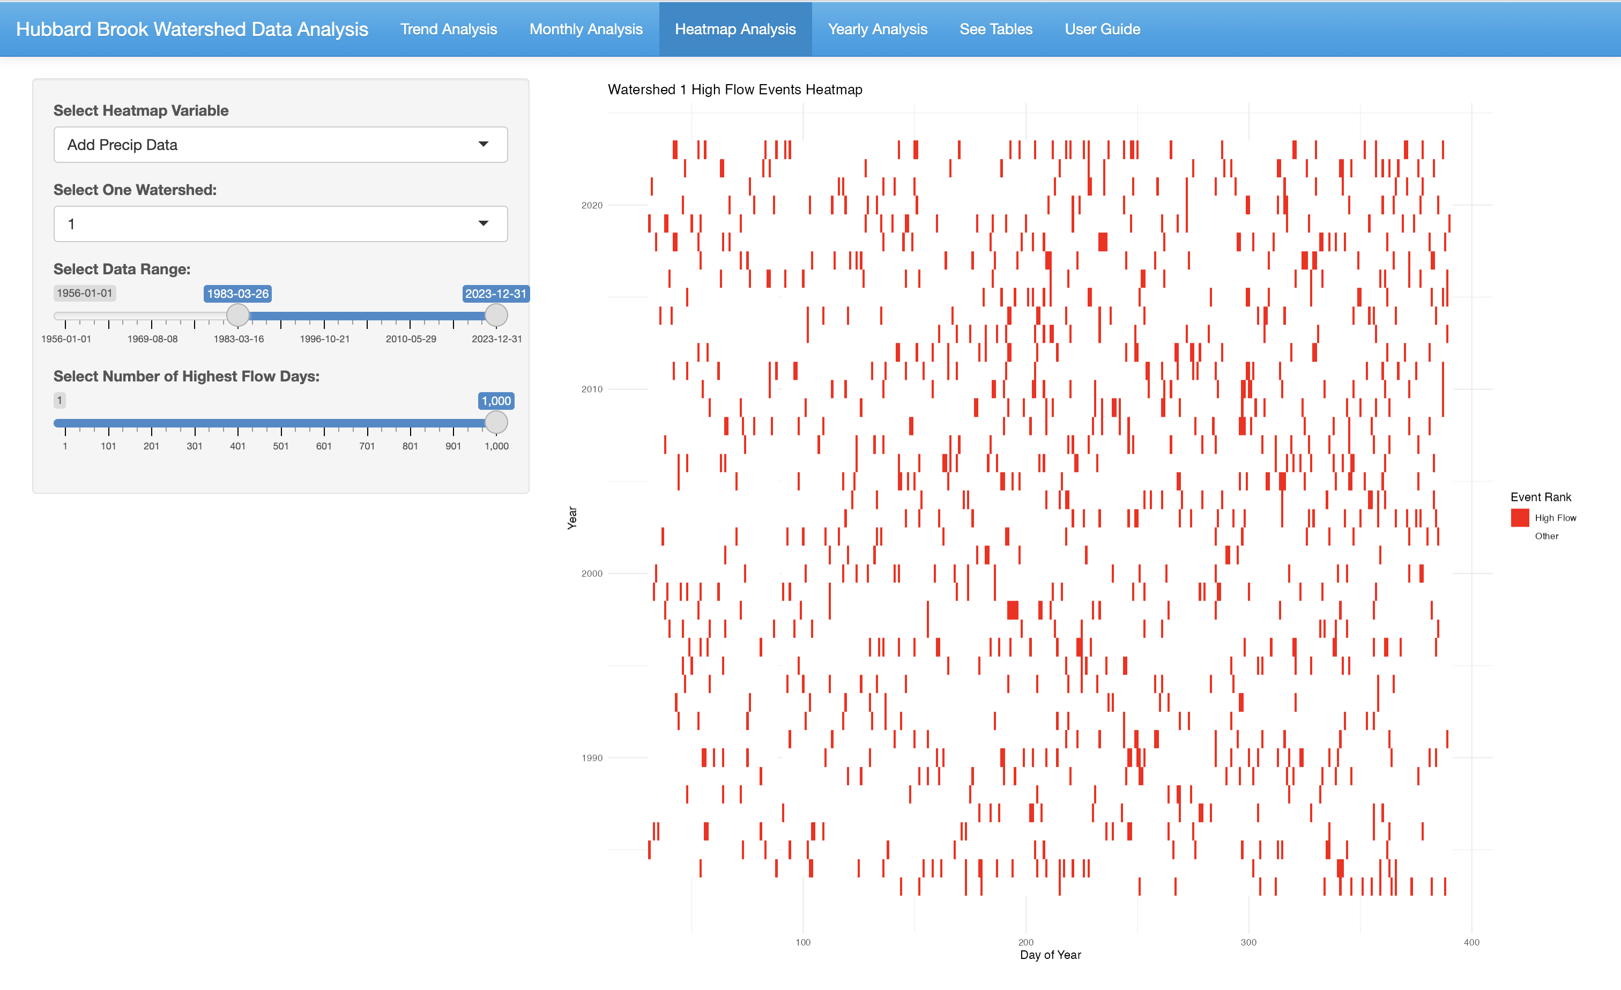
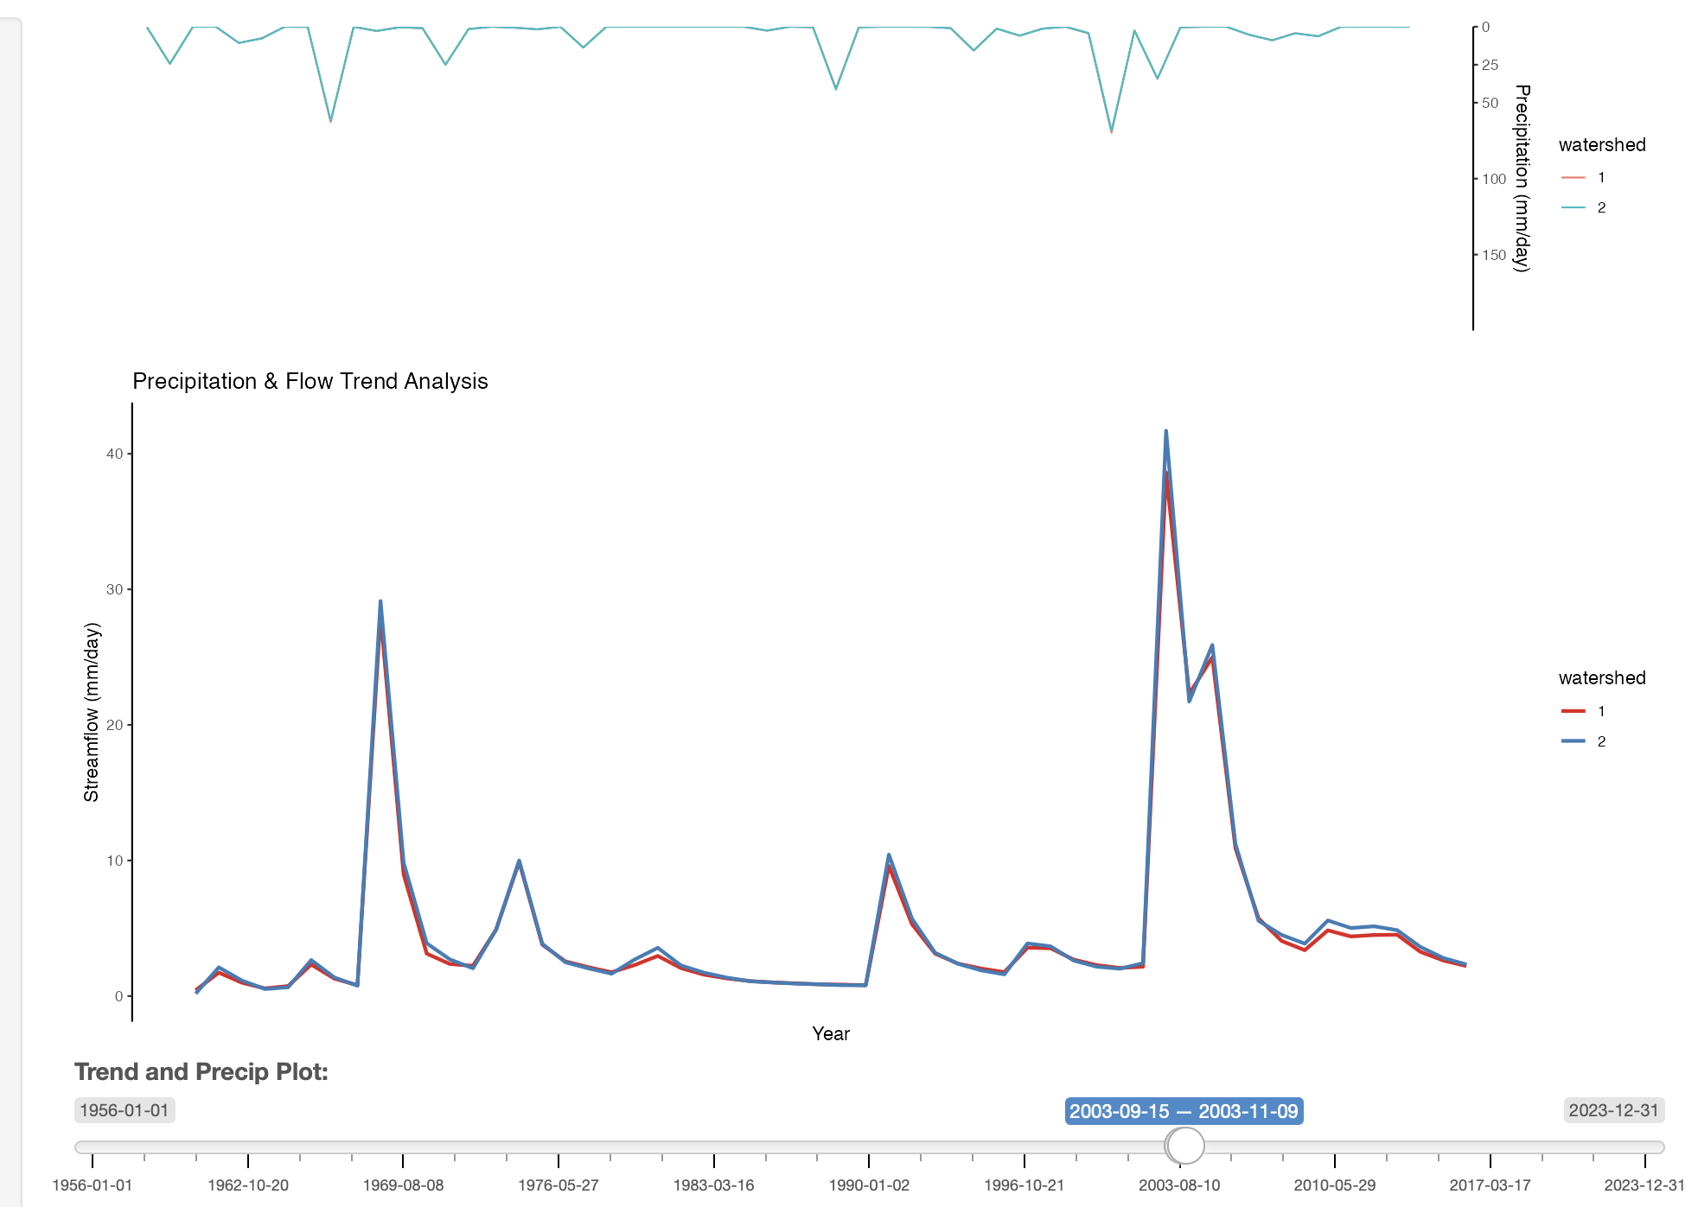
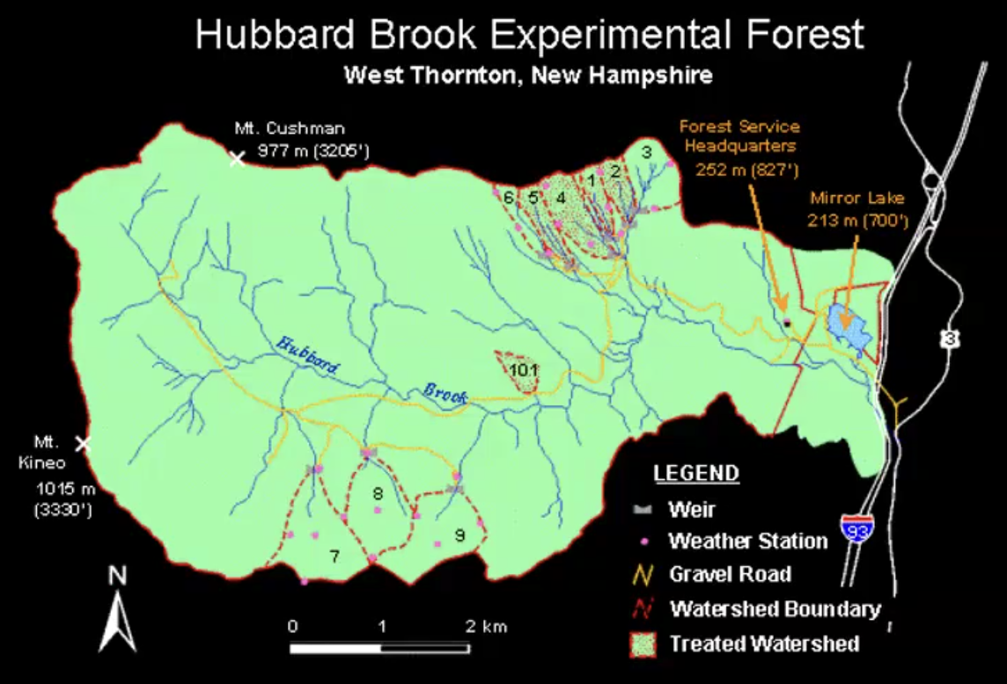
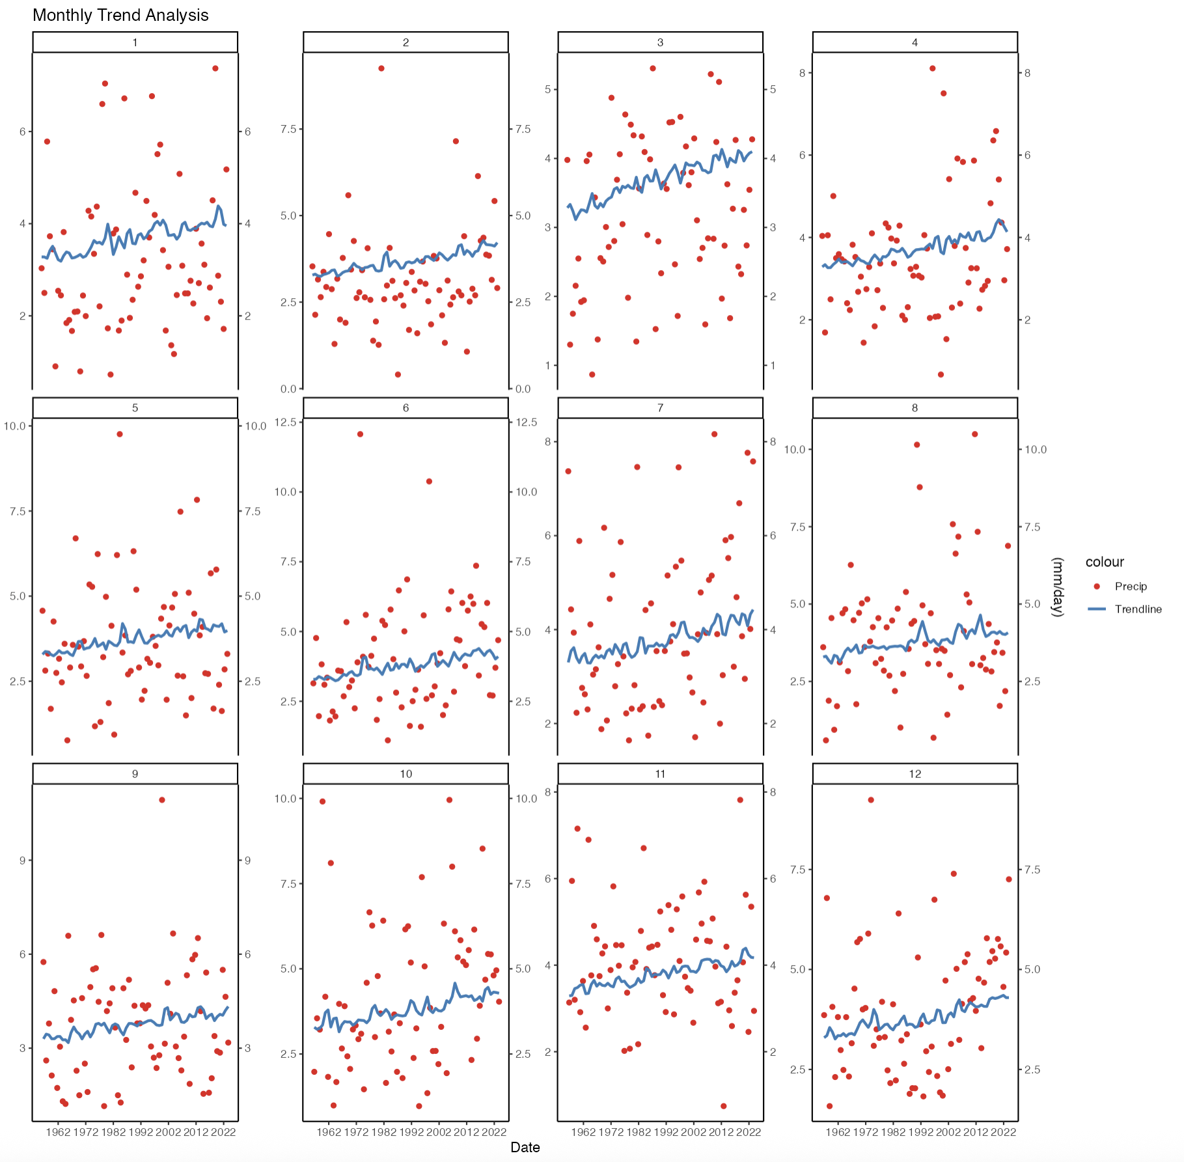
App QR Code
HydroExplore App for The Hubbard Brook Experimental Forest
By: Michael Dunlap, Humzah Naved, Owen Egan
How We Developed The App:
The app was developed primarily using R's Shiny package and was designed to provide an interactive platform for exploring long term precipitation and streamflow data at Hubbard Brook through dynamic graphs and maps.
Background:
The Hubbard Brook Experimental Forest in New Hampshire has been studying precipitation and streamflow trends since 1956 We developed an app using Shiny to observe and analyze these trends with various user interactive graphs and maps
Peak Storm Events
Streamflow and Precipitation Graphs
Map of Hubbard Brook Experimental Forest
This graph shows the sliders we use to manage the selected data, as well as our method to show the highest rainfall or streamflow events across the selected date range
Monthly Trend Plots
This shows two months of our precipitation and streamflow graphs. This allows you to compare across watersheds and see how precipitation and streamflow peaks line up.
This shows the 9 experimental watersheds in the Hubbard Brook Experimental Forest that we got our data from
Conclusion:
Enhances the ability of Hubbard Brook scientists to analyze available data.
Provides tools to examine long-term trends in precipitation and streamflow.
Offers insights into how the forest’s climate is changing over time.
Allows users to assess the impacts of climate changes on different watersheds within Hubbard Brook.
The Data We Used:
Precipitation, streamflow, and snow depth data from the 9 experimental watersheds in the Hubbard Brook Forest. We grouped the data by date and watershed to create a finalized dataset we could use
We created monthly averages, yearly graphs ordered by water year, and daily totals by watersheds.
This shows our monthly trend plots, each point of this graph is equal to the monthly total for a given year, allowing you to see trends across time within a given month. (Like seeing what the snow depth was for January in 2004 compared to 1970)
Acknowledgements:
We would like to give thanks to Dr. Gannon and Amey Bailey for their help with this project

