Slide 1
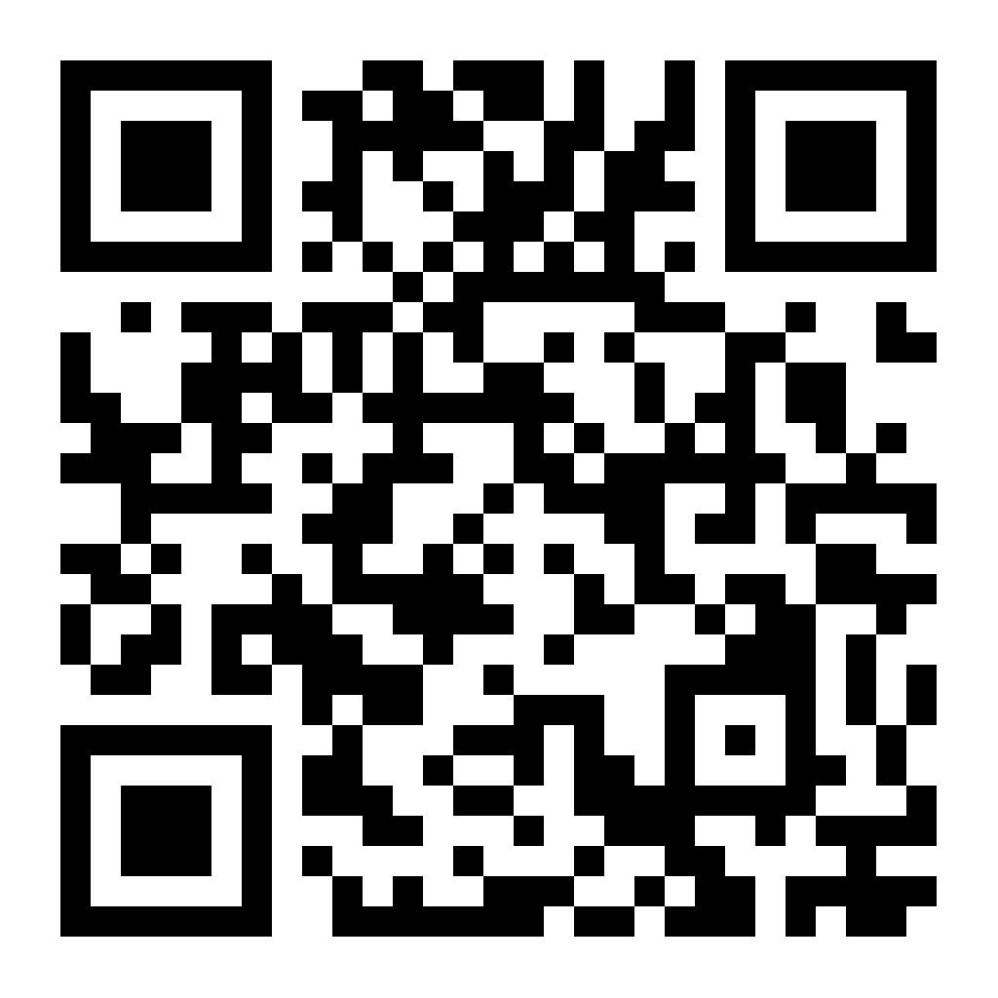
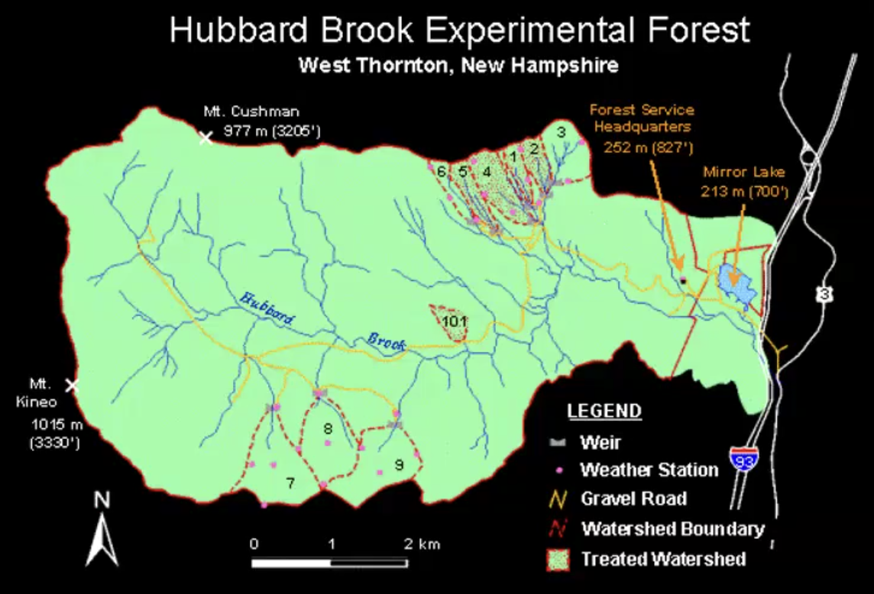
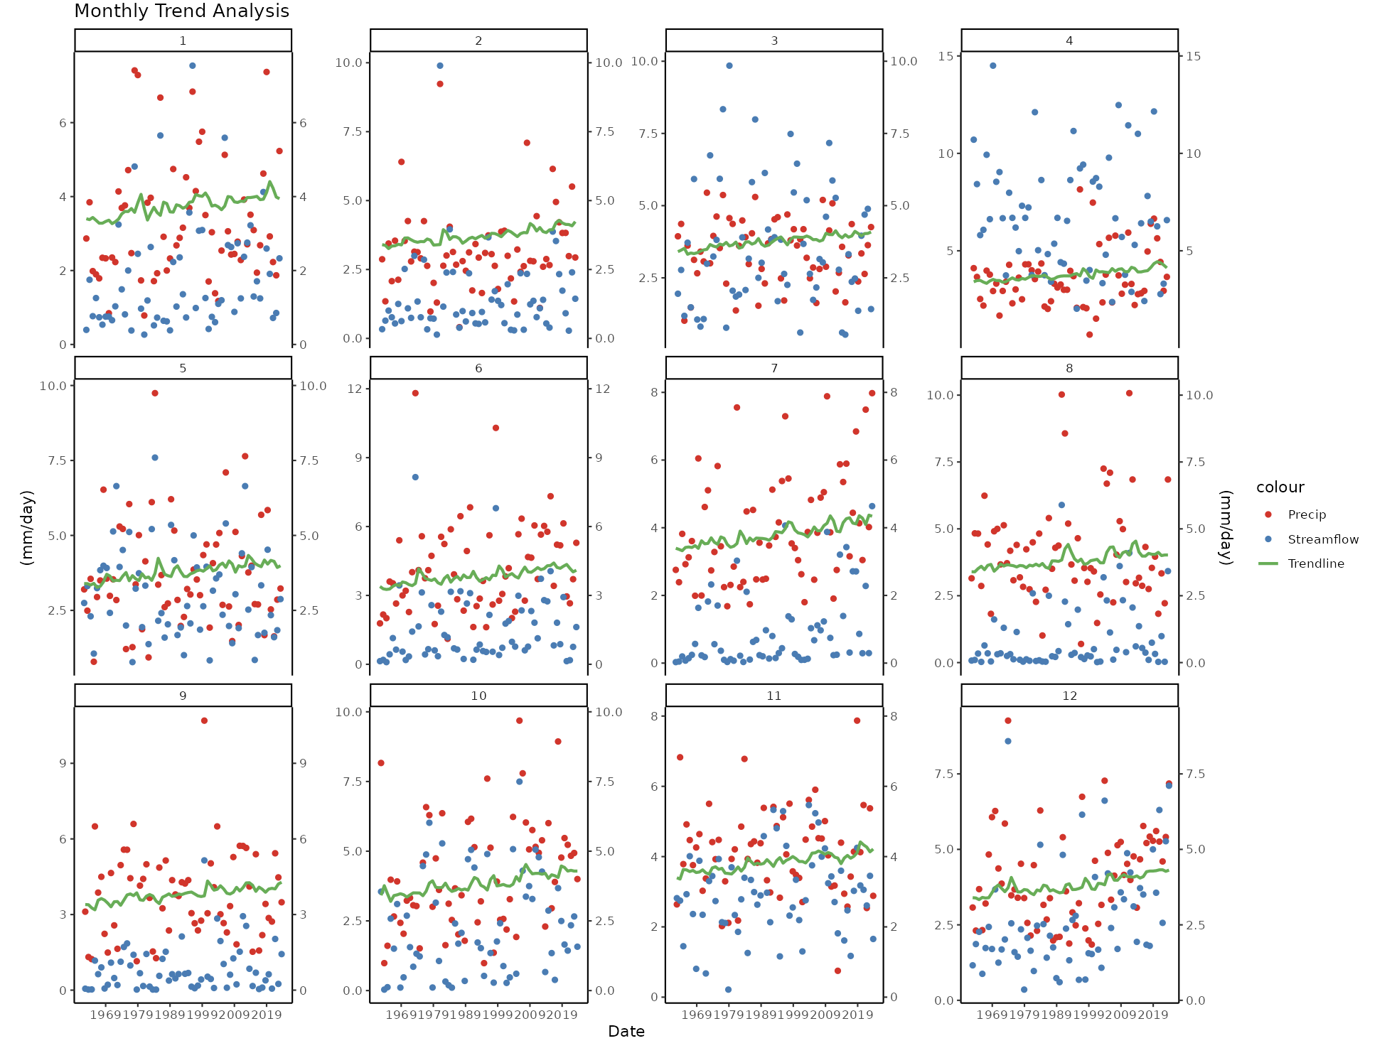
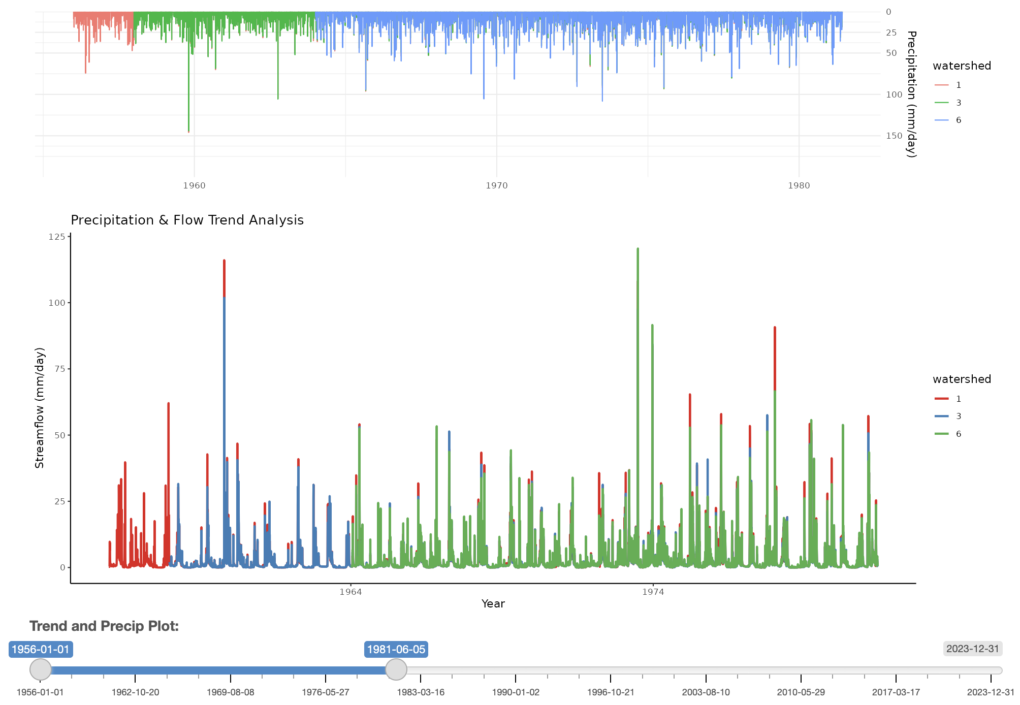
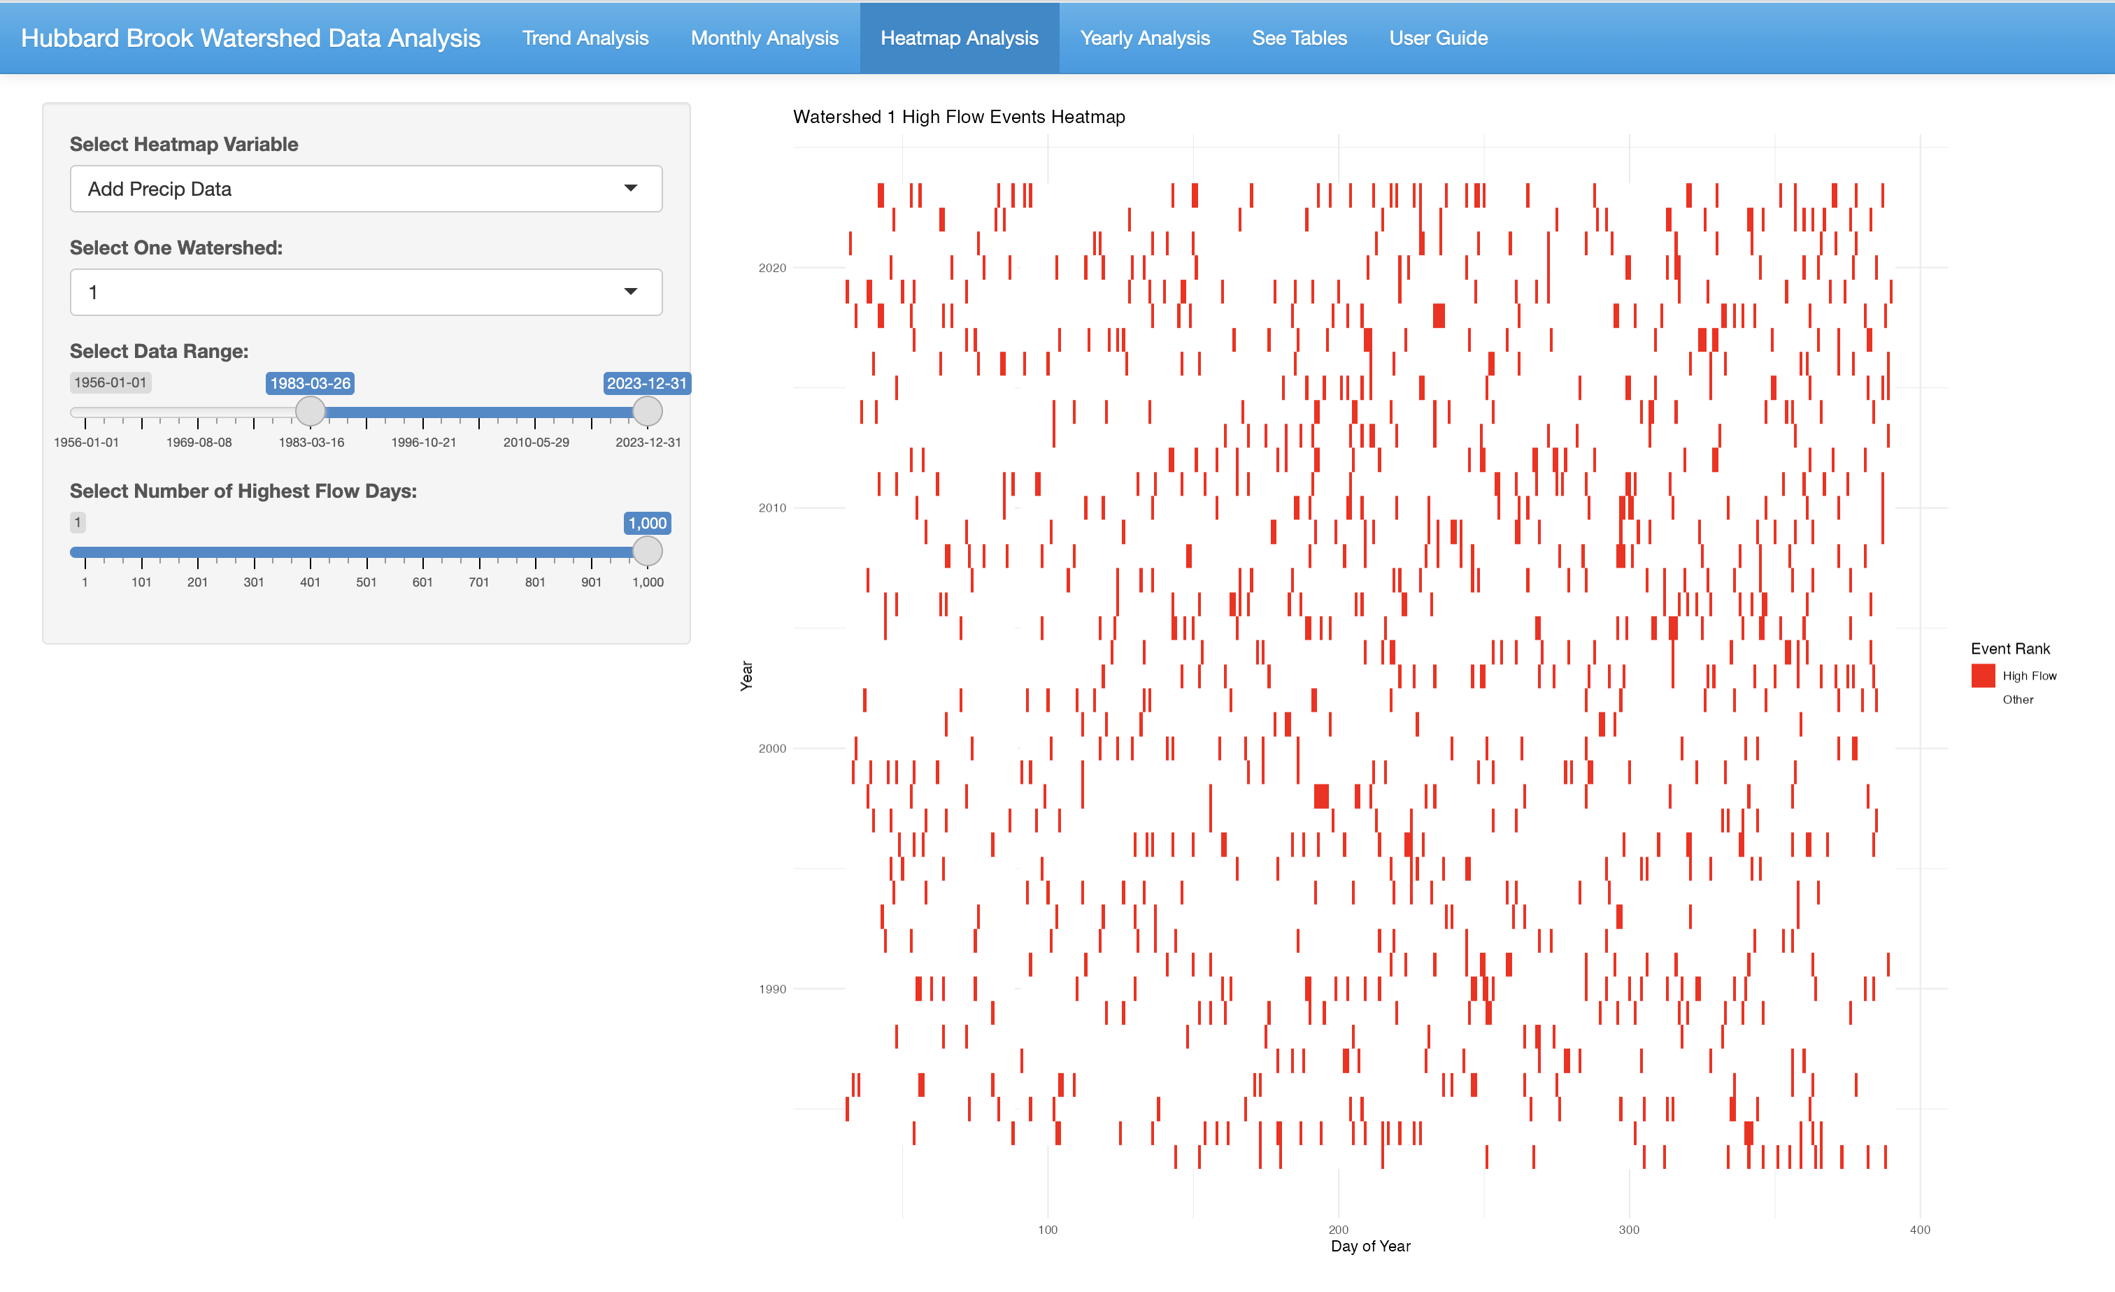
App QR Code
HydroExplore App for The Hubbard Brook Experimental Forest
By: Michael Dunlap, Humzah Naved, Owen Egan
Background: The Hubbard Brook Experimental Forest in New Hampshire has been studying precipitation and streamflow trends since 1956. We developed an app using Shiny to observe and analyze these trends with various user interactive graphs and maps.
How We Developed The App: We worked collaboratively in teams, which allowed us to divide tasks efficiently and bring together our different strengths. The app was developed using R's Shiny package and was designed to provide an interactive platform for exploring long term precipitation and streamflow data at Hubbard Brook through dynamic graphs and maps.
Conclusion: Our app is designed to improve the capacity of the Hubbard Brook Scientists to analyze the data available. By analyzing precipitation and streamflow trends over time, the app provides the user a chance to see how the climate of the forest is changing and the capability to see what effect those changes are having in the different watersheds at Hubbard Brook. It also serves as a valuable tool for communicating scientific findings to a broader audience, including educators, environmental policy makers, and the public.
The Data We Used: Precipitation, streamflow, and ice levels data from the 9 watersheds in the Hubbard Brook Forest. We grouped the data by date and watershed to create a finalized dataset we could use
Functions of the App: Allows the user to look at precipitation and streamflow, isolate days of high flow, and look at monthly or yearly trends of the data. We also allow the user to select the largest storm events and download the data the app generates
The app also has easy to use sliders to help set the dates you want to analyze, and dropdowns to select the watersheds and data you want to analyze
Acknowledgements: We would like to give thanks to Dr. Gannon and Amey Bailey for their help with this project

