Slide 1
E-ROUTE: AN ELECTRIC VEHICLE ROUTING PROBLEM
Juan Pablo Giraldo Restrepo
Juan Felipe Londoño Gaviria
Medellín, 2018

Slide 2

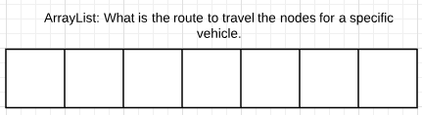
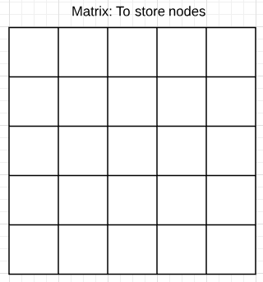
Data Structures

Slide 3
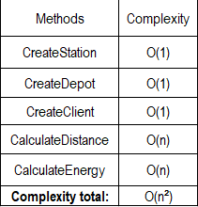
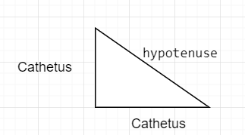
Algorithm and Complexity
Figure 1: CalculateDistance: Applies the Pythagorean Theorem. First get the positions in X and Y for the two nodes. Subtract the b-a to obtain the value of the side of the triangle known as cathetus
Table 1: Complexity of the methods without adding the battery, therefore, it can be more.

Slide 4
Algorithm design criteria
We chose to make a Greedy-type implementation because as a first idea we had planned a Tabu search but it was difficult for us to implement it and we decided to do something more tangible and close to our knowledge.
We took this decision regardless of the fact that it would probably not be the most optimal algorithm.

Slide 5
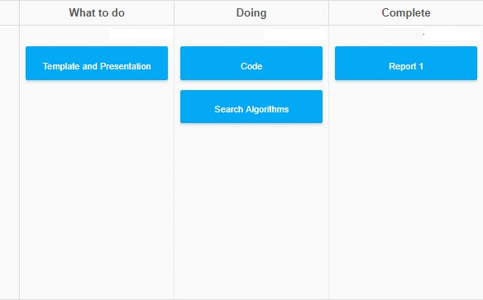
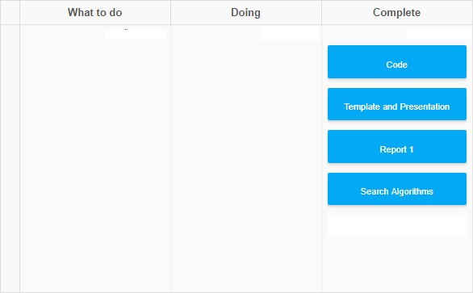



Teamwork

Slide 6
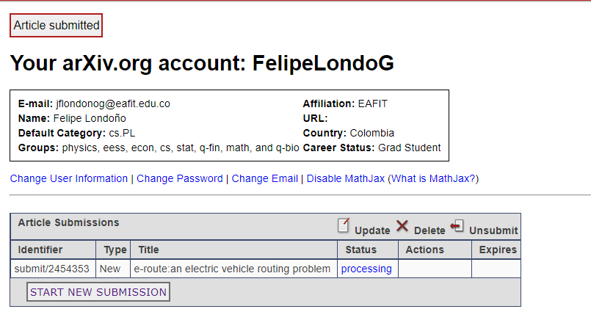

Report accepted in Arxiv
J.Felipe Londono Gaviria and J.Pablo Giraldo Restrepo. E-ROUTE: AN ELECTRIC VEHICLE ROUTING PROBLEM. ArXiv e-prints, Nov. 2018. Available at: https://arxiv.org/submit/2454353/view

