Slide 1
Web Based Student Information System
Overview
Account
Report
Dashboard
Demonstration
Account Registration
Fill out the required information
Account Confirmation
List of students
Grades of students
Summary of students
Personal Information
Certificate of Enrollment
Announcement
Monitoring
Student
Payment
Grades
Latest Update
Account Balance
Curse Curriculum

Slide 2
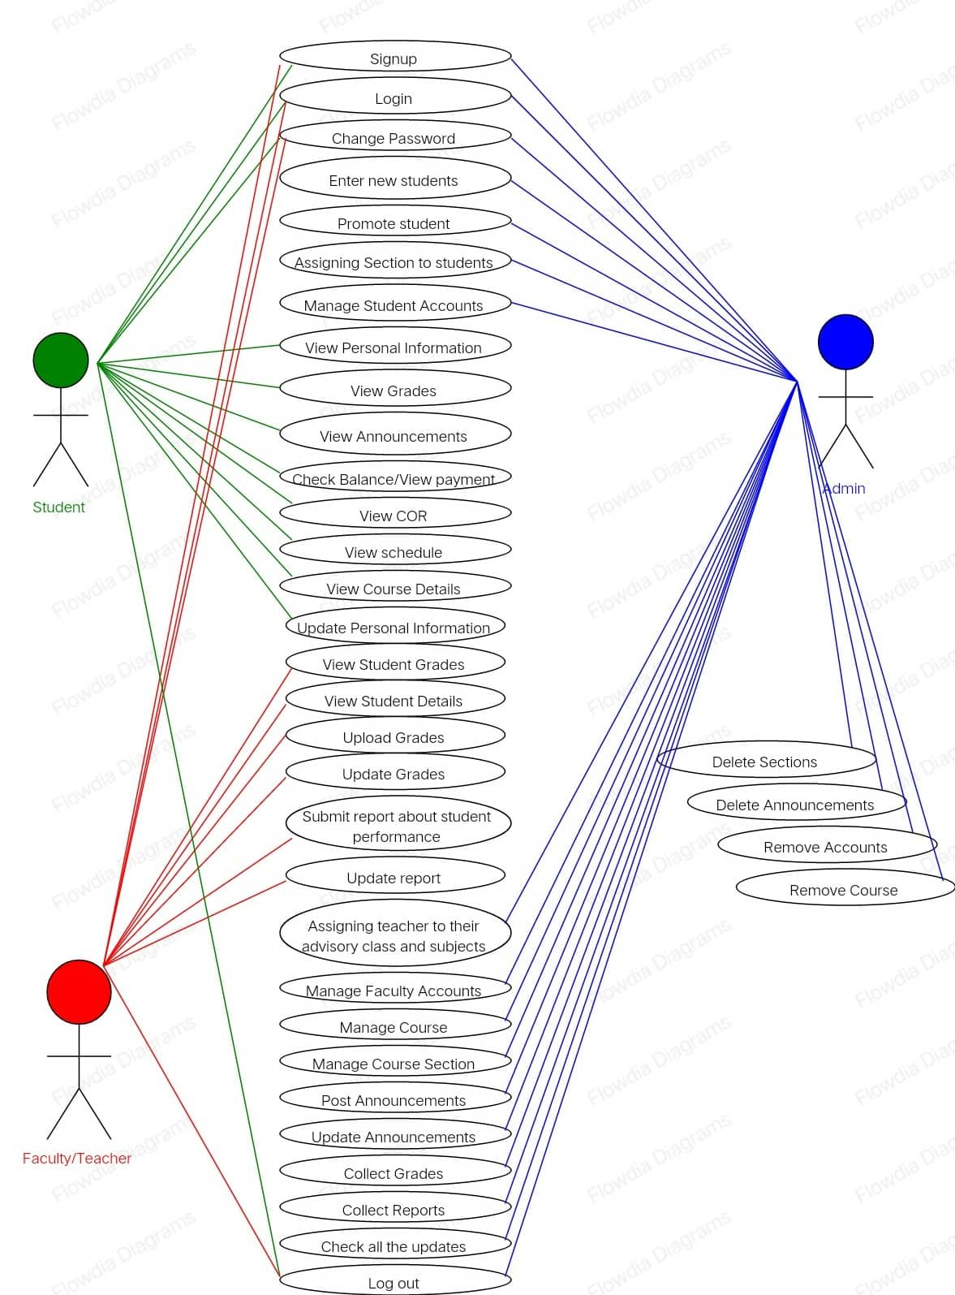

Slide 3
A_ID
R_Number
COR
Student Information System – ERD Diagram
Grade
Account
R_Password
L-name
Student-ID
AccountBalance
M_ID
F-name
R-Number
Registration
Monitoring
M-name
Has
A_ID
R_Email
R_ContactNo
Acad_Calendar
R_Birthday
R_Gender
An_ID
Grade
Annoucement
E_ID
R_Number
E_ID
Latest_Update
E_ID

Slide 4
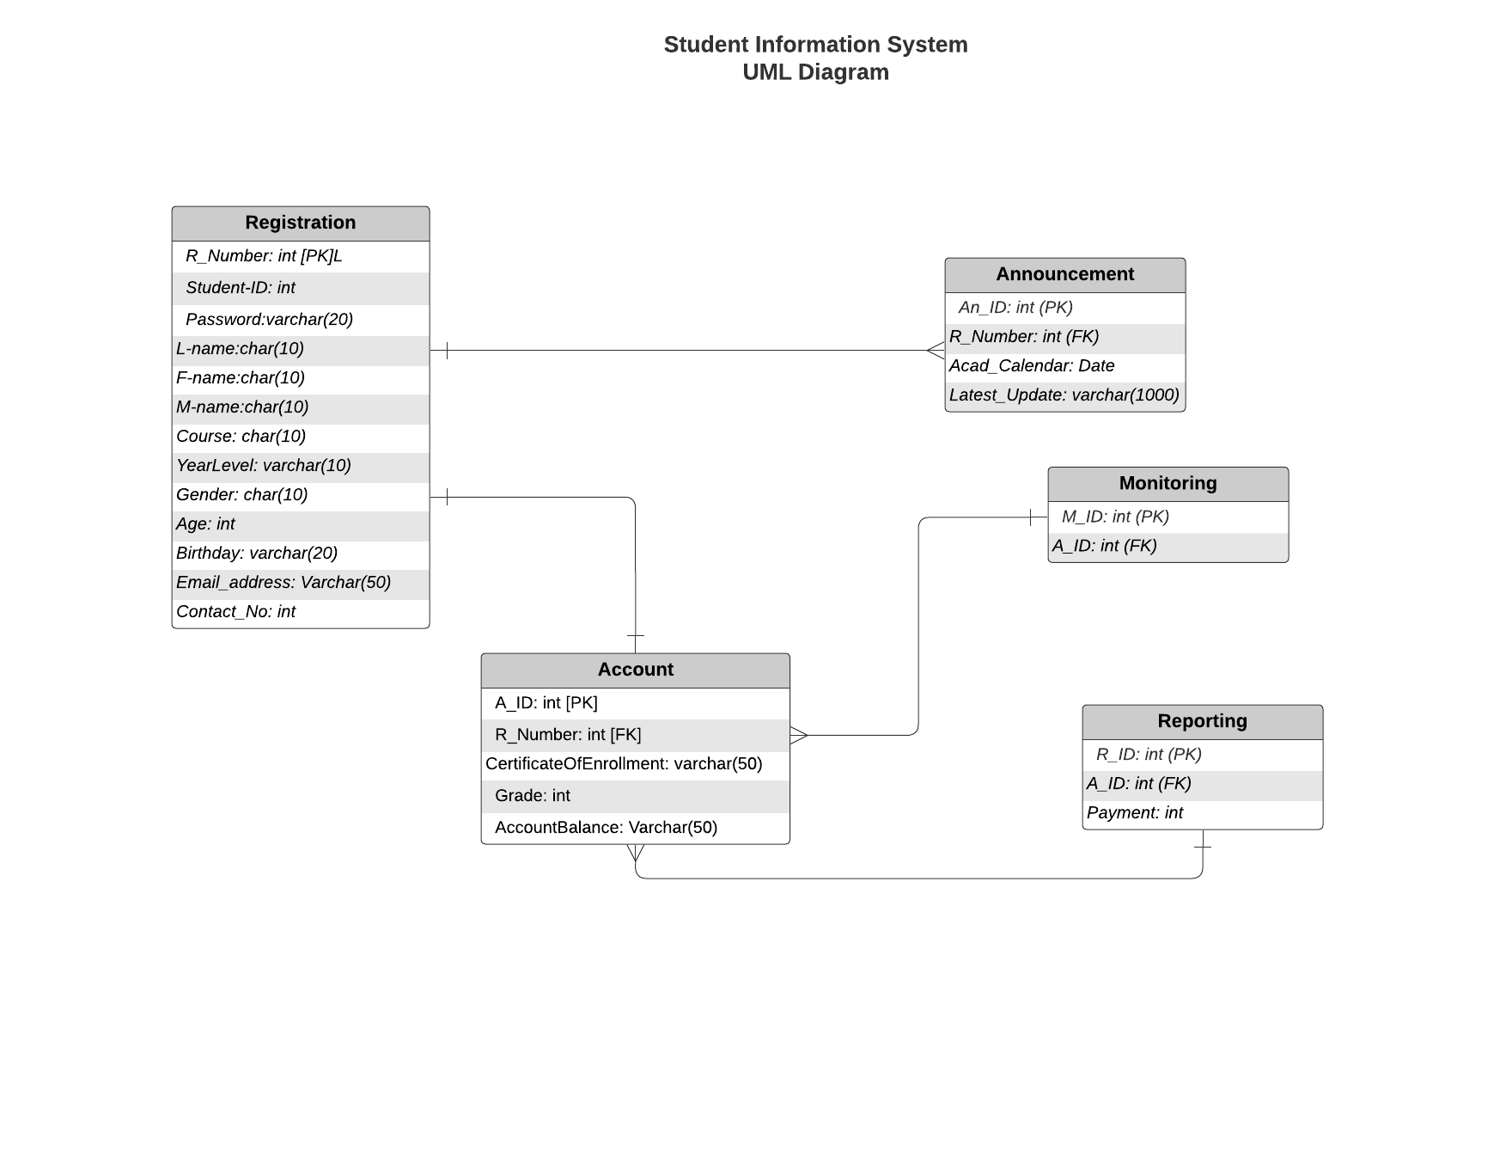

Slide 5
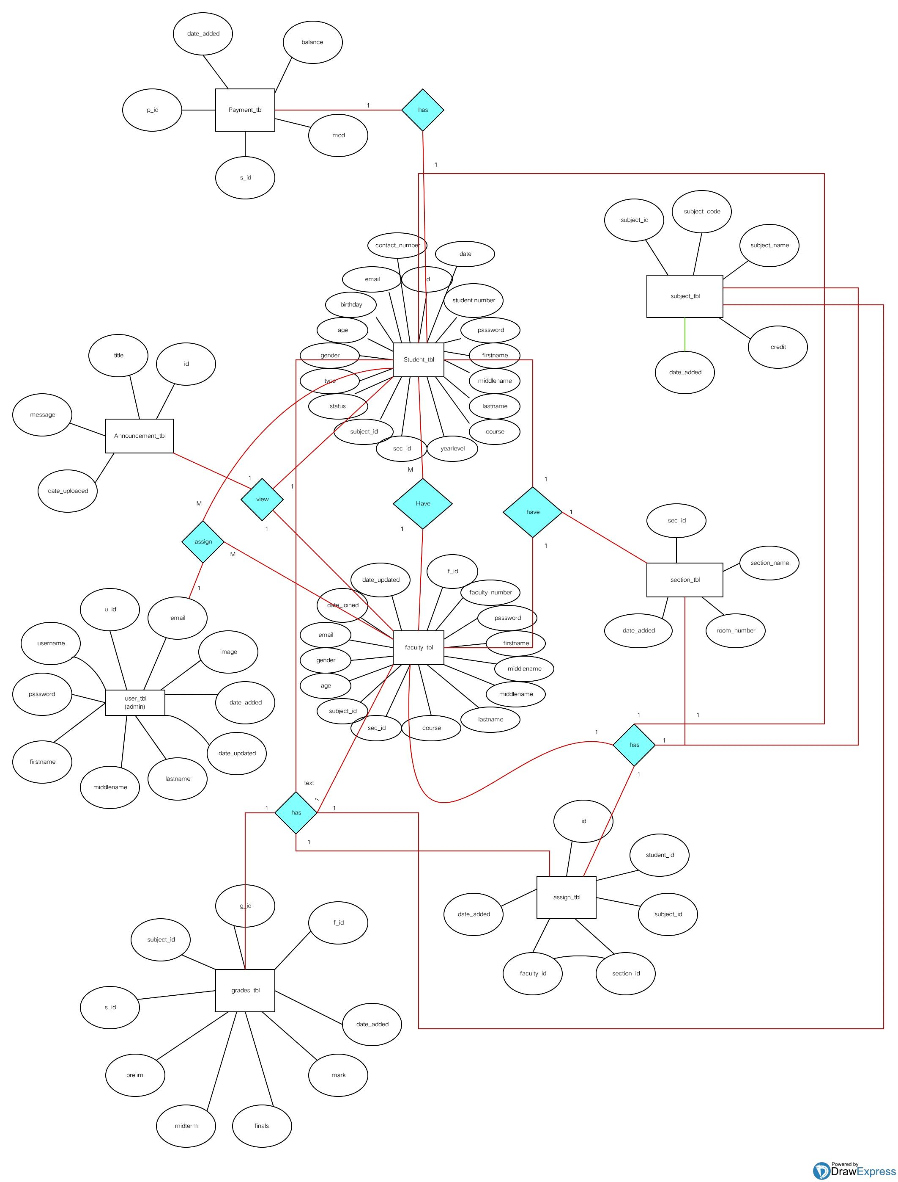

Slide 6
