Slide 1
API Workshop
Build REST APIs with Spring Boot

Slide 2
agenda
Spring Framework Introduction
Spring Boot Features
Web services, APIs and REST
Lab 1 - Build a ToDo list application using Spring Boot
https://github.com/jpgough/api-workshop

Slide 3
What is Spring?
“Make the right thing easy to do”
Rod Johnson

Slide 4
What is Spring?
Dependency injection framework for Java
Lightweight, Open Source
Layered framework
Simplifies application development
Powerful, consistent abstractions for common patterns
Data Access / Transaction Management support (JTA, JDBC, Hibernate, JPA)
Web Frameworks - Spring MVC and the newer WebFlux
Unit / Integration testing using mocks
JVM Multiple language support (Java / Groovy / Kotlin)

Slide 5
Building services using java
In the old(ish) days
<XML />
<XML />
<XML />

Slide 6

goals of spring boot
Make it easy to create stand-alone production-grade Spring applications
Facilitate rapid development through Spring Boot Starters
Provide common non-functional features
Embedded servers
Security
Metrics
Health checks
Externalized configuration

Slide 7
What is spring boot?
Opinionated
Stand Alone
<XML />

Slide 8
Opinionated
Opinionated view of Spring Platform and third-party libraries
Favours convention over configuration
Reduces need to write boiler-plate code
Quick to start-up, Hello World in a few minutes!
Opinionated
WARNING: hidden complexity!

Slide 9
Auto configuration
Including a library dependency will introduce intelligent auto configuration
Favours Java-based configuration over XML
Convenience Annotations
@SpringBootApplication equivalent to:
@EnableAutoConfiguration
@ComponentScan
@Configuration
<XML />

Slide 10
Standalone
Flexible Packaging
Self-contained executable jars with embedded web server (vs)
Traditional WAR files
Multiple deployment options
Cloud-Native platforms
Container Images (Docker)
Virtual / Real machines
Stand Alone

Slide 11
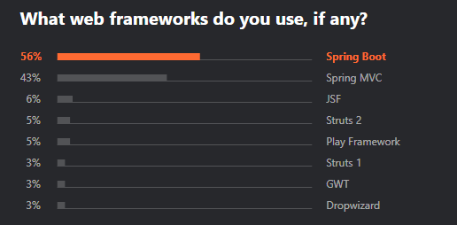
why use spring boot?
Based on mature Spring Framework (known for stability, backwards compatibility)
Open Source, active community support
ThoughtWorks Technology Radar - ADOPT in 2016 - "If you live in a Spring ecosystem and are moving to microservices, Spring Boot is now the obvious choice"
JetBrains Developer Ecosystem survey (2019)
56% use Spring Boot for Web Application development
61% use Spring Boot as an alternative to application servers
https://www.thoughtworks.com/radar/languages-and-frameworks/spring-boot
https://www.jetbrains.com/lp/devecosystem-2019/java/

Slide 12
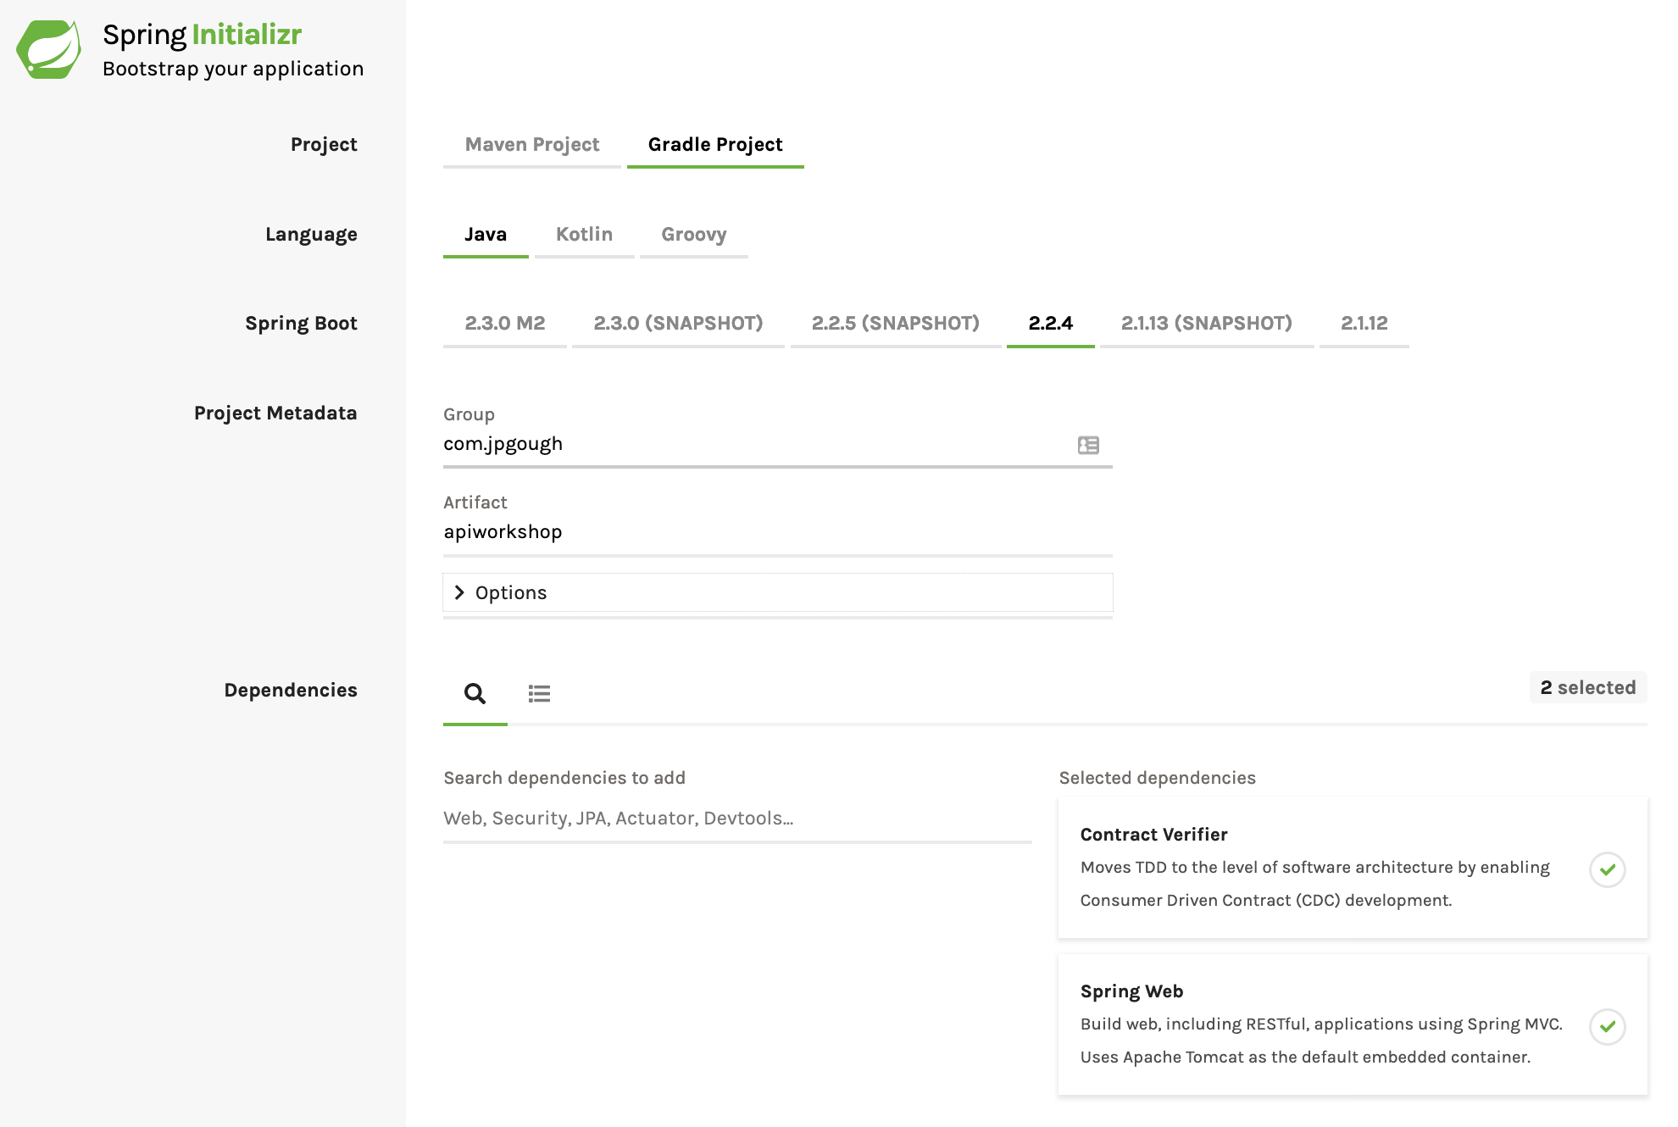
Spring Initializr - http://start.spring.io

Slide 13
Web services, apis & rest
SpringBoot makes it straightforward to build and deploy HTTP based web services
Web services expose business data and capabilities via Application Programming Interfaces (APIs)
REST can be used over HTTP to provide structure to those APIs
Spring Web spring-boot-starter-web | Starter for building web applications using Spring MVC. Uses Tomcat as the default embedded servlet container
Spring Reactive Web spring-boot-starter-webflux | Starter for building event-driven reactive web applications with Spring WebFlux and Netty

Slide 14
What is rest?
REpresentational State Transfer - Software Architecture style with guiding constraints
Client-server Architecture - Separation of concerns, allows components to evolve independently
Statelessness - No client context saved on server
Cacheability
Layered System
Code on Demand (optional)
Uniform Interface -
Resources identified using URIs
Resource manipulation through representation
Self-descriptive Messages
HATEOAS (hyperlinks based access of resources)

Slide 15
RESTful Web Services
Web Service APIs adhere to REST constraints
HTTP - commonly used as the transport layer
URLs identify resources
http://www.api-workshop.com/todos
http://www.api-workshop.com/todos/1
Operations
Create, Read, Update, Delete supported by HTTP Methods

Slide 16
REST over HTTP
HTTP verbs for operations
POST, GET, PUT, DELETE
HTTP status codes represent the result of a request
HTTP 2xx - Success
HTTP 3xx - Redirection
HTTP 4xx - Client errors
HTTP 5xx - Server errors

Slide 17
Lab 1 - Spring Boot
Build a ToDo list application using Spring Boot
https://github.com/jpgough/api-workshop

Slide 18
SPRING BOOT ANNOTATIONS
@RestController - HTTP Requests handled by this controller
@RestController equivalent to:
@Controller
@ResponseBody
@GetMapping - Maps HTTP GET Requests
@PostMapping - Maps HTTP POST Requests

Slide 19
example: get all todos
Request:
GET http://www.api-workshop.com/todos
HTTP Headers:
- Accept: application/json
Response:
200 OK
{
"todos": [
{
"id": 1,
"description": "Attend API workshop",
"done": false
}
]
}

Slide 20
example: get with query parameters
Request:
GET http://www.api-workshop.com/todos?done=false
HTTP Headers:
- Accept: application/json
Response:
200 OK
{
"todos": [
{
"id": 2,
"description": "Learn about SpringBoot",
"done": false
}
]
}

Slide 21
example: create a todo
Request:
POST http://www.api-workshop.com/todos
HTTP Headers:
- Content-Type: application/json
{
"description": "Learn about REST APIs"
}
Response:
201 CREATED
{
"id": 3,
"description": "Learn about REST APIs",
"done": false
}

