Slide 1
API Workshop
Open API and Swagger

Slide 2
Agenda
What is an Open API Specification?
Why should I consider using one?
Working with OpenAPI Specification (Swagger) and Spring Boot
Generating client code
Balancing writing specifications vs generating specifications

Slide 3
What is an Open API Specification?
XSD
gRPC
CORBA
WSDL
WADL

Slide 4
What is an Open API Specification?
Defines the structure of a REST API
Defines the objects exchanged in the REST API
Strong patterns for validation of exchanges
Describes the possible interactions between client and server
Becomes a point of consistency in a decoupled software environment

Slide 5
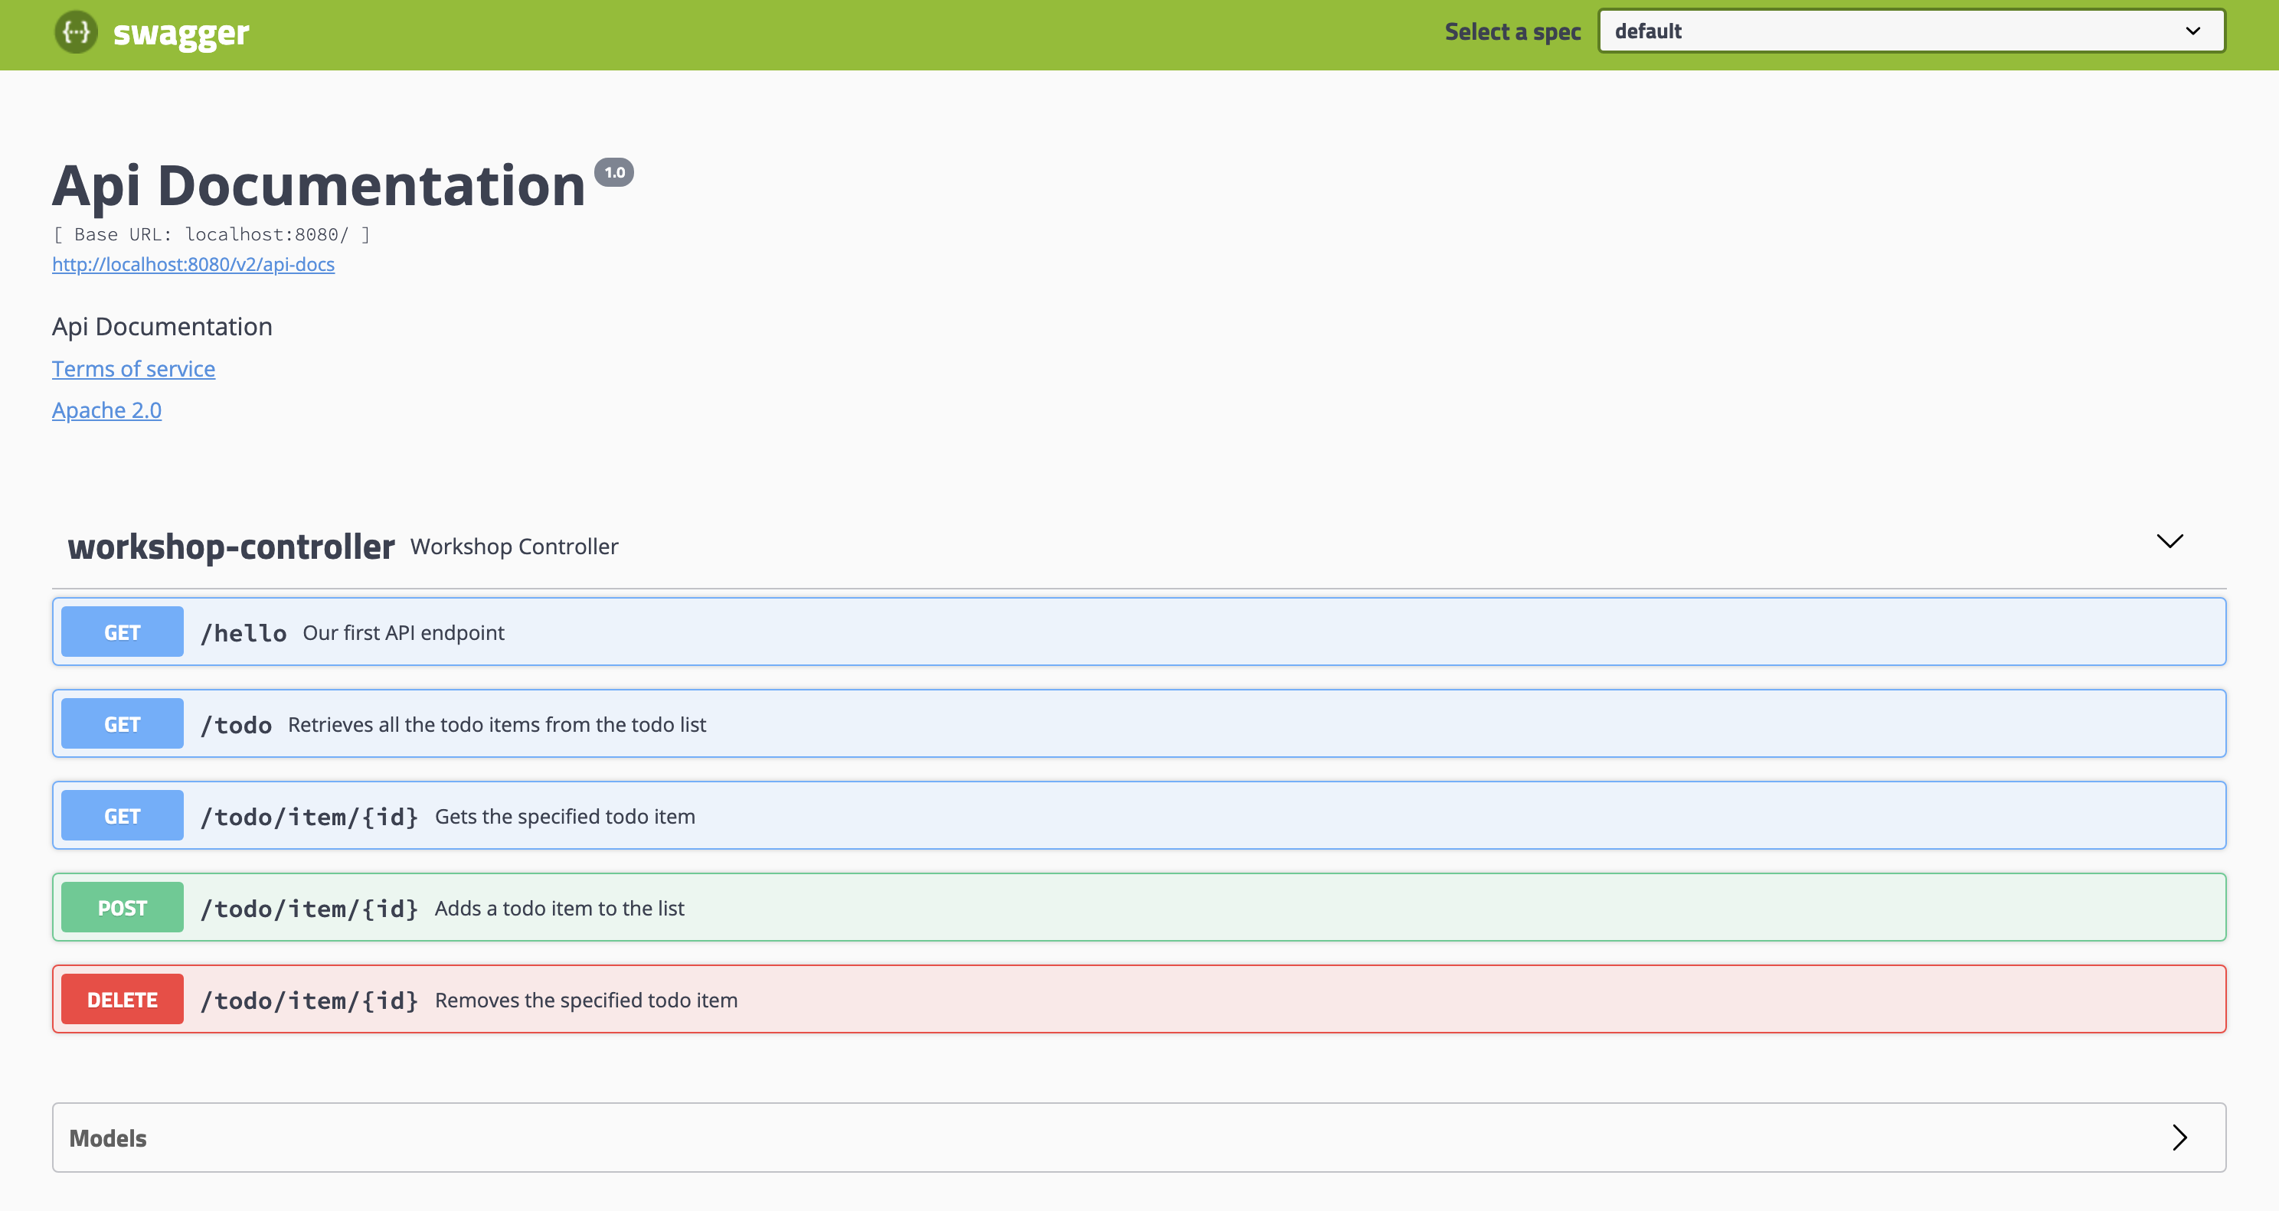
Why should I consider using Open API Specifications?
Users of the API can understand the API structure
Supplies documentation on the API
Allows developers to generate code to interact with your API
Can be used to help describe and observe changes in your API

Slide 6
Spring Boot and Open API Specification
Spring controllers describe and form the structure of an API
spring-fox is an OS project that scans annotations and generates the specification
Enabled via annotations on a Spring Boot project
Has configuration to control the detail of the specification

Slide 7
Generating Client Code
Code generation tools generate the client of an API based on the specification
Many integrations are starting to use Open API specs - e.g. REST/Excel integrations
It is also possible to generate server side code from an Open API Specification
java -jar swagger-codegen-cli.jar generate \
-i http://localhost:8080/v2/api-docs \
-l java \
-o com/jpgough/workshop/java

Slide 8
Contract Driven Development
org.springframework.cloud.contract.spec.Contract.make {
request {
method POST()
headers {
contentType(applicationJson())
}
url '/todos'
body(
"message": "A new todo"
)
}
response {
status CREATED()
headers {
header(location(), anyUrl())
}
}
}
Tests
Stub
Server
Notes:
Autogenerate tests, not code
Stub server helps to decouple UI developers from Server side developers

Slide 9
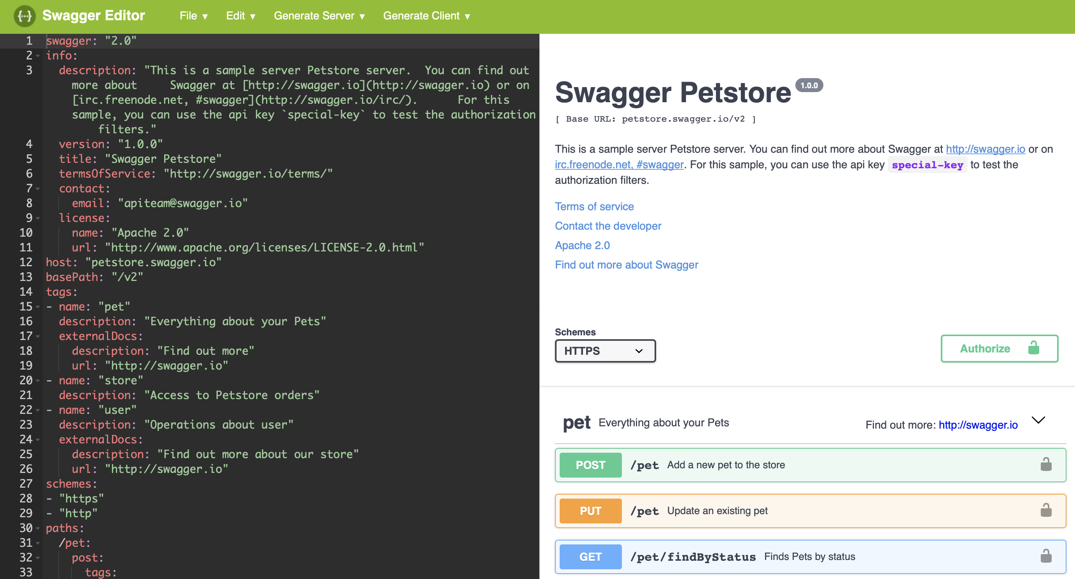
API Specification First
API Spec First
Server Code
Code Generator
Client Code
https://editor.swagger.io
Notes:
Not client focused/driven
Over design the API
Have to manually role stubs

