Slide 1
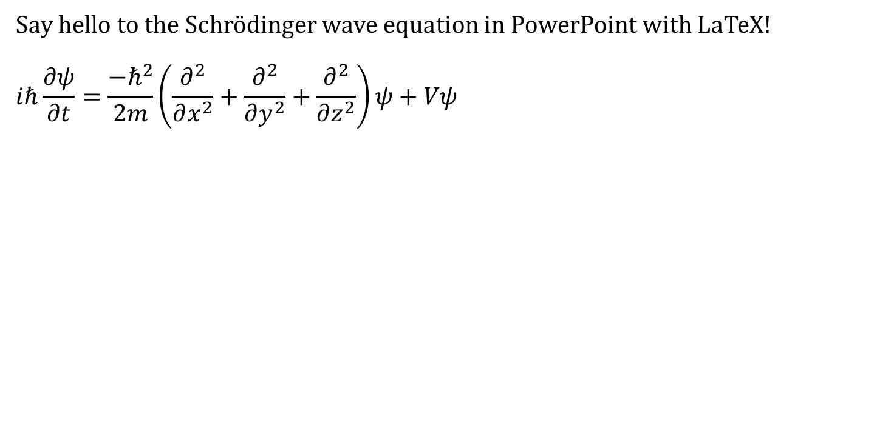
Hello LaTeX
Say hello to the Schrödinger wave equation in PowerPoint with LaTeX!
$$iℏ\frac{∂ψ}{∂t}=\frac{−ℏ^{2}}{2m}\left(\frac{∂^{2}}{∂x^{2}}+\frac{∂^{2}}{∂y^{2}}+\frac{∂^{2}}{∂z^{2}}\right)ψ+Vψ$$

