Slide 1

WEL GW
Women’s Entrepreneurial Leadership
`
This material is for Hot Mommas® Project / Vision Forward, LLC Leadership Academy, not to be replicated, or posted. For questions about speaking or content licensing support@HotMommaProject.org / 202.237.8000

Slide 2
Today:
AI BOA
Why
How
Results
+Bonus
Notes:
Blackbook 12.45-1.05 (really need MORE discussion time here but trying more time on BOA)
Board Build and share 1.05 – 2
Break (possible Liz annc)
2.15 Book Clubs
3 – Team time
OLD
Annc – book club / consolidated plan
Leadership Playbook walk through (or next time) – due 3/20 along with mentorship playbook
Bingo
Team Time
Kiki
Future – work plan (from week 2) and LABS turned in
KKF note: Book club
In the future can decide if we want to give people a choce - b/c a lot chose a date near R2 deadline

Slide 3
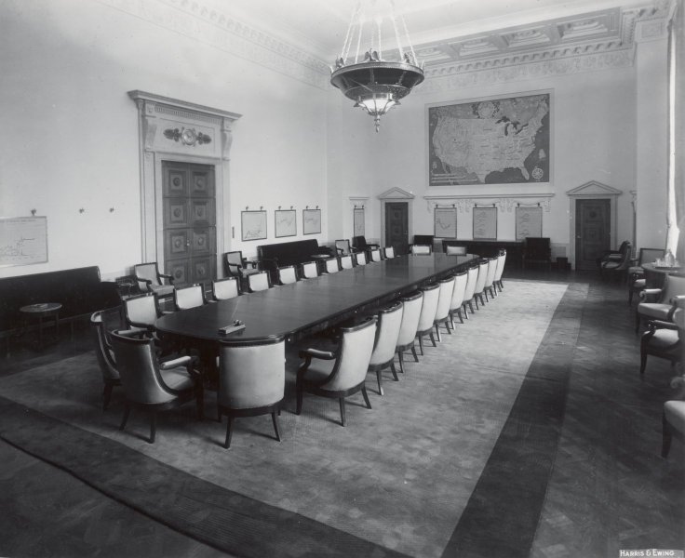
INSIDE THE BOARD ROOM
Copyright Katherine Korman Frey
This Photo by Unknown Author is licensed under CC BY

Slide 4

The challenge: Girls / women have lower self efficacy than boys / men.
*Can start as early as age 11.

Slide 5
Men apply for a job when they meet only 60% of the qualifications, but women apply only if they meet 100% of them.
Source: HP Internal Report

Slide 6

2/3 female CEOs didn’t think of being CEO until someone mentioned it.

Slide 7

Break the Research

Slide 8

Women negotiated higher than male counterparts when acting on behalf of others
Source: Hannah Riley Bowles
Notes:
In this second of three lessons for the future entrepreneur, we will delve into the steps and considerations involved with turning an idea into a business.
You have a passion or a hobby, can this be a business? You have an idea – there is a need for a product or service – but you need to know more about your market before you go into business. Last, of what risks should you be aware? These are all topics that will be covered during this learning module.

Slide 9
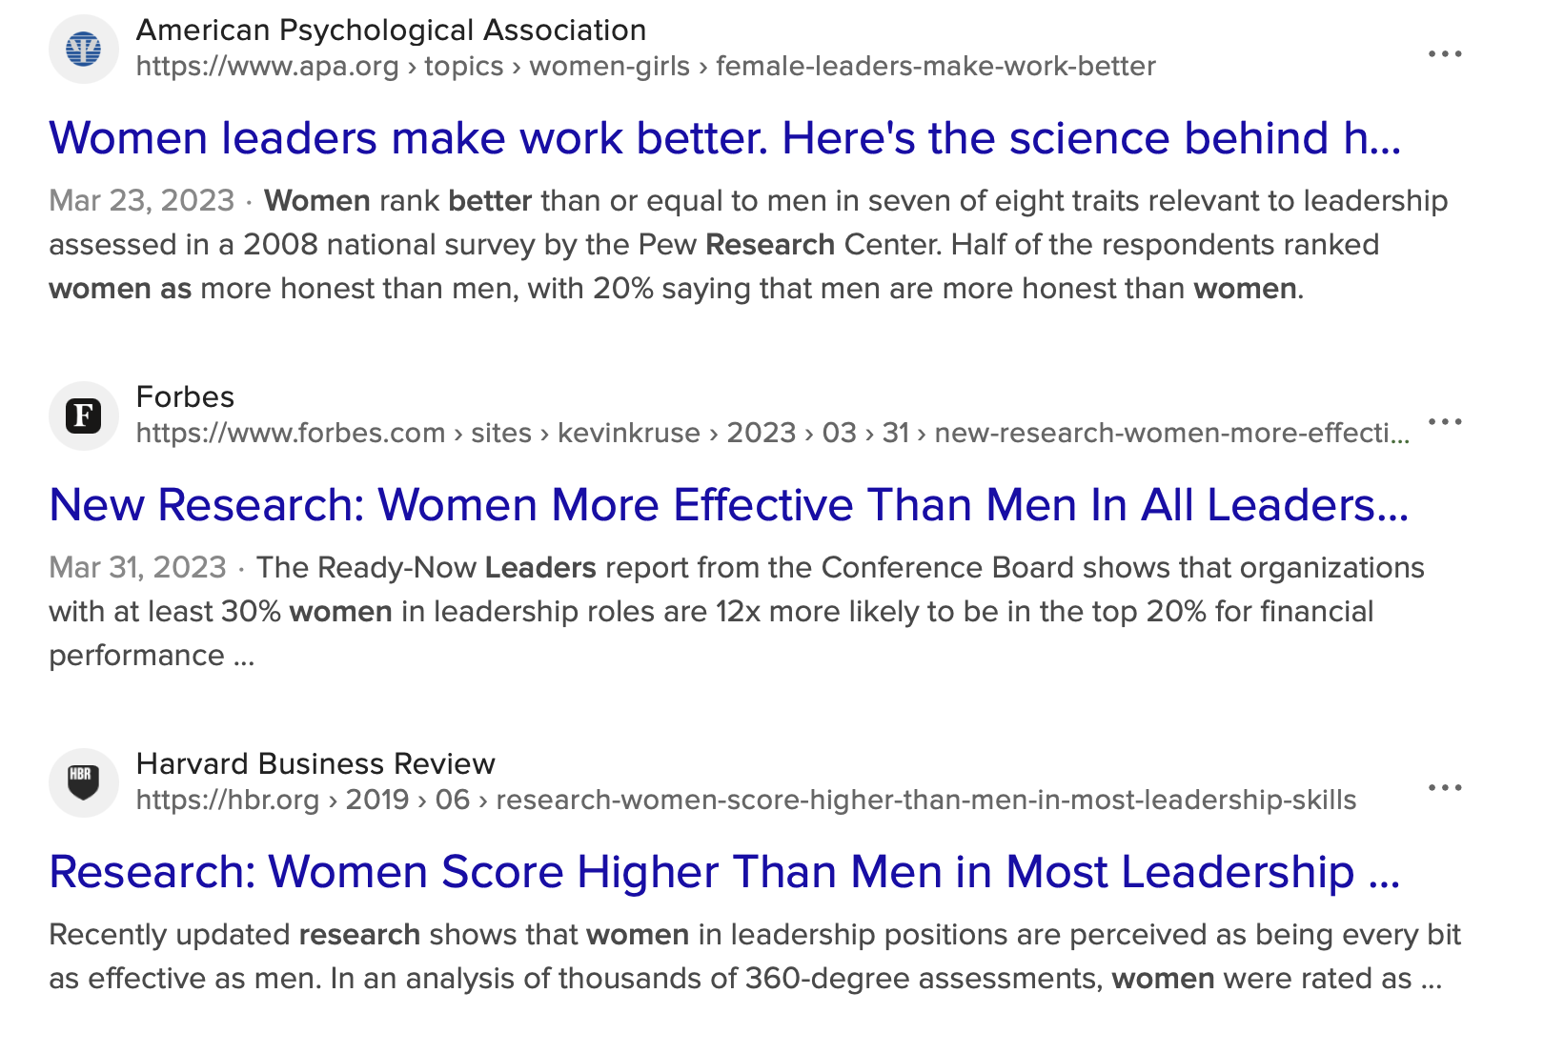
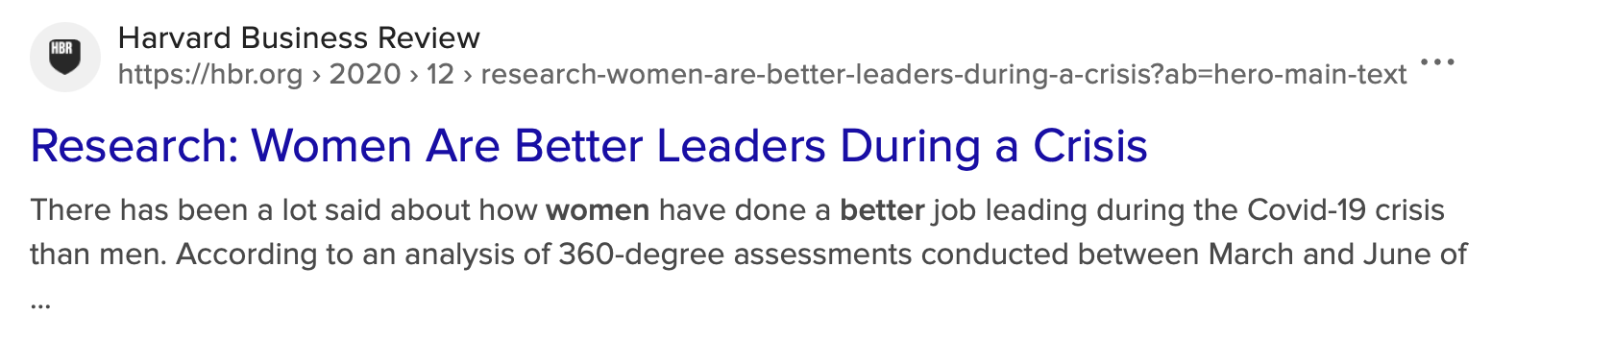
Across many studies, women are better leaders.

Slide 10
Access to mentors and role models shown to entrepreneurial increase self-efficacy for women (5 = minimum number)

Slide 11
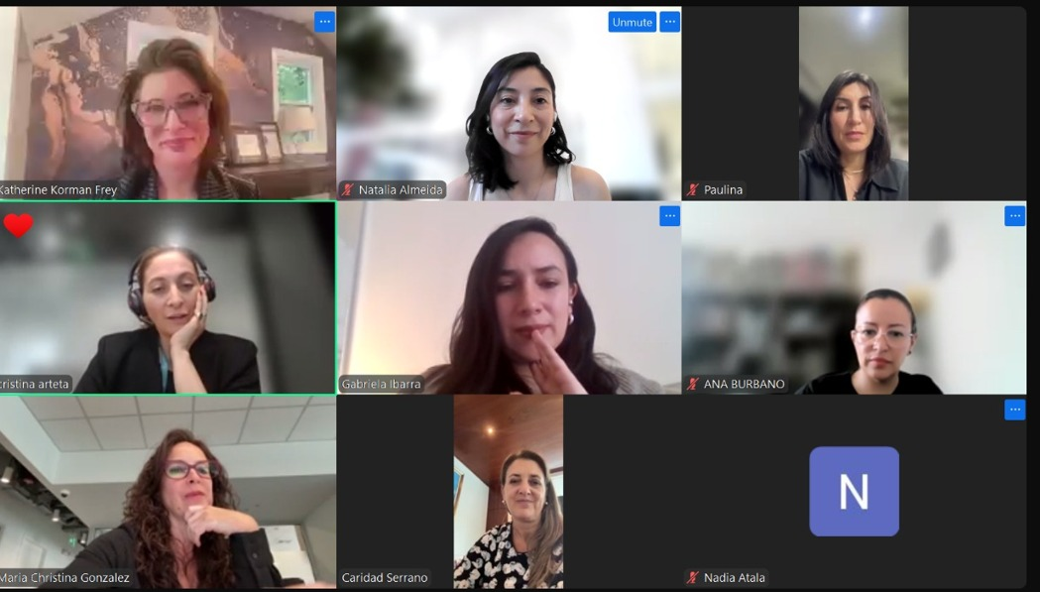
WHO WANTS TO BE CEO?
Copyright Katherine Korman Frey

Slide 12
The Revelation:
Q: Want to be CEO?
A: “Yes” with BOA

Slide 13
YOUR PERSONAL
BOA: BUILD IT
Copyright Katherine Korman Frey
This Photo by Unknown Author is licensed under CC BY

Slide 14
It takes just as much time and effort to dream small as to dream big, so you might as well DREAM BIG!
~ Rosabeth Moss Kanter

Slide 15

I. “DREAM BIG” Career Goal
II & III: CONTEXT and BOA
Formation
IV & V: (more) CONTEXT and BOA Revision
Game Time: Call the Meeting To Order

Slide 16
I. DREAM BIG CAREER GOAL
  Sample chat prompt:
  I want to be ________ in 5/10/20 years. I want to assemble a board of advisors to coach, mentor, and get me there. What do you information do you need to know to assemble this personal BOA?
  Two scenarios:
  You know the goal
  You don’t (let AI guide you)

Slide 17
II. CONTEXT ROUND 1
  Answer the bot’s questions, which may be:
  About board
    E.g., Historical or current figures (or chat bot assembles on own)
  About you
    Your background, skills, education, plans for education, skill acquisition, career between now and then (or let bot guide you)
    Your values and motivations

Slide 18
III. BOA ROUND 1
  Ask AI to assemble the board for you.

Slide 19
IV. CONTEXT ROUND 2
  Enhance context with YOUR info to shape a revised board. E.g.,
  What other information can you provide to deepen results?
  Where would you like to work (geography / field)
  What culture of organization are you seeking (or would you like to create)
  People (not institutions, if bot has put offices on your board).

Slide 20
V. BOA ROUND 2
  Ask AI to re-assemble the board for you given the additional context.

Slide 21
GAME TIME: CALL THE MEETING TO ORDER
  Ask the first question to your personal board of advisors.
  Sample: Specific /General
  Lay out a career, education, and skills acquisition path for me for the next ____ years.
  I want to _____, how do I best go about that?

Slide 22
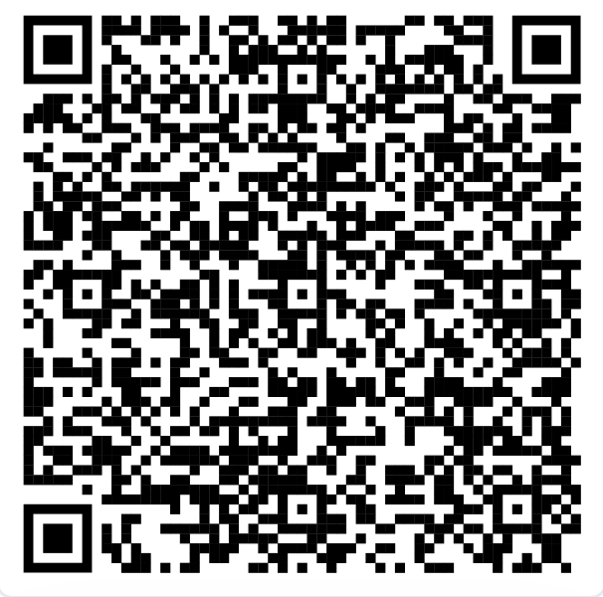
AI BOA:
HOW DID IT GO?
Self Efficacy Equation – Build It:
Confidence-building experience
Group of mentors
What they say to you
Jedi Mind-Tricks (self-talk)

Slide 23
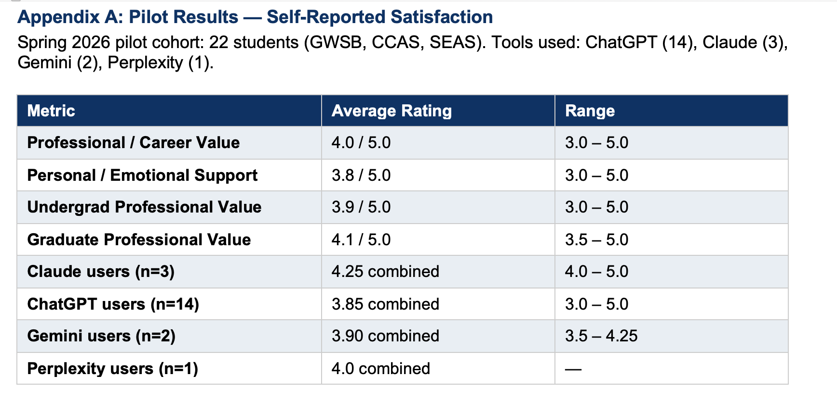
RESULTS: Professional Satisfaction + Claude Highest Marks

Slide 24
RESULTS: Sample Board 1
Student: Undergraduate, Marketing / Entrepreneurship
Student goal (prompt): "I want to be a CEO of a fashion or lifestyle brand within 10 years. I'm good at marketing and brand storytelling but weak on finance and operations."
AI tool used: ChatGPT
Student satisfaction: 4 / 5

Slide 25
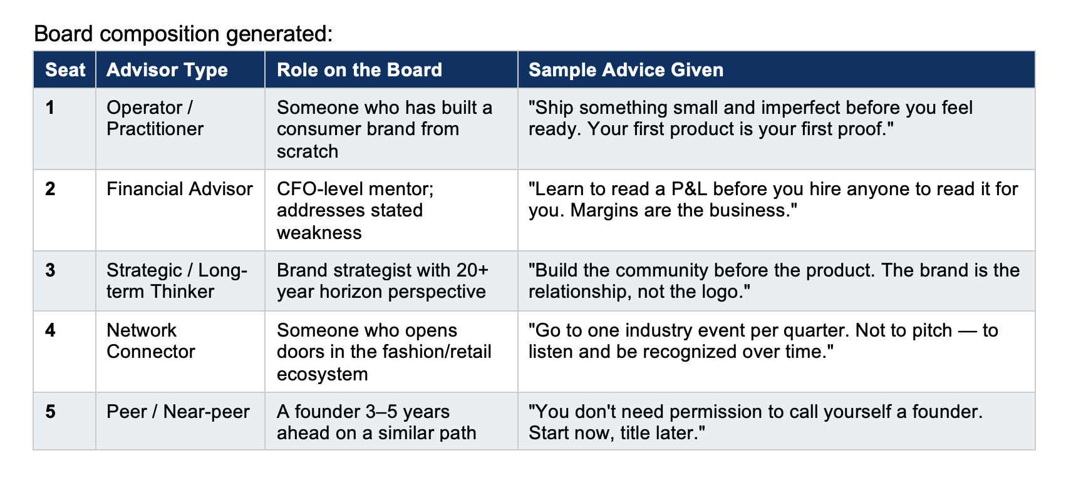
Sample Board 1

Slide 26
RESULTS: Sample Board 2
Student: Graduate Student, International Business / Impact Investing
Student goal (prompt): "I'm building a dairy farming operation in Zimbabwe with a 3-year plan to raise $500K in impact capital. I need help with financial modeling, investor relations, and navigating the political and regulatory environment in MENA/Africa."
AI tool used: Claude
Student satisfaction: 5 / 5

Slide 27
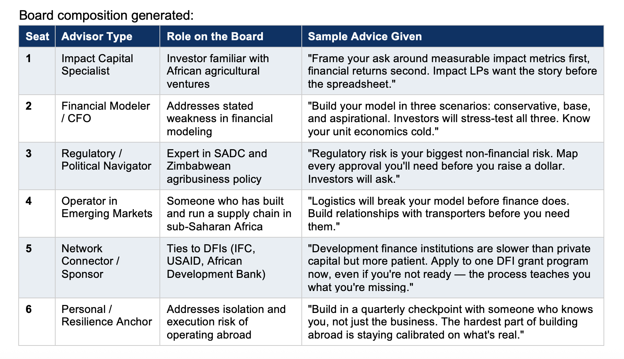
Sample Board 2

Slide 28
RESULTS
  Success correlation: The more specific the student's prompt, the more targeted and actionable the board.
  Limitations: AI couldn't fully account for IRL specifics (e.g., on-the-ground political complexity in Zimbabwe).

Slide 29
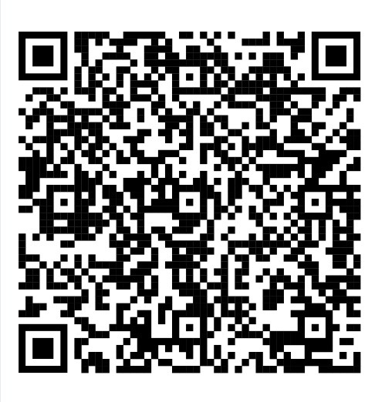
…And now for something completely different
Self Efficacy Equation – Build It:
Confidence-building experience
Group of mentors
What they say to you
Jedi Mind-Tricks (self-talk)
KKF’s GW AI Expense Coach

