Slide 1
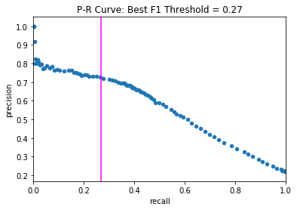
Validation Precision-Recall Curve for g_{mono}
Best F1 at p = 0.27
Precision
Recall

Slide 2
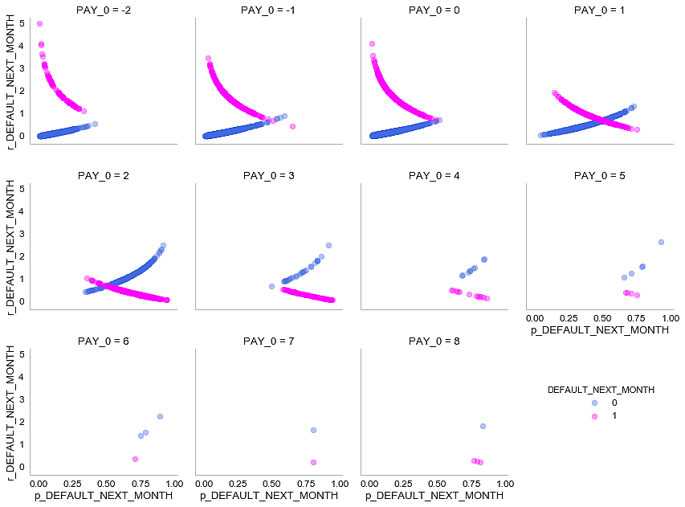
PAY_0 = -2
PAY_0 = -1
PAY_0 = 0
PAY_0 = 1
r_DEFAULT_NEXT_MONTH
PAY_0 = 2
PAY_0 = 3
PAY_0 = 4
PAY_0 = 5
r_DEFAULT_NEXT_MONTH
PAY_0 = 6
PAY_0 = 7
PAY_0 = 8
p_DEFAULT_NEXT_MONTH
DEFAULT_NEXT_MONTH
r_DEFAULT_NEXT_MONTH
0
1
p_DEFAULT_NEXT_MONTH
p_DEFAULT_NEXT_MONTH
p_DEFAULT_NEXT_MONTH

Slide 3
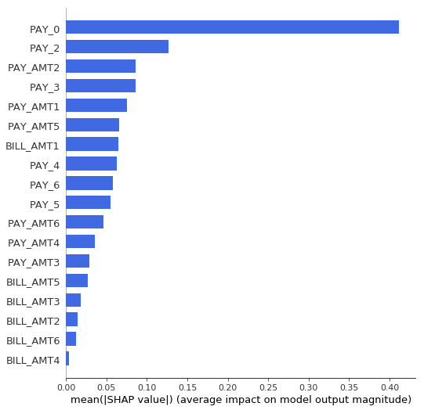
PAY_0
PAY_2
PAY_AMT2
PAY_3
PAY_AMT1
PAY_AMT5
BILL_AMT1
PAY_4
PAY_6
PAY_5
PAY_AMT6
PAY_AMT4
PAY_AMT3
BILL_AMT5
BILL_AMT3
BILL_AMT2
BILL_AMT6
BILL_AMT4
Mean(|SHAP| value) (average impact on prediction magnitude)

Slide 4
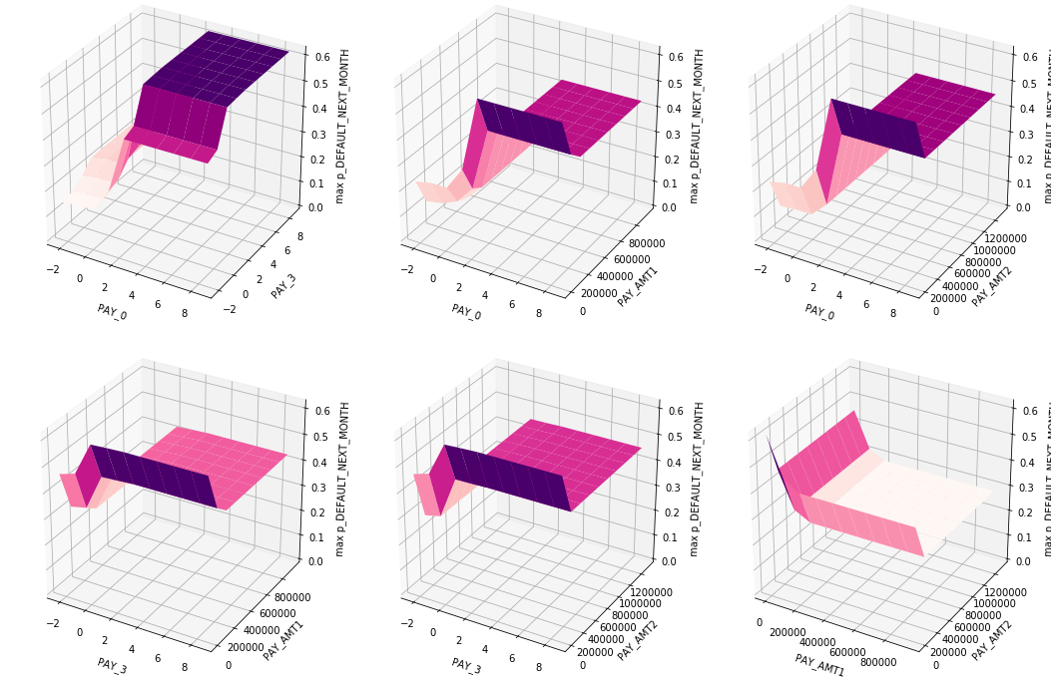
p_DEFAULT_NEXT_MONTH
p_DEFAULT_NEXT_MONTH
p_DEFAULT_NEXT_MONTH
Possible Adversarial Attack
PAY_3
PAY_AMT1
PAY_AMT2
PAY_0
PAY_0
PAY_0
Over-emphasis on PAY_* features results in prediction of default, even for massive repayments.
Possible Adversarial
Attack
p_DEFAULT_NEXT_MONTH
p_DEFAULT_NEXT_MONTH
p_DEFAULT_NEXT_MONTH
PAY_AMT1
PAY_AMT2
PAY_AMT2
PAY_3
PAY_3
PAY_AMT1

Slide 5
p_DEFAULT_NEXT_MONTH
p_DEFAULT_NEXT_MONTH
p_DEFAULT_NEXT_MONTH
PAY_3
PAY_AMT1
PAY_AMT2
PAY_0
PAY_0
PAY_0
p_DEFAULT_NEXT_MONTH
p_DEFAULT_NEXT_MONTH
p_DEFAULT_NEXT_MONTH
PAY_AMT1
PAY_AMT2
PAY_AMT2
PAY_3
PAY_3
PAY_AMT1

Slide 6
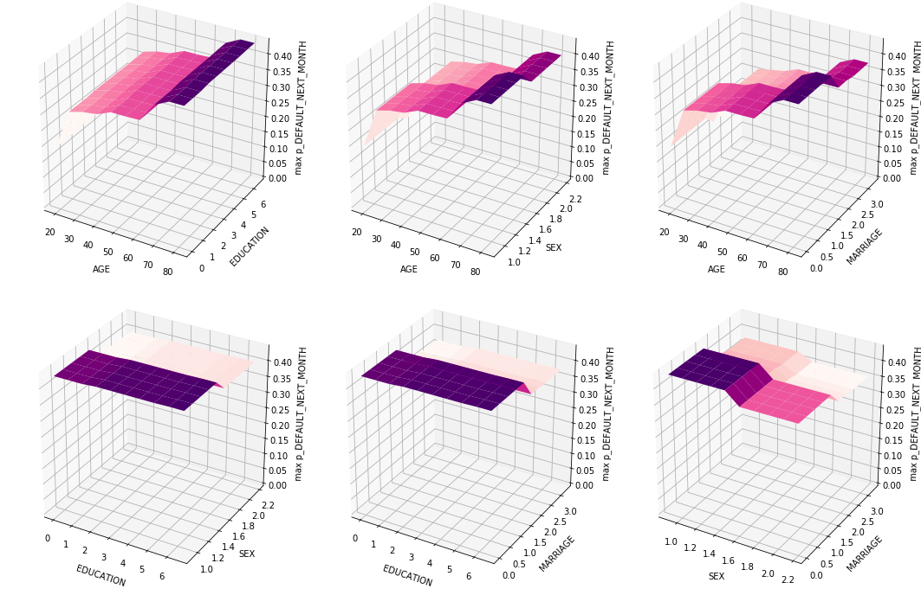
p_DEFAULT_NEXT_MONTH
p_DEFAULT_NEXT_MONTH
p_DEFAULT_NEXT_MONTH
EDUCATION
MARRIAGE
SEX
AGE
AGE
AGE
p_DEFAULT_NEXT_MONTH
p_DEFAULT_NEXT_MONTH
p_DEFAULT_NEXT_MONTH
MARRIAGE
MARRIAGE
SEX
EDUCATION
EDUCATION
SEX

Slide 7
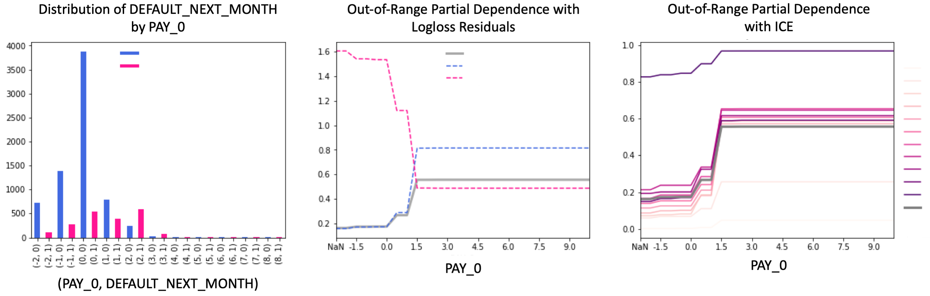
DEFAULT_NEXT_MONTH: 0
DEFAULT_NEXT_MONTH: 1
Partial Dependence
Residual: 0
Residual: 1
Percentile: 0
Percentile: 10
Percentile: 20
Percentile: 30
Percentile: 40
Percentile: 50
Percentile: 60
Percentile: 70
Percentile: 80
Percentile: 90
Percentile: 99
Partial
Dependence

Slide 8
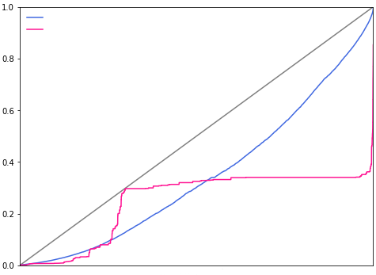
Ranked Predictions on Random Data
33% Missing Data
0% Missing Data
p_DEFAULT_NEXT_MONTH
Ranked Row Index

Slide 9
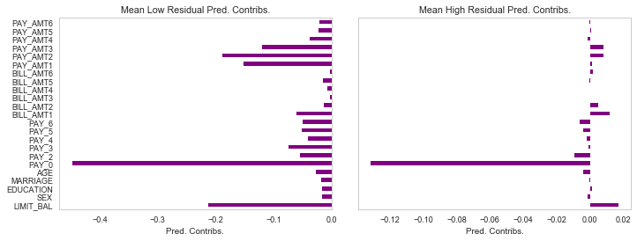
Low Residual Rows
High Residual Rows
PAY_AMT6
PAY_AMT5
PAY_AMT4
PAY_AMT3
PAY_AMT2
PAY_AMT1
BILL_AMT6
BILL_AMT5
BILL_AMT4
BILL_AMT3
BILL_AMT2
BILL_AMT1
PAY_6
PAY_5
PAY_4
PAY_3
PAY_2
PAY_0
AGE
MARRIAGE
EDUCATION
SEX
LIMIT_BAL
Average Shapley Feature Contributions
Average Shapley Feature Contributions

Slide 10
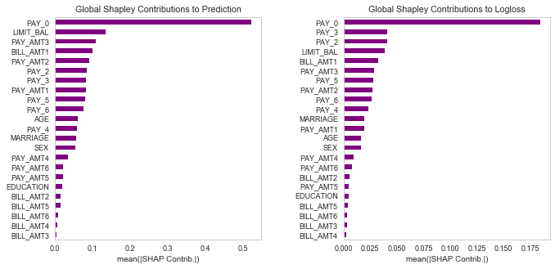
Global Shapley Feature Importance for Predictions
Global Shapley Feature Importance for Logloss
PAY_0
LIMIT_BAL
PAY_AMT3
BILL_AMT1
PAY_AMT2
PAY_2
PAY_3
PAY_AMT1
PAY_5
PAY_6
AGE
PAY_4
MARRIAGE
SEX
PAY_AMT4
PAY_AMT6
PAY_AMT5
EDUCATION
BILL_AMT2
BILL_AMT5
BILL_AMT6
BILL_AMT4
BILL_AMT3
PAY_0
PAY_3
PAY_2
LIMIT_BAL
BILL_AMT1
PAY_AMT3
PAY_5
PAY_AMT2
PAY_6
PAY_4
MARRIAGE
PAY_AMT1
AGE
SEX
PAY_AMT4
PAY_AMT6
BILL_AMT2
PAY_AMT5
EDUCATION
BILL_AMT5
BILL_AMT6
BILL_AMT3
BILL_AMT4
Mean(|SHAP| value)
(average impact on prediction magnitude)
Mean(|SHAP| value)
(average impact on logloss magnitude)

Slide 11
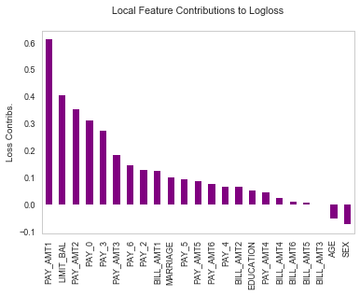
Local Shapley Feature Contributions to Logloss
PAY_AMT1
LIMIT_BAL
PAY_AMT2
PAY_0
PAY_3
PAY_AMT3
PAY_6
PAY_2
BILL_AMT1
MARRIAGE
PAY_5
PAY_AMT5
PAY_AMT6
PAY_4
BILL_AMT2
EDUCATION
PAY_AMT4
BILL_AMT4
BILL_AMT6
BILL_AMT5
BILL_AMT3
AGE
SEX
Shapley Feature Contributions

Slide 12
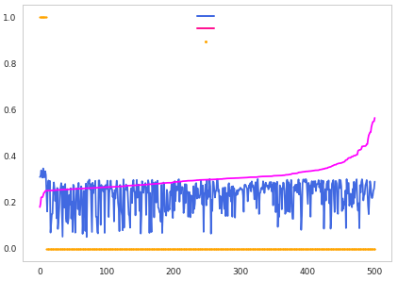
p_glm_DEFAULT_NEXT_MONTH
p_gbm_DEFAULT_NEXT_MONTH
DEFAULT_NEXT_MONTH
p_DEFAULT_NEXT_MONTH
Ranked Row Index

