Slide 1

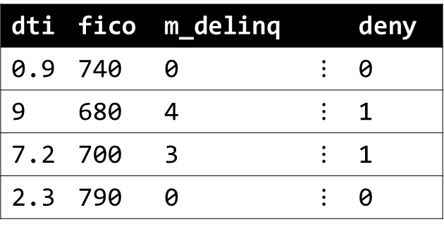
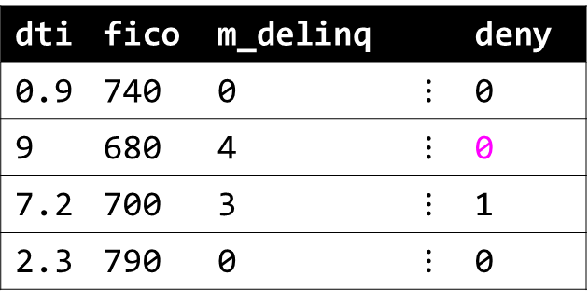
Attributes of attacker
dti: 10.4
fico: 690
m_delinq: 4
…
dti | fico | m_delinq |  | deny
0.9 | 740 | 0 | $$⋮$$ | 0
9 | 680 | 4 | $$⋮$$ | 1
7.2 | 700 | 3 | $$⋮$$ | 1
2.3 | 790 | 0 | $$⋮$$ | 0
dti | fico | m_delinq |  | deny
0.9 | 740 | 0 | $$⋮$$ | 0
9 | 680 | 4 | $$⋮$$ | 0
7.2 | 700 | 3 | $$⋮$$ | 1
2.3 | 790 | 0 | $$⋮$$ | 0
attack
Original training data
Altered training data
Attacker alters data before model training to ensure favorable outcomes.

Slide 2

Attacker adds backdoor into model scoring mechanisms, then exploits backdoor with watermarked data to attain favorable outcomes.
start
start
fico < 700:
deny
fico >= 700
fico < 700:
deny
fico >= 700
m_delinq <= 2
m_delinq > 2:
deny
yoj >= 0:
deny
yoj < 0:
approve
m_delinq <= 2
m_delinq > 2:
deny
attack
dti >= 2.5:
deny
dti < 2.5
approve
dti >= 2.5:
deny
dti < 2.5
approve
Original model
Altered model

Slide 3
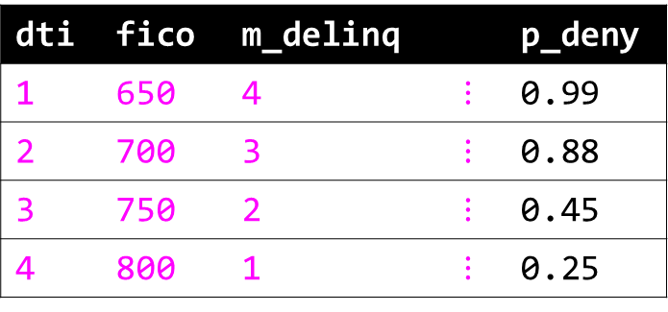
start
API data input
1. Attacker simulates data.
start
fico < 700:
deny
fico >= 700
fico < 703:
deny
fico >= 703
dti | fico | m_delinq |  | p_deny
1 | 650 | 4 | $$⋮$$ | 0.99
2 | 700 | 3 | $$⋮$$ | 0.88
3 | 750 | 2 | $$⋮$$ | 0.45
4 | 800 | 1 | $$⋮$$ | 0.25
m_delinq <= 2
m_delinq > 2:
deny
m_delinq <= 1.8
m_delinq > 1.8:
deny
dti >= 2.5:
deny
dti < 2.5
approve
API prediction output
dti >= 2.1:
deny
dti < 2.1
approve
2. API returns predictions for simulated data.
Original model
3. Attacker trains surrogate model between simulated data and API predictions.
Attack

Slide 4
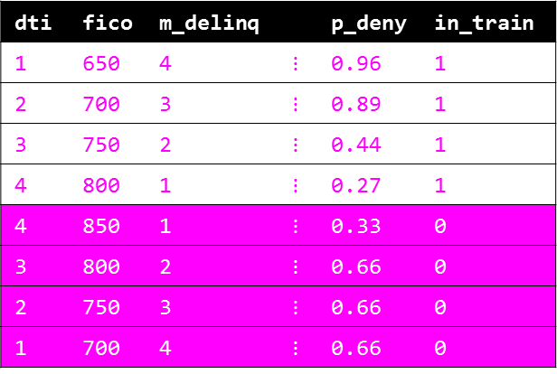
Attack
start
dti | fico | m_delinq |  | p_deny | in_train
1 | 650 | 4 | $$⋮$$ | 0.96 | 1
2 | 700 | 3 | $$⋮$$ | 0.89 | 1
3 | 750 | 2 | $$⋮$$ | 0.44 | 1
4 | 800 | 1 | $$⋮$$ | 0.27 | 1
4 | 850 | 1 | $$⋮$$ | 0.33 | 0
3 | 800 | 2 | $$⋮$$ | 0.66 | 0
2 | 750 | 3 | $$⋮$$ | 0.66 | 0
1 | 700 | 4 | $$⋮$$ | 0.66 | 0
in_train
fico < 703:
deny
fico >= 703
H₁
H₂
H₃
m_delinq <= 1.8
m_delinq > 1.8:
deny
dti
fico
m_delinq
p_deny
2. Attacker augments surrogate training data with new rows not in the original surrogate training data and scores them with the surrogate model.
3. Attacker trains a second-level surrogate model that can discriminate between rows in your training data and not in your training data.
dti >= 2.1:
deny
dti < 2.1
approve
1. Attack begins with trained surrogate model.

Slide 5
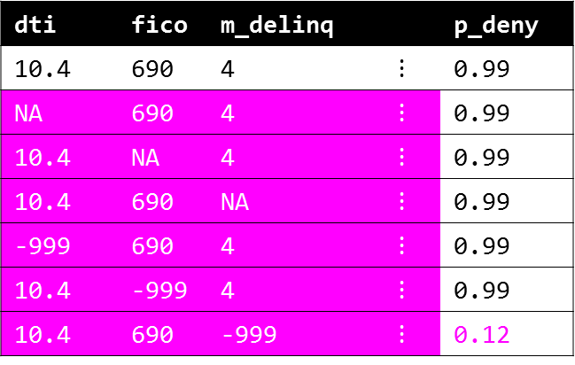
Attack
start
API data input
dti | fico | m_delinq |  | p_deny
10.4 | 690 | 4 | $$⋮$$ | 0.99
NA | 690 | 4 | $$⋮$$ | 0.99
10.4 | NA | 4 | $$⋮$$ | 0.99
10.4 | 690 | NA | $$⋮$$ | 0.99
-999 | 690 | 4 | $$⋮$$ | 0.99
10.4 | -999 | 4 | $$⋮$$ | 0.99
10.4 | 690 | -999 | $$⋮$$ | 0.12
fico < 700:
deny
fico >= 700
m_delinq <= 2
m_delinq > 2:
deny
dti >= 2.5:
deny
dti < 2.5
approve
API prediction output
Attacker systematically alters input data until they receive a favorable outcome.
Original model

Slide 6

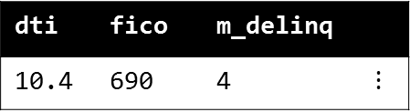
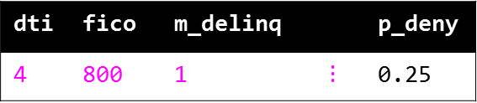
start
API data input
fico < 700:
deny
fico >= 700
attack
m_delinq <= 2
m_delinq > 2:
deny
dti | fico | m_delinq |  | p_deny
4 | 800 | 1 | $$⋮$$ | 0.25
dti | fico | m_delinq
10.4 | 690 | 4 | $$⋮$$
dti >= 2.5:
deny
dti < 2.5
approve
API prediction output
Attacker mimics data of favorable customer to receive a favorable outcome.
Original model

