Slide 1
Topic Modeling and Sentiment Analysis on Aesthetic Procedure Reviews
Predicting hidden topic ratings based on users sentiments

Slide 2
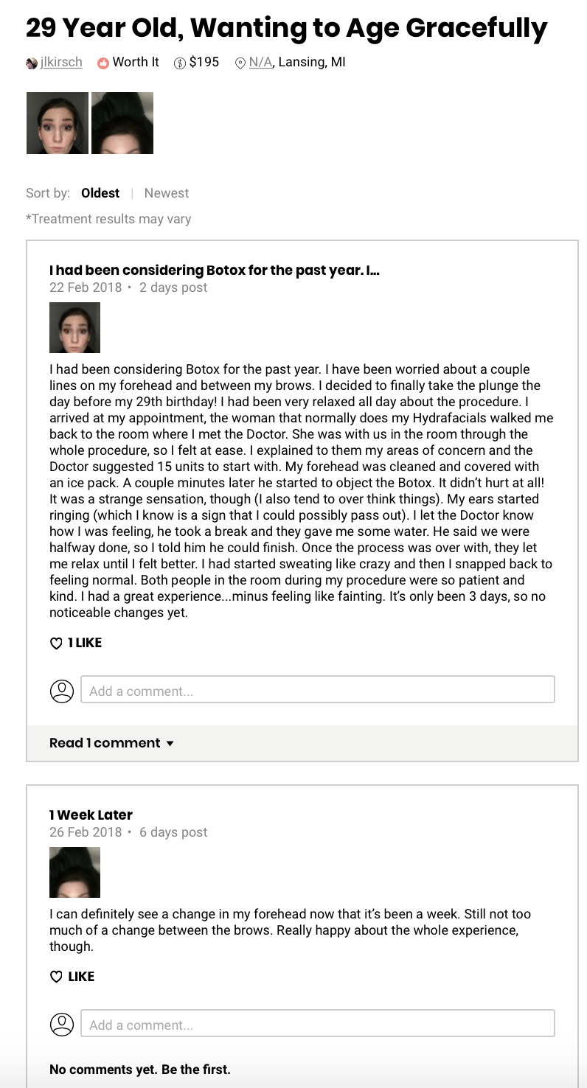
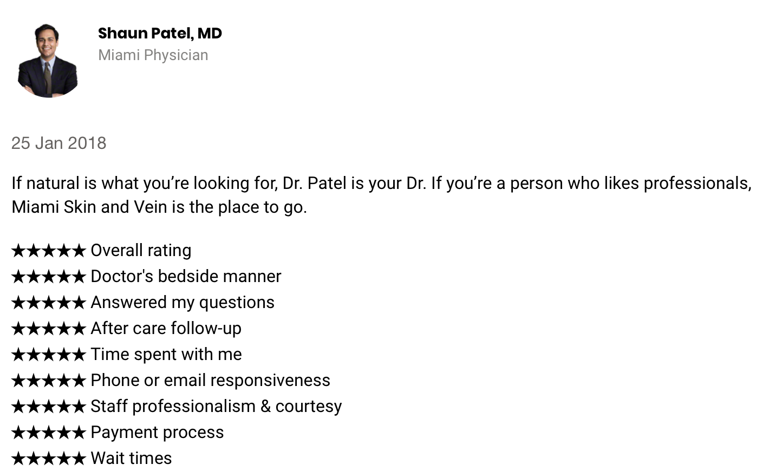
Realself Users’ Reviews
Treatment’s Review:
1 rating
Doctor’s Review:
9 different ratings

Slide 3
Business Scenario
Topic Modeling:
What topics do users talk about on reviews?
What people take into consideration when choosing a treatment?
Developing functionality for users:
Display rating for topics

Slide 4
Data + Methods
Data Extraction and Cleaning
BeautifulSoup
Selenium
Remove stop words
Lemmatize
53,547
posts
17,270
unique users
Topic Modeling
NMF
LDA
K-means
Sentiment Analysis
Vader
TextBlob
3 Treatments
Ratings by topics
Notes:
I employed Scikit-learn’s count vectorizer to build a word matrix, aggressively paring down which words I wanted to include, choosing a max_df of 60% and min_df of 10. This meant that the matrix would only capture words that appeared in less than 60% of the texts (to avoid commonly used words such as ‘and’, ‘the’) and appeared a minimum of 10 times. I also chose an ngram range of (1, 3), to be able to capture names and places if two words were commonly used together. Then, I applied LDA to my word vector to distribute the posts in topics. Each topic was labeled after reviewing the top words for each group

Slide 5
Latent Dirichlet Allocation to identify topics from text
Coolsculpting
Rhinoplasty
Botox
Dr/Staff
Surgery/pos op
Surgery/pos op
Discomfort (swelling/numb/pain)
Dr/Staff
Discomfort (swelling/numb/pain)
Injection/Motivation/other
Updates/photos
Cast Removal/expectations
Updates/photos
Side-effects
Overall Reviews
Overall Reviews
Results
Reflecting Decision
Reflecting decision/ results

Slide 6
Latent Dirichlet Allocation to identify topics from text
Coolsculpting
Rhinoplasty
Botox
Dr/Staff
Dr/Staff
Procedure
Injection/Motivation/other
Surgery/pos op
Surgery/pos op
Recovery
Discomfort (swelling/numb/pain)
Discomfort (swelling/numb/pain)
Cast Removal/expectations
Side-effects
Updates/photos
Updates/photos
Results
Overall Reviews
Overall Reviews
Results
Reflecting Decision
Reflecting decision/ results

Slide 7
Sentiment Analysis to find topics’ ratings
Rating = % positive reviews on aggregated topic
More than 75% users reviewed positively
50% ~ 75% users reviewed positively
25% ~ 50% users reviewed positively
Less than 25% users reviewed positively

Slide 8
Dashboard demo

Slide 9
Insights
Downtime/Results trade-off:
Some people prefer short recovery time while other prefer drastic results
Negative reviews on less-invasive procedure are usually for the minimal result.
High amount of “Not Sure” Reviews
Many patients wait months to decide if they like the results or not.

Slide 10
Future Works
Classification model (SVM) for assigning topics to new reviews.
Extract Reviews’ Highlights
Based on:
Term frequency
Social engagement (likes, comments, etc)
Sentiment
Comparison tool
Comparison between similar treatments (e.g. liposuction vs. Coolsculpting)

Slide 11
Thank you!

