Slide 1
Transformer Pipeline
Bidirectional JSON-to-Relational Conversion EGS Award Management System

Slide 2
The Business Problem
Form data collected as flexible JSON documents from web forms
JSON storage creates challenges:
Reporting tools cannot query individual fields
Compliance audits require structured data access
Cross-form analytics impractical with opaque JSON blobs

Slide 3
The Solution: Bidirectional Transformation
Bidirectional Flow

Slide 4
Write Path: Extract fields from JSON, convert types, store in typed columns
Read Path: Query typed columns, reconstruct original JSON structure
Round-trip fidelity: What goes in comes back out identically

Slide 5
Real-World Example: PI Budget
Stage | What Happens | Value
JSON Input | User enters budget | 1448199 (JS number)
Transform | toBigDecimal conversion | BigDecimal(1448199.00)
Database | Stored in NUMERIC column | 1448199.00 (15,2 precision)
Read Back | Column value retrieved | BigDecimal(1448199.00)
JSON Output | Returned to frontend | 1448199.0

Slide 6
No precision loss. No rounding errors.

Slide 7
Key Business Benefits
Queryable data — Each field in its own typed column; direct SQL for reports
Data integrity — Dates stored as dates, numbers as numbers
Validation at the gate — Required fields and formats enforced before database
Extensible — Custom business logic via named hook points, not hardcoded
Compliance-ready — Schema versioning for historical data reconstruction

Slide 8
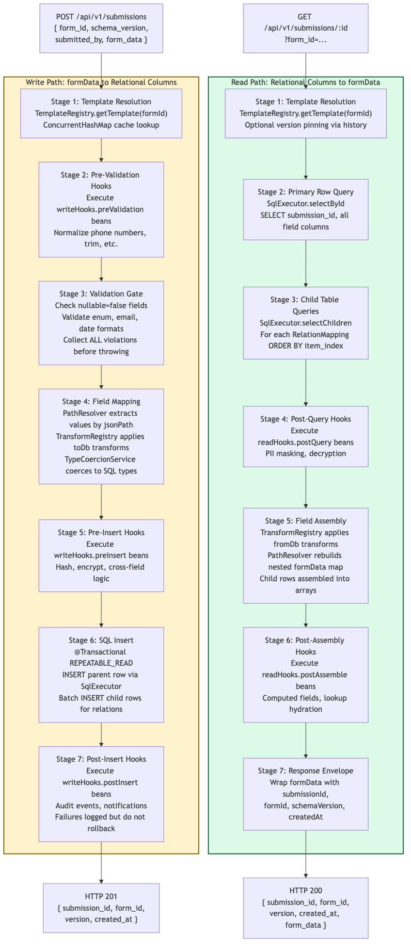
Pipeline Architecture
Full Pipeline

Slide 9
Write Pipeline: 7 Stages
Template Resolution — Load template from cache by formId
Pre-Validation Hooks — Normalize data (trim, format phones)
Validation Gate — Check required fields, enums, formats; collect ALL errors
Field Mapping — Extract by jsonPath, apply transforms, coerce types
Pre-Insert Hooks — Encrypt, hash, cross-field logic
SQL Insert — Atomic parent + child table writes
Post-Insert Hooks — Audit events, notifications

Slide 10
Field Mapping Detail
Field Mapping

Slide 11
Built-In Transforms (13 Total)
Transform | Direction | Behavior
toLocalDate | toDb | ISO string to LocalDate
toIsoDateString | fromDb | LocalDate to yyyy-MM-dd
toBigDecimal | toDb | Number/String to precise decimal
jsonStringify / jsonParse | both | Map/List to/from JSON string
trimString | toDb | Whitespace removal
toLowerCase | toDb | Case normalization
toBoolean | toDb | “true”/1/true to Boolean
maskLast4 | fromDb | PII masking for display

Slide 12
Validation Gate: Complete Error Reporting
{ "error": "VALIDATION_FAILED", "violations": [ { "json_path": "program_manager", "message": "Required field is missing" }, { "json_path": "prime_award_type", "message": "Value not in allowed values" } ] }
All violations collected before throwing — caller gets a complete error list.

Slide 13
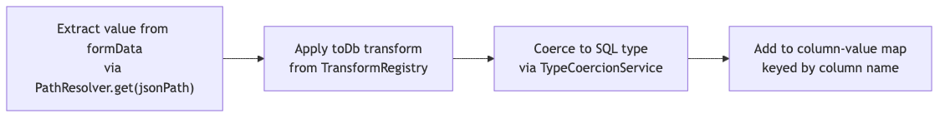
SQL Insert: Transactional Safety
SQL Insert

Slide 14
@Transactional(isolation = REPEATABLE_READ)
Parent + child tables in single atomic transaction
GeneratedKeyHolder captures auto-generated submission_id
Duplicate key caught and returned as HTTP 409

Slide 15
Read Pipeline: 7 Stages
Template Resolution — Same template, optional version pinning
Primary Row Query — SELECT by submission_id
Child Table Queries — SELECT children ordered by item_index
Post-Query Hooks — PII masking, decryption
Field Assembly — fromDb transforms, rebuild nested JSON
Post-Assembly Hooks — Computed fields, lookup hydration
Response Envelope — Wrap with metadata

Slide 16
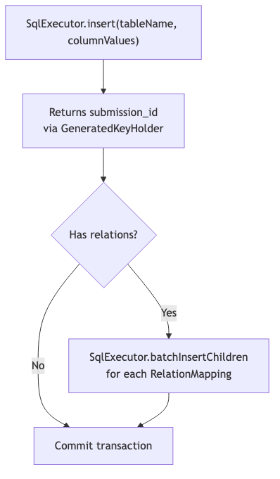
Hook System: Extensible Business Logic
Hook System

Slide 17
Writing a Custom Hook
@Component("normalizePhoneNumbersHook") public class NormalizePhoneNumbers implements WriteHook { @Override public Map<String, Object> apply(Map<String, Object> data) { // Normalize phone fields to E.164 format return data; } }
Reference by name in template JSON — no pipeline code changes needed.

Slide 18
API Contract
Write:
POST /api/v1/submissions { "form_id": "pre-award-overview", "form_data": { "pi_budget": 1448199, ... } } → 201 { "submission_id": 1, "version": 1 }
Read:
GET /api/v1/submissions/1?form_id=pre-award-overview → 200 { "submission_id": 1, "form_data": { ... } }

Slide 19
Error Handling
HTTP | Error Code | Condition
400 | TEMPLATE_NOT_FOUND | No template for formId
400 | VALIDATION_FAILED | Field constraint violations
400 | VERSION_MISMATCH | Version exceeds template
404 | SUBMISSION_NOT_FOUND | No row for submissionId
409 | DUPLICATE_SUBMISSION | Unique constraint violation

Slide 20
Safety Guarantees
Guarantee | Implementation
Atomic writes | @Transactional with REPEATABLE_READ
Rollback on error | DataAccessException triggers rollback
SQL injection prevention | IdentifierValidator + named parameters
Additive-only DDL | Never drop columns or tables
Post-insert isolation | Hook failures don’t rollback data

Slide 21
Summary
For Business: Queryable, typed data for reporting and analytics
For Compliance: Schema-versioned submissions with audit trail
For Development: 13 built-in transforms, pluggable hooks, zero-code form additions
For Operations: Atomic transactions, additive-only DDL, safe error handling

