Slide 1
Template Registry
Configuration-Driven Form Management EGS Award Management System

Slide 2
The Business Problem
Every new government form requires custom development: database tables, API endpoints, mapping code
Form changes wait in a development queue
Each change carries risk of introducing bugs into production
This creates a bottleneck between form analysts and the running system

Slide 3
The Solution: Data-Driven Templates
Administrators create a JSON template file describing form-to-database mappings
The system automatically reads templates, creates tables, and handles storage
No code changes required for new or modified forms
Templates are the single source of truth for the schema

Slide 4
How It Works
Template Registry Flow

Slide 5
Key Business Benefits
No code deployments for new forms — drop a JSON file and go
Zero-downtime schema changes — new fields added while system runs
Safe by design — the system never deletes data; removed fields are flagged for review
Audit trail — every template version recorded for historical reconstruction
Reduced cost — form analysts define templates without backend developer involvement

Slide 6
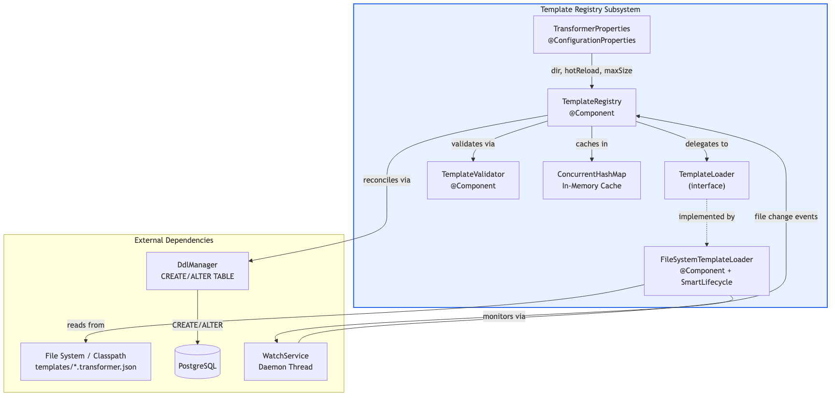
Architecture Overview
Architecture

Slide 7
Components
Component | Responsibility
TransformerProperties | Binds configuration from application.yml
FileSystemTemplateLoader | Reads template files; runs WatchService
TemplateValidator | Validates template structure on load
TemplateRegistry | Central cache, loading, and hot-reload
DdlManager | Creates/reconciles database tables

Slide 8
Template File Format
{ "formId": "pre-award-overview", "version": 1, "tableName": "form_pre_award_overview", "fields": [ { "jsonPath": "pi_budget", "column": "pi_budget", "sqlType": "NUMERIC", "transform": { "toDb": "toBigDecimal" } } ] }

Slide 9
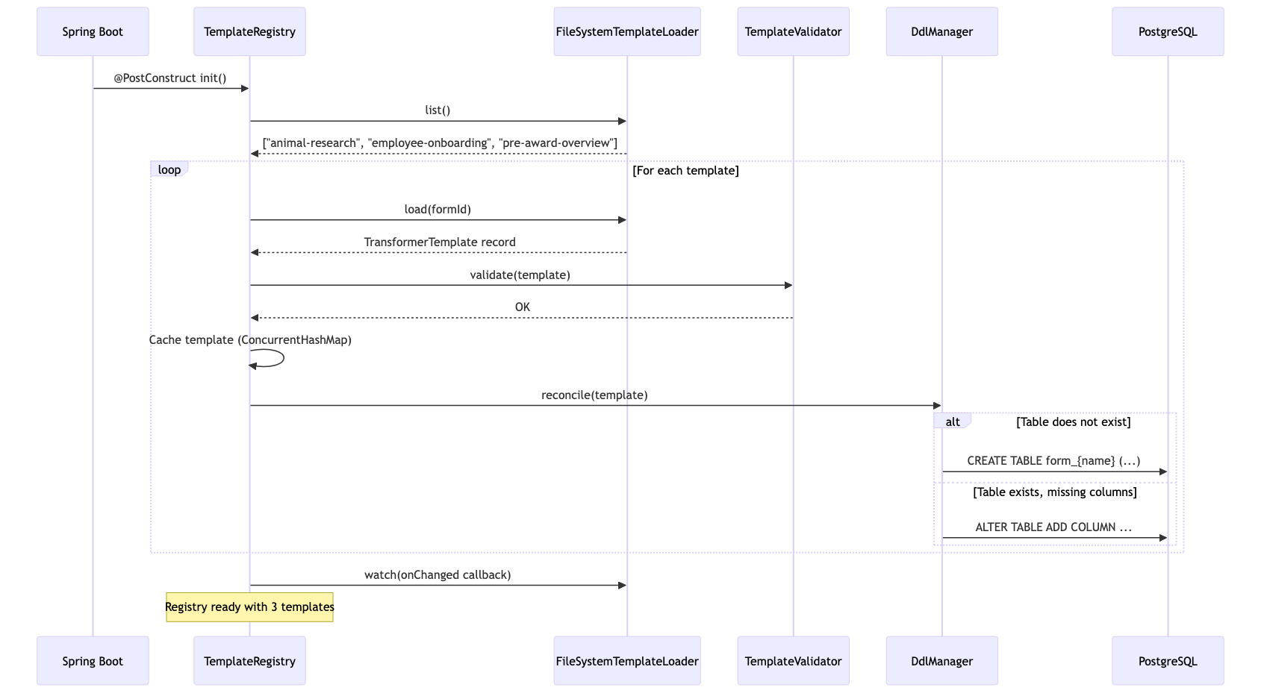
Startup Sequence
Startup Sequence

Slide 10
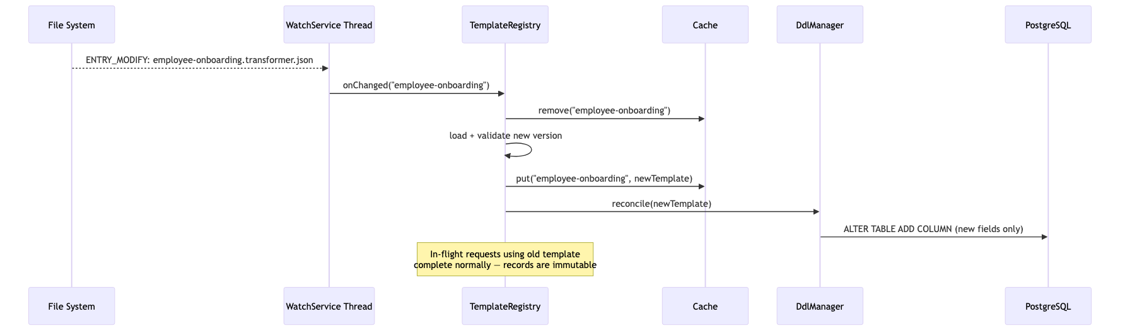
Hot Reload: Zero-Downtime Updates
Hot Reload

Slide 11
File system WatchService detects changes in real-time
Cache invalidated and refreshed atomically
In-flight requests complete normally (immutable records)
Database columns added automatically (never dropped)

Slide 12
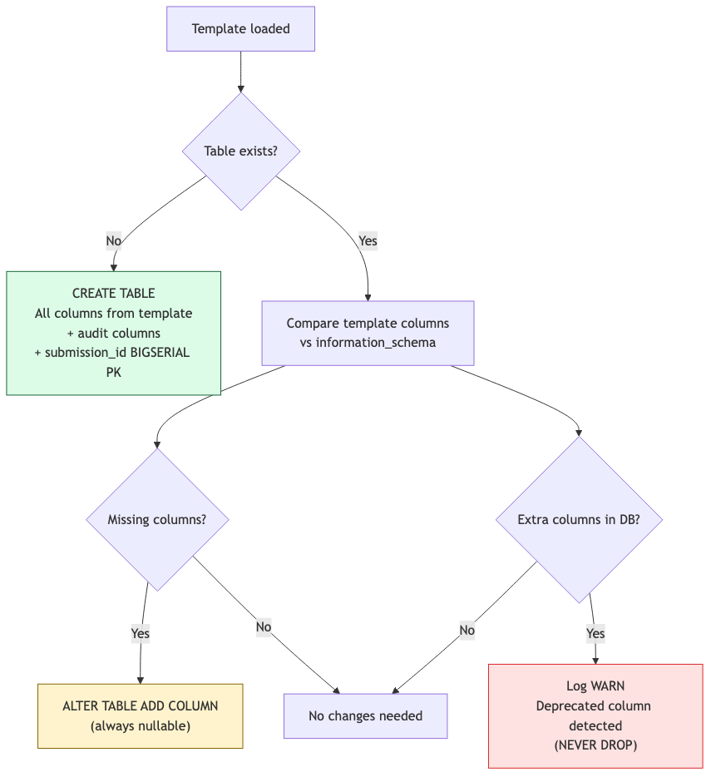
DDL Safety Rules
DDL Safety

Slide 13
DDL Safety Summary
Rule | Enforcement
Never DROP | No DROP COLUMN or DROP TABLE — ever
New columns nullable | ALTER TABLE omits NOT NULL
Identifier validation | Regex-validated table/column names
SQL type whitelist | Only known PostgreSQL types permitted

Slide 14
Version History and Audit
Every loaded template recorded in transformer_template_history table
Enables historical reads: reconstruct data using the exact template active at submission time
Critical for compliance and audit scenarios

Slide 15
Adding a New Form
Create {formId}.transformer.json in templates directory
Define formId, tableName, fields, and optional relations/hooks
System detects file automatically (hot-reload) or on restart
DdlManager creates the database table
Form immediately available for submissions
No Java code. No migration scripts. No redeployment.

Slide 16
Configuration
transformer: template: dir: classpath:templates # or /etc/templates hot-reload: true # WatchService on filesystem cache: max-size: 500 # Max cached templates
All properties overridable via environment variables for containerized deployments.

Slide 17
Summary
For Business: New forms in minutes, not sprints
For Operations: Zero-downtime changes, safe-by-design DDL
For Compliance: Full version history and audit trail
For Development: Extensible via hooks and custom transforms

