Slide 1
POJO/JPA Implementation Plan
Dual Sync Strategy with Runtime Toggle RJSF Pre-Award Review System | April 2026

Slide 2
Problem Statement
Current system uses a Map-based transformer pipeline for relational sync
Pipeline is flexible (JSON templates, zero Java changes for new forms)
But relies on raw JDBC, dynamic SQL, and runtime type coercion
Goal: Implement a second code path using JPA @Entity classes (POJOs)
Both approaches write to the SAME 6 relational tables
Runtime UI toggle enables direct comparison of both approaches

Slide 3
Architecture: Before (Single Path)
FormSubmissionService.syncToRelationalTable()
↓
SubmissionWriteService.writeSection()
↓
SqlExecutor (raw JDBC) → PostgreSQL
Single code path: Template JSON → PathResolver → TransformRegistry → TypeCoercion → SQL Upsert

Slide 4
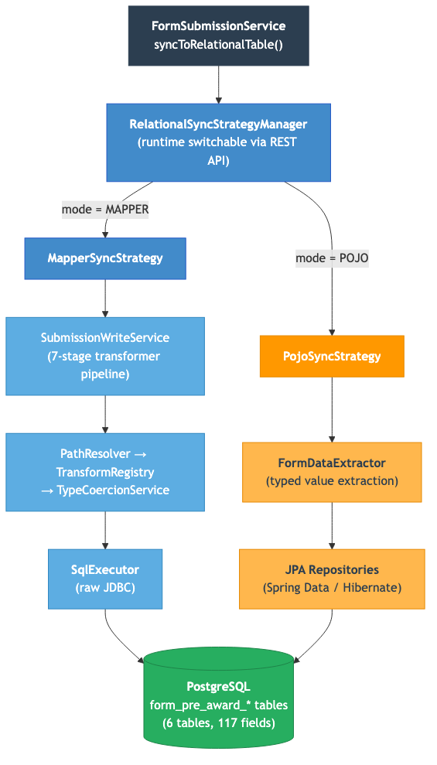
Architecture: After (Dual Path Strategy Pattern)

Slide 5
Phase 1: JPA Entity Layer
Entity Class | Table | Fields | Special Types
FormPreAwardOverview | form_pre_award_overview | 12 | BigDecimal, LocalDate, JSONB
FormPreAwardSafety | form_pre_award_safety | 10 | All TEXT
FormPreAwardAnimal | form_pre_award_animal | 9 | JSONB (species)
FormPreAwardHuman | form_pre_award_human | 29 | Boolean, TEXT
FormPreAwardAcquisition | form_pre_award_acquisition | 50 | BigDecimal, JSONB
FormPreAwardFinal | form_pre_award_final | 7 | All TEXT

Slide 6
Phase 2: Strategy Pattern
RelationalSyncStrategy interface
getName() and writeSection() — matches existing service signature
MapperSyncStrategy: thin wrapper around existing SubmissionWriteService
Zero behavior change — existing pipeline runs as-is when active
PojoSyncStrategy: JPA-based with section-aware partial updates
find-or-create pattern, per-section setter methods prevent data clobbering
FormDataExtractor: type-safe extraction from Map<String, Object>
getString(), getBigDecimal(), getBoolean(), getLocalDate(), getJsonb()
RelationalSyncStrategyManager: thread-safe mode switching via AtomicReference
Defaults to MAPPER, switchable via REST API at runtime

Slide 7
Phase 3: Integration
FormSubmissionService modified to use strategy manager
Replaced direct SubmissionWriteService with RelationalSyncStrategyManager
New REST endpoint: GET/PUT /api/sync-mode
Returns/accepts {"mode": "MAPPER"} or {"mode": "POJO"}
Frontend: getSyncMode() and setSyncMode() API functions
UI toggle: clickable Chip in ReviewPage footer bar
MAPPER shown in blue (#428bca), POJO shown in orange (#FF9800)

Slide 8
Deliverables: Files Created & Modified
Category | Count | Details
Entity Classes | 7 | FormDataBase + 6 form-specific entities
JPA Repositories | 6 | One per entity with findByAwardId()
Strategy Layer | 5 | Interface + 2 strategies + extractor + manager
REST Controller | 1 | SyncModeController
Modified Backend | 1 | FormSubmissionService
Modified Frontend | 2 | api.js + ReviewPage.jsx
Total | 22 | 19 new files, 3 modified files

Slide 9
Testing: 51 New Tests, All Passing
Test File | Type | Tests | Key Coverage
FormDataExtractorTest | Unit | 21 | Type coercion, null safety, edge cases
RelationalSyncStrategyManagerTest | Unit | 6 | Mode switching, defaults, validation
PojoSyncStrategyTest | Unit | 10 | Entity mapping, section isolation
SyncModeToggleIntegrationTest | Integration | 14 | End-to-end: API toggle + both write paths

Slide 10
Comparison: Mapper vs POJO Approach
Aspect | Mapper (Transformer) | POJO (JPA)
Adding a new form | JSON template, no Java changes | New entity + repository, recompile
Type safety | Runtime errors | Compile-time errors
SQL generation | Hand-built parameterized SQL | Hibernate auto-generated
Schema evolution | Update JSON template | Update entity class
Dynamic forms | Fully supported | Not feasible
Developer familiarity | Custom framework | Standard JPA
Performance | Single raw SQL upsert | Hibernate select + merge

Slide 11
Conclusion
Both approaches coexist and produce identical database state
Runtime toggle enables direct A/B comparison during development
Mapper approach remains the default — better for dynamic forms
POJO approach offers stronger type safety for stable schemas
Strategy pattern makes it easy to add future sync approaches
All 84 tests passing (70 unit + 14 integration)

