Slide 1


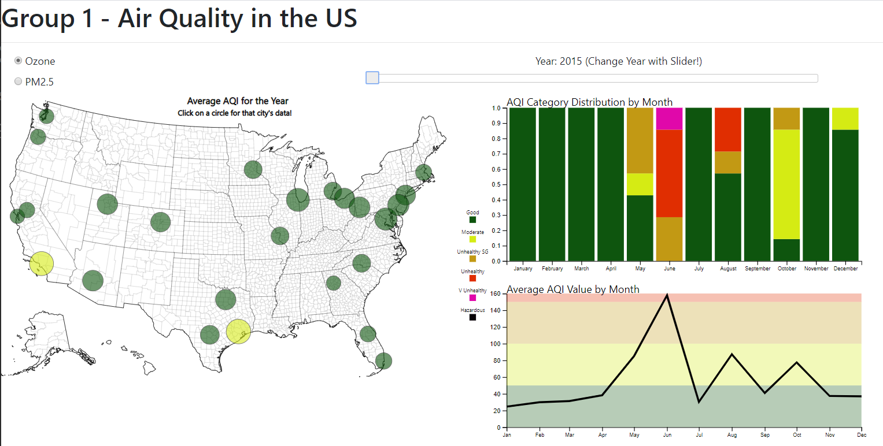


U.S. Air Quality 2015-Present
Project group 1
Joey Picca
Cenez Tindoc
Shane Gatenby
Audelia Torres
Joseph McManus

Slide 2
Project Introduction
Motivation: Reflecting on the challenges that COVID-19 has posed, we wanted to explore one of the positive benefits that are expected to result from reduced travel and production activity: Air Quality improvements
Primary question: Are there any notable trends in Air Quality over the last 5 years for the largest 25 cities in the U.S.?
Final output: A web-based user dashboard that allows a user to visualize Air Quality Index levels from 2015-Present for the largest 25 cities in the U.S.

Slide 3
Project Overview
Airnow.gov api
Postgres Database
Flask app
4 JS, 1 html, 1CSS file
CSV output of AQI data
User Dashboard
Data Gathering | Database Setup | Data Query & Manipulation, Web App | Data Visualization & User Dashboard

Slide 4
Data Gathering
Airnow.gov API call made via Python
Data collected for first 7 days of each month from 2015 – Present for the top 25 U.S. cities by population
Data includes Air Quality Index (AQI) measurements for both Ozone and PM2.5
Measurements include absolute levels and categorical groupings (i.e. Good, Moderate, Unhealthy, etc.)
Data output: CSV file with total data
Overview

Slide 5
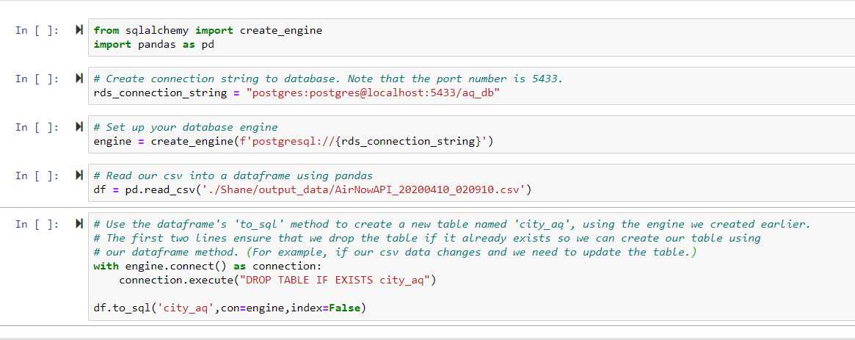
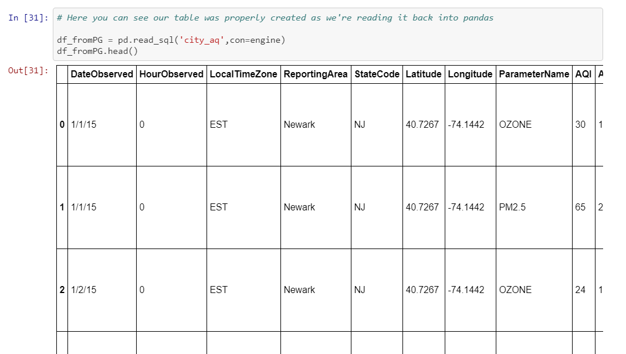
Database Setup
Load our CSV data from the AirNow API call into Postgres database

Slide 6
Data Query and Manipulation, Web App
Data query and manipulation done via Flask app
Flask app enables our web-based dashboard
App works with JavaScript files and D3 to take in user input as a URL route, then return specific data based on the URL route navigated to
URL route can specify City, Year and AQI type (Ozone or PM2.5)
Overview

Slide 7

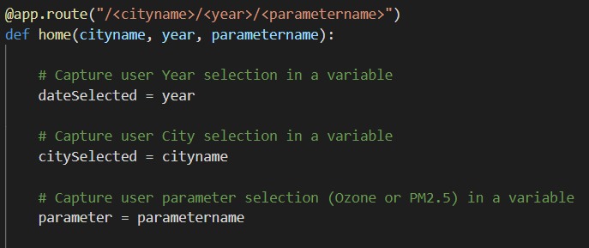
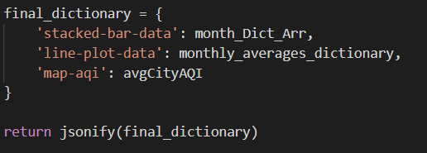
Data Query and Manipulation, Web App
Flask app navigates to a route based on user inputs
Captures user inputs as variables
Filters the data according to those selected variables
Then returns the correct data as a jsonified dictionary
Key elements of code

Slide 8
Data Visualization and User Dashboard Overview
Flask App
4 JavaScript Files
1 HTML File
1 CSS File
User Dashboard
User Input from dashboard interactions determines what data is provided, and new data updates dashboard display

Slide 9


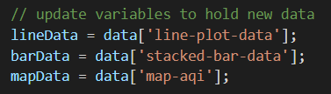



Data Visualization and User Dashboard KEY VARIABLES AND FUNCTIONS
interactions.js
Initializes variables: Defines functions for user selection of new City, Year or Parameter: Each function runs our grabData function from getData.js:
getData.js
Defines our grabData function, which uses D3 to return a json object from the specified url route, as determined by user selections: Updates key variables to capture new data for our visualizations: Runs functions which update bar and and map display:
buildCharts.js
Builds SVG areas for charts, and pro Defines updateBar function called in getData.js:
makeMap.js
Creates D3 map of U.S. that we plot our cities on, as well as dynamic circles for each city and tool tips Defines updateMap function that is called in getData.js

Slide 10
Data Visualization and User Dashboard OVERVIEW OF CODE FOR DASHBOARD ELEMENTS
Map and City Markers
File: makeMap.js
Overview: utilizes D3 SVG, D3 event listeners, and TopoJSON to create map of U.S. and provide responsive and dynamic city markers
Walk-through: Cinez
Stacked Bar Chart and Line Chart
File: buildCharts.js
Overview: uses D3 SVG to set up stacked bar chart and line chart to display monthly and average monthly AQI data
Walk-through: Audelia

Slide 11
Dashboard Walk-through

Slide 12
Thank you!

Slide 13
Supplementary Slides

Slide 14
Overview of files
Step 1
Data Gathering
1 Python file for making the api call
Output: CSV file of AQI data
Step 2
Database Load
1 Python file which loads the CSV output into Postgres
Output: new Postgres database of all AQI data from 2015 – Present for the top 25 cities by population in the U.S.
Step 3
Data Manipulation
1 Flask App which filters the AQI data based on user interactions from the dashboard
Output: returns filtered and organized data which informs the visualizations on our dashboard
Step 4
Data Visualization and Dashboard build
4 JS files – utilize D3 to capture user interactions, create stacked bar chart, build map, and route to the appropriate url address
1 CSS file – styling and animation of webpage
1 HTML file – Provide structure of webpage, including dashboard, analysis and member info

Slide 15
Data Gathering
Airnow.gov API call made via Python
Data collected for (all days // first 7 days of each month) from 2015 – Present for the top 25 U.S. cities by population
Data includes Air Quality Index (AQI) measurements for both Ozone and PM2.5
Measurements include absolute levels and categorical groupings (i.e. Good, Moderate, Unhealthy, etc.)

Slide 16
Data Query and Manipulation, Web App
Data query and manipulation done via Flask app
Flask app also serves as enabler of web-based dashboard
App works with JavaScript files and D3 to take in user input as a url route, then return specific data based on the route navigated to

Slide 17
Data Query and Manipulation, Web App

Slide 18
Data Visualization and User Dashboard
4 JavaScript files:
buildCharts.js – establishes SVG dimensions, creates stacked bar chart and line chart
getData.js – sets variables to capture data for the Map, Bar graph and Line graph
interactions.js – enables interactivity of dashboard: captures user selection of Year, AQI type and City selection
makeMap.js – uses D3 to create map of U.S., plot interactive circles over our 25 cities, provide tooltips for each city, and enable responsive circle sizing and coloring based on AQI levels
1 CSS file and 1 HTML file:
CSS provides styling to webpage elements, as well as animations for city circles
HTML provides structure and layout of webpage
Overview

Slide 19
Data Query and Manipulation, Web App
Data query and manipulation done via Flask app
Flask app also enables web-based dashboard
App works with our JavaScript files and D3 to take in user input as a url route, then return specific data from our database, based on the url route navigated to
url route can specify City, Year and AQI type (Ozone or PM2.5)
(any other manipulation done in the JS files? Or just specifying how visualized?)
Overview

Slide 20
Data Visualization and User Dashboard
4 JavaScript files:
buildCharts.js – establishes SVG dimensions, creates stacked bar chart and line chart
getData.js – sets variables to capture data for the Map, Bar graph and Line graph
interactions.js – enables interactivity of dashboard: captures user selection of Year, AQI type and City selection
makeMap.js – uses D3 to create map of U.S., plot interactive circles over our 25 cities, provide tooltips for each city, and enable responsive circle sizing and coloring based on AQI levels
1 CSS file and 1 HTML file:
CSS provides styling to webpage elements, as well as animations for city circles
HTML provides structure and layout of webpage
Overview

Slide 21
Data Manipulation – Flask app
Utilize Flask to make an API call to our Postgres database
Flask app provides the majority of our data manipulation
Will filter data based on user inputs for year, city and AQI measurement type (ozone, PM.5)

Slide 22
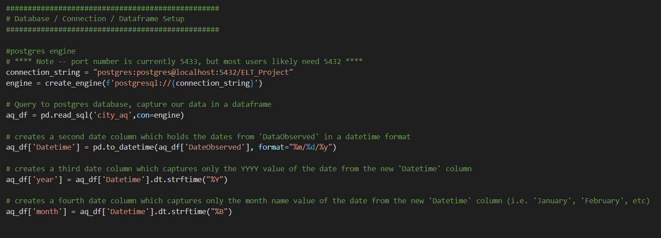
Flask App
Database setup, connection, and database setup

Slide 23
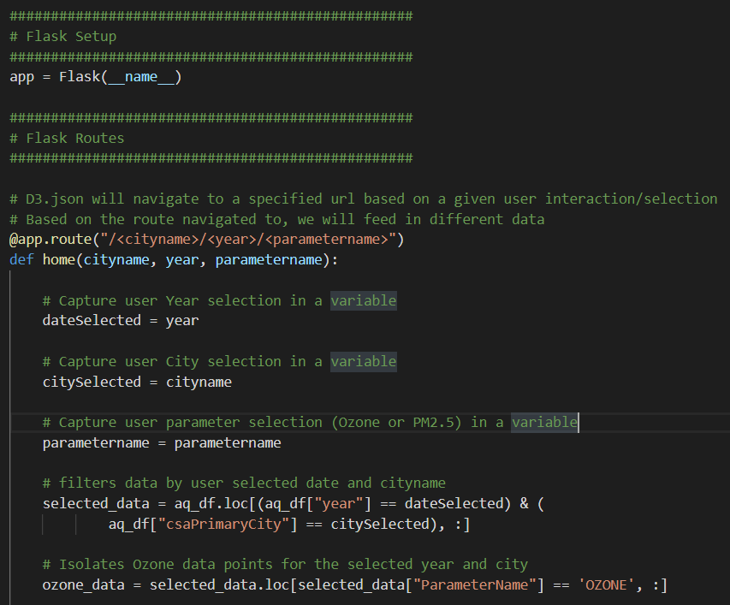
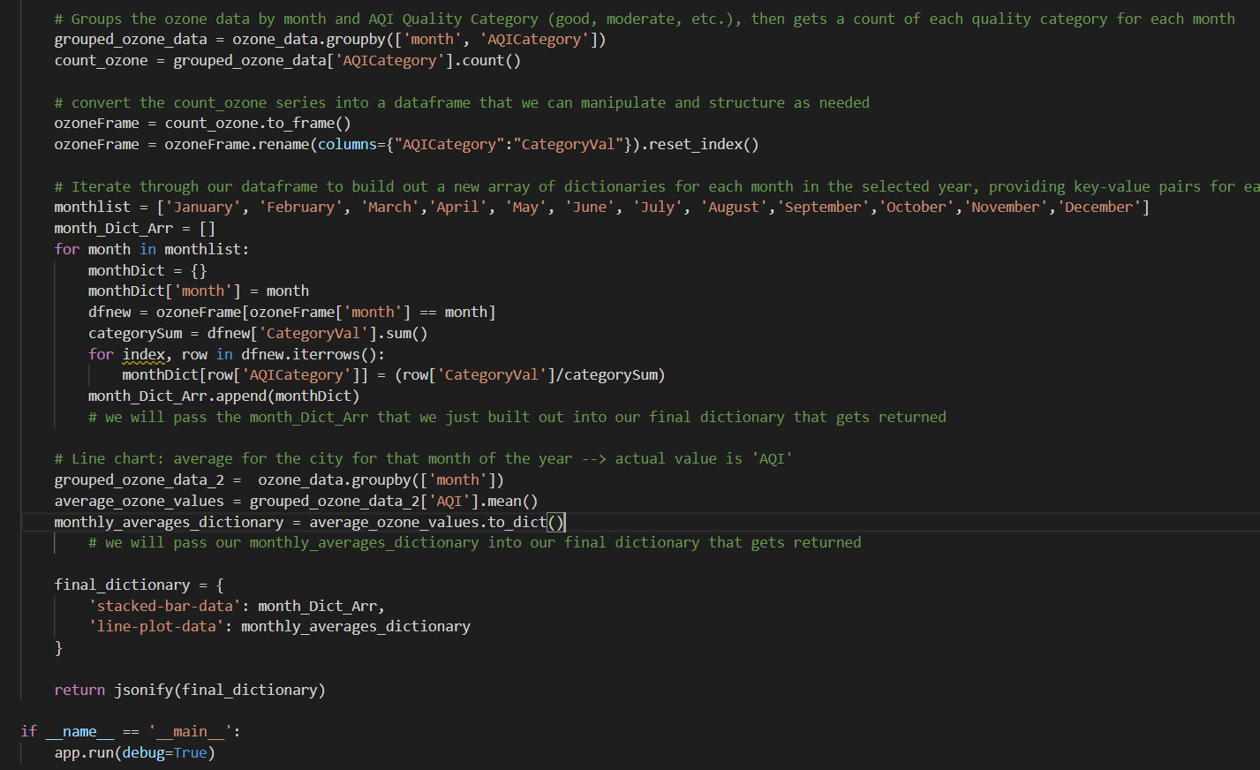
Flask App
Database setup, connection, and database setup

Slide 24
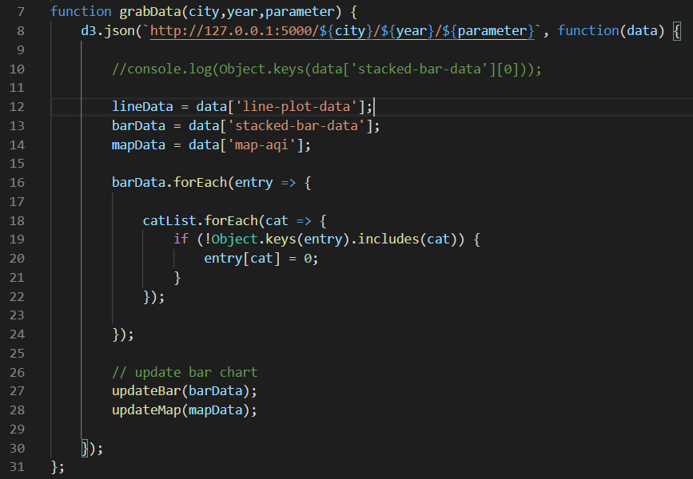
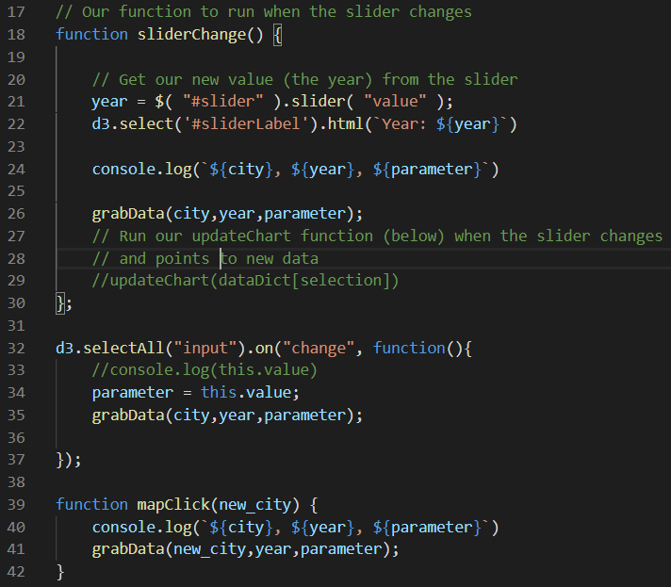
Data Visualization and User Dashboard
User interaction prompts navigation to new url route, returning data specific to user selections

Slide 25
D3 and HTML
getData.js
Dynamic functions calling each other:
Grabdata (getData.js)
updateBar(buildCharts.js)
updateMap(makeMap.js)
Image 2 here
interactions.js
Initializes variables: city, year, parameter function sliderChange() { D3 event listener for selection of parameter Function mapClick (new_city) {
buildCharts.js
makeMap.js

Slide 26
D3 and HTML
Image 3 here

Slide 27
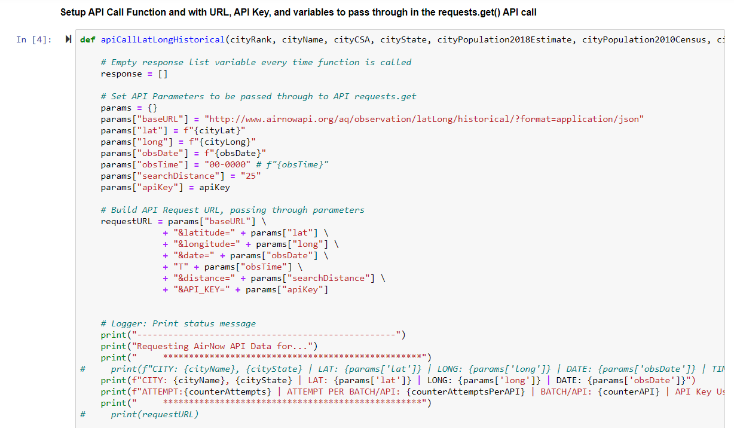
Data Gathering
API Call to airnowapi.org

