Slide 1
Aerial/Satellite Imagery Retrieval
CS513 Geospatial Vision / Visualization
Assignment 3
Jiaxing Wu(A20398273) / Jingwen Pickens(A20349887) / Sumukh Ballal(A20442681) / Hyesoo Noh(A20360464)

Slide 2
Introduction
For this assignment, we wrote a program that automatically downloads aerial imagery with maximum resolution available given a user input bounding box
Input
Latitude/longitude pair for the top left corner of the bounding box
Latitude/longitude pair for the bottom right corner of the bounding box
Output
An aerial imagery within the bounding box defined by the user

Slide 3
Background / Motivation
Bing Maps provides a world map that users can directly manipulate to pan and zoom
When an user inputs latitude and longitude, we always want to output an image with the highest zoom level
Having chosen the projection and scale to use at each level of detail, Bing Map can convert geographic coordinates into pixel coordinates
To optimize the performance of map retrieval and display, the rendered map is cut into tiles pixels
To optimize the indexing and storage of tiles, the two-dimensional tile XY coordinates are combined into one-dimensional strings called quadtree keys

Slide 4
Approach
Part 1 : Image Retrieval
Lat1, Lon1
Lat2, Lon2
Take two lat/lon coordinates which define a bounding box
Start at the max level of detail (level=23) and decrement the level until the max level of detail available is found for the given bounding box
At each level, do:
Convert lat/lon coordinates to pixel coordinates, then tile coordinates at this given level
Convert the generated tile coordinates to quadkeys
Check whether the image downloaded using the quadkeys are valid
If the images are null images, decrement level and repeat the process
If the images are valid, we have found the max level available for this bounding box
Once the max level of detail is found for this bounding box, tile images are retrieved for this bounding box one row at a time

Slide 5
Approach
Part 2 - Image Stitching
In the image retrieving step, tile images are downloaded one row at a time
Since all tile images are of the same level of details and have the same width and height, rows of tile images are simply stitched together using numpy.concatenate() with axis=0

Slide 6
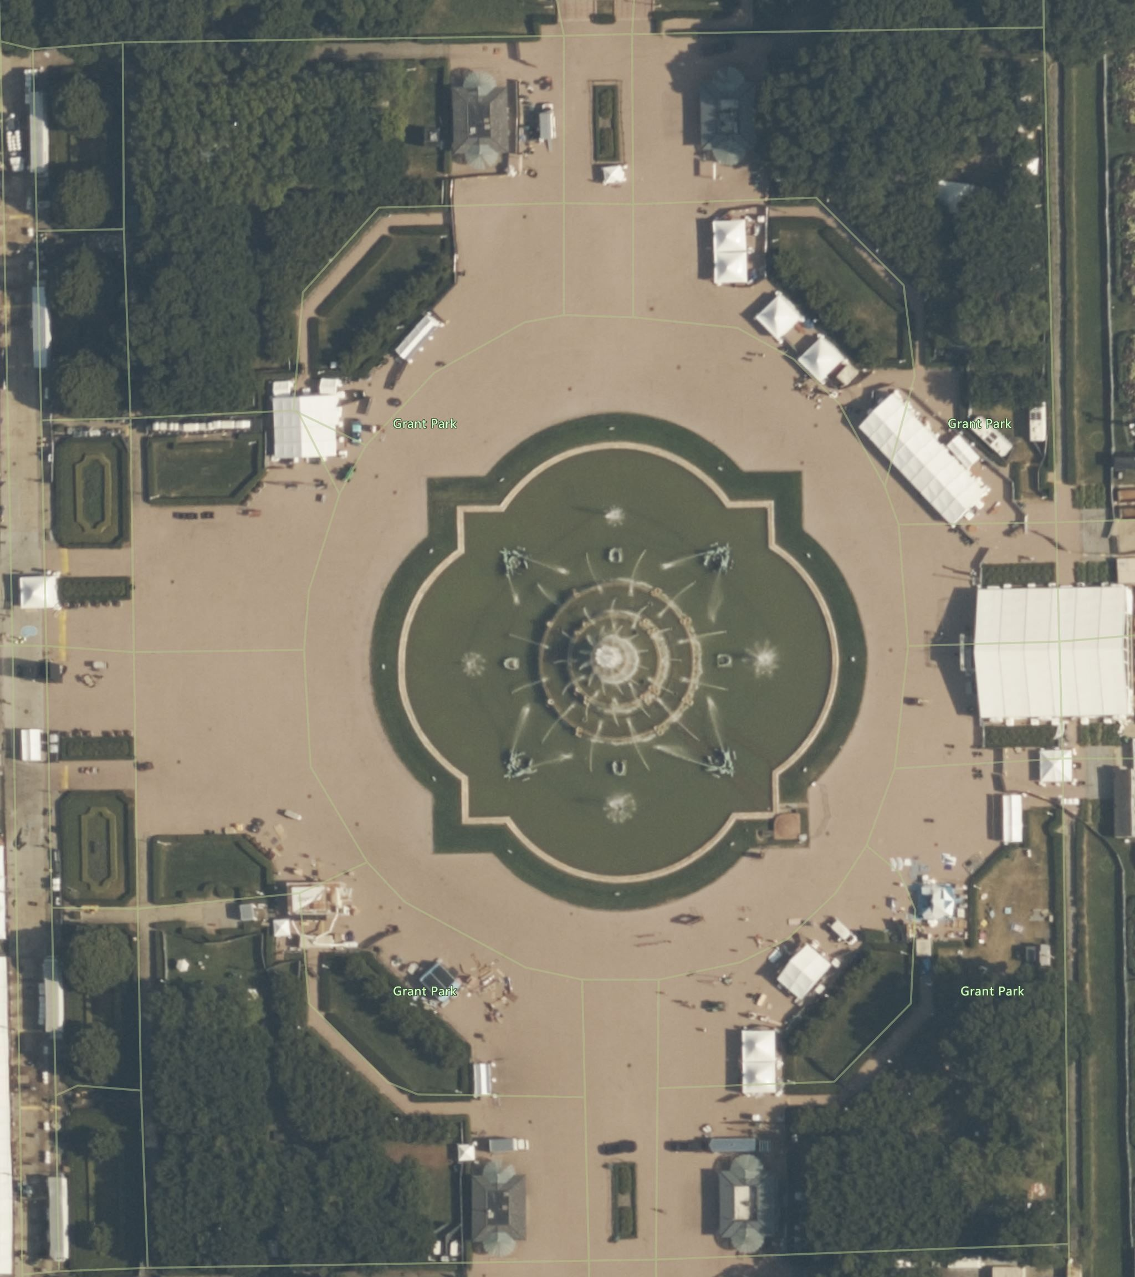
Results
41.876876, -87.620112
Buckingham
Fountain
41.874723, -87.617816
The highest level of detail available for this bounding box is level 20
The final aerial image of this bounding box is composed of 72 individual tile images at level 20

Slide 7
Conclusion
Level 20 is the max level of detail for all bounding boxes tested for varies Chicago and NYC locations
Quadkeys generated at levels above 20 returns null tile images for all bounding boxes tested

Slide 8
Reference
Bing Maps Tile System
https://docs.microsoft.com/en-us/bingmaps/articles/bing-maps-tile-system

