Slide 1
Guide to planning and organising an evening Street O
A copy of this presentation is available on the MVOC website: http://www.mvoc.org/Events/2020WinterSeries/Guide_to_planning_and_organising_an_Evening_Street_O_V1-4.pptx
http://www.mvoc.org/Events/2020WinterSeries/Guide_to_planning_and_organising_an_Evening_Street_O_V1-4.pdf
Mole Valley Orienteering Club
Version 1.4

Slide 2
Change Log
V1.0 (June 2016)
First Draft for 2016 Winter Series
V1.1 (May 2017)
Minor updates following feedback
Addition of the Useful Links slide
Addition of Marking Guidelines slid
Completion of the Checklist slide
Updated links to latest documentation
V1.2 (October 2018)
Links updated to point to 2018 Street O folder
V1.3 (July 2019)
Links updated to point to 2019 Street O folder
V1.4 (September 2020)
Updated with Virtual Course (SmartRunF) guidance
Links updated to point to 2020 Street O folder
COVID-19 notes

Slide 3
By the end of this presentation you will know how to plan and organise an Evening Street O
Timeline of Events
Choosing a location and HQ
Completing the Risk Assessment
Publicising the Event
Producing the Map
What to do on the Night
Marking – right or wrong?
A handy Checklist
Useful Links

Slide 4
Timeline of events…
August
3 months before the event
2 months before the event
1 month before the event
2 weeks before the event
1 week before the event
Evening of the Event
Within 1 day of the event
Choose location and confirm date with series coordinator
Finalise the map and risk assessment – provide copies to Risk Assessor
Confirm HQ booking
Record entries and scores
Record pre-entries in spreadsheet
Help any newcomers
Book the HQ
Start planning the map
Produce the Event Flyer and distribute to Member Sec and Webmaster
Confirm Start and Finish Controls available
Send results to Webmaster and Series Coordinator
Confirm printing arrangements

Slide 5
Choose a location and suitable HQ…
Things to consider when choosing a location:
The location should be within the Mole Valley OC area – this stretches from Horsham all the way to Beddington Park
The location should be easily accessible, i.e. nearby train station
The running area should be interesting, for example extensive road networks allowing for multiple route choices
Things to consider when choosing an HQ*:
Large enough to accommodate the likely number of runners
The staff need to be accommodating to runners (particularly in short shorts)
Ideally, there should be plenty of parking
Ideally, there should be food available
Once you have chosen your location, you will need to inform the series coordinator
*COVID-19: With the restrictions as they currently stand (October 2020), these events are being run using the MapRunF format over the course of a week, so a HQ is not required. The start can therefore be located anywhere within the map area.

Slide 6
Review the risk assessment…
Available online in MS Word format: https://www.britishorienteering.org.uk/images/uploaded/downloads/events_forms_riskassessment_v1.doc
This is important and your life will be easier if you consider this from the start
The club is required to produce a risk assessment for any competition event registered with BOF
You will be paired with someone who can sign off the risk assessment – make contact with them early and keep them informed
Some specific points to consider:
Main Roads – place controls close to pedestrian crossings to give runners the option of using the crossing
Railway Lines – level crossings must be avoided
Ponds and rivers – controls must not be placed close to unlit or unfenced bodies of water
Alleyways – avoid using unlit or ones that have barriers
Open areas – avoid unlit areas as vulnerable competitors may find these intimidating

Slide 7
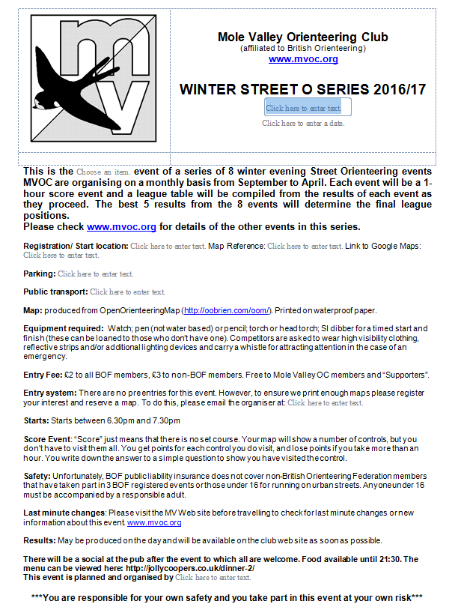
Produce the event flyer and forward to Mike Bolton and Dan Sullivan…
Start with the flyer template – a copy in MS Word format is available online here: http://www.mvoc.org/Events/2019WinterSeries/20YYMMDDDetails.docx
Rename the file in the following format:
20YYMMDDDetails.docx
The template has been created as a form, this means only the fields can be edited
Simply click on a field and enter the relevant information
The tab key can be used to move to the next field
Should you need to change anything else, speak to Dan
Once complete, email a copy to:
Mike Bolton (Membership Sec.) membership@mvoc.org
Dan Sullivan (Webmaster) web@mvoc.org

Slide 8
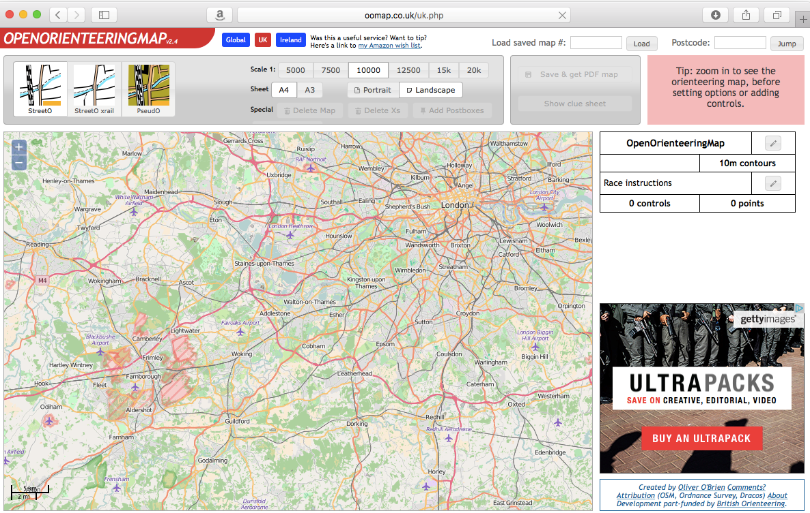
Getting started with Open Orienteering Map…
Open Orienteering Map is the tool for producing the map - http://oomap.co.uk/uk.php
Overview of the different windows
Map settings
Save a map
Load an existing map
Map window
3
1
2
4

Slide 9
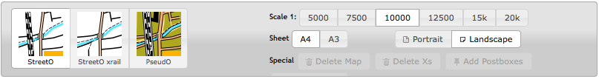
Basic map settings to start with…
Make sure the following are selected:
Street O as the map type
A4 sheet size
10000 as the Scale
Portrait or landscape is optional depending on the desired map area

Slide 10
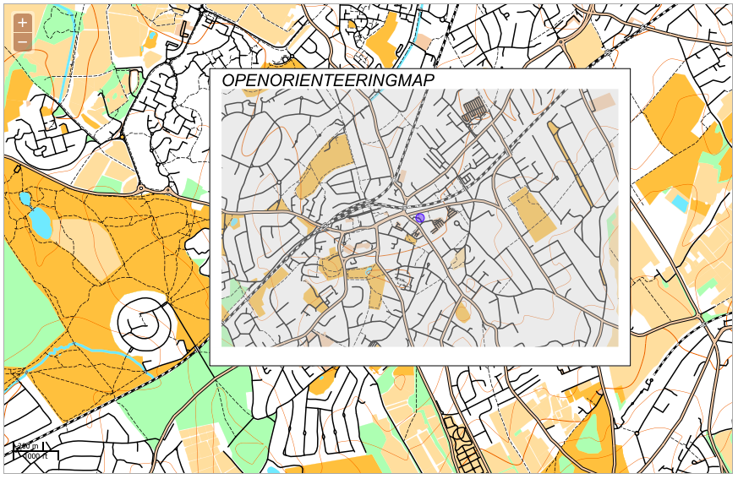
Change the map centre and orientation to produce an interesting map area…
Start by clicking on the map to place the centre point
A frame will be added showing the extent of the map area – if it’s outside the frame, it won’t be on the map
Click and drag the blue dot to move the centre point
Try switching between portrait and landscape
Think about how the map area will affect the available route choices
Don’t forget the risk assessment

Slide 11
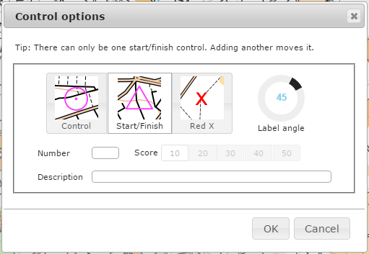
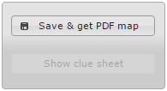
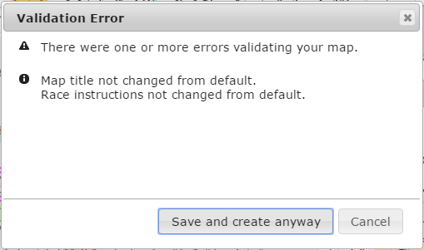
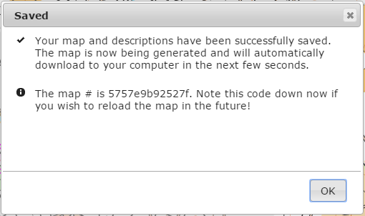
Adding the Start and saving the map…
Click on the map where the start is to be located
Choose ‘Start/Finish’ and click OK
Click on Save & get PDF map
Acknowledge the error
Note the map#, without this you cannot reopen your map
Click OK – the map will download as oom.pdf

Slide 12
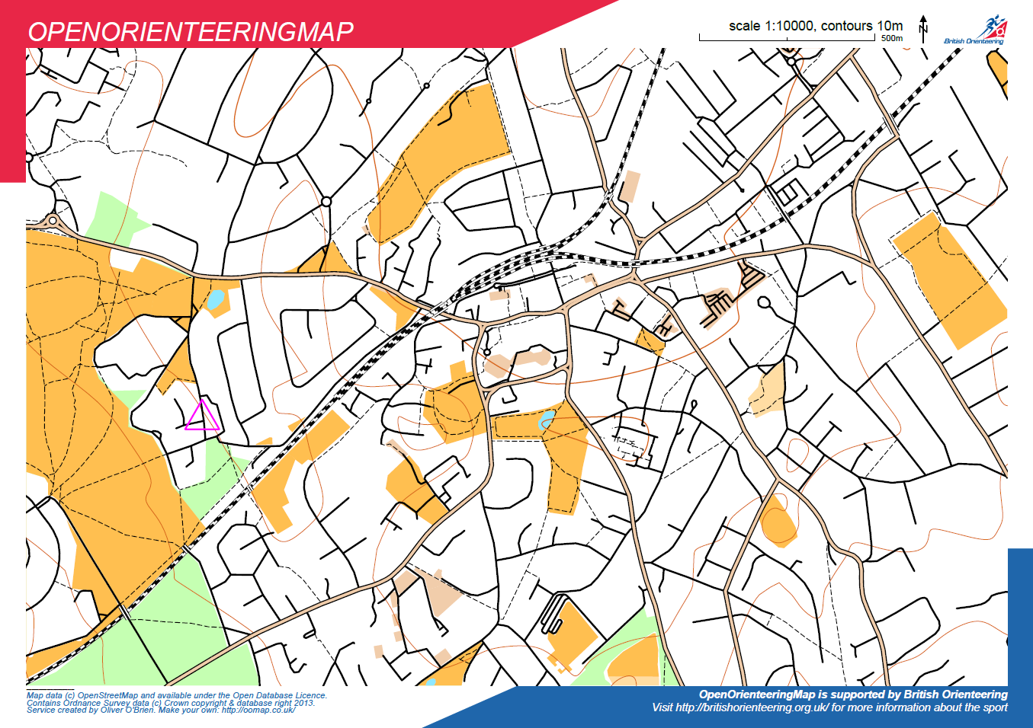
Consider route options and identify approximate locations for the controls…
How far can you run in 1 hour?
There should be route options for all abilities
The slowest may cover 3 miles
The fastest may cover 9 miles
There will be plenty in between
Working on paper:
Draw some route options – you may wish to use something like MapMyRun to get some distances
Start adding controls
Don’t forget the risk assessment

Slide 13
Some things to think about when adding controls to the map...
Avoid dead-ends – the odd one is fine, but they quickly become tedious. This is particularly important for MapRunF courses, where the trigger point can cary depending on the individual device being used.
You don’t need to constrain yourself to the routes you have drawn – people will find routes you haven’t thought of
Work on a total of about 40 controls
Think about what you liked and didn’t like about Street Os you have run

Slide 14
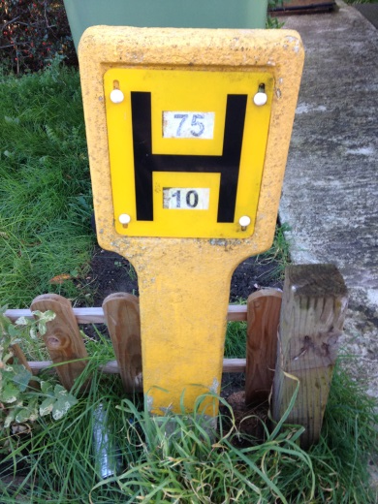
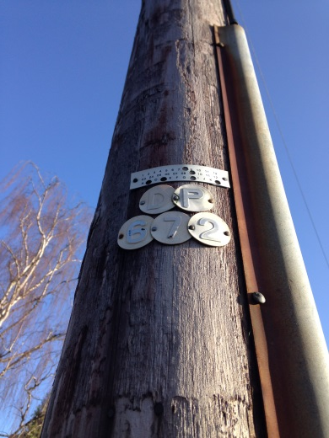
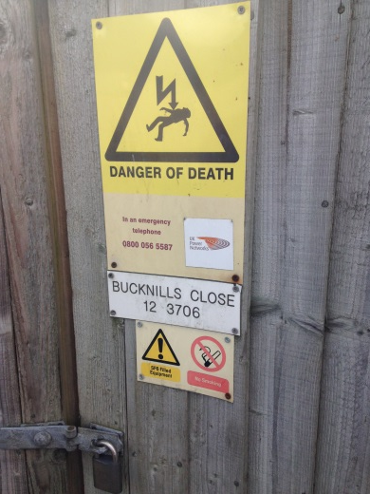
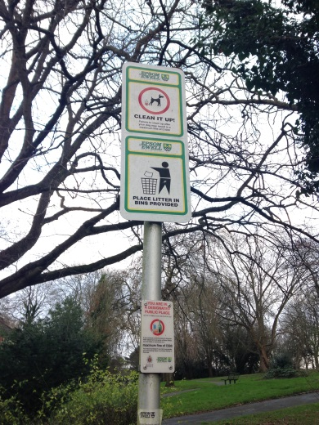
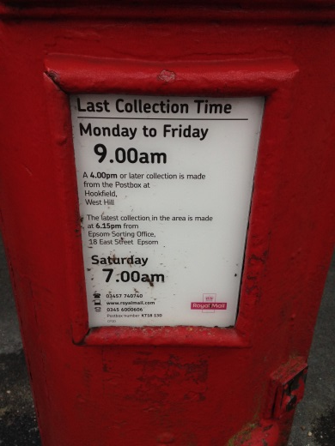
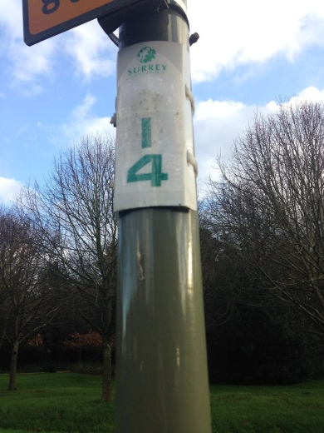
Go outside and visit the locations to identify suitable control features…
Having determined the approximate locations of the controls, you will need to physically visit the locations and find a suitable feature
These may include:
Post Box, Fire Hydrant Sign, Telegraph Pole, Telephone Exchange Cabinet, Lamp Column, or any sign with some unique information on
Using a mixture will make for a more interesting run and reduce annoying mistakes
Avoid ambiguity – if there is more than one of a particular feature, choose something else
Make sure they are legible
Record the information and ideally, take a photograph
Mark the correct location on the map
Don’t forget the risk assessment

Slide 15
Value the controls…
Back at home, decide how many points each control is worth: 10, 20, 30 or 40
Controls should be assigned a higher value because they require a runner to make a route choice because of them, not necessarily because they are further from the Start
You could try and balance the points so that the total scores for each route are close together

Slide 16
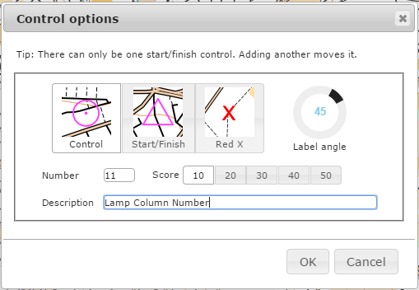
Add the controls to the map in Open Orienteering Map…
Reopen your map in Open Orienteering Map – type your map number in the ‘Load saved map’ field at the top right of the window
To add a control:
Click the location on the map
Make sure ‘Control’ is selected (this is the default)
Enter the control number – controls should be numbered so that the first digit is equal to the decade of the score or points, for example a control worth 10 points should be numbered between 10 and 19
Enter the description text – this will appear on the control list, so try to be consistent
Adjust the label angle so as to avoid obscuring relevant map information and to avoid ambiguity with other controls

Slide 17
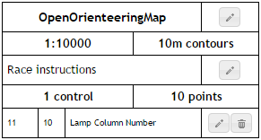
Some notes on Open Orienteering Map…
Control information can be edited by clicking on the pencil button next to control
It is not possible to reposition the control. To move a control, you need to delete (click the bin button next to the control) the existing one and recreate it
The control may appear to be well placed when zoomed in to the map, but consider how it will appear when exported at the correct scale. The best way to check this is to save the map, open the PDF and check in there. You may need to go back and reposition some of the controls
Each time you save the map, the map # will change!

Slide 18
Produce the control description sheet...
Change the default map name to “LOCATION STREET O”
Add any Race instructions, as a suggestion “1 hour score event. Time penalties will be incurred at 10 points per 30 seconds or part of over the 1 hour time limit.”
Once you are happy with all the Control Descriptions, click the ‘Show clue sheet’ button to the top right of the map window
A couple of points to note:
As an alternative to the clue sheet generated by Open Orienteering Map, you can use the following template – available online in MS Excel format http://www.mvoc.org/Events/2019WinterSeries/StreetOScoreSheetTemplate.xlsx. The ‘answer’ column has been moved next to the ‘score’ column making it easier for the runner to complete
You may wish to use multiple choice answer questions

Slide 19
Setting the map up for MapRunF
Some specific points to consider when planning the course for use with MapRunF:
Try to make sure that the start and finish control is located somewhere the competitors will not run past again on the way to another control as this would stop their run. Whilst it is their responsibility to avoid doing so, by locating the start in a cul-de-sac or car park etc. you should avoid this problem.
Do not locate any controls in tunnels, underground car parks, very narrow alleyways flanked by high sided buildings etc. as the GPS signal will be weak. The app should work fine in forest.
As people will be running the course at different times of the day, you should avoid any areas that are not open 24/7 like parks etc. For my event, I marked parks with locked gates as Out of Bounds and threatened to disqualify anyone who entered them even if they run it at a time that it is open. You can mark areas as OOB by using another bit of free software called Purple Pen.
If you use a control site that is located a short distance from the road/pavement, for example, a sign on a house or hall/school, make sure you locate the GPS point (in Step 3 below) on the pavement where the competitor would be when writing down the answer (i.e. don't locate it on the actual site).
The penalty on the scoring system will be MINUS 30 POINTS per minute or part therof late. This is set in the app and cannot be changed unfortunately.

Slide 20
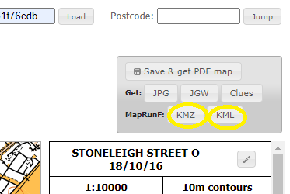
Convert your completed course to the KMZ and KML files needed for the app
Once finished, export your course as KMZ and KML files using the function on the OOMap website.

Slide 21
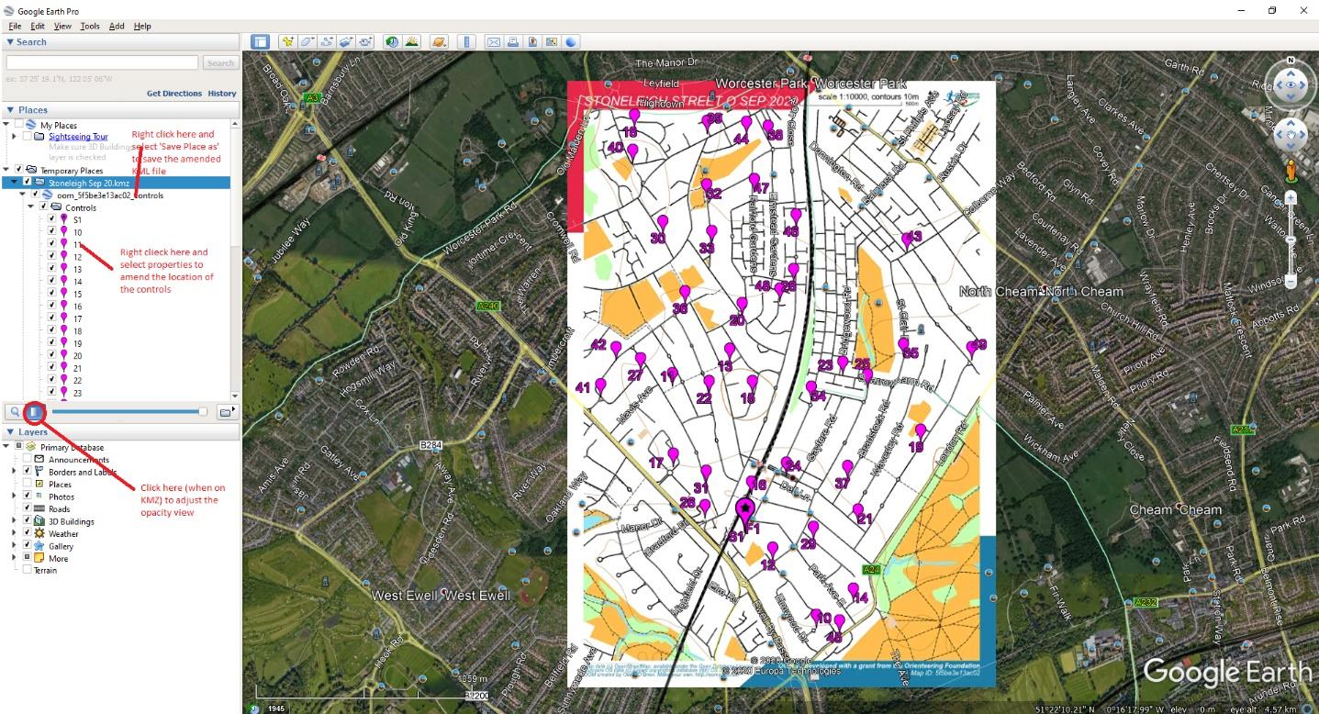
Adjust the controls to the exact GPS location required using Google Earth Pro
Open both the KMZ file and KML files at the same time in Google Earth Pro (free to download) on a PC/laptop. Once opened it should look like below.
When the KMZ file is selected you can adjust the opacity of the map file. By reducing it, you can see the satellite view behind it.
To select a control to view, left click on it in the left-hand menu and zoom in.

Slide 22
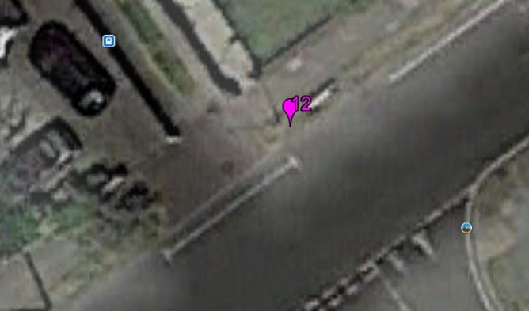
Adjust the control position
To amend the control position, right click on the control number in the left-hand menu and select properties. A yellow flashing box will appear, and you can drag this to the correct location. For each control, view either from above on satellite view, or on street view (drag the yellow man in the top right of the screen) and simply re-position to the right place. Press OK to save this position. Examples of views in satellite and street view are shown below. If any controls are located off roads, (in alleyways, fields, parks etc.) you will not be able to view on Street view for site location.

Slide 23
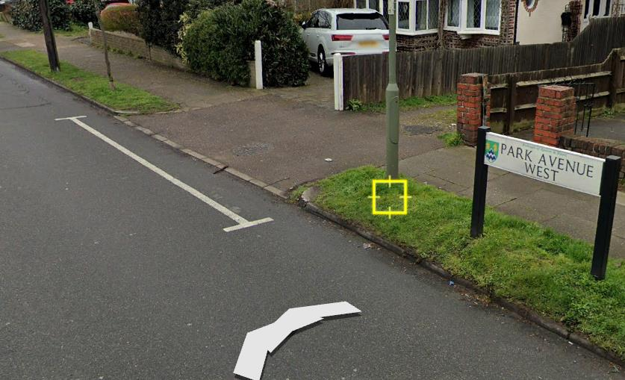
Save the amended KML file
When you have repositioned all controls, right click on the controls top header in the left hand menu and select 'Save Place As...' and save the amended new KML file (be sure to change the file type to KML as it will default to KMZ), calling it what you like.

Slide 24
Test the control locations work in the real world
Upload the KMZ and KML files to the Check Sites function of MapRunF at the following location: http://www.p.fne.com.au/#/checksitesupload A PIN code will appear at the bottom of the webpage once you have successfully uploaded it.
In the MapRunF app main page, click the 3 horizontal bars in a green circle button (bottom right) and then click ‘Check Sites’ You will be prompted for the PIN number you were issued when you uploaded to the site.
Once your course is selected you can now amend the ‘Options and Settings’ for this test course. You may wish to allow the ‘Display present location’ and ‘Display track’ options (which will be disabled for the live event).
Physically visit control sites using CheckSites (you may want to do this in 2 trips!) and hopefully everything works. Once complete you may want to email your GPS track by email to yourself to view on Google Earth Pro.
If not, you can open your GPX track (from your phone or watch) in Google Earth Pro and see where the control is correctly located and then amend the KML file. So, if one control doesn't beep in the right place, do a little 5m circle around the correct location so you can see on the GPX track where you need to move it to.

Slide 25
Upload the course and map to MapRunF
Once tested to your satisfaction, email me the KMZ and KML files and I will upload on to the live database and give you the password you will need to pass to the competitors.
If you only made minor changes to the control site locations, you won't need to amend the OOMap PDF course. However if you have moved any of the controls a fair distance it might be because you have not sited it right on OOMap and you may wish to change the OOMap course to correctly locate a control. If you do change the OOMap, do not then re-export the KML file, use the one you have used above.
If you have any questions or are struggling, please contact me.
Justin Farhall – justin_farhall@hotmail.com

Slide 26
Have the map and risk assessment reviewed by the risk assessor…
You will need to complete a copy of the Risk Assessment
Having already reviewed this, completing it should be relatively straightforward
Any questions or queries, speak with the Risk Assessor or Series Coordinator
You will need to send a draft copy of the Risk Assessment and Map to the Risk Assessor
Give them time to review both – ideally 2 weeks before the event
Send the Risk Assessment in MS Word format, so that they can make minor changes
Take a copy of the completed Risk Assessment and the Street O Safety Notes Document with you on the night
A boiler plate version of the Safety Notes Document is available here – http://www.mvoc.org/Events/2019WinterSeries/StreetOSafetyNotesTemplate.doc

Slide 27
Record pre-entries and arrange for maps to be printed…
Keep a list of pre-entries
It will make the job of the person processing the results easier if you type the pre-entries into this Excel Spreadsheet – http://www.mvoc.org/Events/2019WinterSeries/StreetOResultsTemplate.xlsx
Agree printing arrangements at least 1 week before the event, this includes by when you need to confirm map numbers
Mike Elliot - mike.i.elliot@btinternet.com
Philip Gristwood - pgristwood@btinternet.com
Confirm number of maps required with the printer
Allow for runners turning up unannounced on the night
Numbers approaching 50 were seen last year
Not currently applicable

Slide 28
On the night, give yourself time to setup...
Arrive early – ideally by 18:00
Introduce yourself to the Pub Staff
Position the ‘Finish’ Control and ‘Start/Finish’ kite somewhere prominent outside
Secure the Finish Control
Find somewhere suitable to setup inside
You will need in front of you:
The runner list for checking people off and recording their scores + a writing implement
The ‘Check’ and ‘Start’ controls
Blank map showing the Start
The Safety Notice
A small kitty
Not currently applicable

Slide 29
Record entries, manage the starts and record the scores…
When someone arrives:
Check they are a member of MVOC or are a supporter and have paid for the year, if not collect £2
Check them off if they have pre-entered or add their name and club
If they need a dibber, loan them one and record the dibber number against their name
Instruct them to read the safety notice and inform them of any alterations/corrections to the map
If they are a newcomer, make sure to explain how it works, what the start looks like, how long they have, what a score event is
Before a runner starts, make sure:
They have read the safety notice
They know where the finish control is located
They have cleared
When they dib the Start Control, give them the map
When a runner finishes:
It will get busy – a helper is extremely useful
Ask the runner to download – write their name on the print out
Make sure their name is on the map and record their time on the map and any penalty
It is easier to mark the maps with an example map filled in correctly
Run down the map and mark correct answers with a tick
If two answers have bee obviously transposed it is at your discretion at to whether you award them the points – just make sure that you are consistent
Not currently applicable
Keep an eye out for newcomers and make sure they know what they are doing

Slide 30
Things to consider when marking…
The key is to be consistent; the only thing that upsets competitors more than getting an answer wrong is giving someone else the benefit of the doubt and not them.
Ultimately, it is down to the organisers judgement as to how lenient or not they choose to be.
Recording the answer to the clue is akin to punching an orienteering control. Getting an incorrect answer is the same as punching the wrong control.
However, Street Os are meant to be fun events suitable for beginners, so sometimes a little discretion is required.
If you find many/all competitors return with the same wrong answer, it’s possible that the control was ambiguous. In this situation, you may choose to mark them ALL right.
But, if some competitors have got it right, it may be because they took more care.
Whatever your decision, stand by it.
Not currently applicable

Slide 31
Checklist
Choose a location and HQ
Confirm the location and date with the series coordinator
Review the Risk Assessment
Contact your Risk Assessor
Produce the event flyer and send to Mike Bolton and Dan Sullivan
Choose the map area
Recce the map area
Plan the course – control location and points
Produce the map
Produce the control description sheet
Complete the Risk Assessment
Send Risk Assessment to Risk Assessor for review
Setup the pre-entry sheet
Arrange for maps to be printed
Arrange collection of the start, finish, clear, check controls and printer…
Know what time to arrive on the night
Make sure you have everything you will need on the night
Pay-in money
Send results to Dan Sullivan
Event Location
Event Date
Event HQ
Risk Assessor
Useful Contacts
Series Coordinator: Deborah Sullivan chair@mvoc.org
Membership Sec.: Mike Bolton membership@mvoc.org
Webmaster: Daniel Sullivan web@mvoc.org
Map Printing:
Mike Elliot mike.i.elliot@btinternet.com
Philip Gristwood pgristwood@btinternet.com

Slide 32
Useful Links
Guide to Planning and Organising an Evening Street O (This Presentation) – http://www.mvoc.org/Events/2019WinterSeries/Guide%20to%20planning%20and%20organising%20an%20Evening%20Street%20O%20V1-3.pptx
Risk Assessment Template – https://www.britishorienteering.org.uk/images/uploaded/downloads/events_forms_riskassessment_v1.doc
Event Details Flyer Template – http://www.mvoc.org/Events/2019WinterSeries/20YYMMDDDetails.docx
Open Orienteering Map - http://oomap.co.uk/uk.php
Score Sheet Template (Alternative to the one created using oomap) - http://www.mvoc.org/Events/2019WinterSeries/StreetOScoreSheetTemplate.xlsx
Safety Notes Boilerplate – http://www.mvoc.org/Events/2019WinterSeries/StreetOSafetyNotesTemplate.doc
Results Template – http://www.mvoc.org/Events/2019WinterSeries/StreetOResultsTemplate.xlsx

