Slide 1


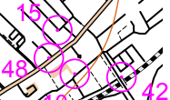
SmartRun Courses
Permanent Courses
Virtual Courses

