Slide 1


GNU/Linux
(c) Julian Pieles 2021

Slide 2
history
architecture
development cycle
distributions
advantages and flaws
showcase

Slide 3
history
architecture
development cycle
distributions
advantages and flaws
showcase

Slide 4
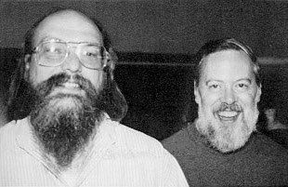
Ken Thompson
Dennis Ritchie

Slide 5
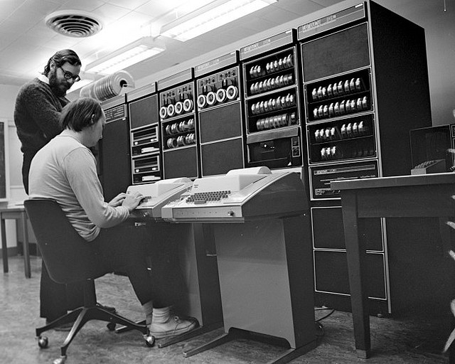

Slide 6
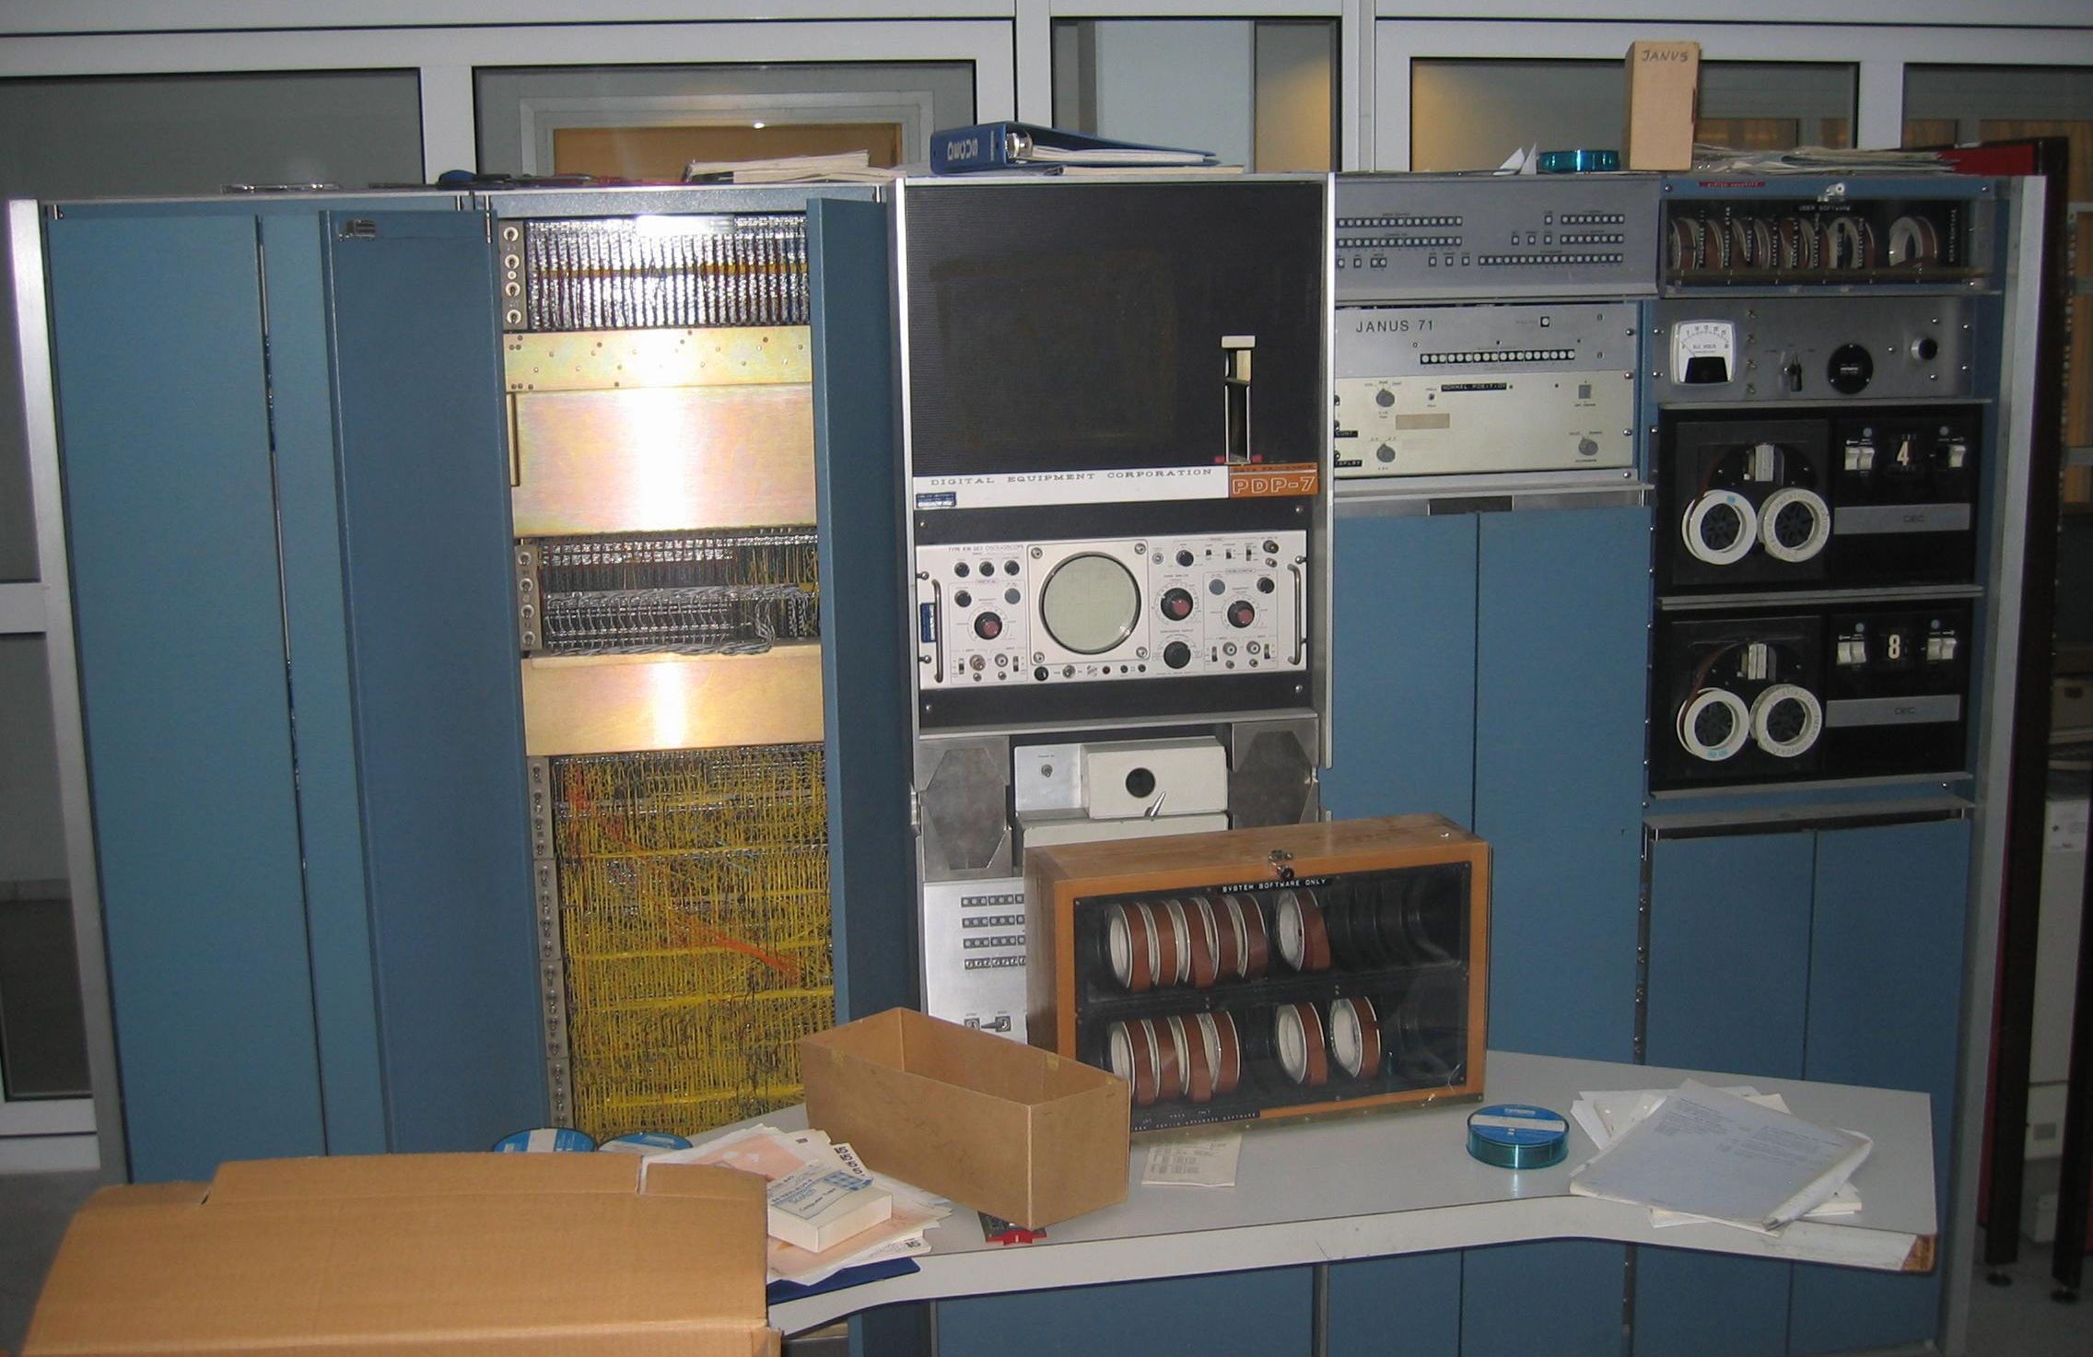
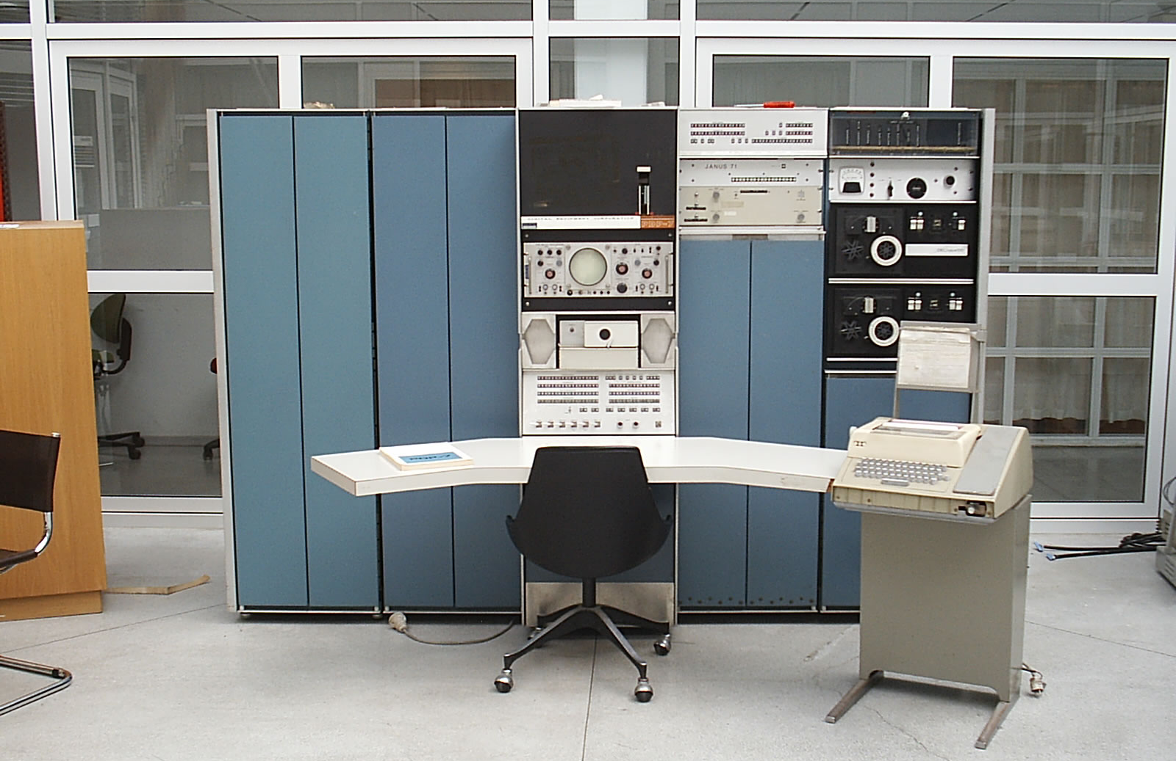
PDP-7 minicomputer by DEC

Slide 7
history
architecture
development cycle
distributions
advantages and flaws
showcase

Slide 8
history
architecture
development cycle
distributions
advantages and flaws
showcase

Slide 9
history
architecture
development cycle
distributions
advantages and flaws
showcase

Slide 10
history
architecture
development cycle
distributions
advantages and flaws
showcase

Slide 11
history
architecture
development cycle
distributions
advantages and flaws
showcase

