Slide 1
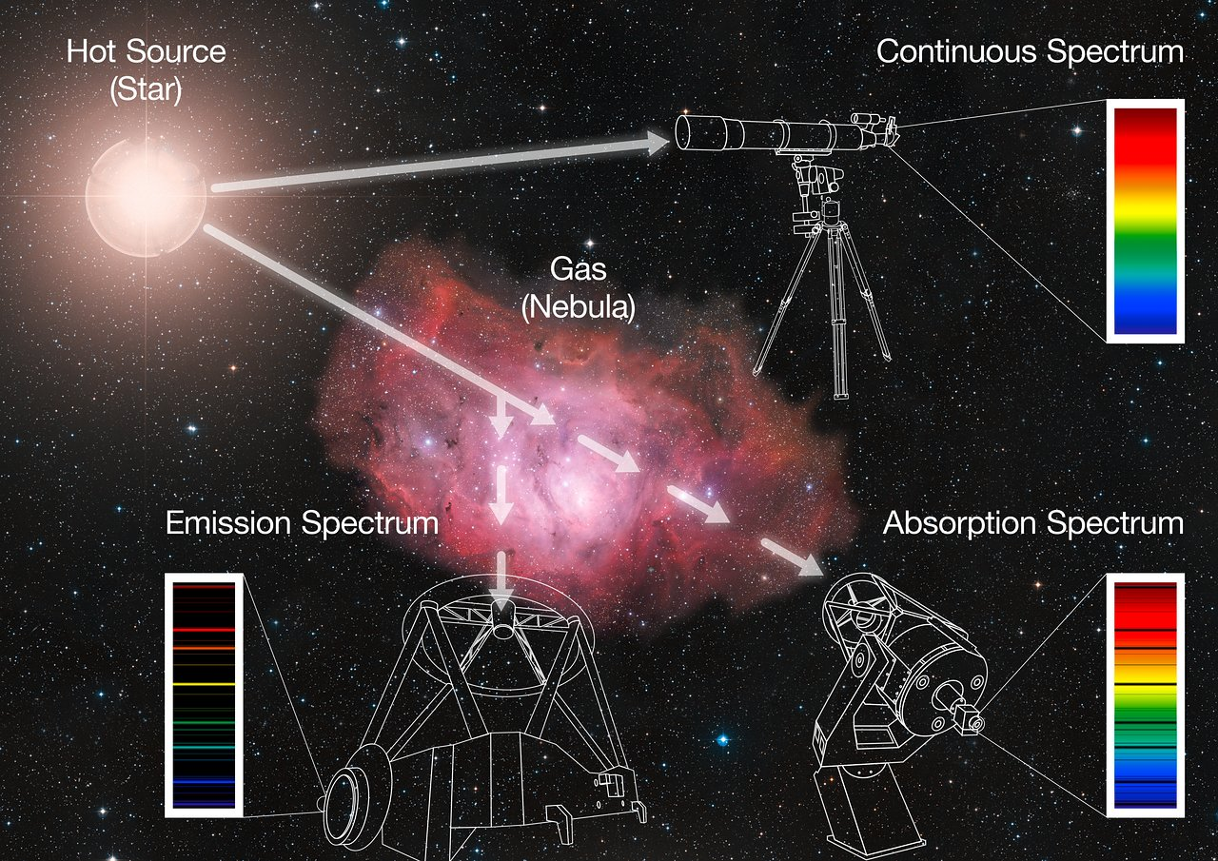
Spectroscopy
Astro 101

Slide 2
Inquiry Process
Introduction (That’s right now!)

Slide 3
Inquiry Process
Introduction (That’s right now!)
Raising Questions

Slide 4
Inquiry Process
Introduction (That’s right now!)
Raising Questions
Investigations

Slide 5
Inquiry Process
Introduction (That’s right now!)
Raising Questions
Investigations
Culminating Assessment

Slide 6
Inquiry Process
Introduction (That’s right now!)
Raising Questions
Investigations
Culminating Assessment
Synthesis

Slide 7
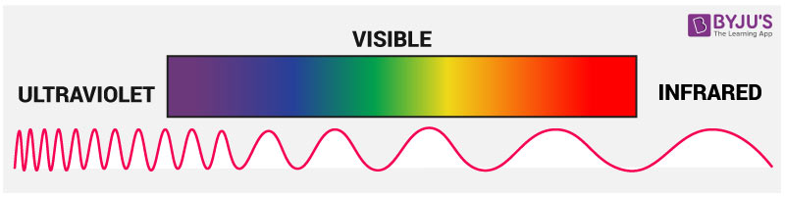
The Electromagnetic Spectrum
Notes:
http://www.rsc.org/learn-chemistry/collections/spectroscopy/introduction

Slide 8
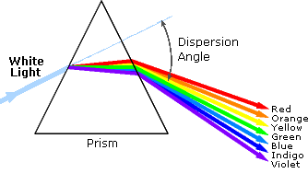
The Electromagnetic Spectrum

Slide 9
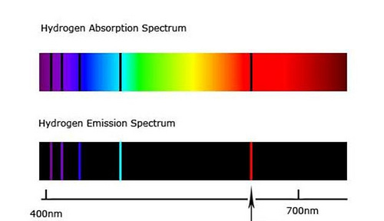
Unique Absorption/Emission

Slide 10
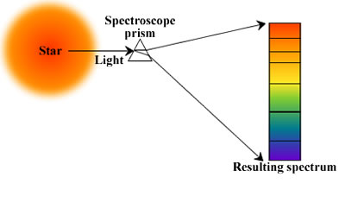
Unique Absorption/Emission

Slide 11
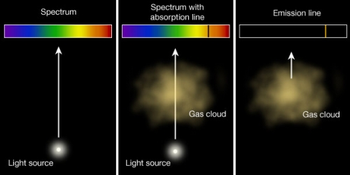

Slide 12
From colors to a plot

Slide 13
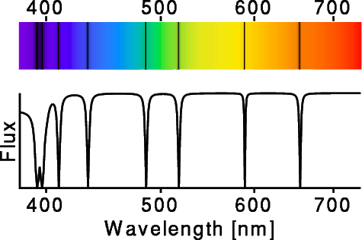
From colors to a plot

Slide 15
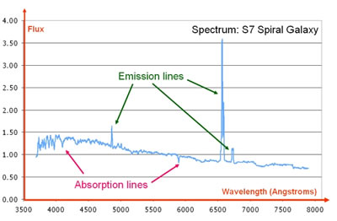

Slide 16
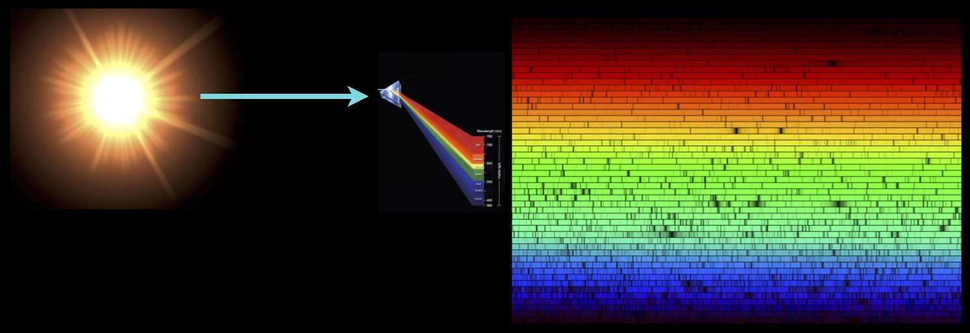

Slide 17
What is spectroscopy used for?

Slide 18
What is spectroscopy used for?
Galaxy composition

Slide 19
What is spectroscopy used for?
Galaxy composition
Galaxy age

Slide 20
What is spectroscopy used for?
Galaxy composition
Galaxy age
Stellar properties

Slide 21
What is spectroscopy used for?
Galaxy composition
Galaxy age
Stellar properties
Exoplanet composition/temperature

Slide 22
What is spectroscopy used for?
Galaxy composition
Galaxy age
Stellar properties
Exoplanet composition/temperature
Distances/velocities of stars/galaxies

Slide 23
What is spectroscopy used for?
Galaxy composition
Galaxy age
Stellar properties
Exoplanet composition/temperature
Distances/velocities of stars/galaxies
Determining supernova type

Slide 24
What is spectroscopy used for?
Galaxy composition
Galaxy age
Stellar properties
Exoplanet composition/temperature
Distances/velocities of stars/galaxies
Determining supernova type
Much more…

Slide 25
Timeline
Lab 1 (now)
Introduction
Raising Questions
Begin Investigation

Slide 26
Timeline
Lab 1 (now)
Introduction
Raising Questions
Begin Investigation
Lab 2
Finish Investigations
Short writing assignment
Posters
Synthesis

